Slide 1


COMBINEDBrain
Consortium for Outcome Measures and Biomarkers for Neurodevelopmental Disorders
Endpoints: Why do we care?
SLC6A1 Connect
November 30, 2023
Terry Jo Bichell, MPH, PhD
www.COMBINEDBrain.org

Slide 2
COMBINEDBrain
Mission:
The Consortium for Outcome Measures and Biomarkers for Neurodevelopmental Disorders is devoted to speeding the path to clinical treatments for people with severe rare genetic neurodevelopmental disorders by pooling efforts, studies and data.
Structure:
Non-profit consortium led by patient advocacy foundations, working with the clinicians, researchers and pharmaceutical firms that are developing treatments for the disorders they represent.
www.COMBINEDBrain.org

Slide 3
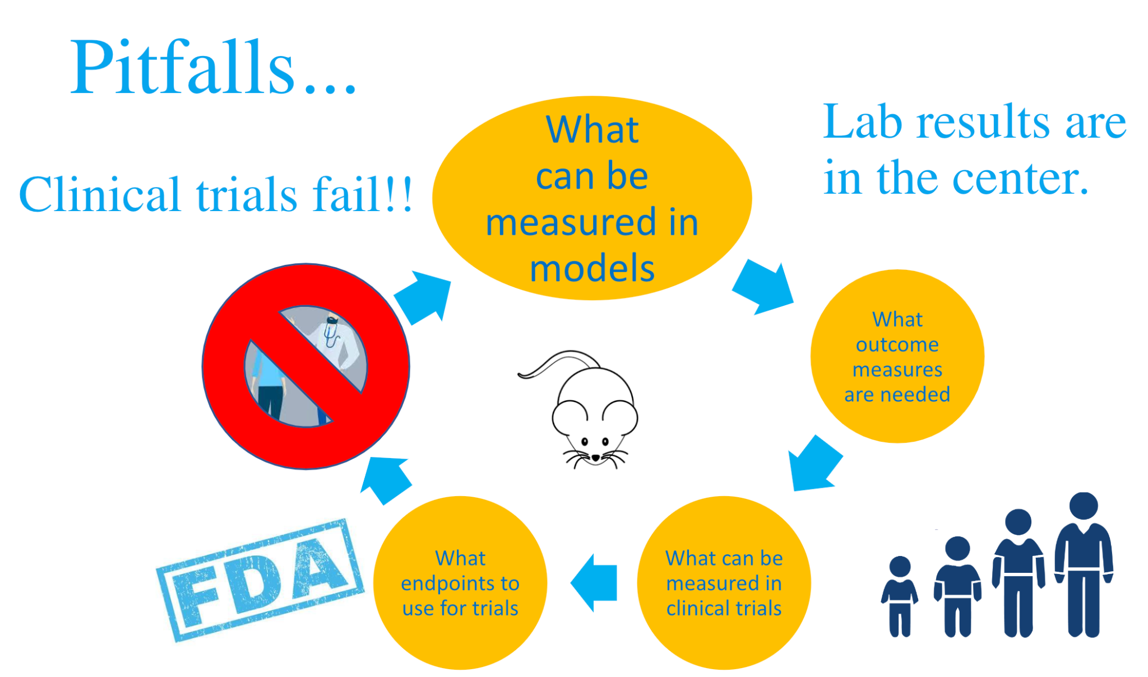
www.COMBINEDBrain.org

Slide 4
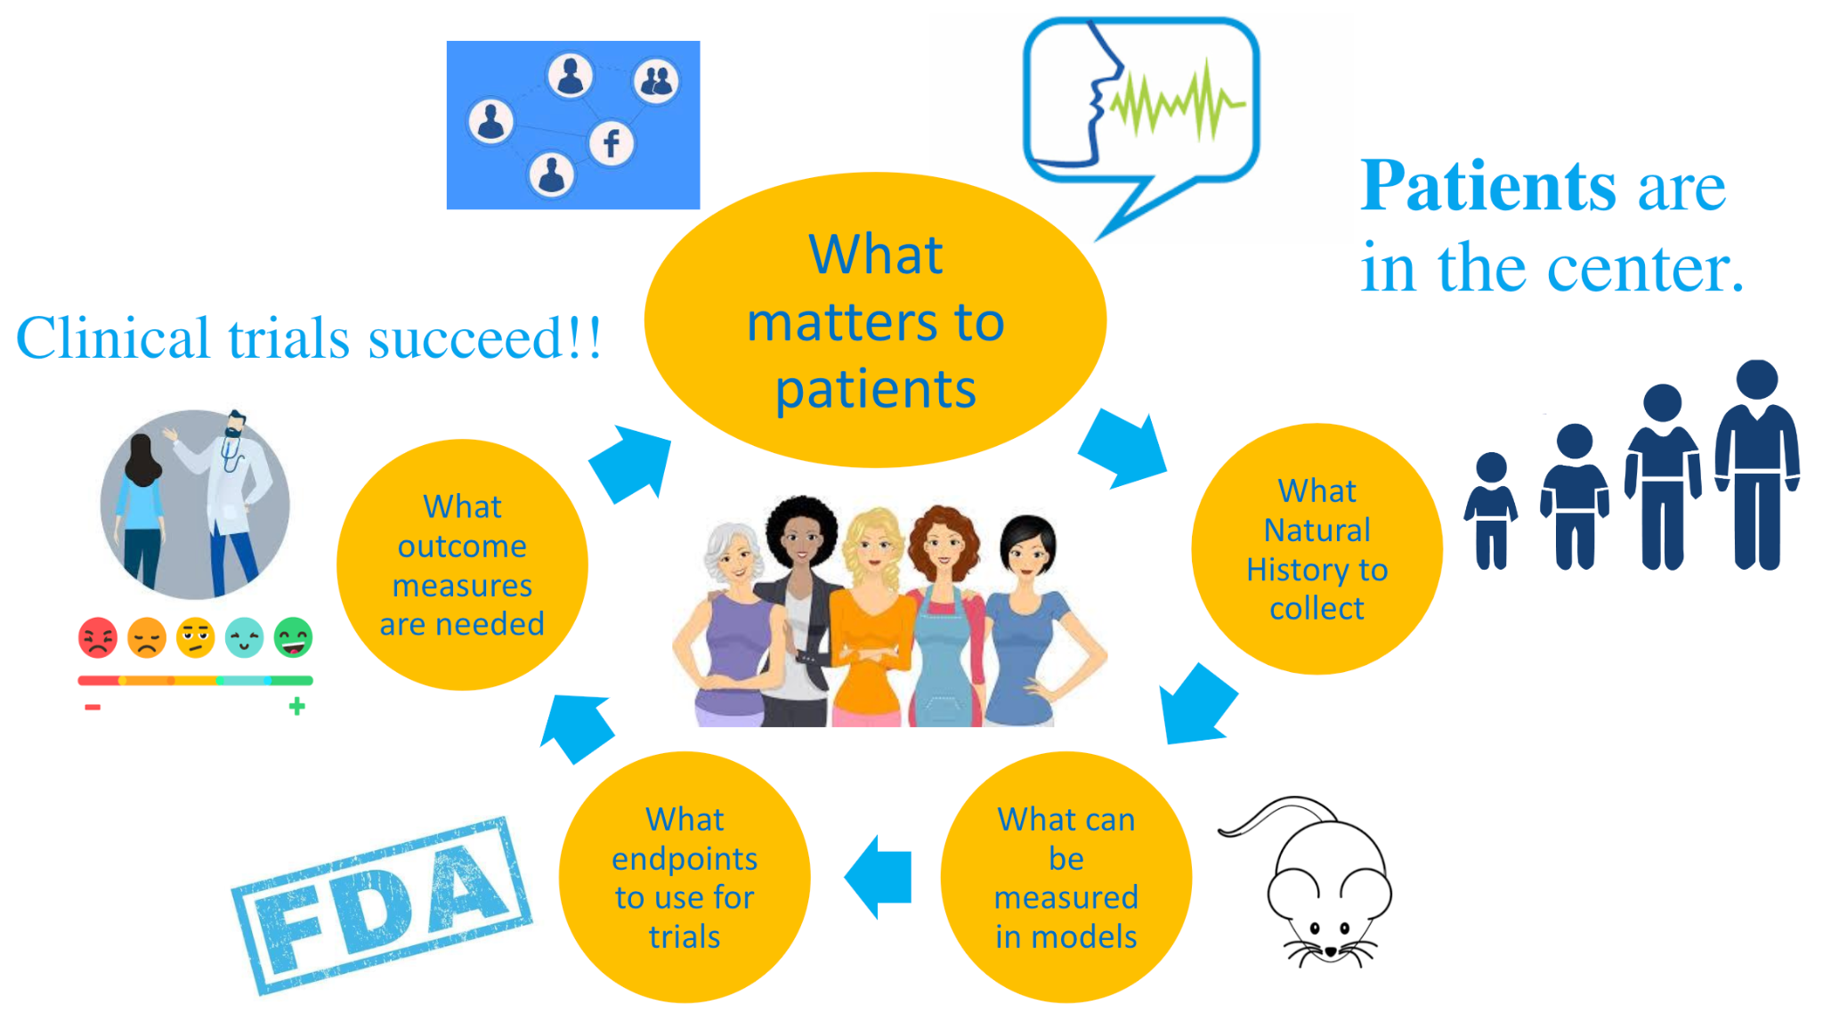
www.COMBINEDBrain.org

Slide 5
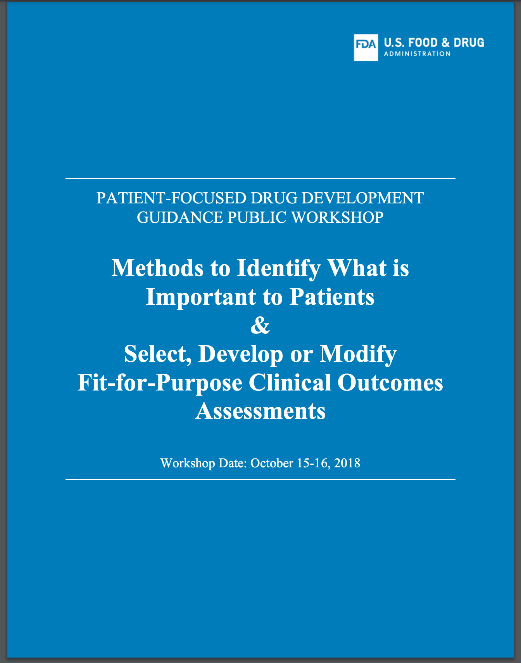
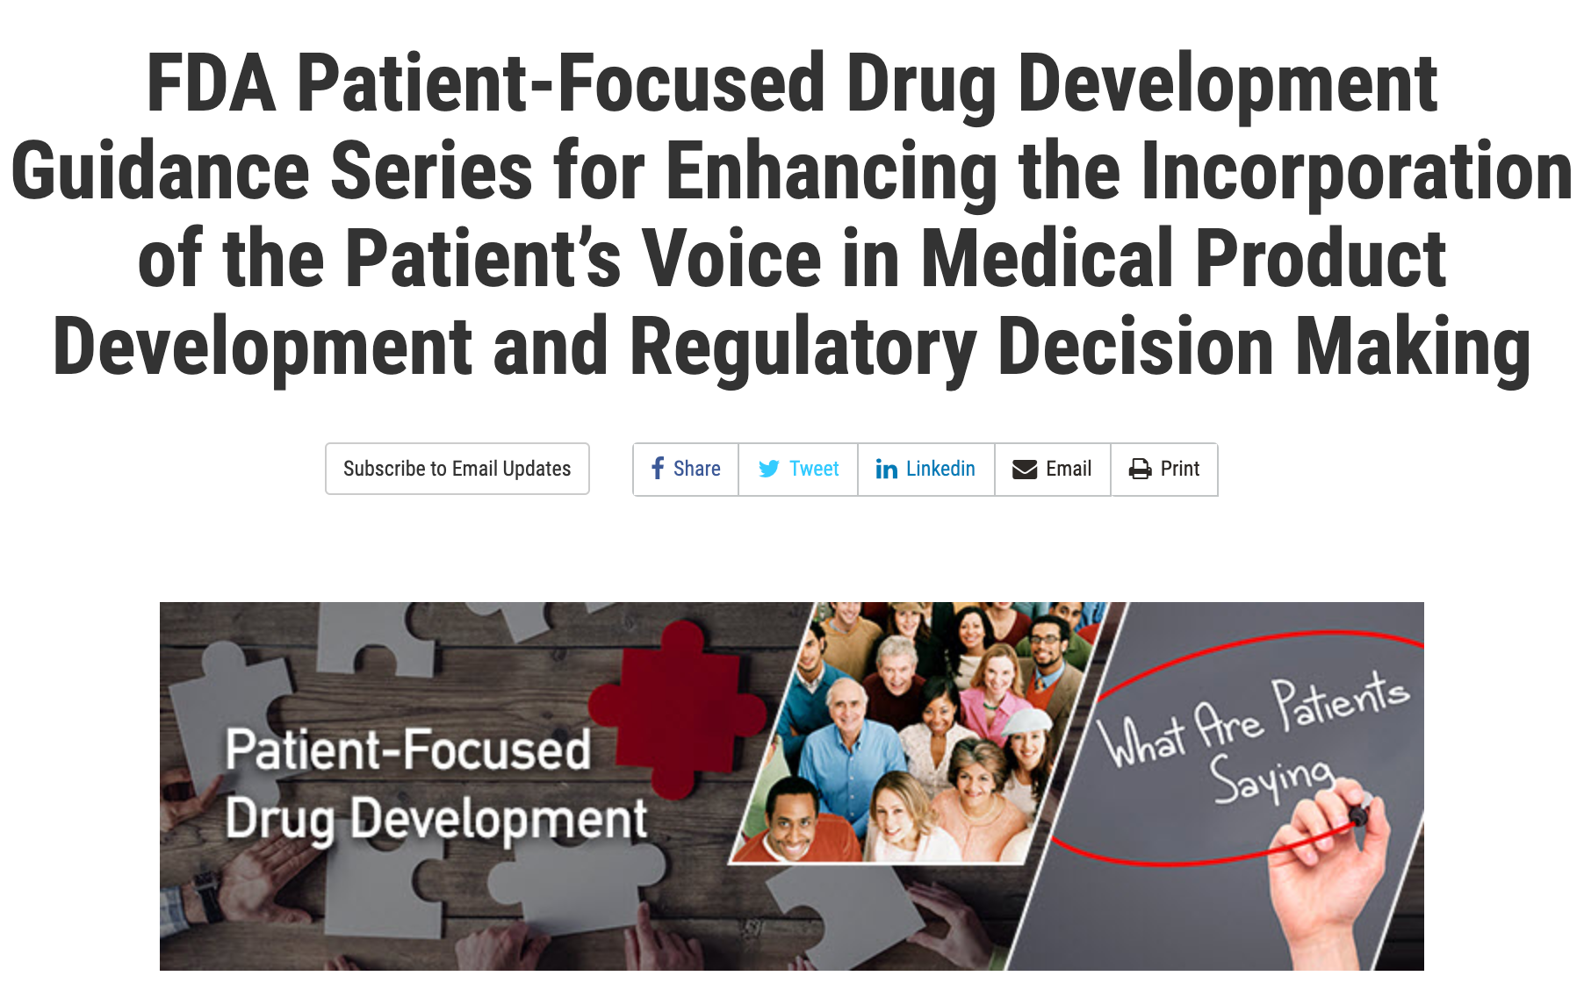
2017 21st Century Cures Act - Patient Involvement
2018 FDA Guidance on the Science of Patient Input
2020 FDA CDER Guidance on PFDD
2022 FDA CDER Guidance on Outcome Measures
2023 FDA Guidance on Real World Evidence
www.COMBINEDBrain.org

Slide 6
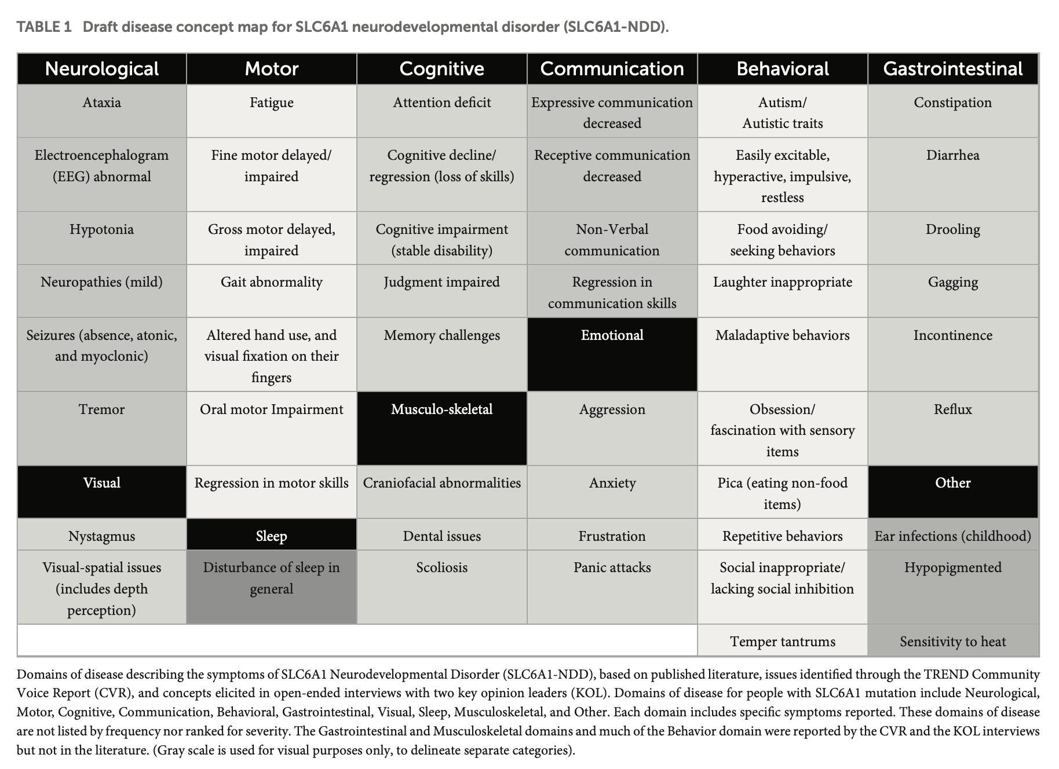
Draft Conceptual Model of SLC6A1-
Related Disorders
Goodspeed et al 2023
www.COMBINEDBrain.org

Slide 7
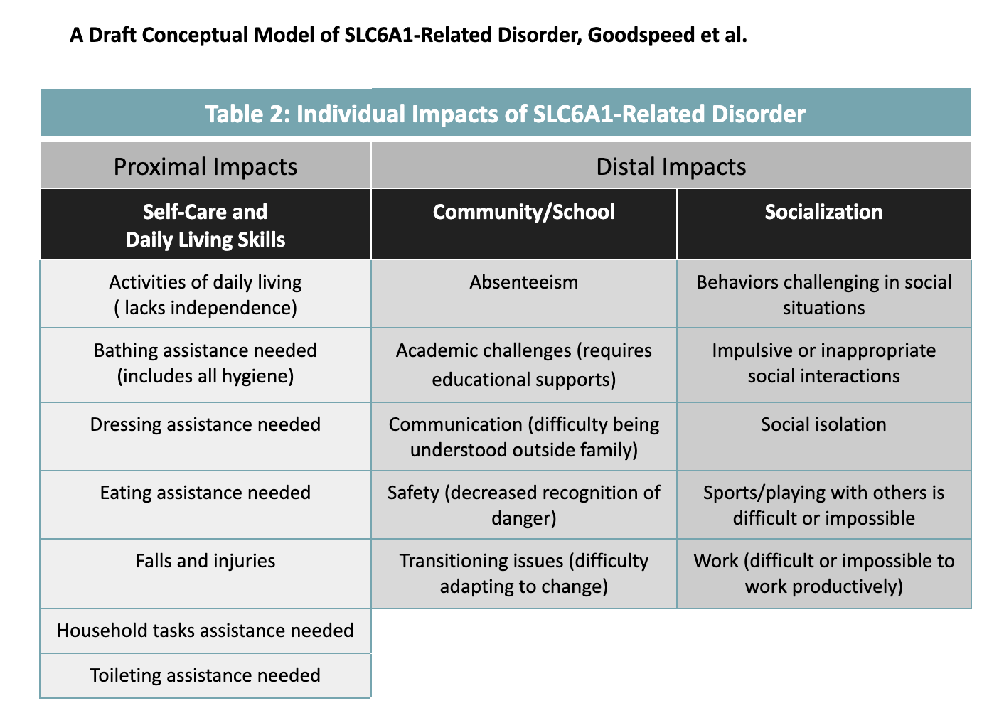
Findings of Conceptual Models
Disease Concept Model differs from what is reported in the clinical setting
  More symptom categories
  Previously unknown symptoms (GI, pulmonary)
Captured the entirety of symptoms for a heterogenous condition
Impact of symptoms varies by subgroups
  age, seizures, ambulation
Goodspeed et al 2023
www.COMBINEDBrain.org

Slide 8

What is an Endpoint?
An endpoint is a targeted outcome of a clinical trial that is statistically analyzed to help determine the efficacy and safety of the therapy being studied.
Endpoints for a clinical trial may include one or more clinical outcome assessments and/or surrogate endpoints.
Clinical outcomes assessments measure direct clinical benefit to the participant
Surrogate endpoints, including biomarkers, predict clinical benefit.
NCATs Glossary
Adapted from J Panagoulias, FAST Summit 2023
www.COMBINEDBrain.org

Slide 9
What is an Outcome Measure?
Outcome measures assess the way a patient feels, functions, or survives
An ideal measure captures what matters to patients/caregivers
AND
  Captures what was measured
  Evaluates the effects and safety of a drug
  Can clearly be described in the labeling for the drug
Adapted from J Panagoulias, FAST Summit 2023
www.COMBINEDBrain.org

Slide 10
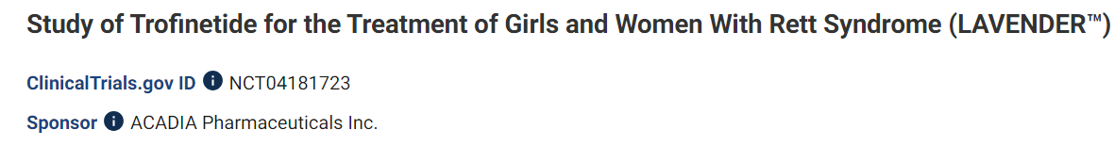
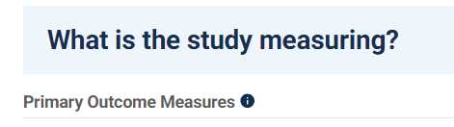
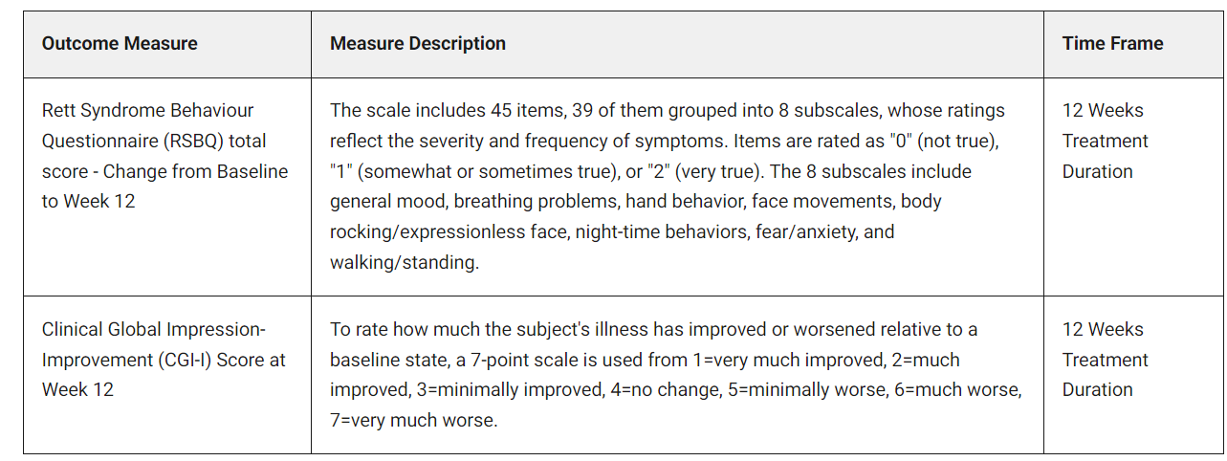


Outcome Measures as Endpoints in a study to establish the effect of Trofinitide/Daybue on Rett syndrome
Primary endpoint: ranked 1st - before other endpoints
endpoint: change in behavior on the rsbq after 12 weeks of treatment
J Panagoulias, FAST Summit 2023

Slide 11

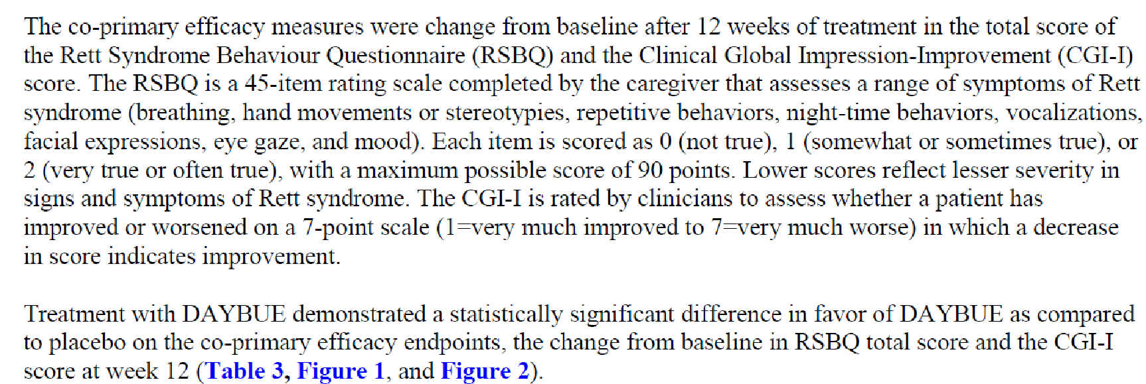

It worked! FDA approves first treatment for Rett syndrome
-Measures an aspect of the condition important to caregivers
-Tool is able to measure the concept
-Measurement can clearly be described in the labeling for the drug
J Panagoulias, FAST Summit 2023

Slide 12
It worked! FDA approves first treatment for Rett syndrome
“Study 003 provided reliable and statistically persuasive evidence that trofinetide can help patients with Rett syndrome achieve a clinically meaningful improvement in symptoms of their disease.”
-FDA
-Measures an aspect of the condition important to caregivers
-Tool is able to measure the concept
-Measurement can clearly be described in the labeling for the drug
J Panagoulias, FAST Summit 2023

Slide 13

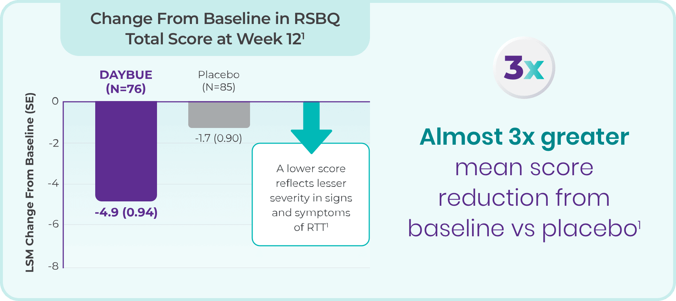
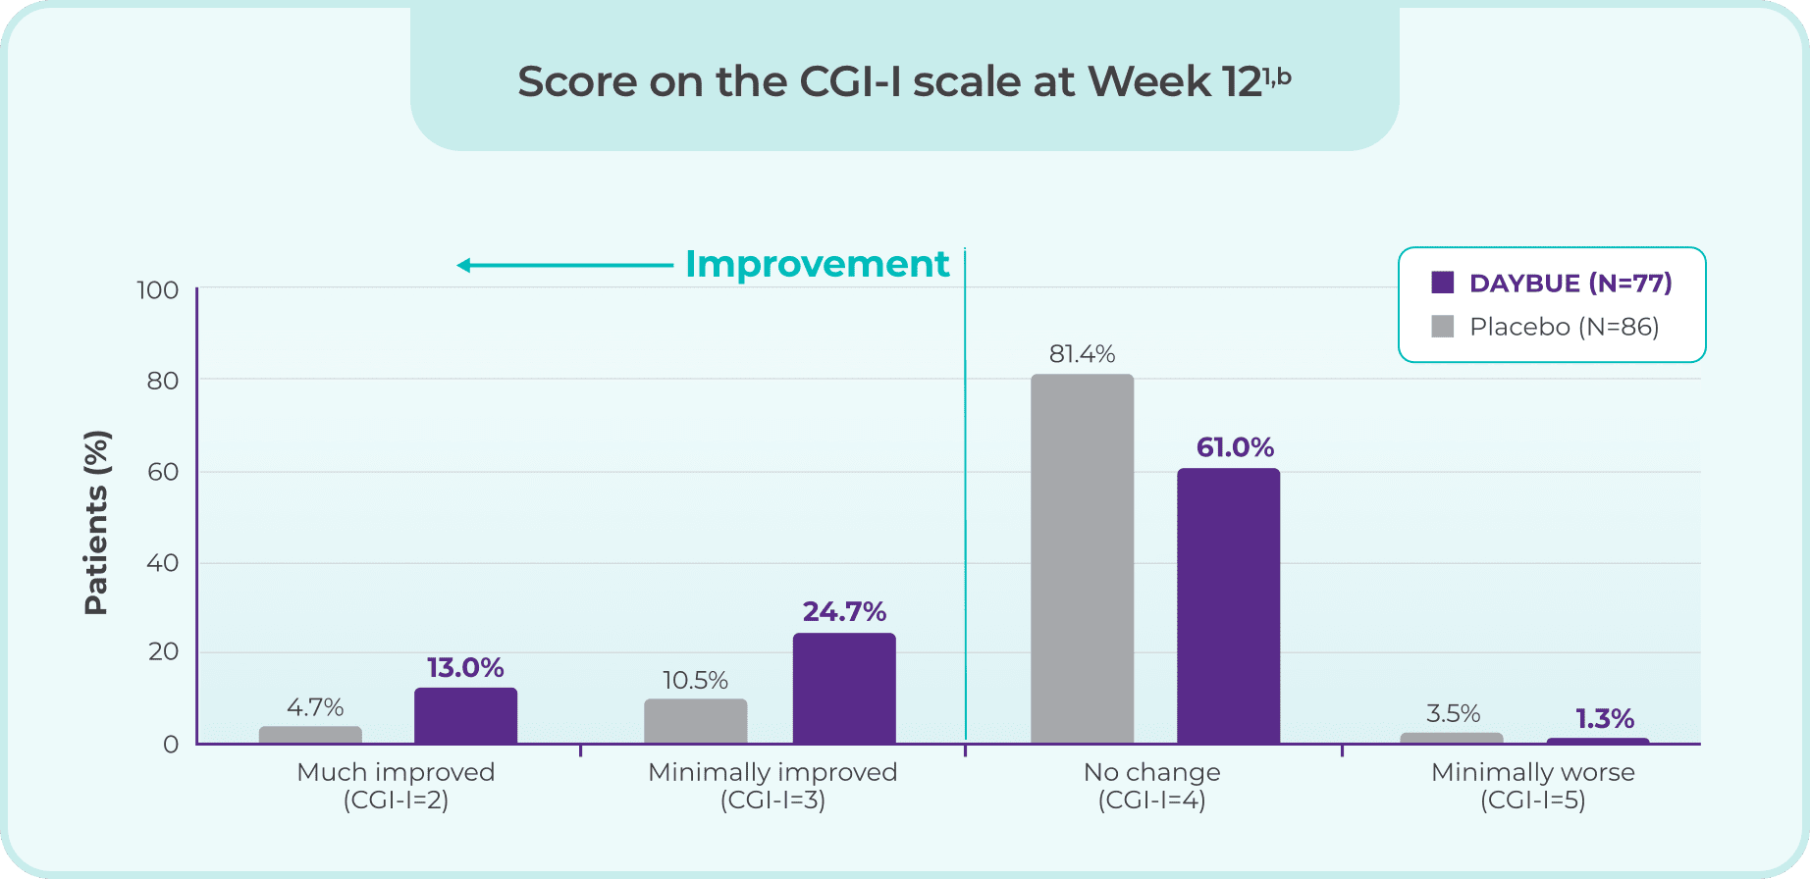
The primary endpoints showed improvement
(Behavior and CGI-I)
J Panagoulias, FAST Summit 2023

Slide 14







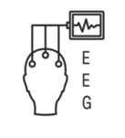

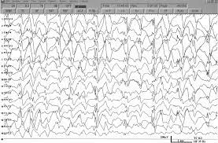



Potential endpoints for SLC6A1?
Communication
Motor
Outcome Measures
Sleep
Cognition
Seizures
Daily Activities
Behavior
Adapted from J Panagoulias, FAST Summit 2023
www.COMBINEDBrain.org

Slide 15


Patient-reported outcome measures
ORTAS
Observer-Reported Toileting Abilities Survey
FDA Grant
Duke University Team
Angelman -> 12 Disorders
Detect increases in abilities
Meaningful changes for families
Caregiver-entered
Internal funding for Development
Pilot launch late 2023
Hunter Syndrome -> CB Disorders
Detect increases in abilities
Meaningful changes for families
Caregiver-entered
www.COMBINEDBrain.org

Slide 16

What is a Surrogate Endpoint
A surrogate endpoint is a marker…something that can predict clinical benefit, but is not itself a measure of clinical benefit
Surrogates are used when:
Clinical outcomes take a very long time to study (e.g. mortality, stroke)
Clinical benefit of improving the surrogate endpoint is well understood (e.g. blood pressure → stroke)
Conducting a clinical endpoint study would be unethical
Extensive evidence must accumulate, including evidence from epidemiological studies and clinical trials.
Usually, clinical trials are needed to show that the surrogate endpoint can be relied upon to predict, or correlate with, clinical benefit
J Panagoulias, FAST Summit 2023

Slide 17
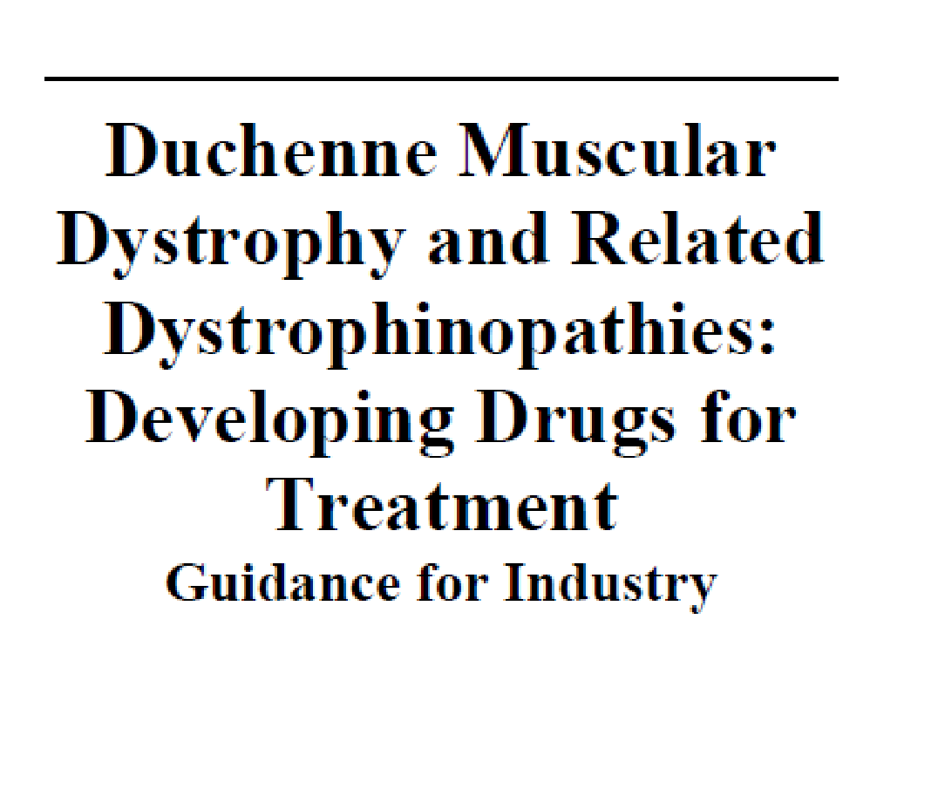





Surrogate endpoints can shorten the timeline
“Deficiency of functional dystrophin appears to be the proximate cause of the symptomatic and functional consequences of dystrophinopathies, justifying particular interest in dystrophin as a biomarker and as a potential surrogate endpoint for accelerated approval.”
J Panagoulias, FAST Summit 2023

Slide 18
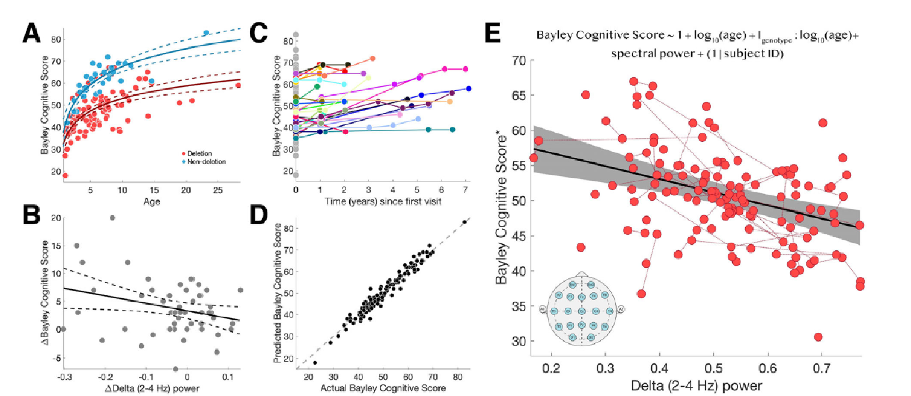
EEG delta power predicts cognitive function in Angelman syndrome
J Panagoulias, FAST Summit 2023
Ostrowski, Annals of Clinical and Translational Neurology, 2021

Slide 19
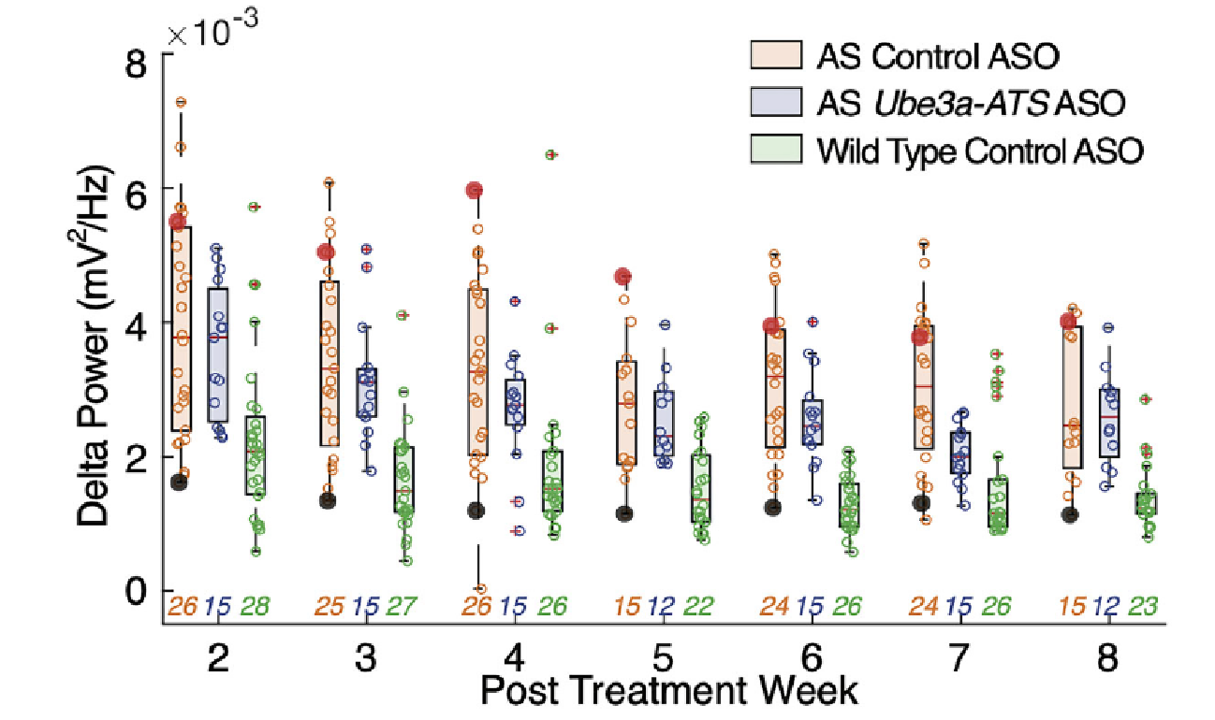
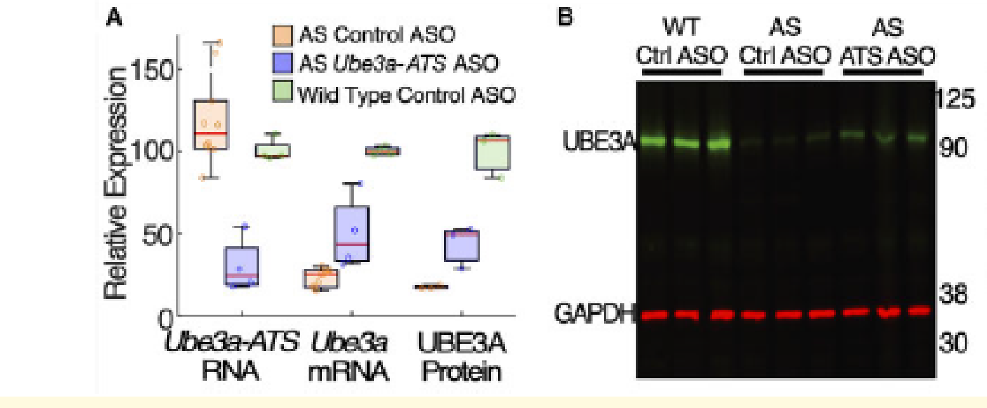
Reduction in abnormal delta power following ASO treatment in AS mice
J Panagoulias, FAST Summit 2023
Spencer, Brain Communications, 2022

Slide 20


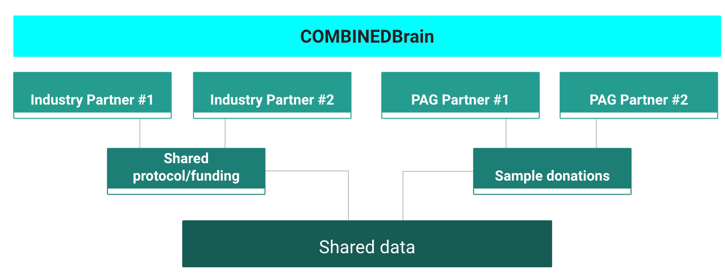

SLC6A1 surrogate endpoints
Biosamples -> Biomarkers
Blood
Plasma
Dried Blood spots
Urine
Cerebrospinal fluid
Plasma biomarker studies
Metabolomics
Proteomics
Methylomics
Exosomes
www.COMBINEDBrain.org

Slide 21
SLC6A1 surrogate endpoints - EEG biomarkers
COMBINEDBrain EEG Bank
Phase 1
Collect previously recorded EEGs
De-Identify
Store in accessible platform
Convert to be analyzable across software systems
Link to natural history data
Link to biosamples
Phase 2
Collect prospective EEGs at-home
Standard protocol
Novel technologies alongside standard rig
Laan & Vein (2005)
www.COMBINEDBrain.org

Slide 22

To succeed, a new drug must:
  Treat what matters to patients
  Affect how a patient feels, functions or survives
  Make a meaningful change
A good drug can fail if the endpoint is wrong
Clinical trials cost more without appropriate endpoints
A good drug can take too long to pass without surrogate endpoints
Why do we care about Endpoints?
www.COMBINEDBrain.org

Slide 23
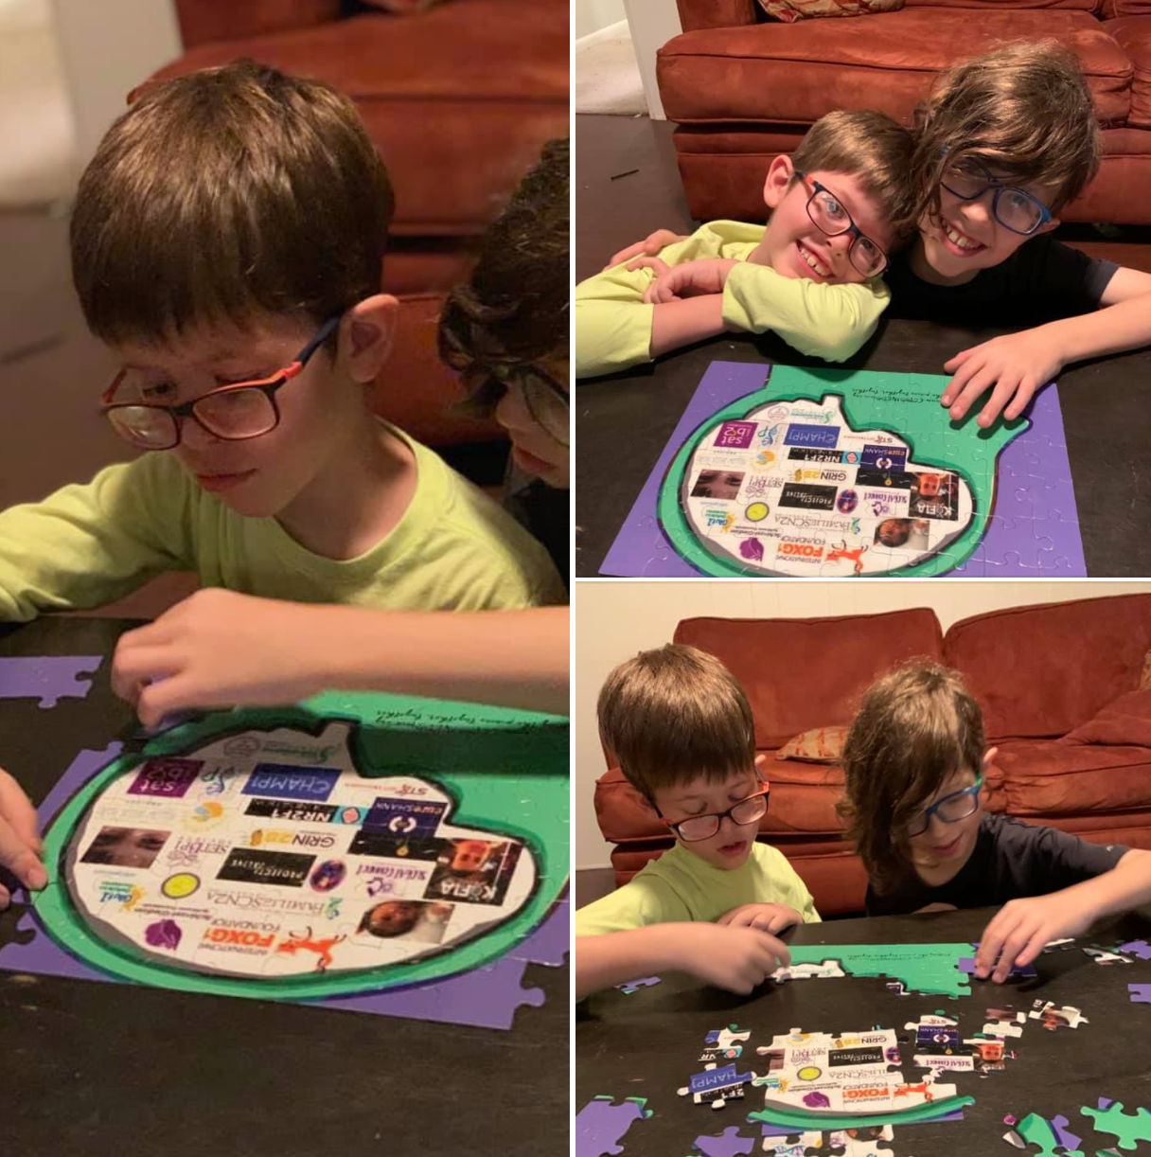
Putting the pieces together.
Together!
www.COMBINEDBrain.org

