Slide 1
ATX-018
TREATMENT OF NEURODEVELOPMENTAL DISORDER
CONFIDENTIAL

Slide 2

Aayam Therapeutics
On a Mission to Deliver Drugs : Faster and Cheaper
(www.aayamtx.com)

Slide 3

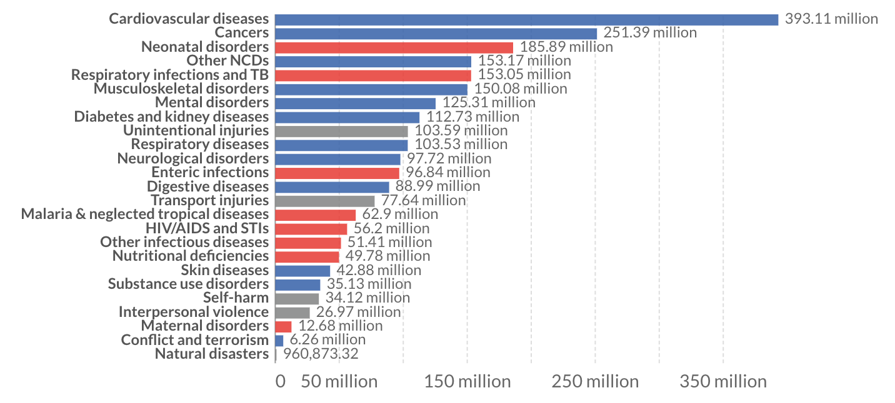
Millions suffer from thousands of diseases
400M+
People with 9,000 Rare Diseases
90%
Diseases have no approved therapies
$8 Trillion
Economic Cost of Rare Diseases in US
Notes:
https://ourworldindata.org/burden-of-disease

Slide 4
“Innovation and new drugs that save people’s lives shouldn’t come at a price that bankrupts people or ruins their lives.”
“3 in 10 adults reported not taking their medicines as prescribed because of the cost.”
Kaiser Family Foundation
David Mitchell, Cancer Survivor & Founder,
Patients for Affordable Drugs
4

Slide 5
COST OF THERAPEUTICS
  Exclusivity (branded drugs) to ensure profitability
  Business models demand block buster markets
  Orphan drugs average drug prices >$200K / year
  Priority review vouchers have become a commodity, traded for >$100M
  Drug pricing based on market support
  = Ravicti® priced at ~$740,000/pt/yr

Slide 6
COLLABORATIVE MODEL FOR R&D
Need drugs for diseases that affect HUMANKIND – it is not an option
Drug Discovery and Development is an experimental science and relies heavily on the experience of the team, takes decades to develop
Multi-lateral partnerships in pharmaceutical discovery and translational science, a commitment from the scientific, patient and financial community
Address the issue around accessibility, affordability and productivity of R&D
Input
  Resources, scientific excellence, DDD experience, translational science, $$$ with acceptable risk/reward ratio
Output
  Continued innovation, innovative medicines for patients
  Education /training for next generation scientists
  $$$ for the investors

Slide 7
REQUIREMENTS FOR A DRUG
Essential properties for a suitable drug
Potency
Good Pharmacokinetics
Acceptable cost of goods
Formulability
Specificity
Solubility
Metabolic Stability
Low Toxicity
Patentable
Good Tolerability
Oral Activity

Slide 8
MODEL TO SUPPORT NEW R&D
New entities assembled in a collaborative network
  Separate entities assembled in an R&D network, affording significant flexibility, innovation and risk management
  R&D strategies that support the assembly of treatment portfolios for the entire disease life cycle
  Disease-specific R&D networks
  R&D processes with outsourcing to maximize flexibility and manage dev. risk
  R&D programs based on genotyped patients/subjects and biomarkers
  Partnering and collaborative ventures to access disease knowledge communities

Slide 9
NEURODEVELOPMENT DISORDERS – RAVICTI®
SLC6A1 mutations leads to endoplasmic reticulum (ER) stress affecting neurodevelopment in children
Ravicti® (glycerol phenylbutyrate) is approved by the US FDA for the treatment of Urea Cycle Disorders (UCD)
  An oral liquid with an Orphan Drug exclusivity for UCD, priced @ ~$740,000/patient/year
Dr. Kang’s lab (Vanderbilt) was the first to demonstrate the effect of phenybutyric acid in SLC6A1, her lab has subsequently demonstrated that ATX-018 also works in her pre-clinical models!
In an Investigator Initiated POC clinical trial with Ravicti® Dr. Grinspan (Weill-Cornell) and Dr. Demarask (Univ of Colorado) have demonstrated efficacy of Ravicti® in pediatric patients with SLC6A1 and STXBP1 disorders
  PK/PD profile of Buphenyl® (sodium phenylbutyrate) precludes its application in pediatric patients
ATX-018 is a patentable prodrug that also delivers the active ingredient phenylbutyric acid, similar to Ravicti®
Out intent is to develop ATX-018 with the intent to provide return to our investors and also keep it affordable for patients

Slide 10
ERYTHRITOL PHENYLBUTYRATE (ATX-018)
ATX-018, an option of improving Ravicti’s safety profile and also be a more cost-effective treatment
Reduce the dose burden on pediatric patients – it delivers the same level of PBA as Ravicti® at 25% lower dose (based on pre-clinical PK studies)
Does not release glycerol with potential to an improved tolerability profile in pediatric patients
  Eliminate GI adverse effects due to glycerol including headaches, nausea, vomiting, and diarrhea.
    Glycerol (4g) at the maximum dose of 19g /day of RAVICTI.
    Glycerol dosed at 25 mg/kg bw per hour (1.75 g for 70kg adult) was determined to be responsible for the side effects (nausea, headache and/or vomiting) https://doi.org/10.2903/j.efsa.2017.4720
ATX-018 breaks down into phenylbutyric acid and erythritol
ATX-018 can be manufactured cost effectively
Ravicti® is currently not approved for SLC6A1
ATX-018 protected by Composition of Matter patent

Slide 11
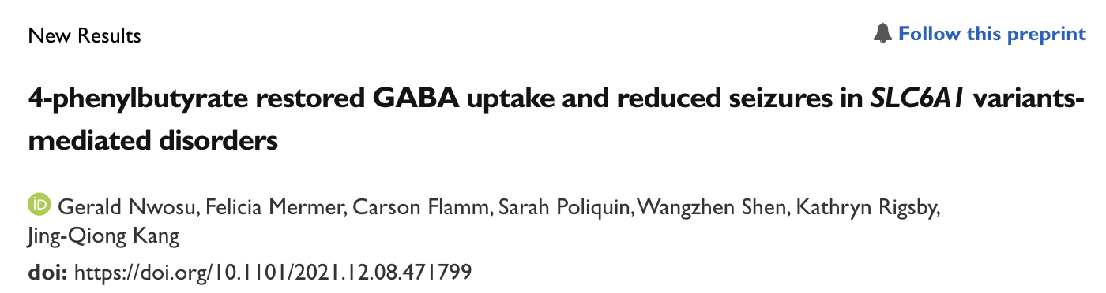
SLC6A1 NEURODEVELOPMENTAL DISORDER
Nearly all patients have epilepsy (91%; typically generalized)
Most with developmental delay / cognitive impairment (82%)
Hypotonia (79%)
Autism spectrum disorder, movement disorder, problems with attention or aggression, high pain tolerance, sleep problems

Slide 12
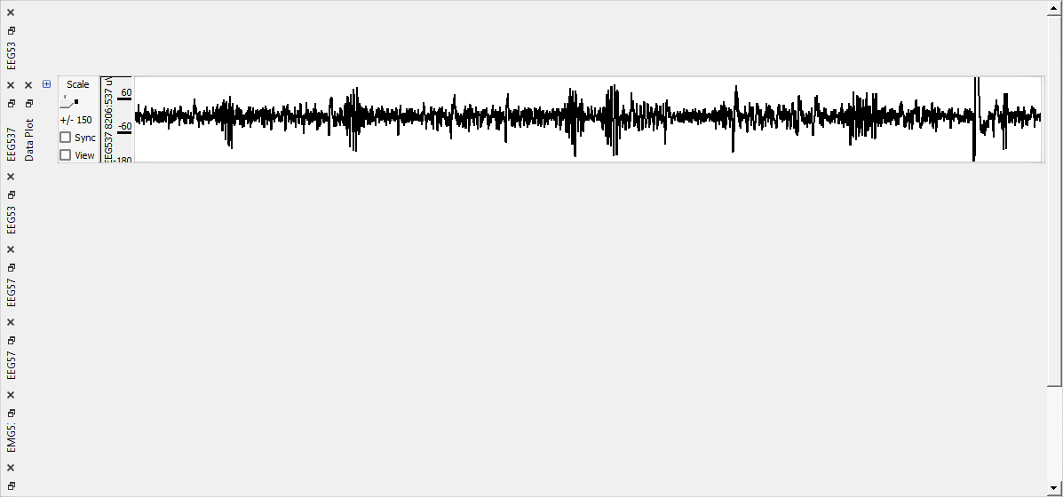
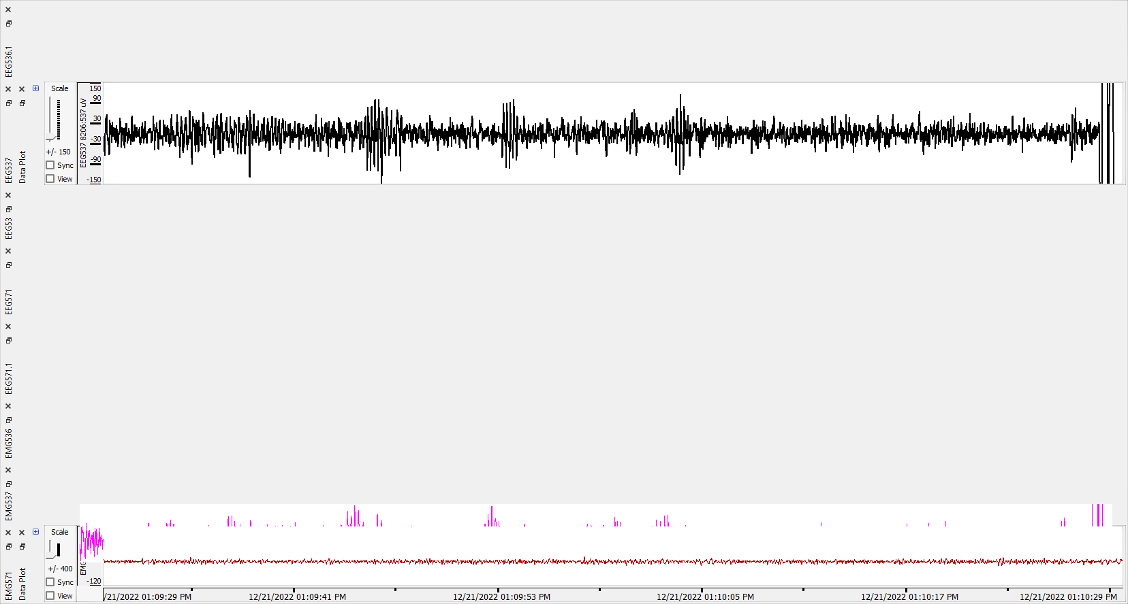
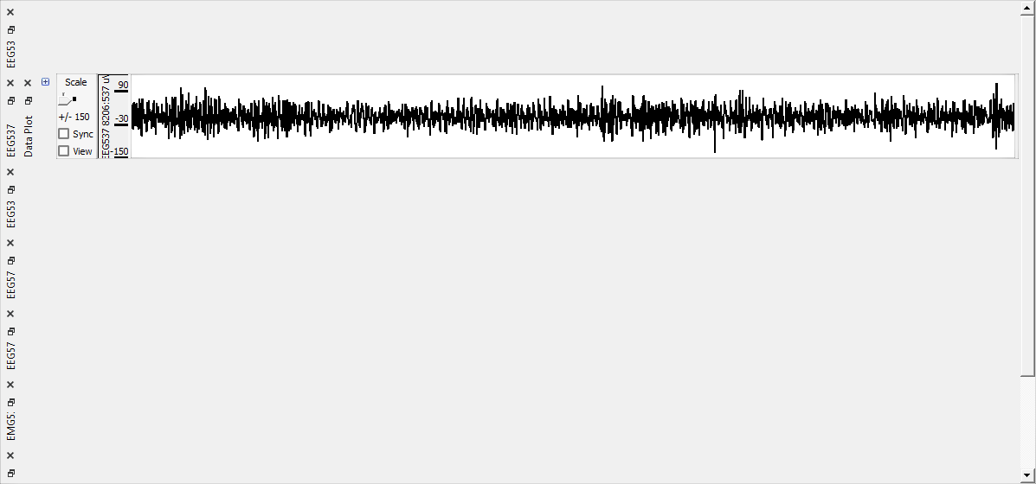
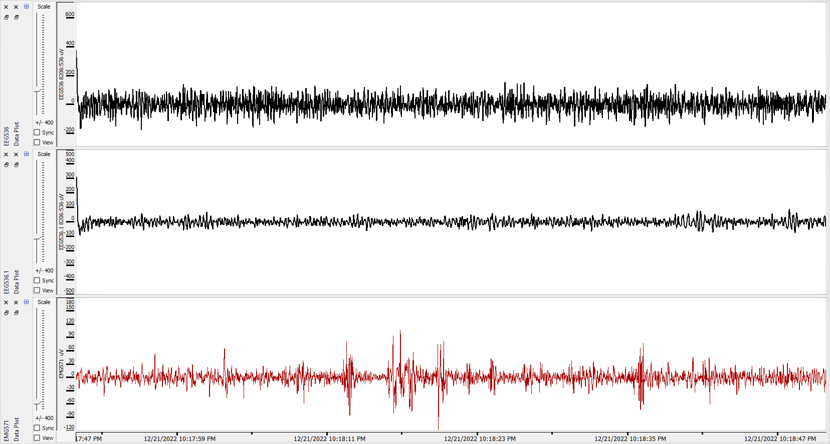
ATX-018 EFFICACY IN SLC6A1^{+/S295L}
A
B
pre
Total 5-7 Hz SWDs
over 48 hrs
P=0.044
Paired t test
post
*
A. Representative EEG recordings show that the heterozygous Slc6a1^{+/S295L} (het) KI mice had frequent absence like spike wave discharges (SWDs) during baseline recordings without ATX-108 drug treatment (100mg/kg, oral dosing, single dose, daily) for 7 days. B. Graph showing the total number of 5-7 Hz SWDs calculated by Seizure Pro during 48 hrs. recordings pre- or after drug treatment. Drug treatment reduced seizure activity. *p < 0.05; vs predrug treatment, paired t test, N=4 mice, Values were expressed as mean ± S.E.M).
Source : Dr. Kang, Vanderbilt University

Slide 13
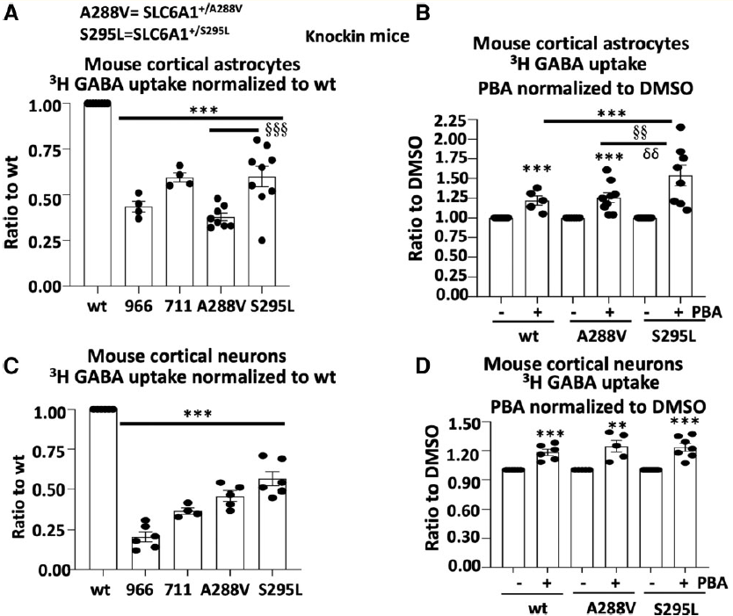
PBA EFFECT ON GABA UPTAKE
PBA rescued GABA uptake in mouse cortical astrocytes or neurons cultured from postnatal pups at Days 0–3 for astrocytes and Day 0 for neurons from the SLC6A1+/A288V or SLC6A1+/S295L mouse line.
GRAPH A/B : Astrocytes show reduced GABA uptake activity (0.38+0.021 for A288V and 0.60+0.06 for S295L). PBA treatment increased the GABA uptake activity in the astrocytes (1.22+ 0.058 for wt; 1.26+0.063 for A288V and 1.54+0.13 for S295L)
GRAPH C/D : A similar pattern of GABA uptake reduction in the mutant mice and the upregulation in PBA-treated cells was observed
Source : Dr. Kang, Vanderbilt University

Slide 14
STXBP1 ENCEPHALOPATHY
Nearly all patients have epilepsy (95%)
Seizure freedom for 1 in 3 patients; 1 in 3 remain therapy resistant.
Intellectual disability in all (88% severe to profound)
20% autism or autistic features
Other features: axial hypotonia, ataxia or ataxic gait, tremor, spasticity and dyskinesia, or dystonia.
MRI Brain normal in half. Others have cerebral atrophy (33%), thin corpus callosum (16%), hypomyelination (16%).
STXBP1 = Munc18-1; regulates synaptic vesicle tracking & docking

Slide 15
POC TRIAL IN SLC6A1 and STXBP1 WITH RAVICTI®
20 children
  10 SLC6A1
  10 STXBP1
Trial design
Source : Dr. Grinspan, Weill-Cornell

Slide 16
EARLY RESULTS – SEIZURE OUTCOMES
Source : Dr. Grinspan, Weill-Cornell

Slide 17



NEXT STEPS ON PATH TO APPROVAL
Pre-IND Package - FDA Filing 6/9 mos from project initiation
  Clinical Design and Protocols: Study design with reference to RAVICTI NDA
  Safety Plan: Initial tolerability studies and results. Proposed GLP studies to support clinical development
  Pharmacology: Animal data to support use of ATX-018 in human subjects
  Pharmacokinetics: Data in two preclinical species with mass balance justifying clinical dose
  Manufacturing of API and Product: Routes, analytical methods, specifications and stability plan
Anticipated IND submission 12/15 mos from project initiation
  IND Enabling Studies - Initiated per FDA Response
  GLP non-clinical safety studies
  cGMP manufacturing (API/DP)
  Identification of clinical sites with site initiation
  Orphan Drug application to treat SLC6A1 and other related disorders
  In collaboration with
ANTICIPATED APPROVAL 36-48 MONTHS FROM PROJECT INITIATION

Slide 18
WHAT NEXT
Dr Kang has shown the effect of PBA on the translocation of GAT-1 and GABA uptake
A key component of the MOA is reduction of ER stress.
ER and mitochondria have multiple contact sites to form specific domains, termed mitochondria-ER associated membranes (MAMs) hence physiological effect on the ER must also affect the mitochondria and vice versa.
What is the function and role of mitochondria?
Is PBA is also acting as an anaplerotic agent?
  TCA cycle functions so intermediates leave the cycle and must be replaced to permit its continued function. This is anaplerosis.
Such an activity will promote bio-energetics and may also contribute to the outcome.
Working with Dr. Kang to study new anaplerotic agents and also agents that protect and improve mitochondria function and levels

Slide 19
MITOCHONDRIA
Present in all human cell, except RBCs, mitochondria are vital to our survival
They are associated with the genesis of life itself, hence it is not surprising that they are affected by every physiological insult
Are causally or consequentially linked to EVERY pathology
Most therapeutics treat/address the pathogenesis of a disease, mitochondria based therapeutics can lead to healing!

