Slide 1



Simons Searchlight Registry Findings for SLC6A1
Paul Wang, MD
November 30th, 2023

Slide 2




Research
resources
Funding
for outside
researchers
DIAGNOSIS FIRST
Participants
Individuals with ASD and
their family members
GENES FIRST
Participants
Individuals with a variant in
one of the more than 150
genetic conditions
POSTMORTEM BRAIN
TISSUE DONATION
Participants
Individuals with and without ASD, or with a genetic change associated with ASD
• Animal model repository
• SFARI Gene
• SFARI Base
Collect
• behavioral information
• clinical data
• blood samples
iPSC

Slide 3






Our mission is to shed light on these conditions by collecting high quality, standardized natural history data and building strong partnerships between researchers, industry and families.
What are the Goals of Simons Searchlight?
Collect detailed medical and behavioral histories along with blood samples
Synthesize the information
you provide and share results back to families
Freely share data and samples with qualified researchers
Connect researchers and participants from around the world
Promote better understanding of these genetic changes
88 articles published

Slide 4
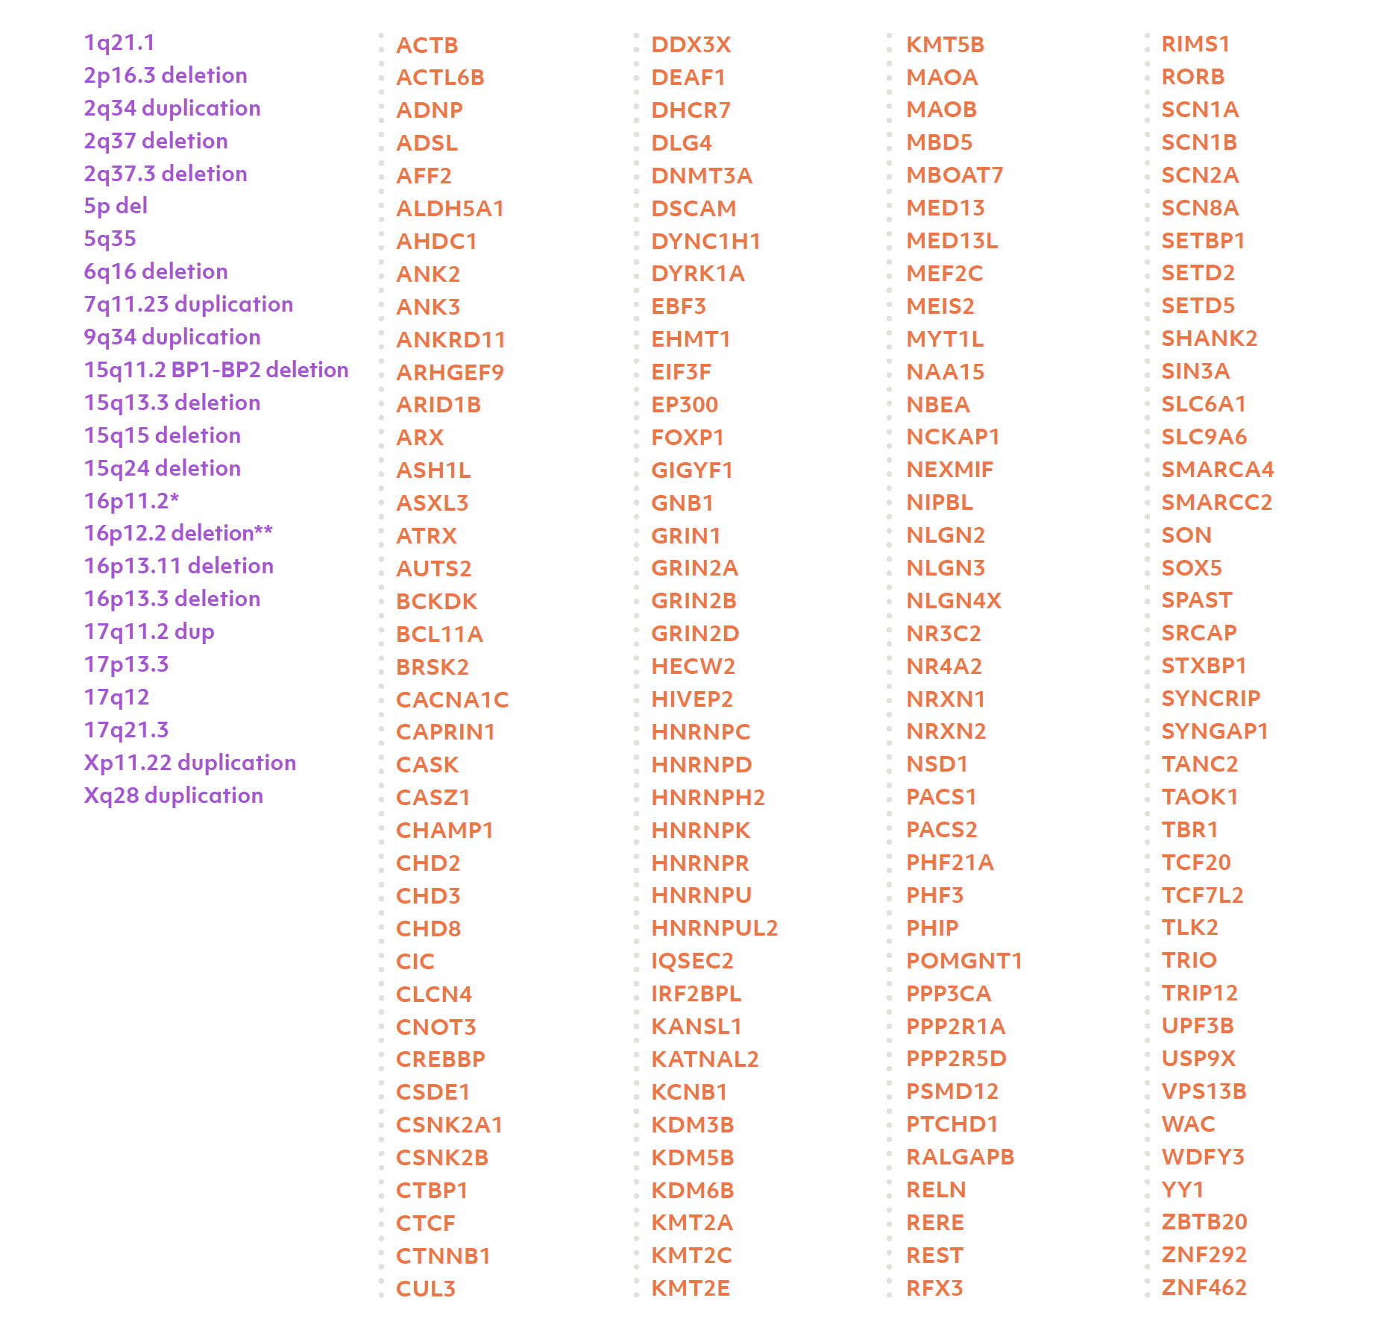

Genetic Conditions We Study
Available in:
English
Spanish
French
Dutch
More to come
*Gene list as of April 2023

Slide 5
The SLC6A1 Registry in Simons Searchlight

Slide 6
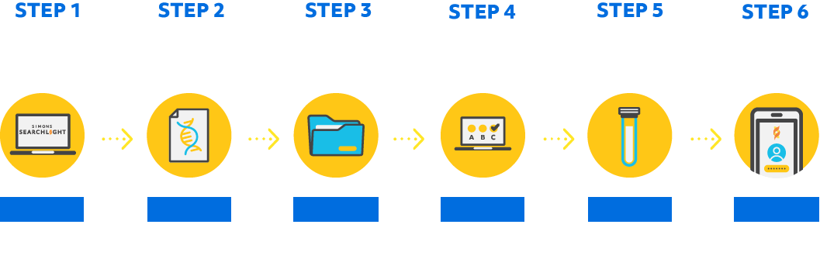
Progress of Individuals with SLC6A1
179
142
113
120
21
Login for more
We are a long-term study, gathering new information from you every year.

Slide 7
SLC6A1 Pathogenic and Likely Pathogenic Variants
103 individuals (16 more participants from last year)
Missense variant (72)
p.Asn327Ser
p.Ser331Gly
p.Val342Met
p.Ala357Val
p.Gly360Asp
p.Pro361Leu
p.Gly362Arg
p.Ser387Pro
p.Leu390_Leu392del
17 Frameshift/nonsense variant (not shown)
p.Leu251Pro
p.Gly263Arg
p.Ala288Val
p.Phe294del
p.Ser295Leu
p.Gly297Arg
p.Gly297Glu
p.Ala305Thr
p.Gly307Arg
10 Splice site/intronic variant (not shown)
4 Intragenic deletion (not shown)
p.Glu101Gly
p.Gln106Arg
p.Gly111Arg
p.Tyr139Cys
p.Tyr140Cys
p.Thr217_Ile220del
p.Cys228_Ile229del
p.Glu402Gly
p.Ser459Arg
p.Val511Met
p.Gly550Arg
Variants
p.Arg44Trp
p.Arg44Gln
p.Gly63Ser
p.Arg69Ser
p.Gly75Arg
p.Gly80Arg
p.Gly94Glu
Functional regions
599
PDZ-binding
Variants as of November 2023
30 VUS in Simons Searchlight; not shown
Na+ binding sites

Slide 8
SLC6A1 iPS Cells
 | c.nomen | p. nomen | # of Carriers | Available
1 | 863C>T | Ala288Val | 2 | (not successful)
2 | 871C>T | Gln291* | 1 | Available
3 | 884C>T | Ser295Leu | 1 | Upcoming
4 | 1222delC | Leu408Trpfs*26 | 1 | Available
5 | 1377C>A | Ser459Arg | 1 | Upcoming
6 | 1435C>T | Arg479* | 1 | (not successful)
Non-profit and for-profit researchers worldwide can request samples through SFARI Base any time for $120/sample

Slide 9
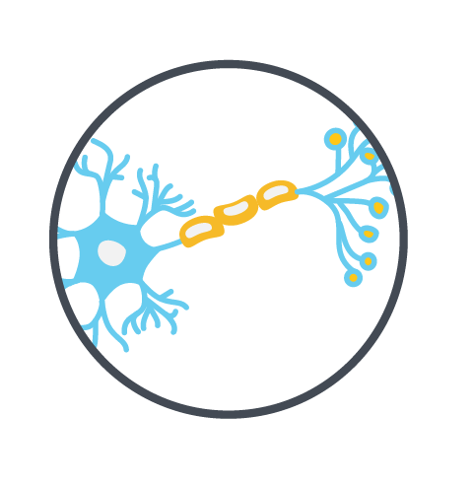



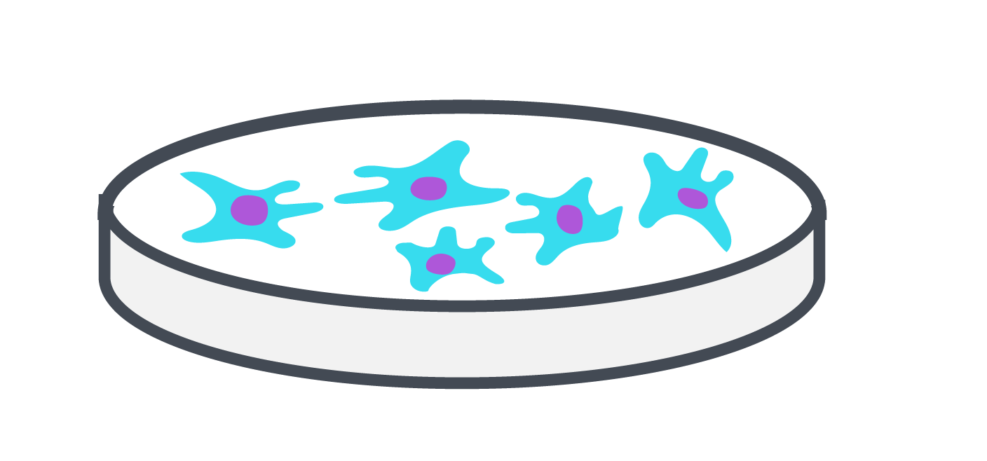




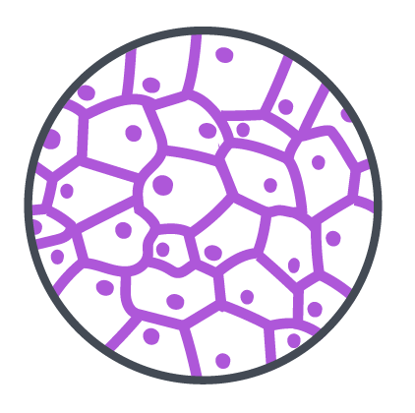

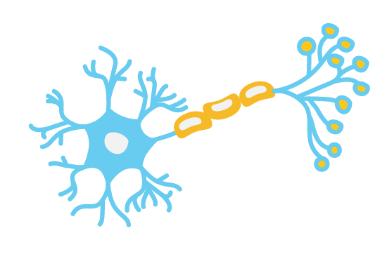

What are induced pluripotent stem cells (iPSCs)?
Treatments to tell the iPSCs to change into something else
Treatments to make iPSCs
Disease Modelling
Nerve Cells
Liver Cells
Other Tissue Cells
Simons Searchlight
Participant
Blood cells
iPSCs
Specialized Cells
Drug Screening
and Discovery

Slide 10











How are blood samples used in Simons Searchlight?
Why is this important?
Sampled
$$Funded by
Simons Foundation Autism Research Initiative
Nancy Lurie Marks Family Foundation
Induced pluripotent
stem cells
Blood
Your samples are directly powering research!
New York Stem Cell Foundation
6–9 months

Slide 11
Simons Searchlight SLC6A1 Medical History Data

Slide 12
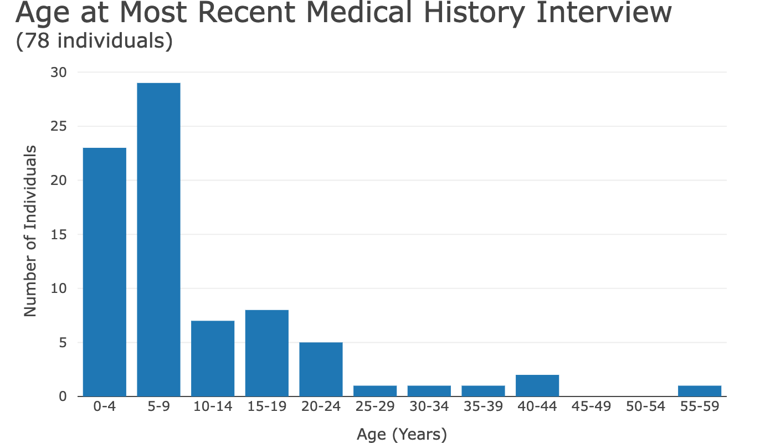
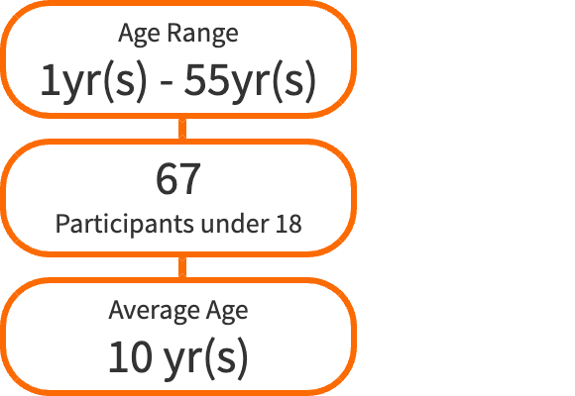
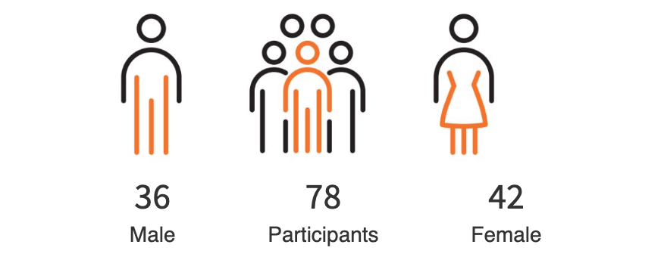


Slide 13
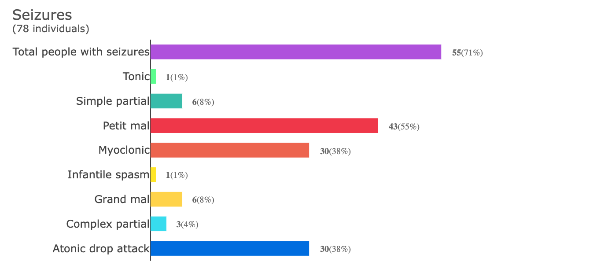

Slide 14
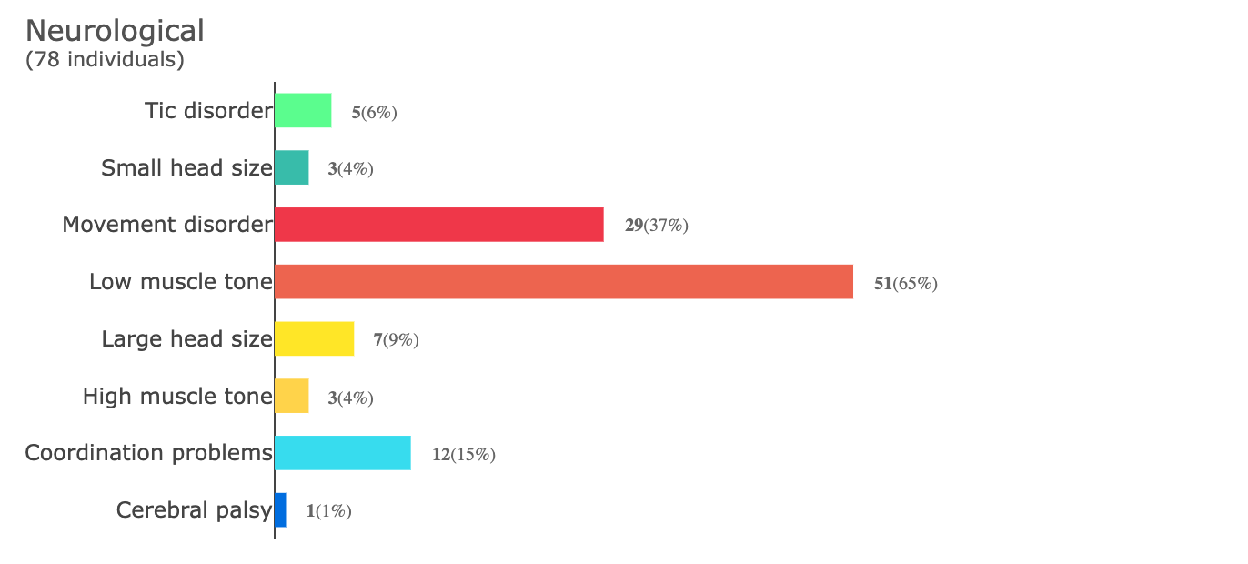
Conditions
Notes:
LIST MOVEMENT DISORDERS - ataxia (6), tremors (7), balance issues, hand-wringing, facial spasm, unsteady (2), abnormal gait (3), balance issues + lack of core strength, dystonia, stereotypey, myoclonus

Slide 15
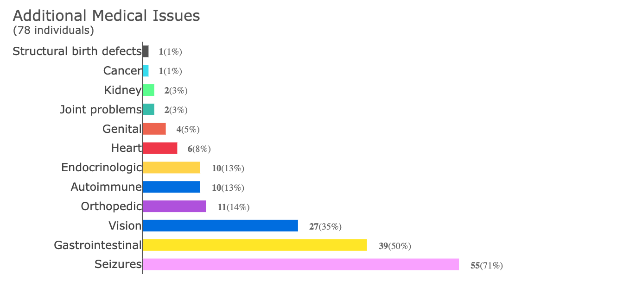


*conditions listed in [brackets] represent a non-exhaustive list of the most common conditions within the specific category
[heart murmur, congenital heart disease, elevated heart rate]
[failure to thrive, hypothyroidism]
[chronic fatigue]
[scoliosis]
[nearsighted, farsighted, crossed eyes]
[constipation, diarrhea, GERD]
Notes:
Orthopedic - no scoliosis bracing listed

Slide 16
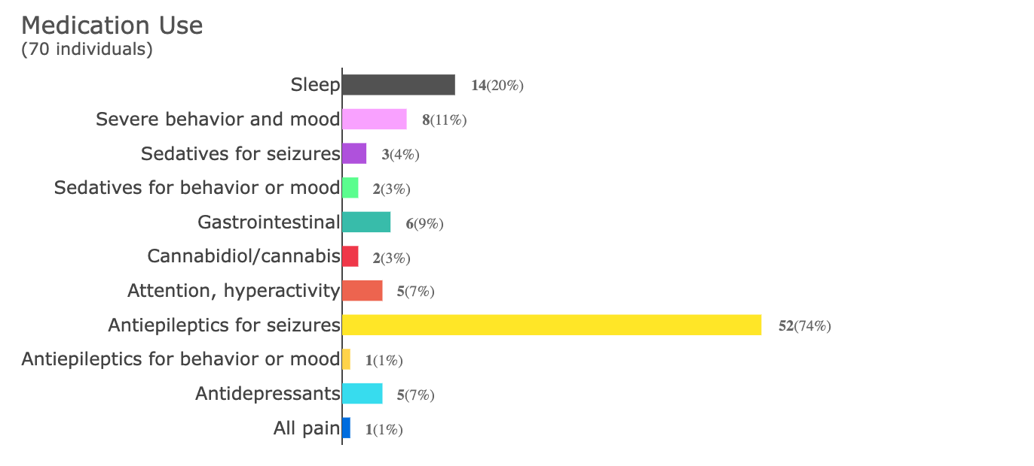
**Neuroleptics and mood stabilizers, including for sleep
*Antidepressants also for anxiety, OCD, and other mood or behavior

Slide 17
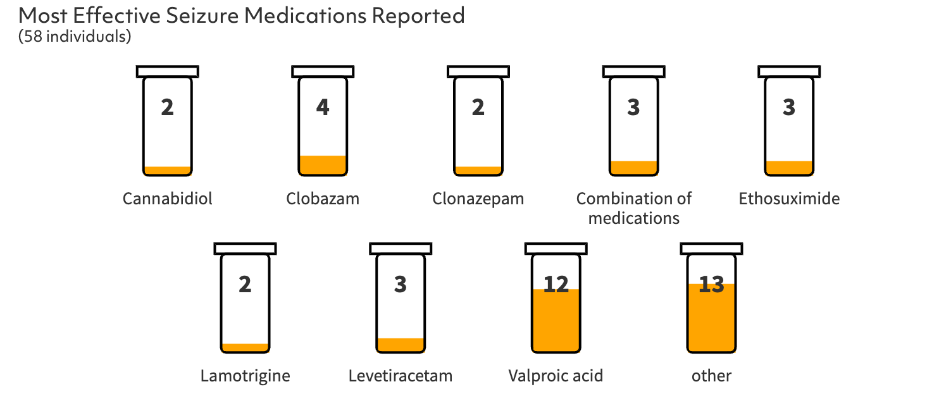
When asked if there was a single medication that seemed to work best for their dependent's seizures, valproic acid stood out to caregivers as particularly effective​.
Notes:
If the only best meds are "combo" or "other" do not show

Slide 18
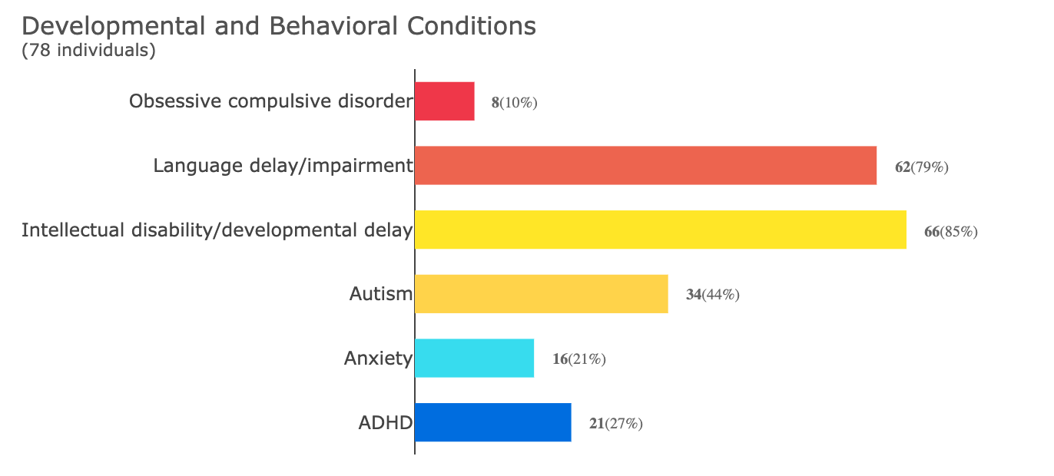

Slide 19
Vineland Adaptive Behavior Scales (Vineland-3)

Slide 20
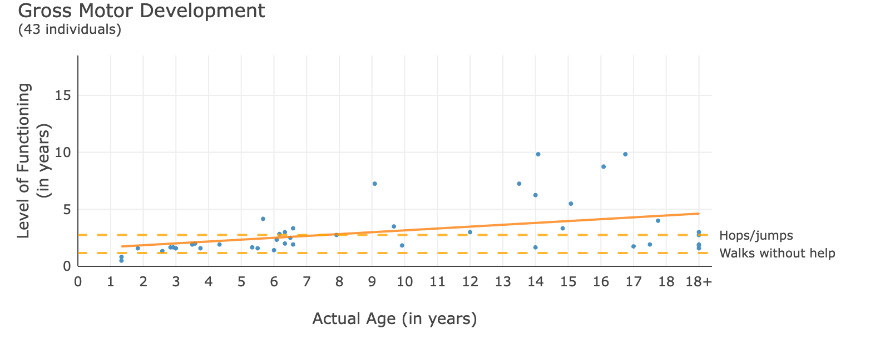
--- at this level, a person typically:
What does this mean as my child gets older?
Along the bottom is the actual age of the person.
The dots are placed at their level of motor skills like walking.
Most children are likely to be walking at age 4 and older, and many are able to do more physical activities.

Slide 21
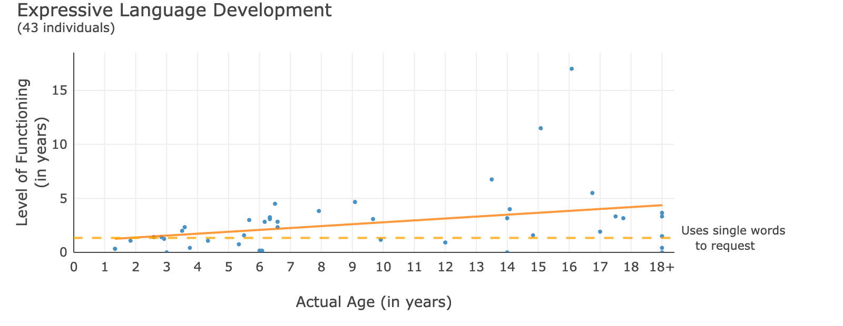
Each blue dot is a person
This child is 3 yo, and at the 1 yo level in speech
The trend line is going up at older ages
--- at this level, a person typically:
What does this mean as my child gets older?
Along the bottom is the actual age of the person.
The dots are placed at the level at which they are expressing themselves
73% of individuals are likely to be using language at age 4 and older.

Slide 22
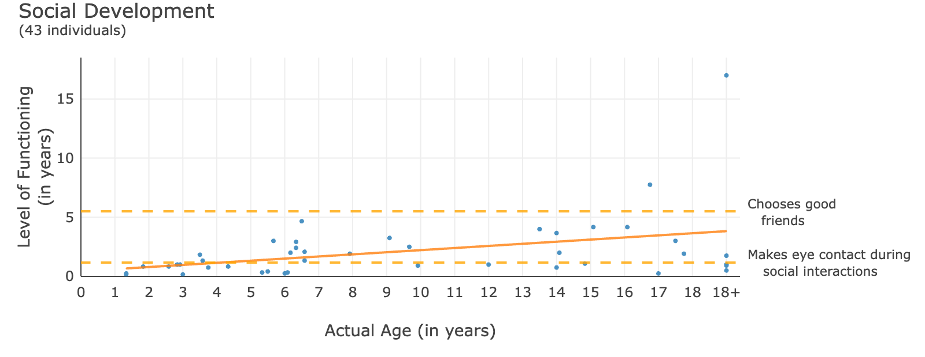
--- at this level, a person typically:
What does this mean as my child gets older?
Along the bottom is the actual age of the person.
The dots are placed at the level of their social behaviors.
61% of individuals are likely to be making eye contact at age 4 and older.

Slide 23
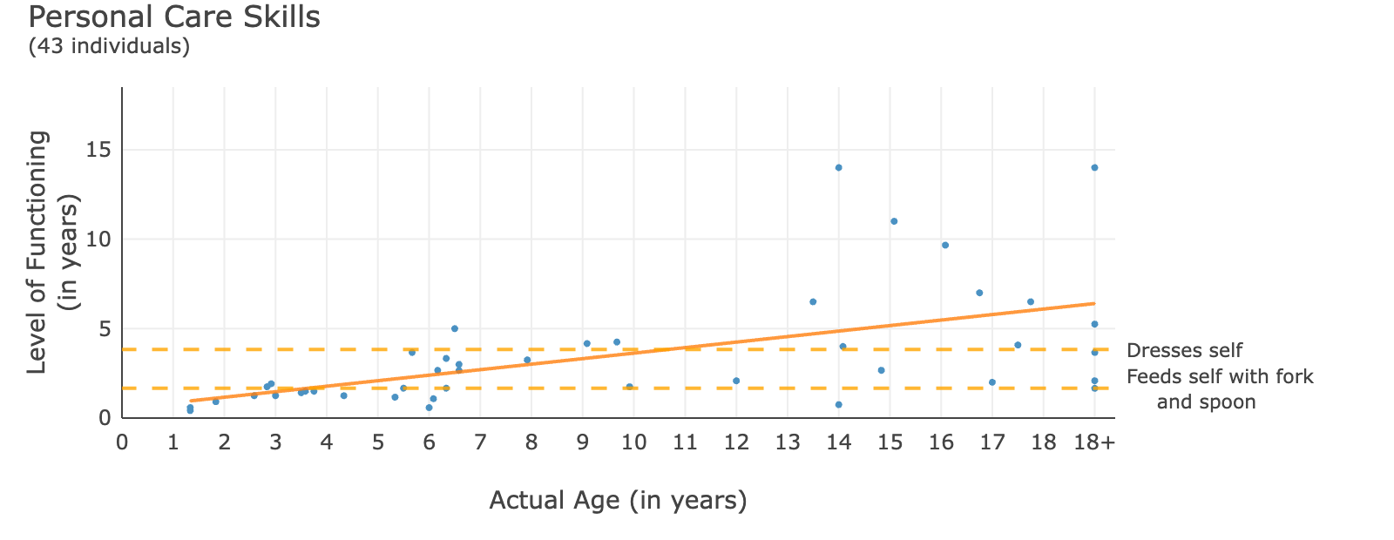
The trend line is going up at older ages
--- at this level, a person typically:
What does this mean as my child gets older?
Along the bottom is the actual age of the person.
The dots are placed at the level at which they are able to do things for themselves.
85% of individuals are likely to be feeding themselves at ages 4 and older, and many can do more things for themselves.

Slide 24
Child Behavior Checklist
(CBCL)

Slide 25
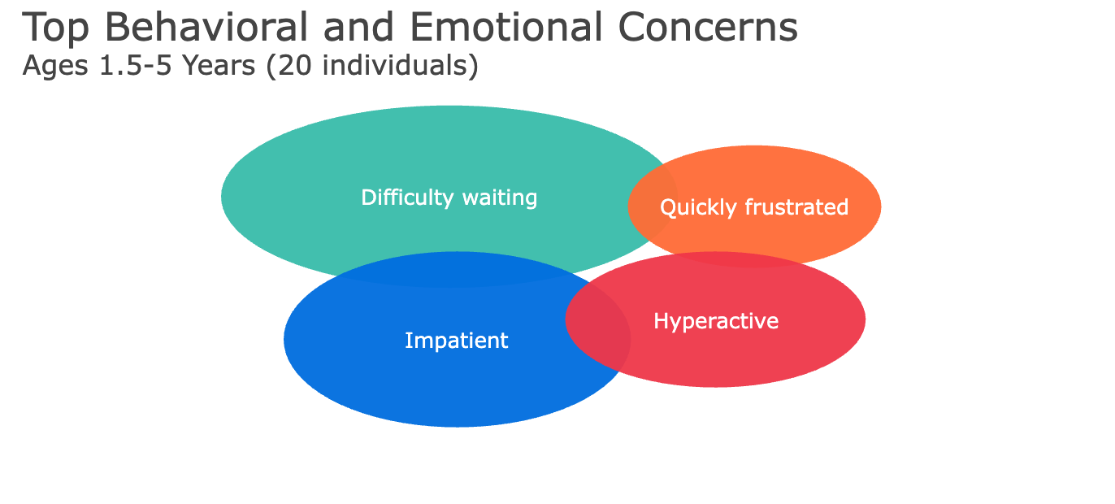

Slide 26


Slide 27

Summary: SLC6A1 Medical and Behavioral Phenotypes
Common issues
Other issues
Intellectual disability and developmental delay
Language delay
Seizures
Low muscle tone
Vision problems
GI issues
Difficulty waiting
Obsessions

Slide 28
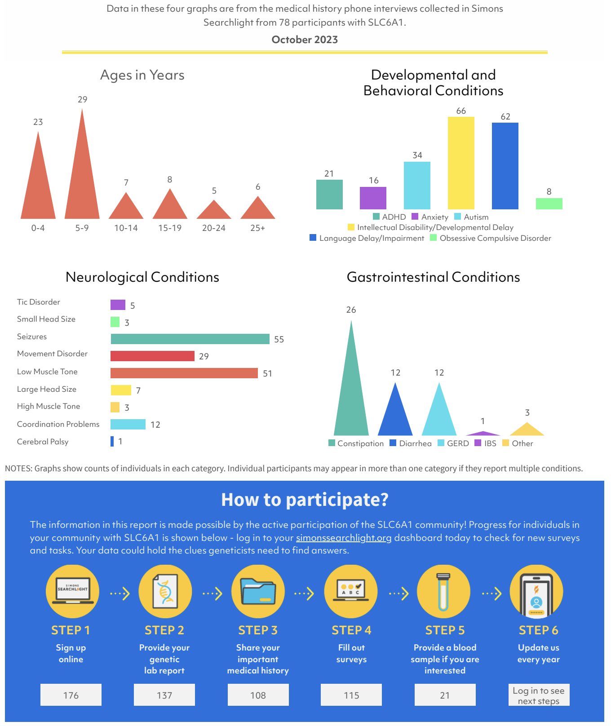
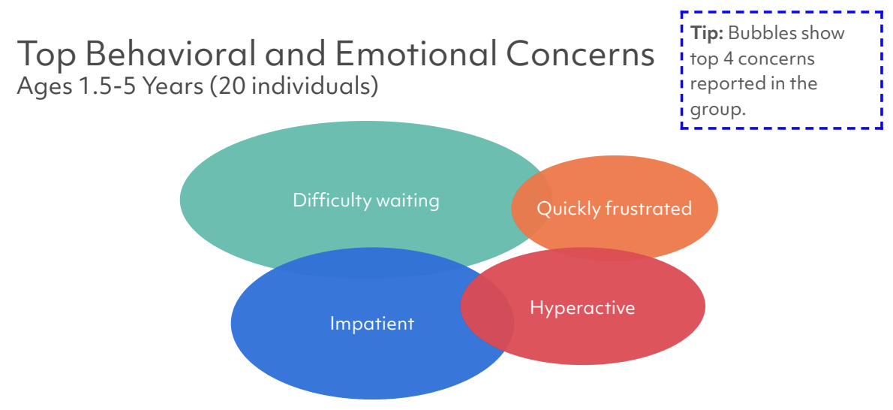
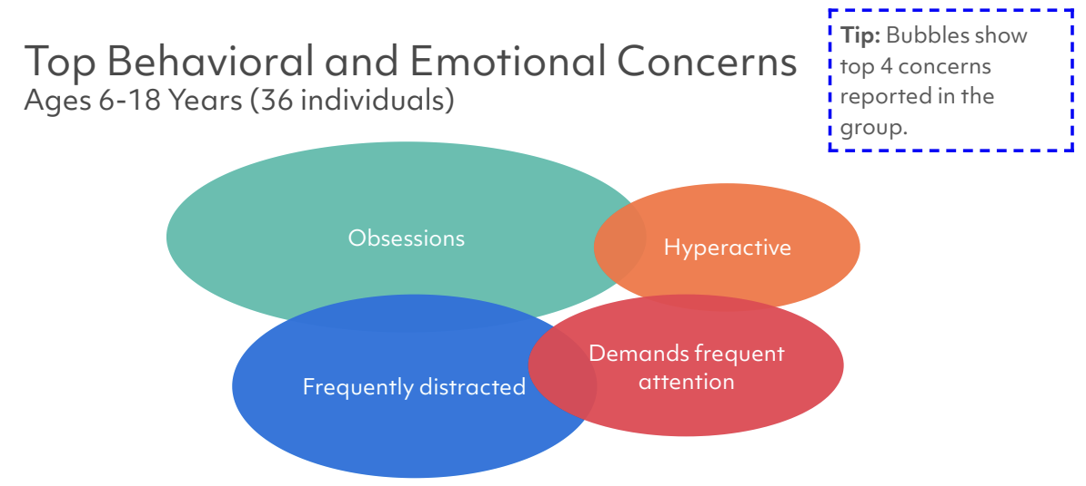
Information for Families
Personalized reports: SCQ, SRS, CBCL and Vineland located on your dashboard
Summary snapshots on your gene page
Presentations at conferences and meetings
https://cdn.simonssearchlight.org/wp-content/uploads/2023/10/27091225/SLC6A1-23Q3.pdf

Slide 29
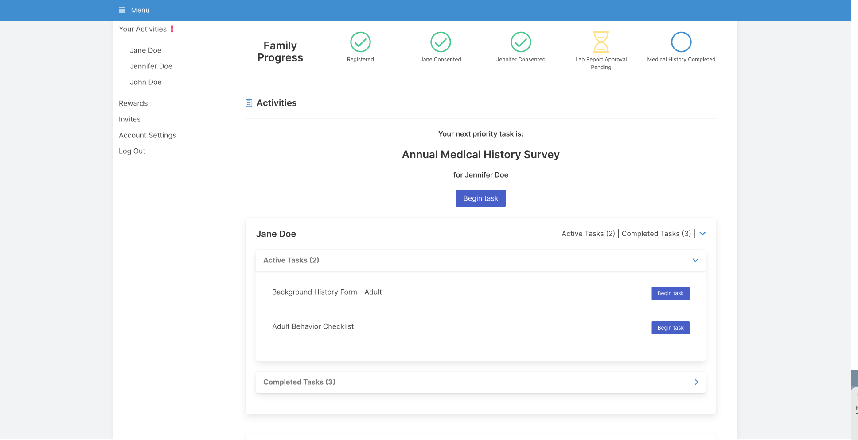
Participant Dashboard
Receive Amazon gift cards after survey completion
Easily view surveys you need to complete

Slide 30
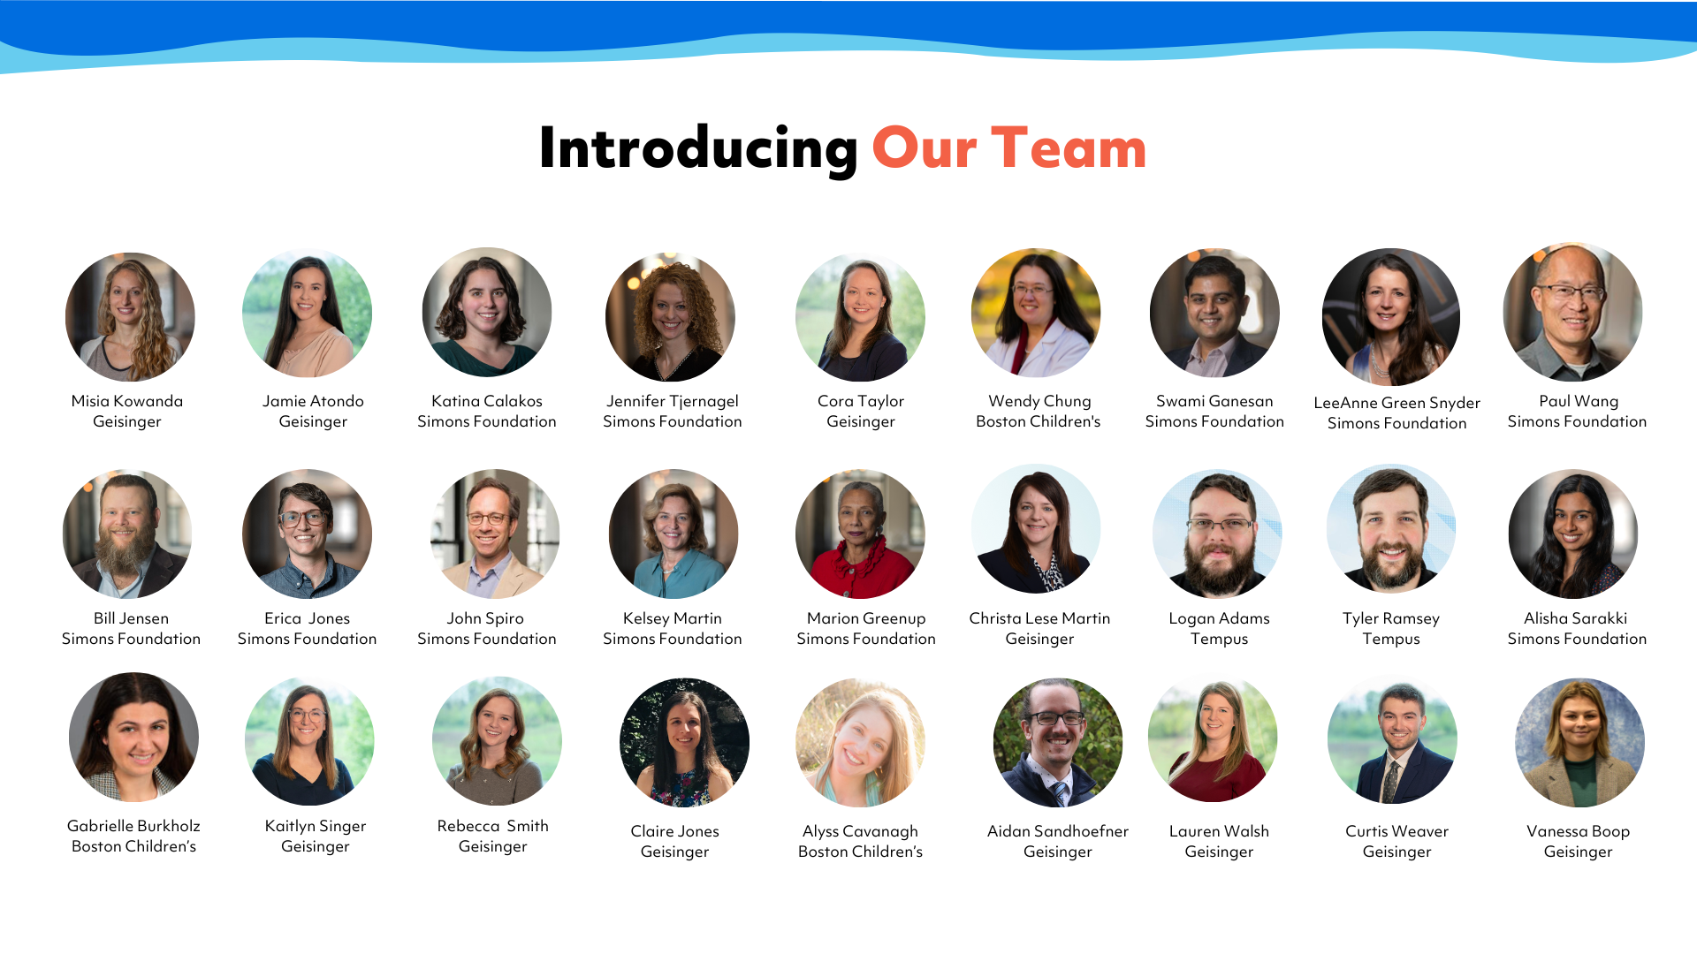

Slide 31





youtube.com/SimonsSearchlight
Thank you!
Register at SimonsSearchlight.org
Coordinator@SimonsSearchlight.org
facebook.com/SimonsSearchlight
@s_searchlight

Slide 32

What information is collected from individuals with genetic variants? | Baseline | Annual
MEDICAL RECORDS
Clinical Genetic Lab Results | X
INTERVIEW + ONLINE SURVEYS *
Medical History | X | X
Other Previous Diagnosis history (Developmental and mental health) | X | X
Medications | X | X
ONLINE SURVEYS
NDAR Global Unique Identifiers | X
Children's Sleep Habits Questionnaire | X
Simons Searchlight Sleep Supplement | X
Seizure History | X | X
Vineland Adaptive Behavior Scales 3rd ed. | X | X
Background History | X
Child Behavior Checklist | X | X
Social Responsiveness Scale-2 | X | X
Social Communication Questionnaire | X
Quality of Life (QI-Disability and Family Impact) | X
Brief Developmental Update | X | X
Information We Collect
Includes individuals with all types of variants
* Online Annual Medical History Survey is currently available to English speaking participants and will be available in other languages soon

Slide 33
Information We Collect
What information is collected from individuals with genetic variants? | Annual
PLANNED ADDITIONS
Observer Reported Communication Assessment (ORCA) | X
Behavior Problems Inventory | X
Developmental Milestone Update | X
Pediatric Evaluation of Disability Inventory (PEDI-CAT) | X
EEG Records

Slide 34

Seizure Course
Available in 56 individuals with seizures completing the Baseline Seizure History Survey, 2020-2023
Seizure onset was from 6 months through 23 years
  Average age of first seizure is 3 years 5 months
50 (89%) of individuals with seizures have had to take medication for their seizures
  47 (94%) continue to take preventative medication for their seizures
17 (30%) of all individuals who ever had a seizure have achieved seizure control or remission
  Average age at seizure control was 4 years 10 months, ranging from 2 years to 12 years (+ one individual with age at seizure control >25 years)
Notes:
qq = zz/xx

