Slide 1

SLC6A1-NDD Natural History Study Update
November 2023
Kimberly Goodspeed, MD
University of Texas Southwestern & Children’s Health Dallas
Department of Pediatrics | Neurology | Psychiatry
Center for Autism Care

Slide 2

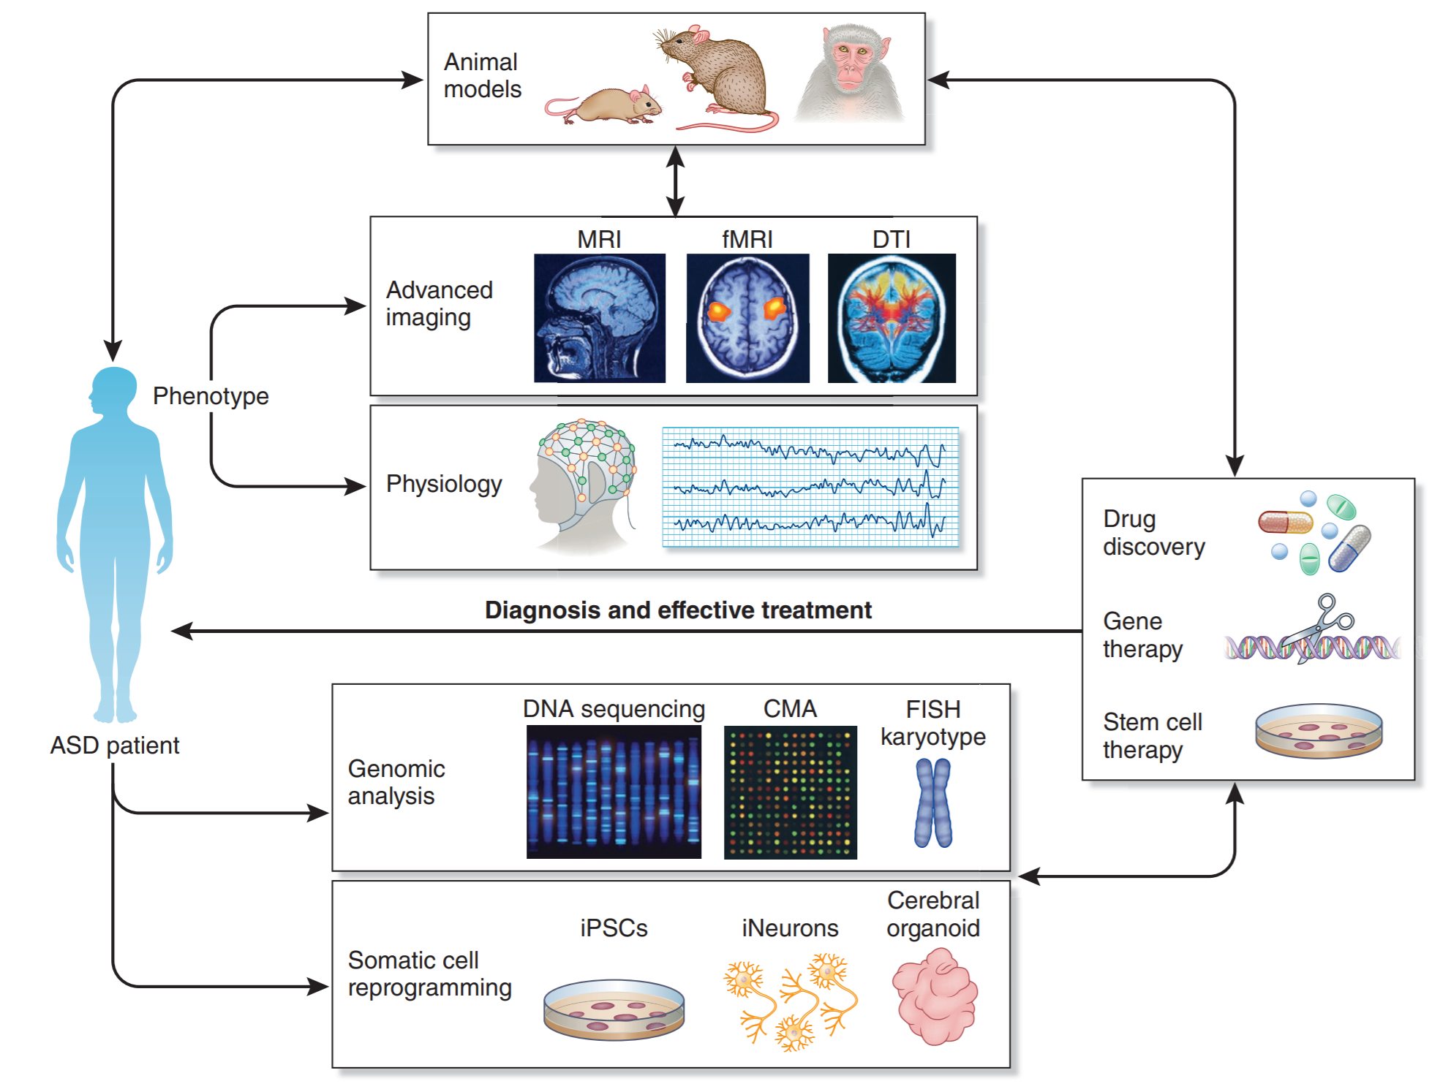
The Life Cycle of NDD Research
Each genetic discovery provides a window into the neural pathways involved in autism
Genetic discoveries identify potential targets for precision therapies
Targeting specific populations may reduce heterogeneity of a study cohort
Sztainberg Y, Zoghbi HY. Lessons learned from studying syndromic autism spectrum disorders. Nat Neurosci. 2016;19(11):1408-1417.

Slide 3
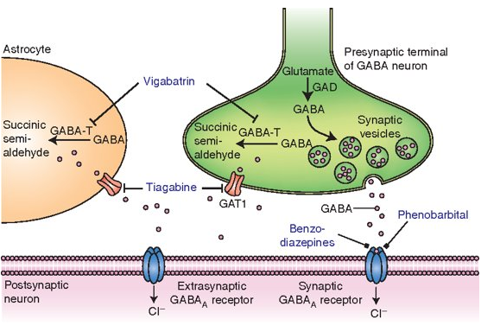
SLC6A1-Related NeuroDevelopmental Disorder
SLC6A1 is on Chromosome 3
Encodes GABA Transporter Type 1
  GAT1 is responsible for reuptake of GABA to maintain GABA homeostasis
  Role in excitability/inhibitory balance and GABA recycling ​
  GABA homeostasis is critical to brain development
Johannesen et al, Epilepsia, 2018; Bragina et al., 2008; Conti et al., 2011​

Slide 4
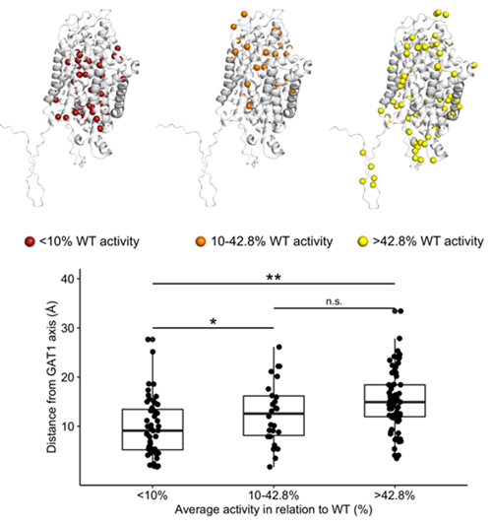
SLC6A1-Related NeuroDevelopmental Disorder
SLC6A1 is on Chromosome 3
Encodes GABA Transporter Type 1
Preliminary analyses show that reduced GAT1 activity may shed light on genotype –phenotype correlation
Stefanski et al, Brain, 2023

Slide 5
SLC6A1-Related NeuroDevelopmental Disorder
Cognitive Impairment
Learning Disability
Epilepsy
Absence
Behavioral Problems
Aggression
ADHD
Motor Impairment
Atypical Absence
Atonic
Myoclonic
Stereotypies
Autistic Traits
Ataxia or Unsteady Gait
Hypotonia
Incoordination
Tremor
Dyskinesia
Mild to moderate intellectual disability
Apraxia
Some have severe ID
Johannesen et al, Epilepsia, 2018; Bragina et al., 2008; Conti et al., 2011​

Slide 6
Available Treatments for SLC6A1-NDD
Developmental Therapy
Speech Therapy
Behavioral Medications
Mood stabilizers
School Supports
Anti-Seizure Medication
Valproic Acid
4-Phenylbutyrate
Occupational Therapy
Individualized Education Plan
Physical Therapy
ABA Therapy
Clobazam
ADHD-medication
Sleep medication
ST, OT, PT
Tutoring
Modified Curriculum
Seizure Action Plan
Johannesen et al, Epilepsia, 2018; Bragina et al., 2008; Conti et al., 2011​

Slide 7
Patient Registry
Retrospective Cohort
Prospective Cohort
Biomarker Study
Collection of patient characteristics
Histories and surveys
Follow patients over time in a standardized way using specific assessments
Explore objective measures of disease state and severity
Review of medical records to summarize what has been passively discovered
Clinical Trial Readiness Programs

Slide 8

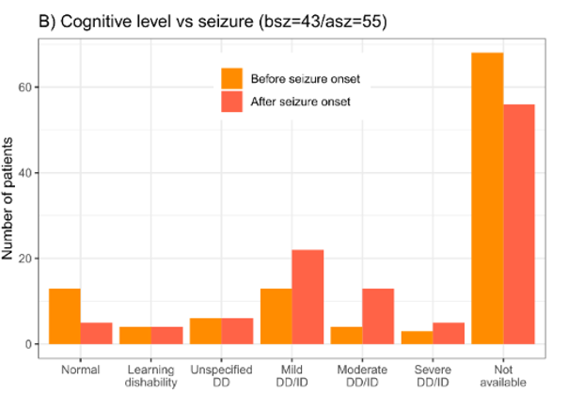
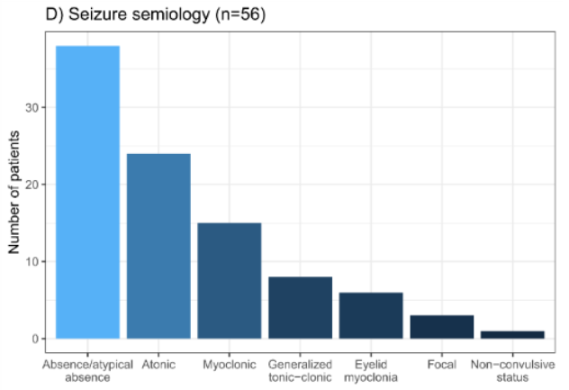
SLC6A1-NDD Retrospective vs Registry
Based on review of 116 cases, the developmental abilities are variable from mild learning disability to severe developmental delay or intellectual disability
Initial cases highlighted myoclonic-atonic seizures, however absence or atypical absence seizures are the most prevalent seizure semiology
Comparison of the rates of core features identified in the published literature to those reported by caregivers
  Concordant on epilepsy and developmental history
  Discordant on features less prominent in the Epilepsy literature
Goodspeed & Perez-Palma, et al, Brain Comm, 2020; Bain et al, 2022

Slide 9
SLC6A1-NDD NHS Medical History Data
Table 1: SLC6A1-NDD Severity Scale
DOMAIN | MILD | SEVERE
Cognition | Mild Impairment (IQ-equivalent ˃85) | Severe Impairment (IQ-equivalent ≤85)
Language | Phrased Speech | Non-verbal (may use AAC)
Motor Coordination | Minimal to no problems (DCDQ ˃45 or Beery-VMI ≥80) | Severe problems (DCDQ ≤45 or Beery-VMI ≤79)
Autism | No Autism or Autism Level 1 | Autism Level 2 or 3
Epilepsy | No Seizures or Well-Controlled (0-1 ASM) | Intractable Seizures (≥2 ASMs)
Neuropsychiatric | Minimal to no problems (No behavioral meds) | Severe behavioral problems (≥1 behavioral meds)
Sleep | Minimal to no problems | Insomnia requiring prescription medication
Table 3: Severity Grouping in UTSW SLC6A1-NDD Cohort
 | Mild (15) | Severe (20)
Gender M:F | 7:8 | 9:11
Mean Age (yr) | 9.1 ± 6.4 yr | 8.7 ± 5.4 yr
Mean IQ | 75.1 ± 18.8 | 65.4 ± 16.3
Verbal : Non-Verbal | 12:3 | 6:13
Movement Disorder | 8/15 | 14/20
Autism Level 2/3 | 4/15 | 17/20
Intractable Epilepsy | 4/15 | 10/20
Challenging Behaviors | 2/15 | 14/20
Insomnia | 1/15 | 6/20

Slide 10
Selecting Endpoints
Blood Test
Metabolite
Genomics
Electrical Measure
EEG
ERP
Imaging
Structural MRI
Retinal Imaging
fMRI
Performance Measures
Cognitive Measures
Motor Assessments
Proxy-Report Measures
Quality of Life Measures
Parent-Report Disease Severity Scales
Physician Rating Scales
CHOP-INTEND
Clinical Global Impression (CGI)
Developmental Testing

Slide 11
Patient-Centered Clinical Development
Disease Concept Study
Clinical Outcome Measure Development

Slide 12



SLC6A1-NDD | Disease Concept Model Study Social Media Listening
Goodspeed et al, 2023

Slide 13
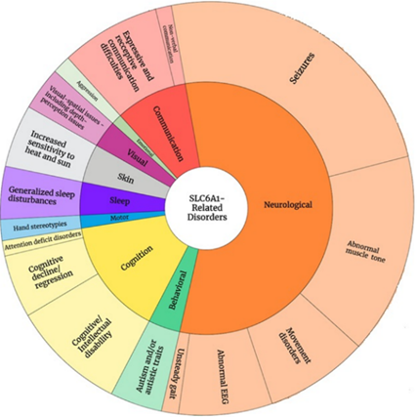
SLC6A1-NDD | Disease Concept Model Study – Draft Model
Goodspeed et al, 2023

Slide 14
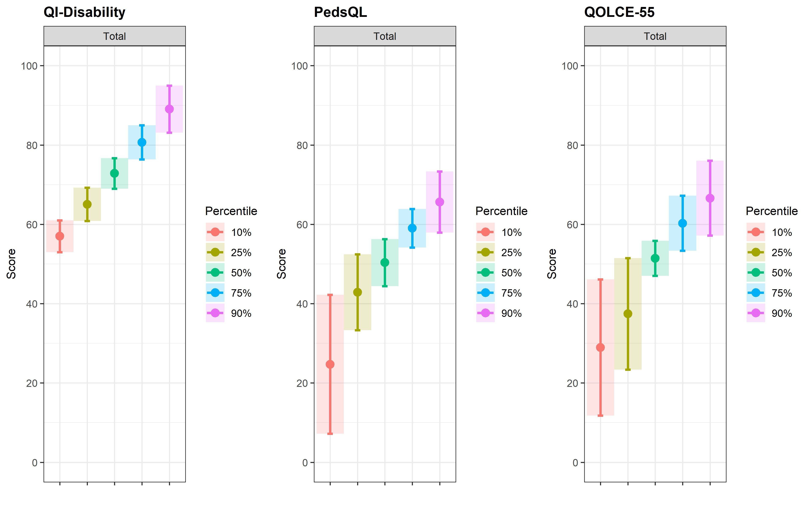
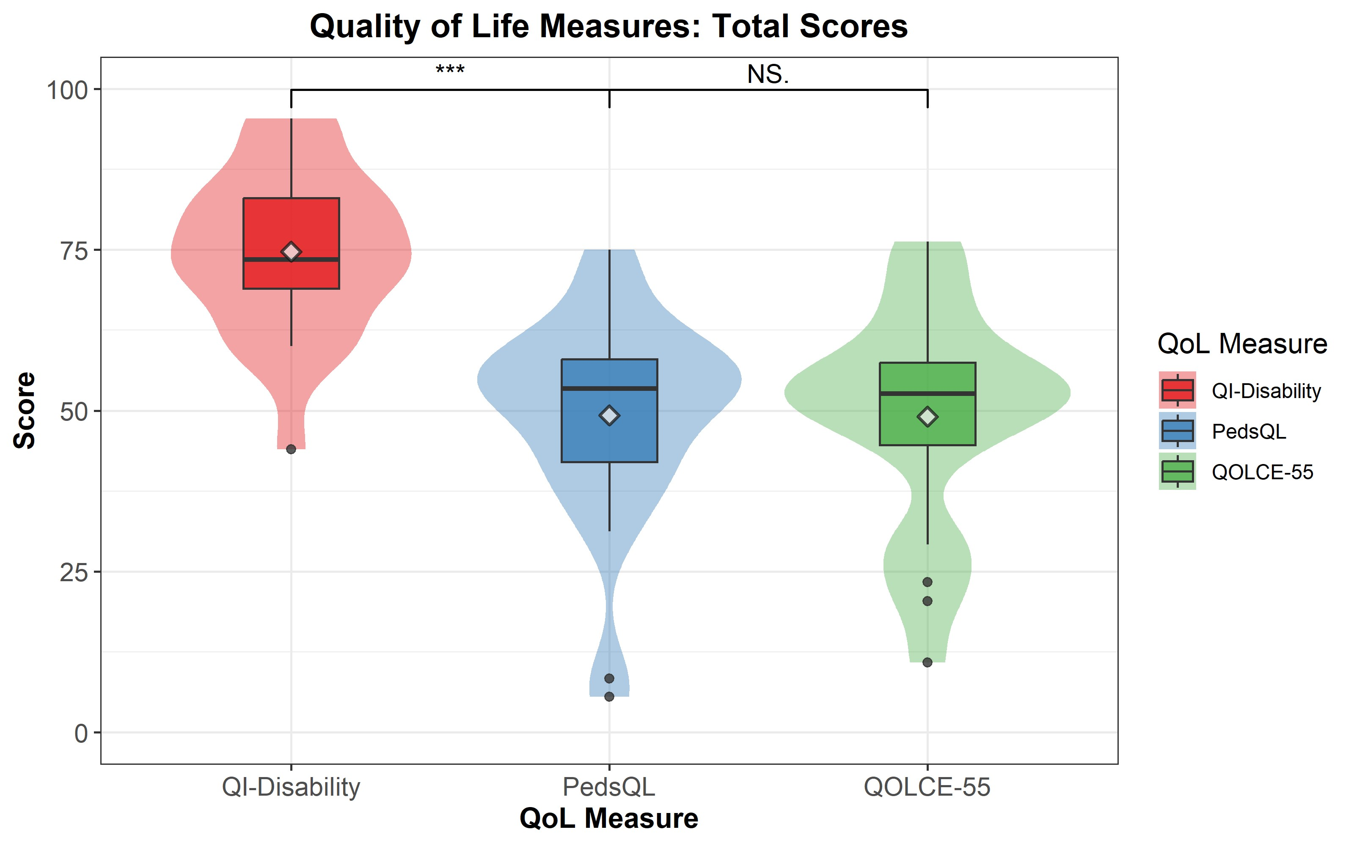
Quality of Life Assessments
Comparison of 3 QoL measures in the SLC6A1 Cohort

Slide 15
Developmental Coordination Disorder Questionnaire
Other features noted by caregivers
  Generally poor coordination & off balance
  Twisting & posturing movements of fingers
  Clumsiness leading to injuries
  Tremulous movements of arms/legs and head
  Teeth-grinding
  Staring at hands
  Tensing postures of arms/legs with emotion
  Body rocking

Slide 16
Developmental Coordination Disorder Questionnaire
DCDQ Age Bracket | Score Indicative of Discoordination
Under 4-years (Little DCDQ) | 15 to 67
5yr to 7yr 11m | 15 to 46
8yr to 9yr 11m | 15 to 55
10yr to 15yr | 15 to 57

Slide 17
Sleep Disorder Questionnaires
Other features noted by caregivers
  Requires a strict bedtime routine to fall asleep
  Weighted blanket
  History of night terrors
  Restless sleep in infancy
  Uses a veil bed
  Jerky movements in sleep
  Sleeps in short intervals

Slide 18
Sleep Disorder Questionnaires
All participants have a Total T-Score >39
Top Issues on SDSC
  >50% of Participants scored 4 or 5
    Startles or jerks while falling asleep
    Frequent twitching or jerking while asleep
    Grinds teeth in sleep
  >25% of Participants scored 4 or 5
    Reluctant to go to bed
    Repetitive behaviors while falling asleep
    Daytime sleepiness
DIMS – Disorders of Initiating and Maintaining Sleep
SBD – Sleep Breathing Disorders
DA – Disorders of Arousal
SWTD – Sleep-Wake Transition Disorders
DOES – Disorders of Excessive Somnolence
SHY – Sleep Hyperhydrosis

Slide 19
Biomarker Development
EEG Biomarker
MRS Biomarker

Slide 20
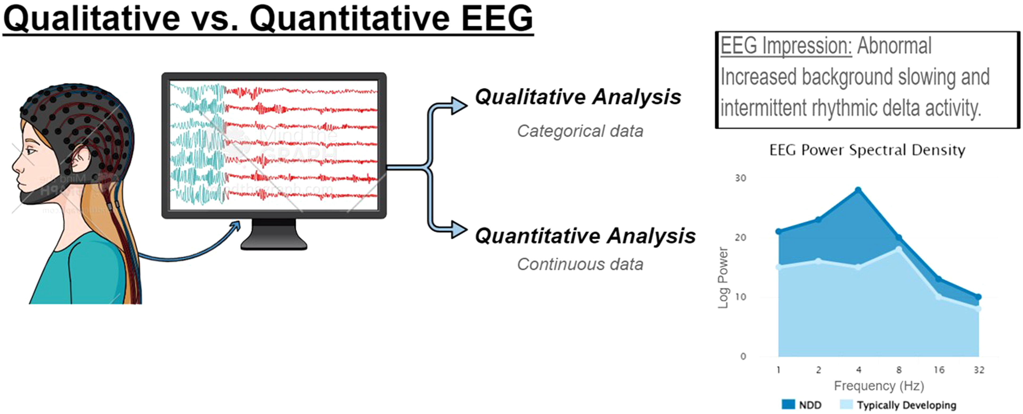
Biomarkers - Electroencephalography
Goodspeed K, Armstrong D, Dolce A, Evans P, Said R, Tsai P, Sirsi D. Electroencephalographic (EEG) Biomarkers in Genetic Neurodevelopmental Disorders. J Child Neurol. 2023 May;38(6-7):466-477. doi: 10.1177/08830738231177386. Epub 2023 Jun 1. PMID: 37264615.

Slide 21
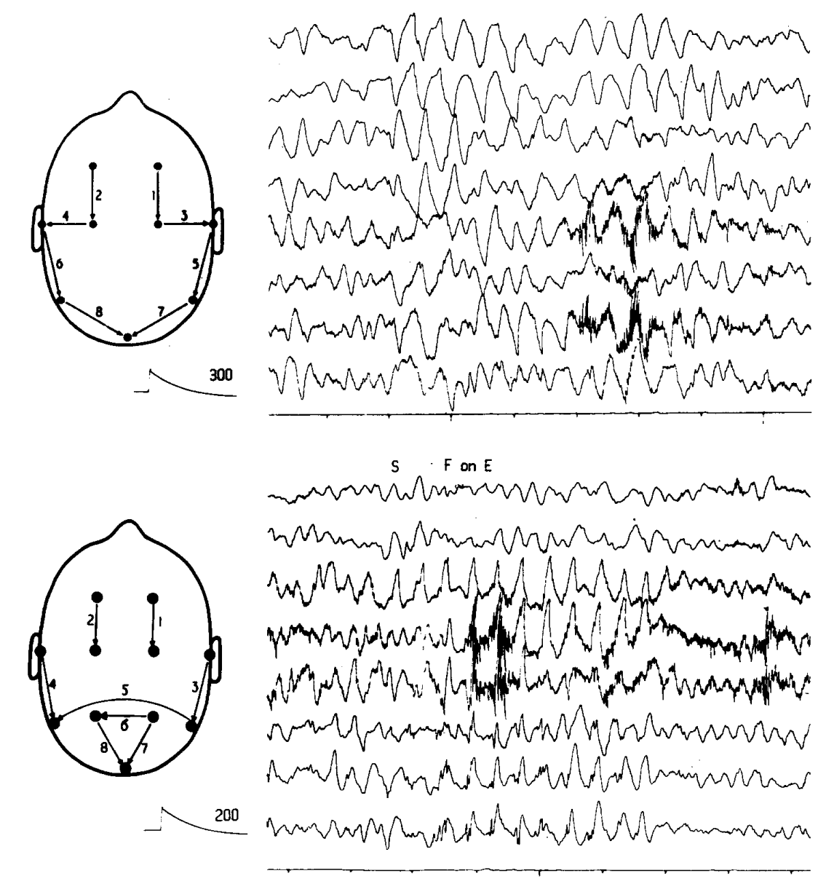
Biomarkers – Electroencephalography in Angelman Syndrome
In 1988, Boyd et al described a characteristic EEG pattern of high amplitude rhythmic delta activity in patients clinically diagnosed with AS
  Developmental Delay
  Absent speech
  Jerky movements & ataxic gait
  Paroxysms of laughter
  Characteristic facial features
EEG findings were seen as early as 1-year of age and often before clinical seizure onset
Boyd SG, Harden A, Patton MA. The EEG in early diagnosis of the Angelman (happy puppet) syndrome. Eur J Pediatr. 1988 Jun;147(5):508-13. doi: 10.1007/BF00441976. PMID: 3409926.

Slide 22
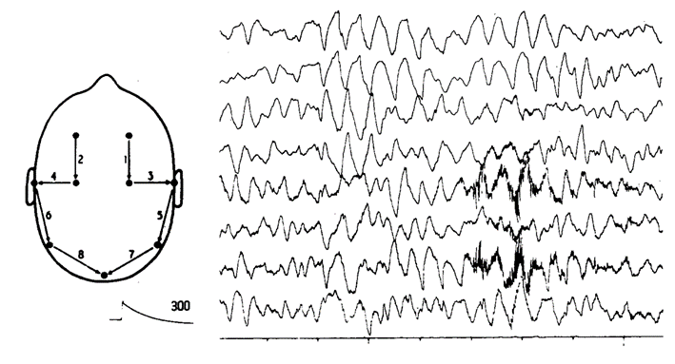
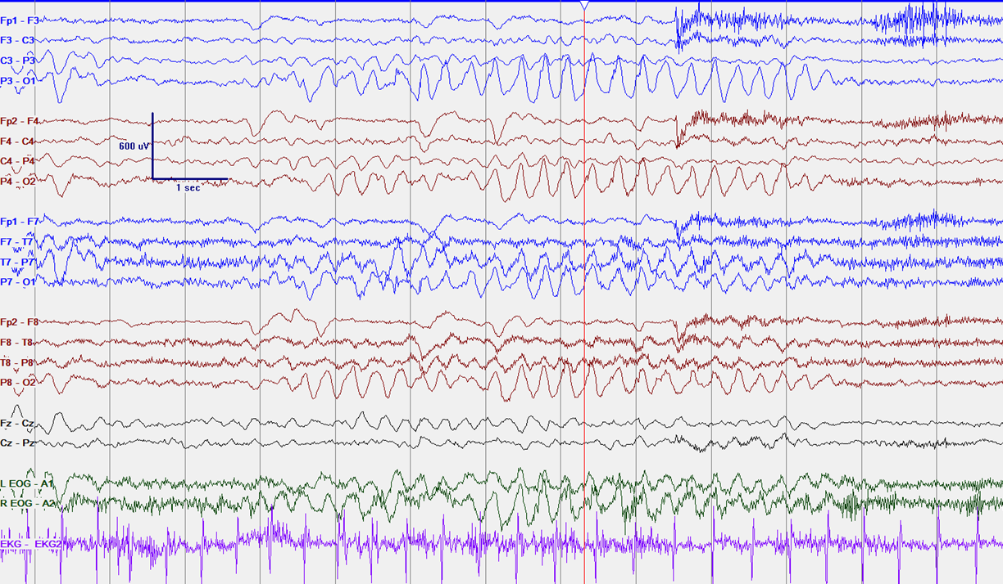
Biomarkers – Electroencephalography in Angelman Syndrome
In 1988, Boyd et al described a characteristic EEG pattern of high amplitude rhythmic delta activity in patients clinically diagnosed with AS
  Developmental Delay
  Absent speech
  Jerky movements & ataxic gait
  Paroxysms of laughter
  Characteristic facial features
EEG findings were seen as early as 1-year of age and often before clinical seizure onset
Boyd SG, Harden A, Patton MA. The EEG in early diagnosis of the Angelman (happy puppet) syndrome. Eur J Pediatr. 1988 Jun;147(5):508-13. doi: 10.1007/BF00441976. PMID: 3409926.

Slide 23
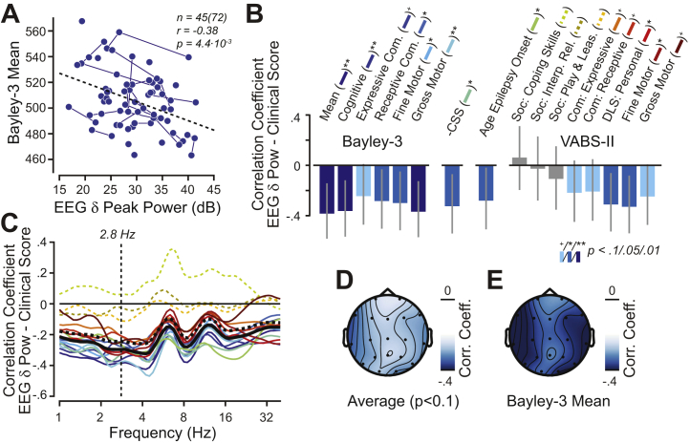
Biomarkers – Electroencephalography in Angelman Syndrome
When controlling for age, Stronger EEG Delta Power correlated with:
  Earlier onset of epilepsy
  Lower performance on cognitive, motor, and communication scales
Delta Power – power at 2.8 Hz averaged across all electrodes
Hipp JF, Frohlich J, Keute M, Tan WH, Bird LM. Electrophysiological Abnormalities in Angelman Syndrome Correlate With Symptom Severity. Biol Psychiatry Glob Open Sci. 2021 Sep;1(3):201-209. doi: 10.1016/j.bpsgos.2021.05.003. Epub 2021 May 25. PMID: 34841387; PMCID: PMC8622755.
Notes:
AS Clinical Severity Scale – higher scores indicate more impairment so they used the negative of the CSS scores
Growth scales from the Bayley Scales of Infant and Toddler Development
Raw scores from the Vineland Adaptive Behavior Scale

Slide 24
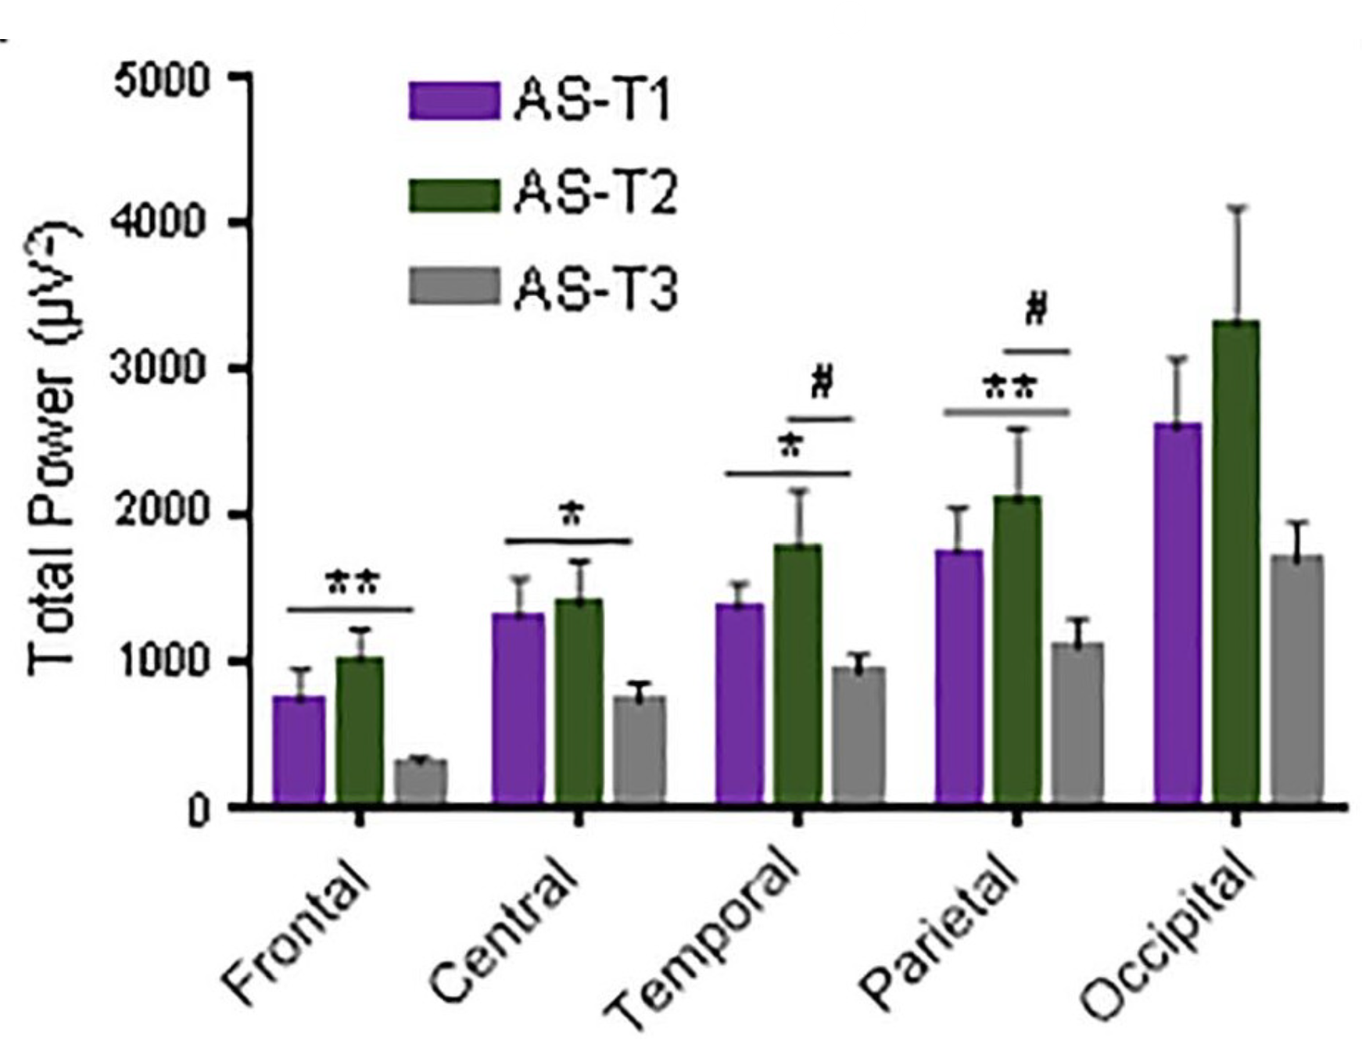
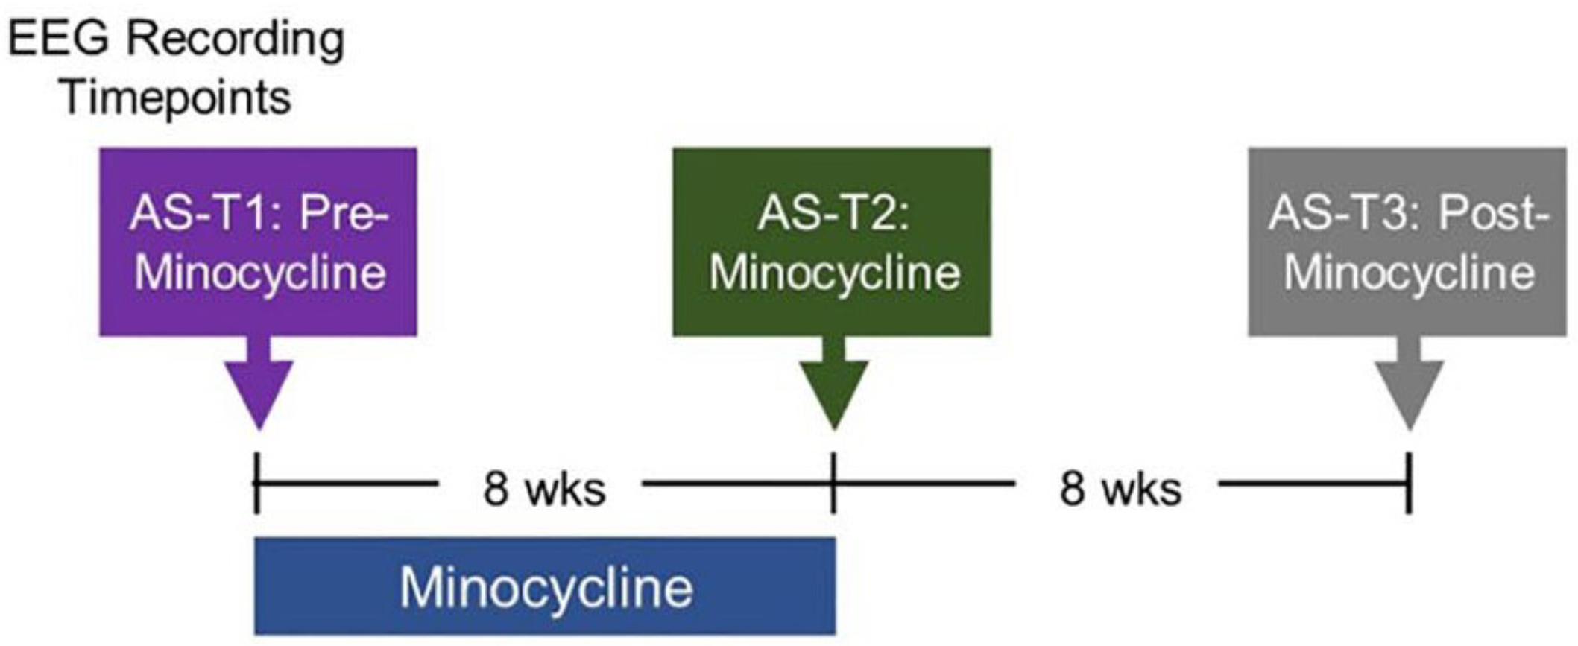
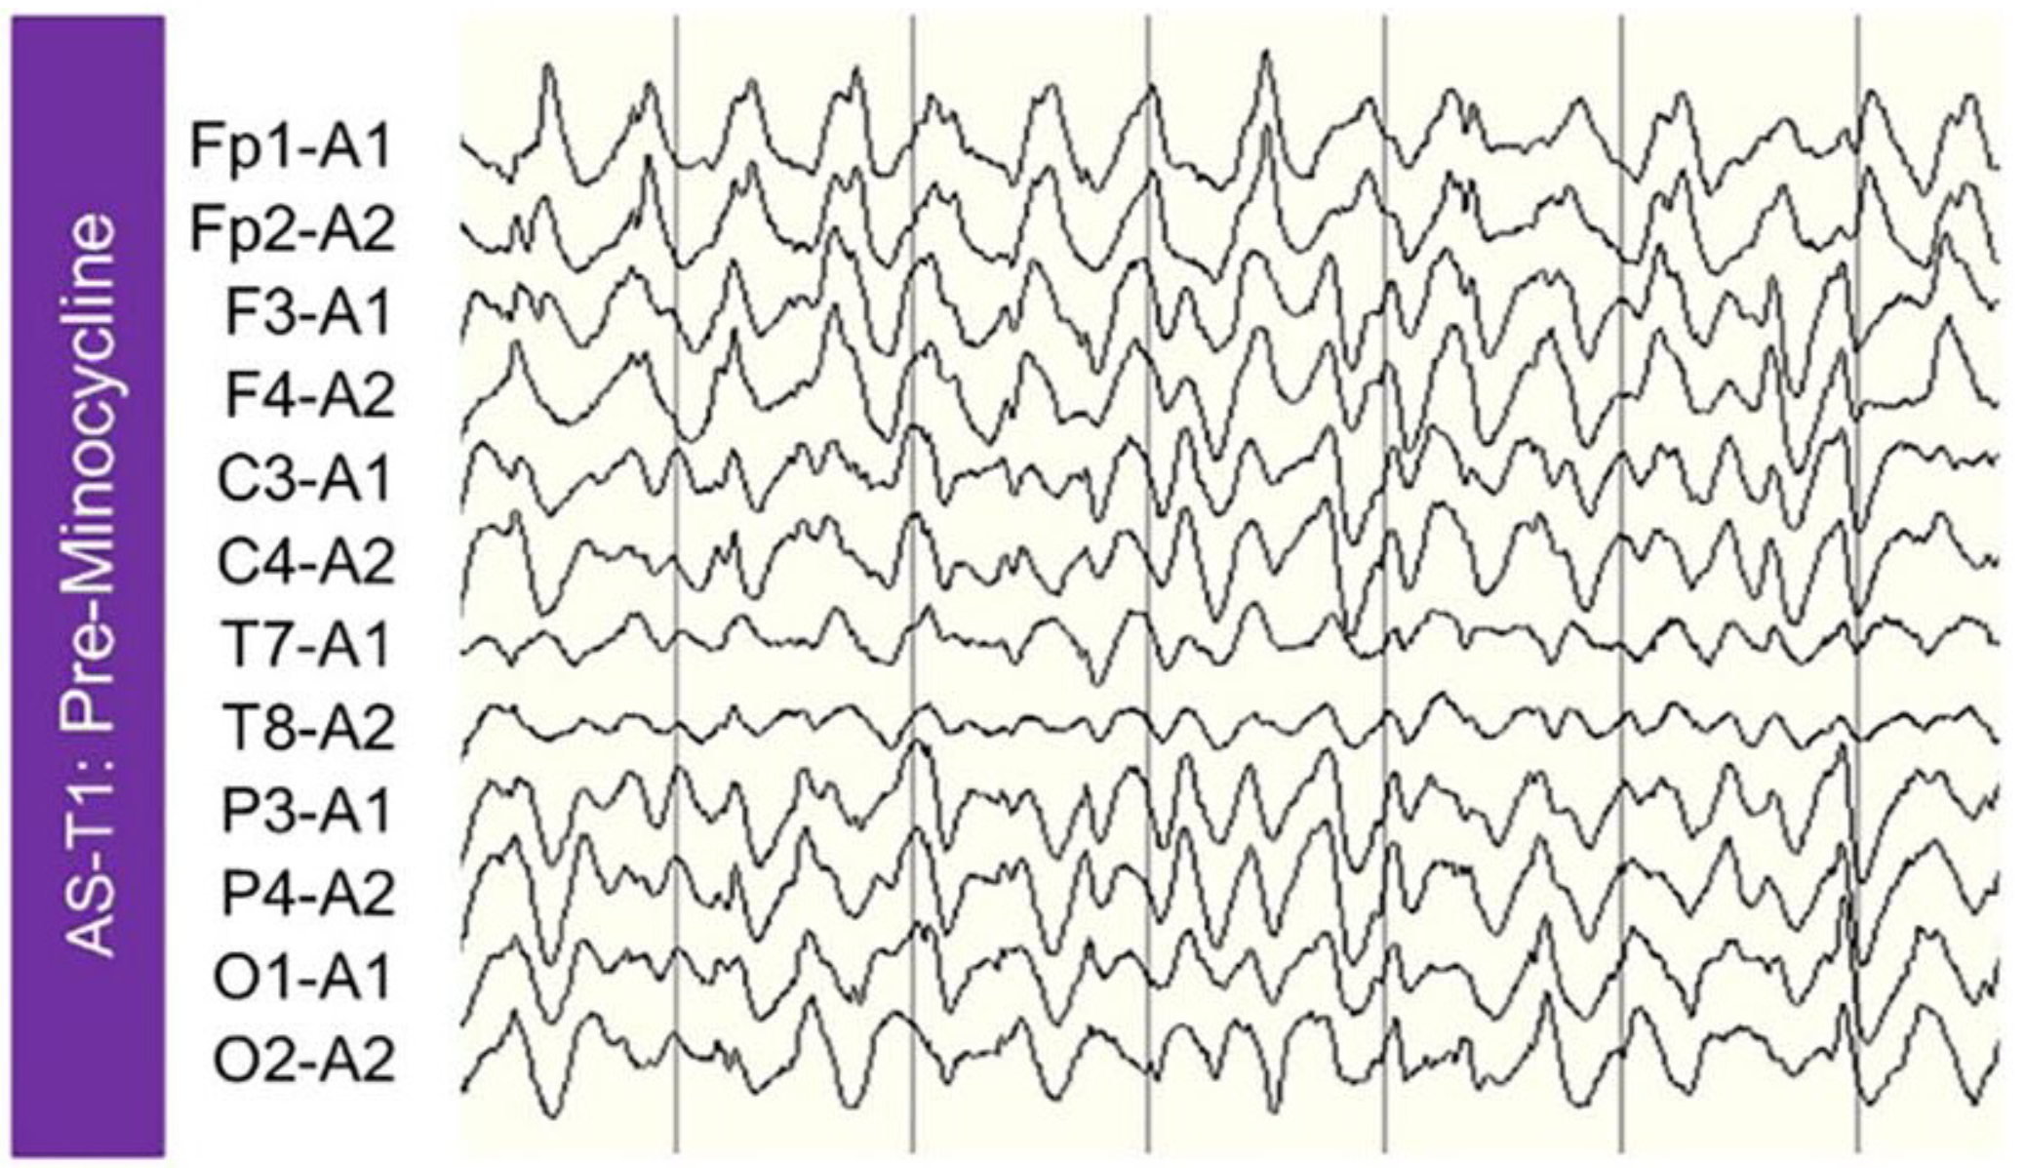
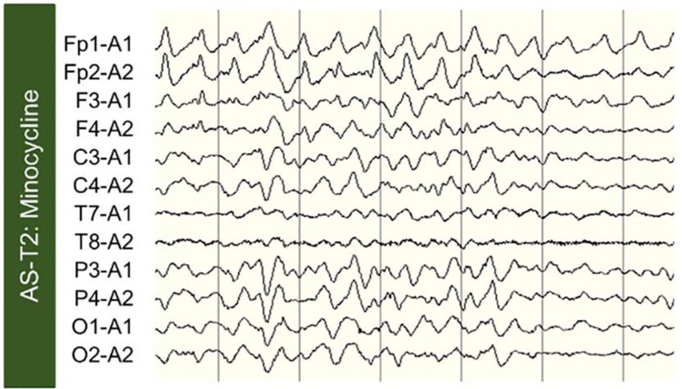
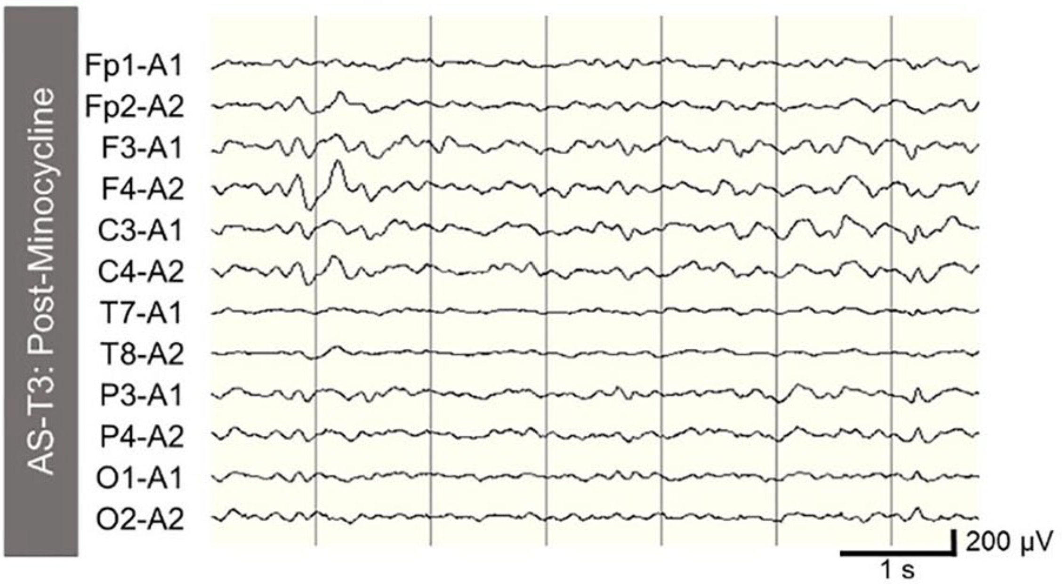
Biomarkers – Electroencephalography in Angelman Syndrome
Post-hoc analysis of data from a clinical trial of Minocycline found that EEGs improved after treatment
Martinez LA, Born HA, Harris S, Regnier-Golanov A, Grieco JC, Weeber EJ, Anderson AE. Quantitative EEG Analysis in Angelman Syndrome: Candidate Method for Assessing Therapeutics. Clin EEG Neurosci. 2023 Mar;54(2):203-212. doi: 10.1177/1550059420973095. Epub 2020 Nov 18. PMID: 33203220.
Notes:
Post-hoc analysis of data from a clinical trial of Minocycline found that EEGs improved after treatment

Slide 25
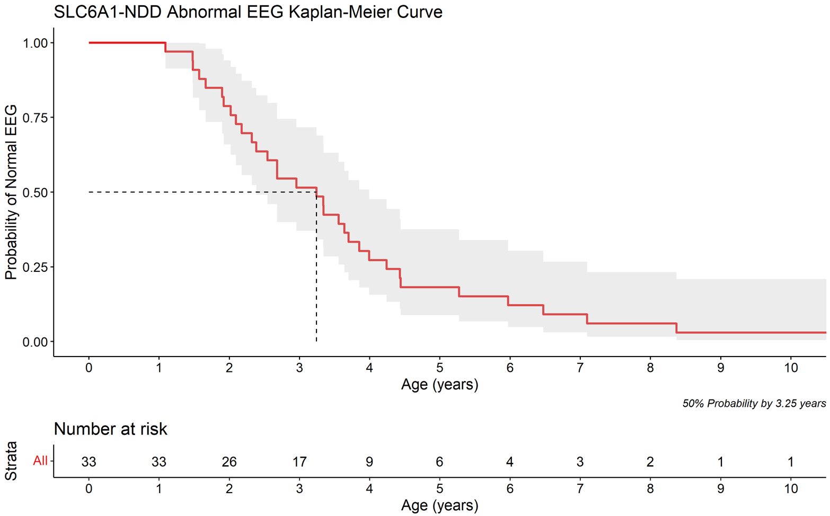
SLC6A1-NDD EEG Biomarker Development
Nested Case-Control Study within our Prospective Cohort Study of SLC6A1-NDD
Generalized epileptiform discharges are the most prevalent & 50% have an abnormal EEG by age 3.5 years

Slide 26
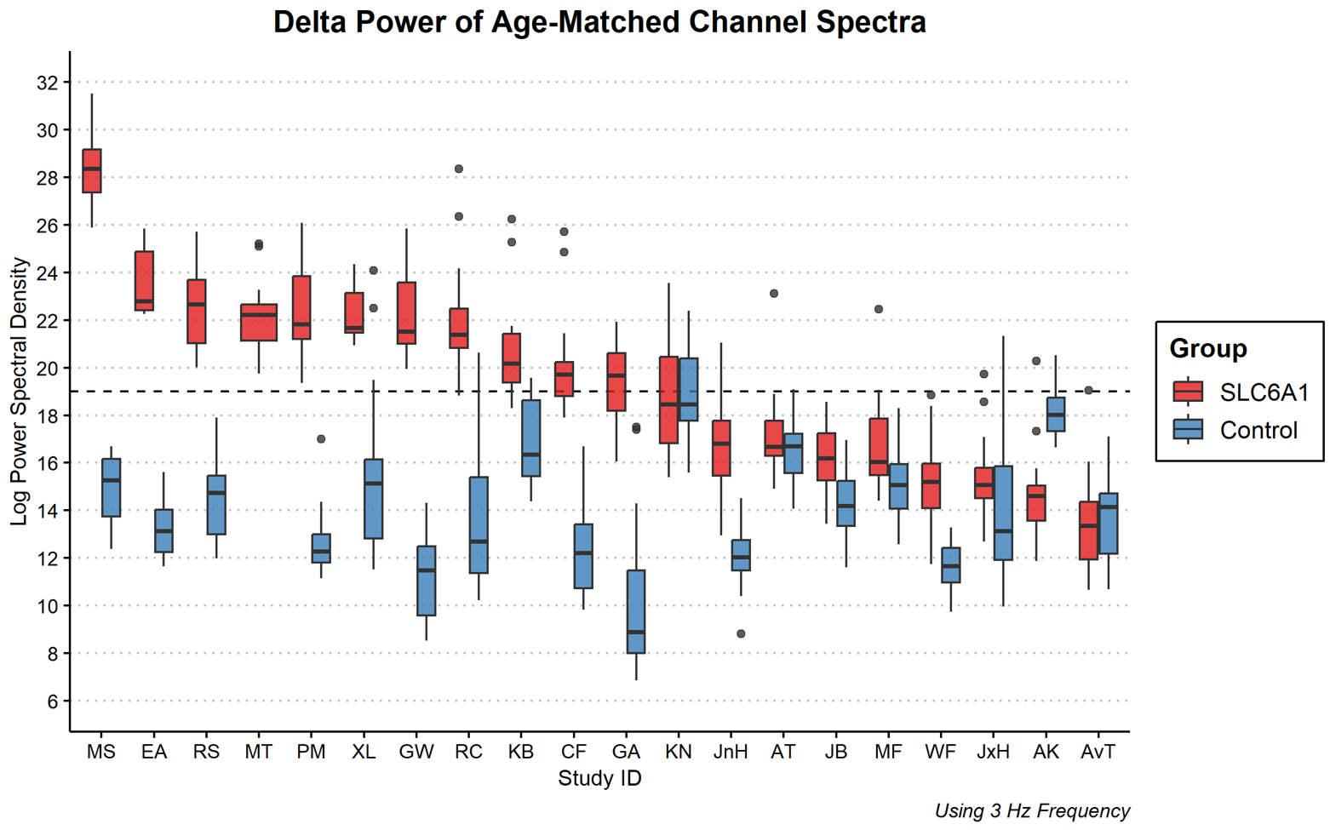
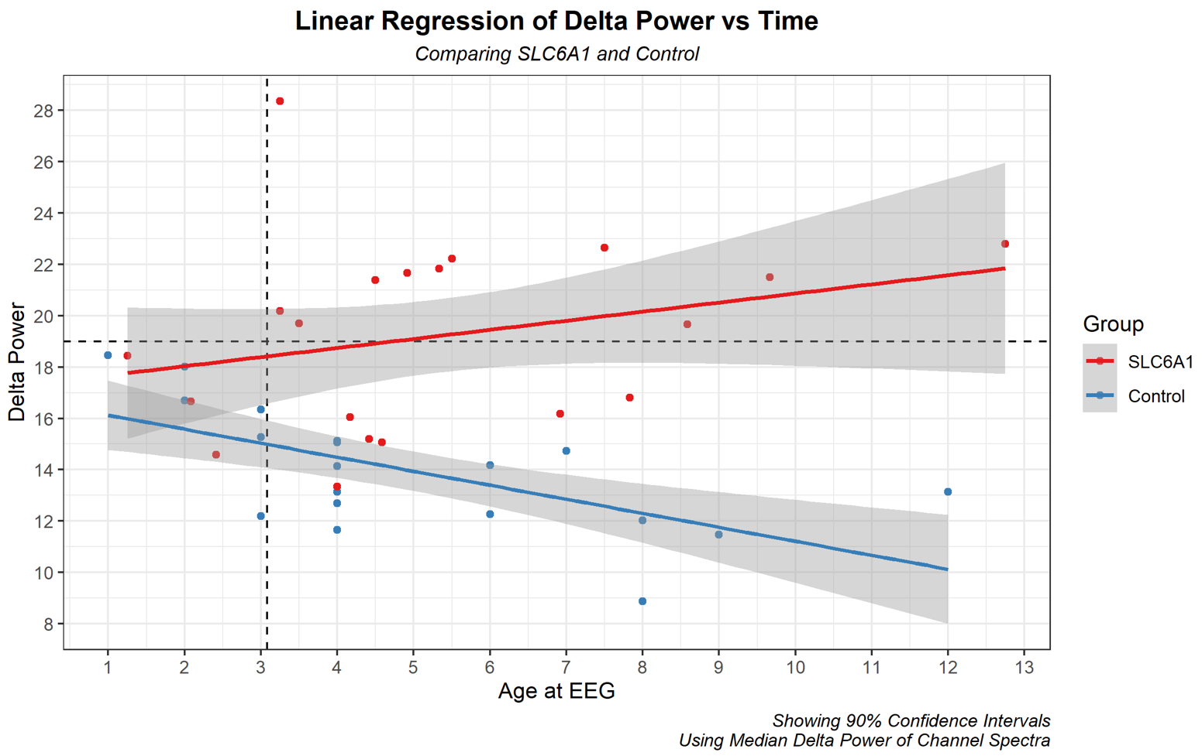
SLC6A1-NDD EEG Biomarker Development
Nested Case-Control Study within our Prospective Cohort Study of SLC6A1-NDD
Generalized epileptiform discharges are the most prevalent & 50% have an abnormal EEG by age 3.5 years
Comparison of SLC6A1-NDD EEG delta power to health controls by age gives you a cross-sectional look at a single time point
We demonstrate that delta power increases with age in SLC6A1-NDD compared to health controls

Slide 27
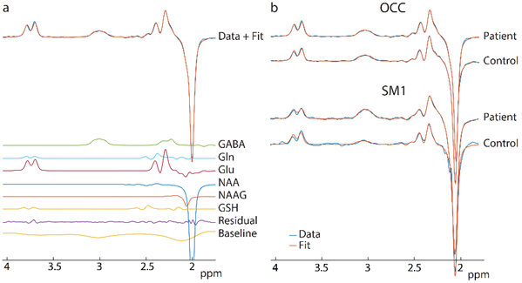
SLC6A1-NDD MRS Biomarker Development
(a) Example GABA-edited spectrum showing high-quality fits to the data. (b) Representative OCC and SM1 MRS GABA spectra from both patients and controls showing narrow NAA linewidths (Occ 5.2747 ± 0.94, SM1 5.67 ± 1.12) and high NAA SNR (Occ 396 ± 101, SM1 358 ± 115).
We have successfully completed non-sedated scans in a broad spectrum of individuals with SLC6A1-NDD (ages: 6-14yr, 3 mild, 1 severe) and 2 TD controls.

Slide 28
Next Steps
Keep collecting data
Analyze & publish data from years 1 & 2

Slide 29


Acknowledgments
UT Southwestern Department of Pediatrics, Division of Neurology
UT Southwestern KL2 Scholars Program
UT Southwestern Gene Therapy Program
UT Southwestern and Children’s Health Center for Autism Care
Dedman Family Endowment for Clinical Scholars
The patients, families, and patient advocacy groups making life-changing treatments a reality

