Slide 1


Molecular And Neurobehavioral Phenotypes Of Two SLC6A1 Mutation Mouse Models
Jing-Qiong (Katty) Kang, MD, PhD
Department of Neurology & Pharmacology
Vanderbilt Brain Institute
Vanderbilt University Kennedy Center of Human Development
Vanderbilt University Medical Center
Nashville, TN, 37232
SLC6A1 mutations in cell
and mouse models
Jing-Qiong (Katty) Kang, MD, PhD
Department of Neurology,
Vanderbilt Brain Institute
Vanderbilt University Kennedy Center of Human Development
Vanderbilt University Medical Center
Nashville, TN, 37232
The speaker has no conflicts of interest

Slide 2
Outlines:
1. A brief summary of previous work
2. A brief summary of the major molecular phenotypes in two representative mouse models Slc6a1^{+/A288V} and Slc6a1^{+/S295L}.
3. A brief summary of the major neurobehavioral phenotypes in two representative mouse models.

Slide 3
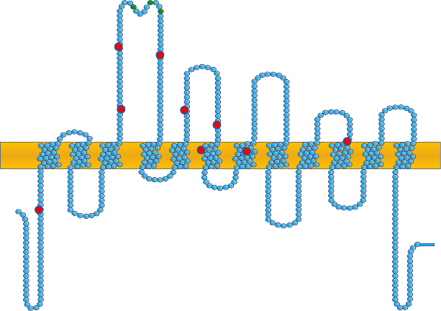
>60 mutations
R44Q#: epilepsy with myoclonic-atonic seizures
R44W: developmental disorder
L73F: epilepsy
G75R#: generalized epilepsy, intellectual disability
Y140C#: epilepsy with myoclonic-atonic seizures, mild to moderate intellectual disability
S145F#: mild intellectual disability
L151RS*35#: intellectual disability
W193X#: epilepsy with myoclonic-atonic seizures
G232V#: epilepsy with myoclonic-atonic seizures, mild to moderate intellectual disability
G234S: Lennox-Gastaut Syndrome
A288V#: autism spectrum disorder
S295L: SLC6A1-related disorder, hypotonia
G297R#: epilepsy with myoclonic-atonic seizures
G299V: autism spectrum disorder
A305T: developmental disorder
A305V: myoclonic atonic epilepsy
A334P#: epilepsy with myoclonic-atonic seizures
A357V#: Rett-like syndrome
P361T: autism spectrum disorder, epilepsy with absence and atonic seizures
F385L#: epilepsy with myoclonic-atonic seizures, mild to moderate intellectual disability
G457Hfs*10#: epilepsy with myoclonic-atonic seizures
V511M#: Generalized epilepsy, mild intellectual disability
G550R#: autism spectrum disorder
#indicates previously-reported variants
A
W193X
L151RS*35
A288V
A357V
P361T
S145F
G457Hfs*10
L73F
G75R
Y140C
Extracellular
NH2
G232V
G234S
G550R
S295L
A334P
G299V
R44Q
G297R
F385L
V511M
R44W
A305T
COOH
Cai .. Kang Exp Neuro 2019
Wang .. Kang Mol Brain 2020
Poliquin .. Kang Exp Neuro 2021
Mermer .. Kang Brain 2021
Nwosu.. Kang Brain Comm 2022
Mermer .. Kang Neurobio of Disease 2022

Slide 4
Summary of previous work:
Majority of mutations are loss-of function, partial or complete loss of function.
Mutations cause destabilized protein, reduced cell surface expression
Mutations cause increased ER retention of the mutant protein in both neurons and astrocytes
EEG recordings indicated absence seizures in both mouse models.
4 phenylbutyrate restored GABA uptake and partially rescue GAT-1 function phenotype.
Seizures were partially mitigated by 4 phenylbutyrate in the Slc6a1^{+/S295L} mouse model.

Slide 5
Mermer et al., Brain, 2021
Loss of GABA uptake function:
R44Q#: epilepsy with myoclonic-atonic seizures
R44W: developmental disorder
L73F: epilepsy
G75R#: generalized epilepsy, intellectual disability
Y140C#: epilepsy with myoclonic-atonic seizures, mild to moderate intellectual disability
S145F#: mild intellectual disability
L151RS*35#: intellectual disability
W193X#: epilepsy with myoclonic-atonic seizures
G232V#: epilepsy with myoclonic-atonic seizures, mild to moderate intellectual disability
G234S: Lennox-Gastaut Syndrome
A288V#: autism spectrum disorder
S295L: SLC6A1-related disorder, hypotonia
G297R#: epilepsy with myoclonic-atonic seizures
G299V: autism spectrum disorder
A305T: developmental disorder
A334P#: epilepsy with myoclonic-atonic seizures
A357V#: Rett-like syndrome
P361T: autism spectrum disorder, epilepsy with absence and atonic seizures
F385L#: epilepsy with myoclonic-atonic seizures, mild to moderate intellectual disability
G457Hfs*10#: epilepsy with myoclonic-atonic seizures
V511M#: Generalized epilepsy, mild intellectual disability
G550R#: autism spectrum disorder
#indicates previously-reported variants
22 variants and associated phenotypes
A
W193X
L151RS*35
A288V
A357V
P361T
S145F
G457Hfs*10
L73F
G75R
Y140C
Extracellular
NH2
G232V
G234S
G550R
S295L
A334P
G299V
R44Q
G297R
F385L
V511M
R44W
A305T
COOH
C
B
% ³H GABA uptake of wt (pmol/µg/min)
100
% ³H GABA uptake of wt (pmol/µg/min)
100
wt=100%
§§§
75
wt=100%
§§§
75
**
**
*
50
*
**
***
% of wt
**
*
% of wt
***
***
50
25
***
25
0
0

Slide 6
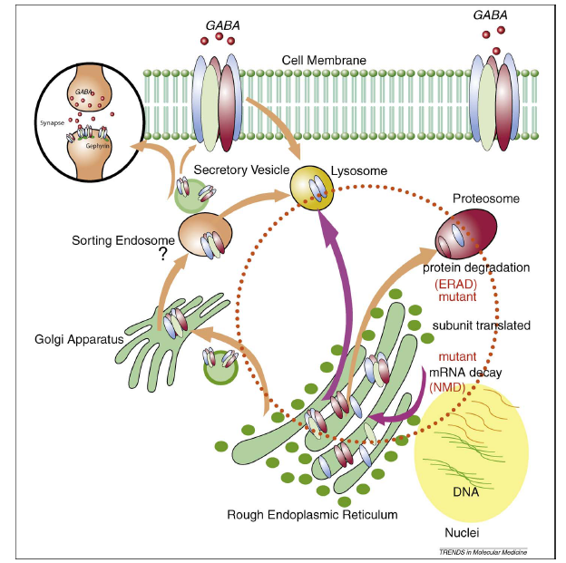
The trafficking pathway of GABA transporter 1
where are the mutant GAT-1 transporters?
Kang & Macdonald, JAMA
Neurology, 2016

Slide 7
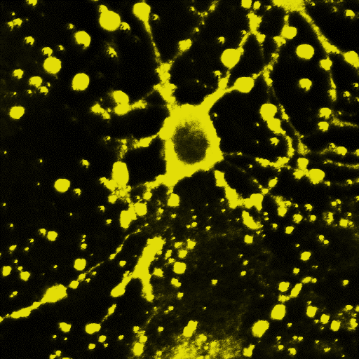
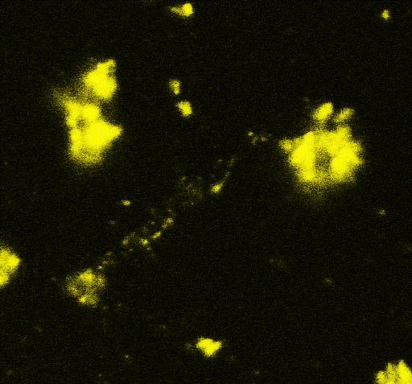
ER retention of the mutant protein in neurons and astrocytes:
wildtype
mutant (S295L)
Live
Astrocyte
Live
neuron
^{10 µm}

Slide 8
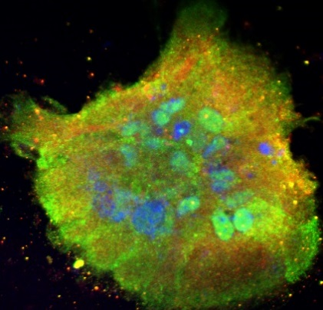
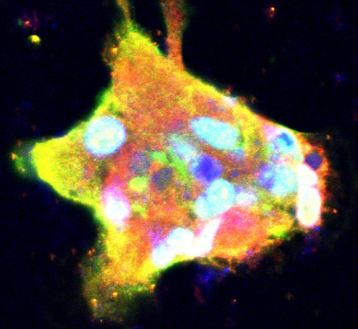
Green=overexpressed GAT-1
mouse astrocytes
Red=endogenous GAT-1
Blue=To-pro-3
wildtype
mutant
mutant
^{10 µm}

Slide 9
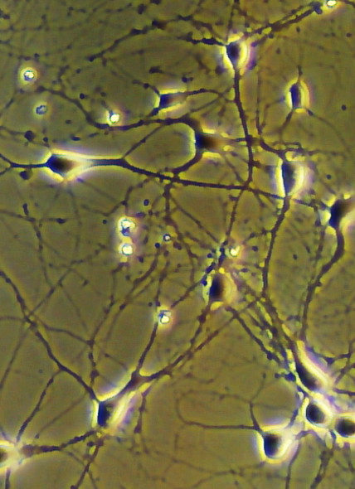
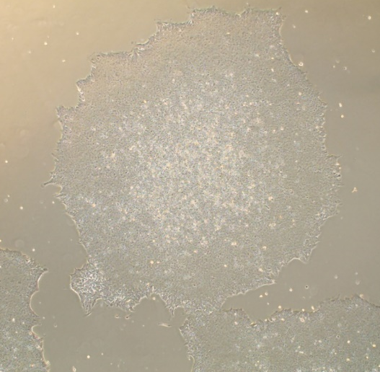
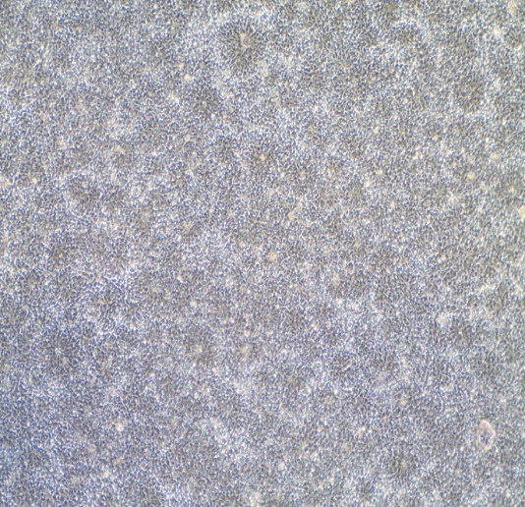
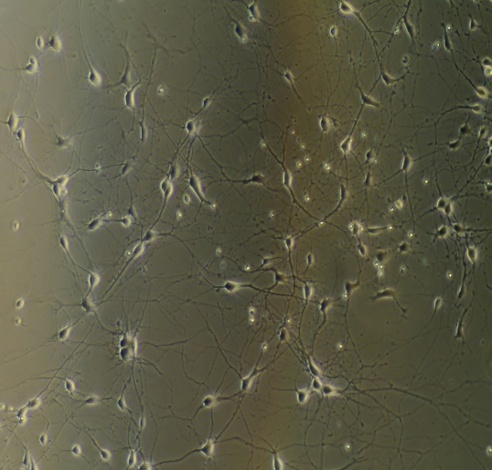
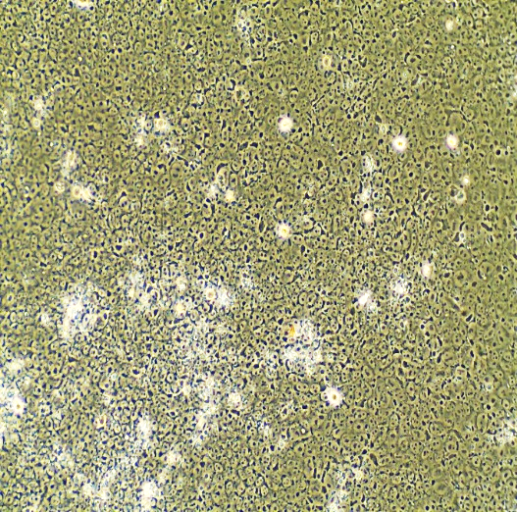
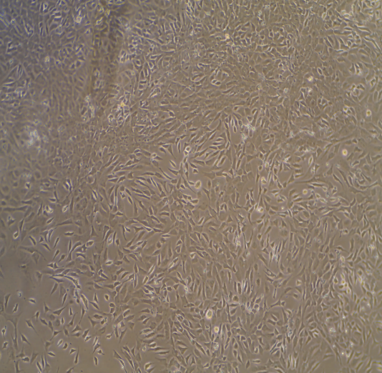
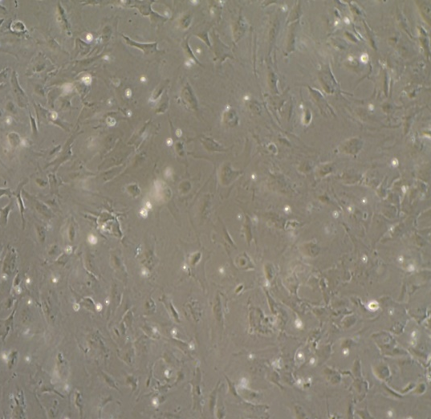
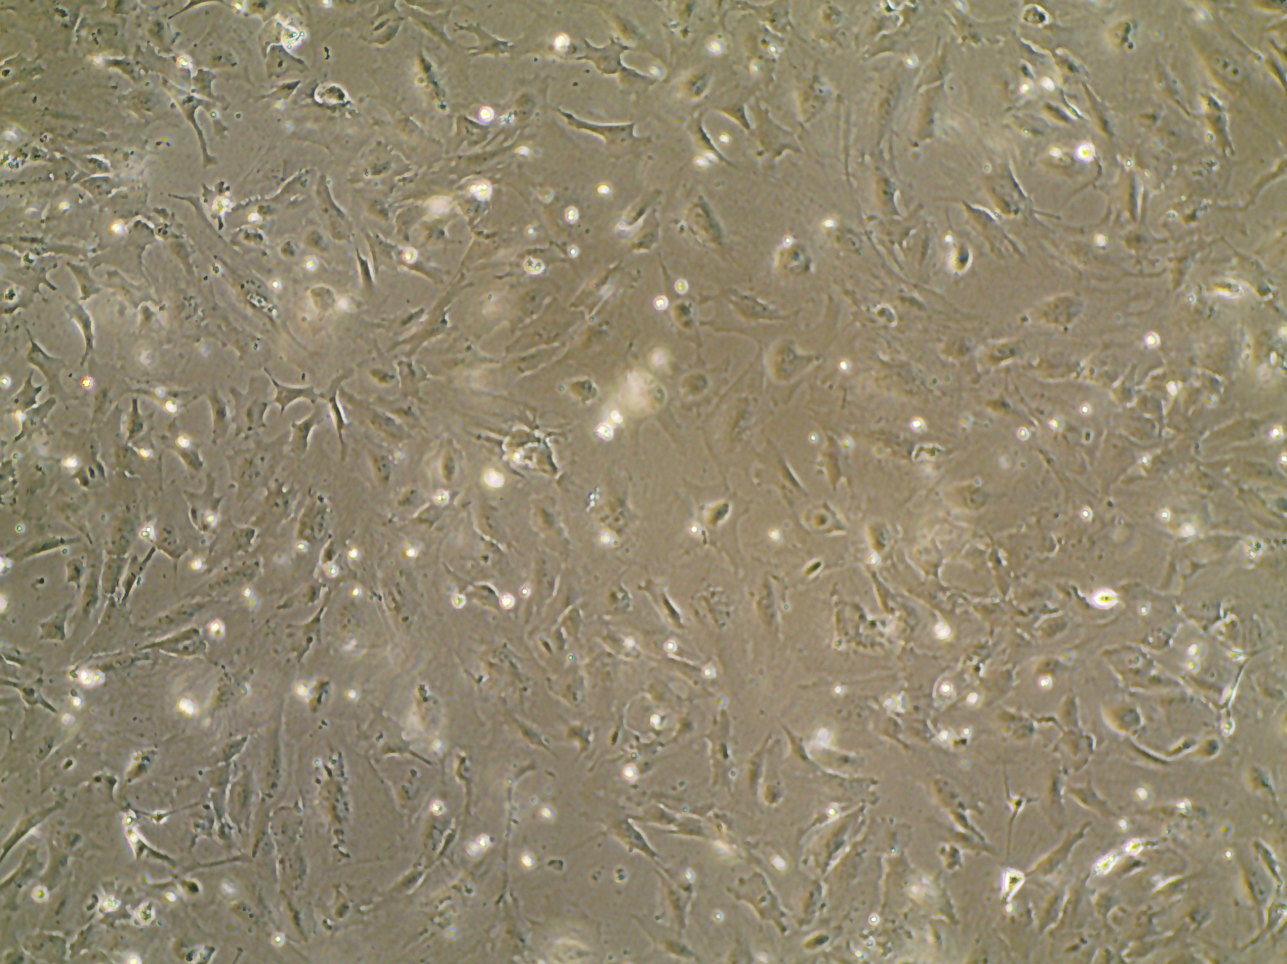
Human iPSC derived NPC, neurons and astrocytes
B
Enlarged
A
Neurons
iPSCs
NPCs
Inhibitory neurons
^{20 µm}
^{20 µm}
iPSCs
NPCs
astrocytes
astrocytes
^{10 µm}
^{5 µm}

Slide 10
Enlarged
Neurons
astrocytes
^{2.5 µm}

Slide 11
ER retention of the mutant protein in human iPSC derived neurons

Slide 12
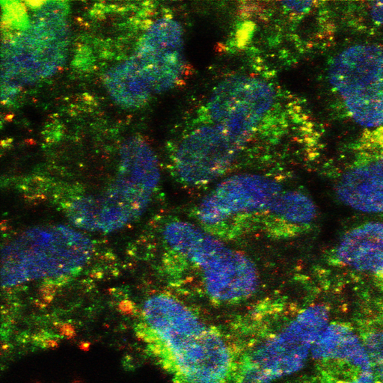
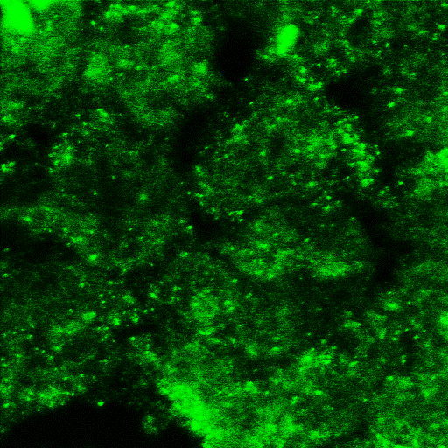
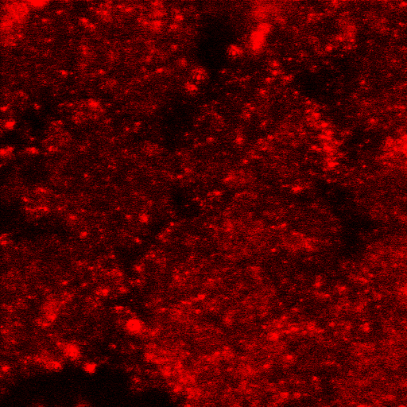
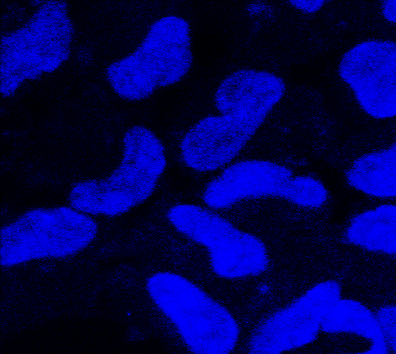
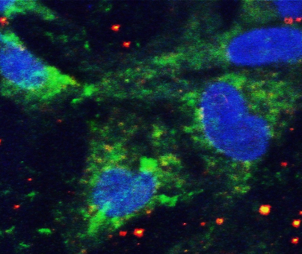
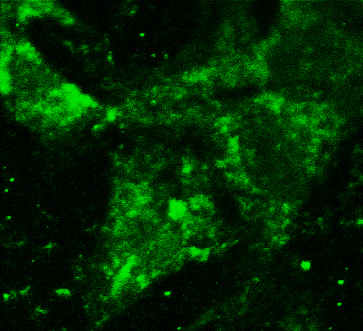
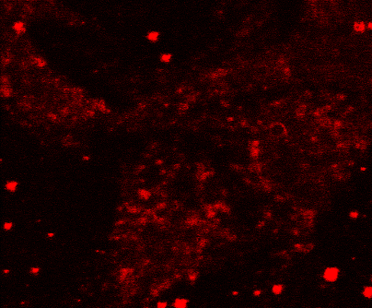
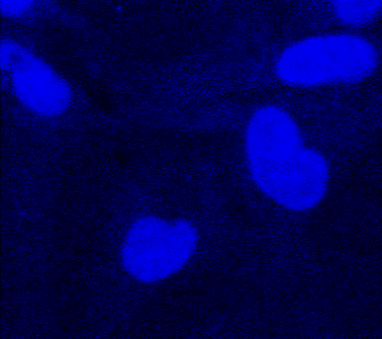
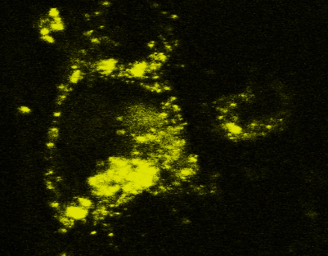
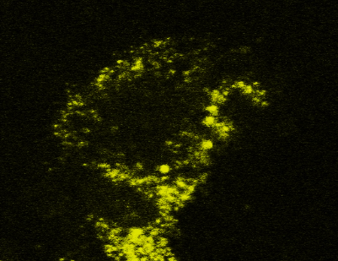
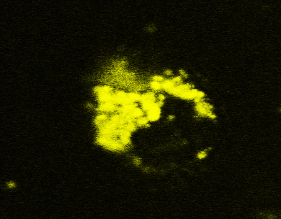
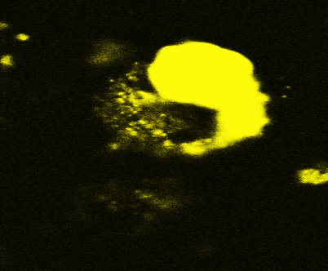
A
Reduced GAT-1 expression in human iPSC derived astrocytes
overlay
GABA
GAT-1
TO-PRO-3
corrected
B
Total GAT-1 fluorescence
in human astrocytes
50
40
Raw values
30
**
20
patient
10
0
patient
corrected
Ratio of fluorescence
periphery over center
C
^{10 µm}
D
live human astrocytes
wt
wt
SL
SL
1.50
1.25
***
Ratio
1.00
0.75
^{10 µm}
0.50
0.25
0
wt
S295L

Slide 13
GAT-1^{YFP}
Reduced cell surface expression of the mutant protein
A
B
Surface
GAT-1^{YFP}
^{Surface}
A
^{Surface}
B
Normalized GAT-1 fluorescence intensity
wt=1
Normalized GAT-1 fluorescence intensity
*
§§§
*
§§§
*
*
count
**
**
count
Ratio to wt
*
*
Ratio to wt
**
**
*
**
***
Control
W193X
wt
C
Alexa 488
D
C
D
GAT-1^{YFP}
Total
^{Total}
^{Total}
GAT-1^{YFP}
Normalized GAT-1 fluorescence intensity
wt=1
count
ns
Normalized GAT-1 fluorescence intensity
count
*
§§§
*
*
§§§
**
*
*
Ratio to wt
Control
W193X
wt
Ratio to wt
***
***
***
Alexa 488

Slide 14
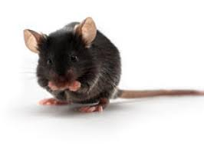
Molecular phenotypes
in the Slc6a1^{+/A288V} and Slc6a1^{+/S295L} mice
Slc6a1^{+/A288V} Slc6a1^{+/S295L}
A partial loss of function A complete loss of function

Slide 15
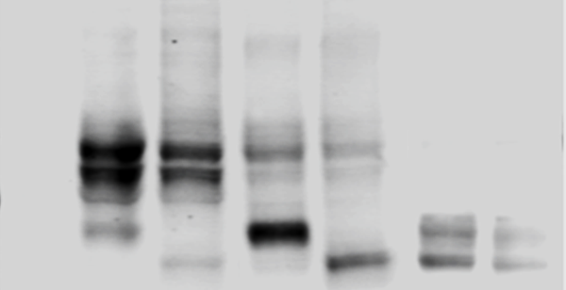
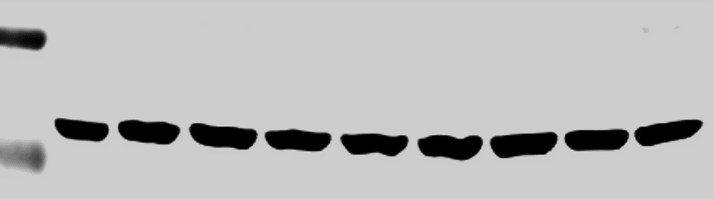
Two representative mutations: a partial loss of function vs a complete loss of function
³H GABA uptake
normalized to wt=1
A
A288V: MAE, CAE, autism
S295L:NDD, CAE
B
A
***
A288V
Extracellular
S295L
§§§
NH2
MAE=myoclonic atonic epilepsy
CAE=Childhood absence epilepsy
NDD=neurodevelopmental delay
COOH
δδδ
A288V
C
D
WT A288V S295L
con U H U H U H
Normalized GAT-1 protein IDVs
of WT (mature form)
KDa
GAT1
100
100
75
1
2
75
3
50
***
25
§§§
LC
***
37
0
WT A288V S295L

Slide 16
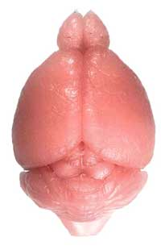
Reduced GAT-1 expression in both mouse models
WT=wildtype
HT=heterozygous
HM=homozygous
mice
^{GAT-1}
Normalized GAT-1 IDVs
A
wt het hom
^{A288V}
^{A288V}
C
Cx Cb Hc Th Cx Cb Hc Th Cx Cb Hc Th
U
1.00
KDa
***
***
***
***
75
0.75
50
0.50
§§§
§§§
§§§
§§
0.25
^{LC}
0
B
wt het hom
WT HT HM
WT HT HM
WT HT HM
WT HT HM
^{S295L}
D
Cx Cb Hc Th
KDa
^{S295L}
U Cx Cb Hc Th Cx Cb Hc Th Cx Cb Hc Th
Normalized GAT-1 IDVs
75
1.00
50
0.75
***
***
***
***
0.50
^{LC}
0.25
§§§
§§§
§§§
§§§
0
WT HT HM
WT HT HM
WT HT HM
WT HT HM
Cx Cb Hc Th

Slide 17
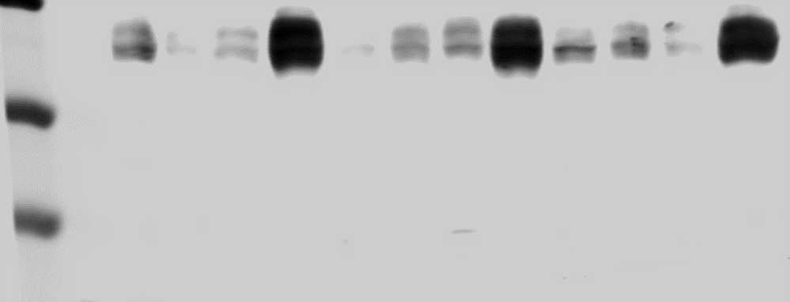
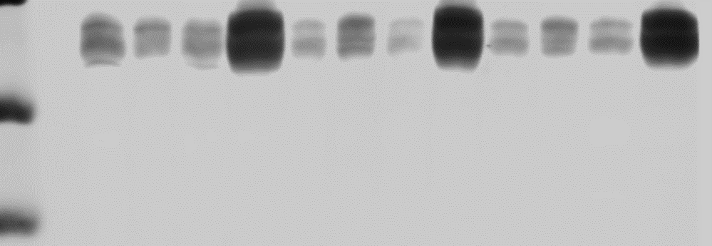
Unaltered GAT-3 in neither mice of 2 months old
^{GAT-3}
WT=wildtype
HT=heterozygous
HM=homozygous
mice
^{A288V}
^{GAT-3}
Normalized GAT-3 IDVs
^{A288V}
wt het hom
wt
E
het
KDa
U Cx Cb Hc Th Cx Cb Hc Th Cx Cb Hc Th
F
hom
75
50
*
^{LC}
^{S295L}
^{GAT-3}
WT HT HM
WT HT HM
WT HT HM
WT HT HM
G
wt het hom
H
Cx Cb Hc Th
U Cx Cb Hc Th Cx Cb Hc Th Cx Cb Hc Th
^{S295L}
wt
75
Normalized GAT-3 IDVs
het
50
hom
^{LC}
WT HT HM
WT HT HM
WT HT HM
WT HT HM
Cx Cb Hc Th

Slide 18
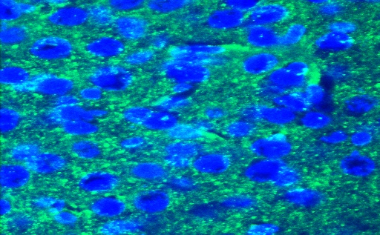
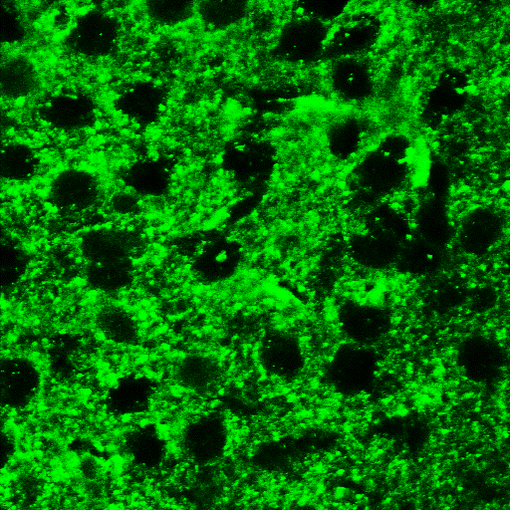
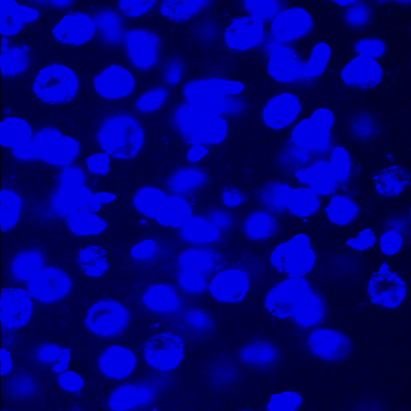
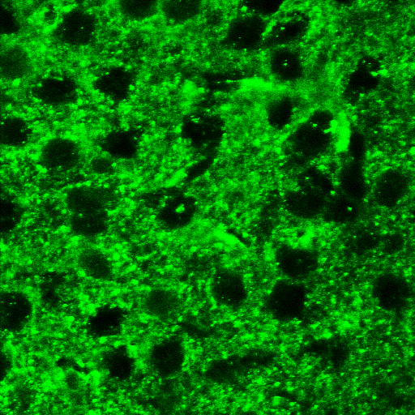
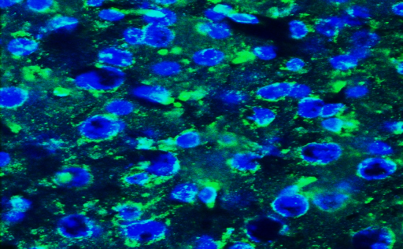
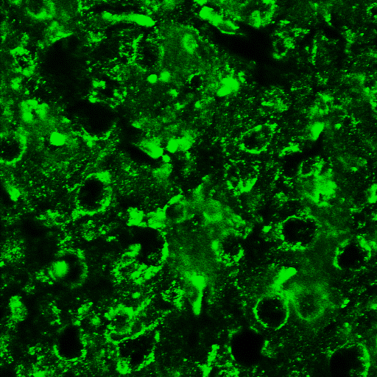
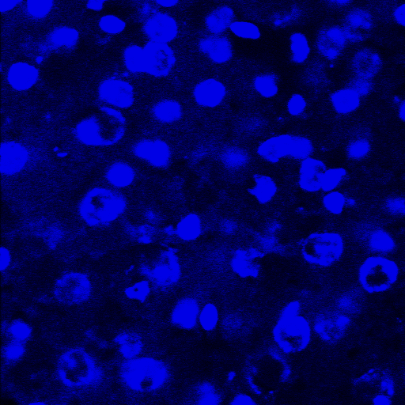
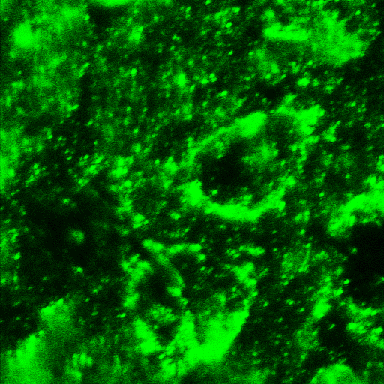
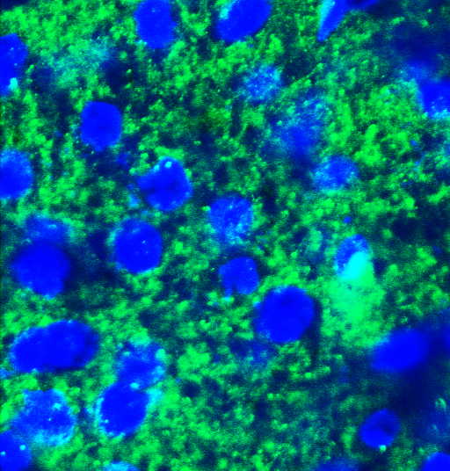
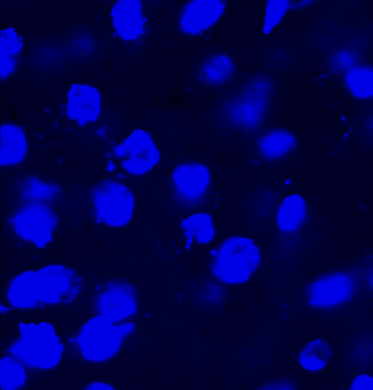
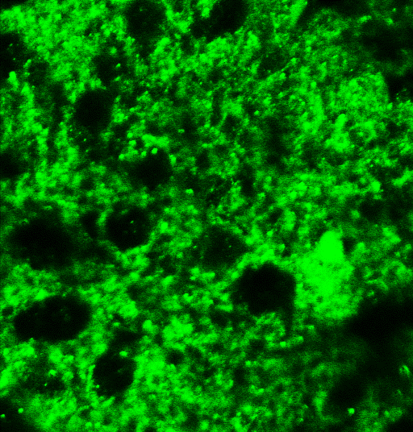
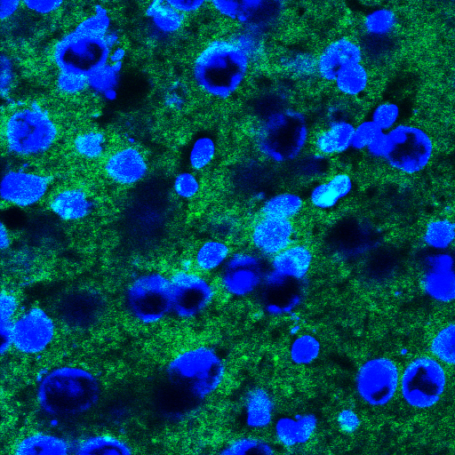
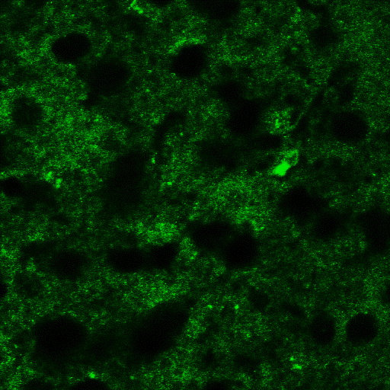
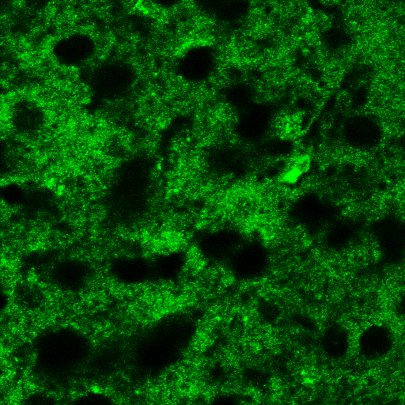
Reduced GAT-1 expression in both mouse models
Overlay
GAT-1
Slc6a1^{+/A288V}
A
To-pro-3
Enlarged
wt
wt
het
het
wt
Slc6a1^{+/S295L}
wt
het
het
^{10 µm}
^{10 µm}
^{3 µm}

Slide 19
Slc6a1^{+/A288V}
Somatosensory cortical region layer IV-VI
^{Enlarged}
^{2 µm}

Slide 20
Reduced GAT-1 expression in the somatic vs nonsomatic regions

Slide 21
Reduced GABA uptake in the live synaptosome of both mouse models:
GAT1 inhibition
vs GAT3 inhibition
Total GATs
GAT-1
GAT-1

Slide 22
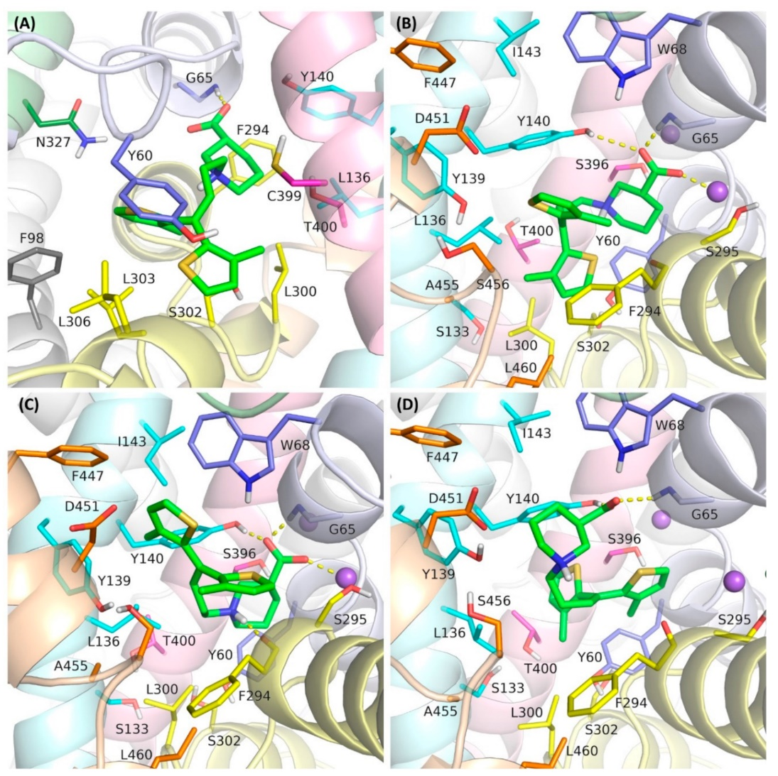
Tiagabine specifically binds GAT-1:
3H Tiagabine binding

Slide 23
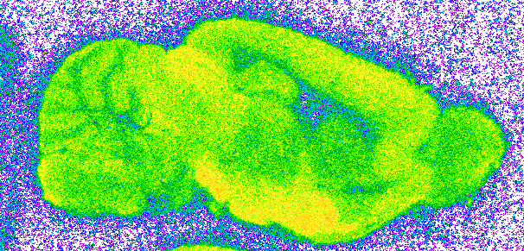
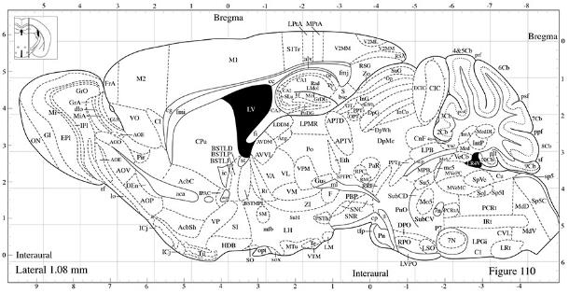

'Data generated in collaboration with Roche Pharma Research and Early Development (pRED
³H Tiagabine binding
Figure 6
A
[³H]Tiagabine (5.2 nM)
wildtype
wildtype
Figure 6a
Figure 6b-c
Superior colliculus
Substantia nigra
Lateral hypothalamic area
VP: ventral pallidum
Data generated in collaboration with Roche Pharma
Research and Early Development (pRED)

Slide 24
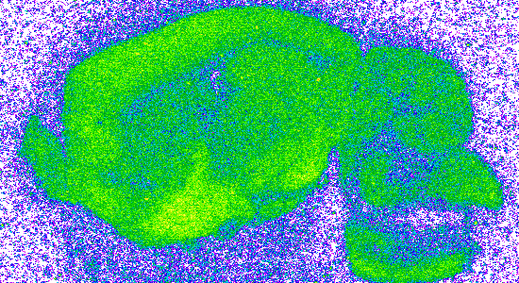










heterozygous
A288V
Reduced ³H Tiagabine binding in the Slc6a1^{+/A288V} mice
A
wildtype
Data generated in collaboration with Roche Pharma
Research and Early Development (pRED)

Slide 25









Reduced ³H Tiagabine binding in the Slc6a1^{+/S295L} mice
B
heterozygous
S295L
A
wildtype
Data generated in collaboration with Roche Pharma Research and Early Development (pRED)

Slide 26
Neurobehavioral phenotypes
in the Slc6a1^{+/A288V} and Slc6a1^{+/S295L} mice
Slc6a1^{+/A288V} Slc6a1^{+/S295L}

Slide 27
The Slc6a1+/A288V exhibited absence epilepsy
Slc6a1^{+/A288V}
1 min
1 min
200 µv
25 sec
5 s
2 s
10 sec
1 s

Slide 28

The Slc6a1+/A288V exhibited absence epilepsy
Baseline
Slc6a1^{+/S295L}
1 min
A
500µV
5 sec
10 sec
500µV
1 sec
Slc6a1^{+/S295l}
3 min
B
500µV

Slide 29




EEG in the SLC6A1 mutation knockin mice correlates with the EEGs in human patients bearing SLC6A1 mutations
(p.G362R)

Slide 30

Reduced weight and prolonged time to right in right reflex in postnatal day 9 old mutant pups
10
Slc6a1^{+/A288V}
Slc6a1^{+/S295L}
weight(g) postnatal day 9
weight(g) postnatal day 9
7 8 9
7 8 9
postnatal day
postnatal day

Slide 31
Deep phenotyping: Reduced traveled distance in both mouse models
Slc6a1^{+/A288V} Slc6a1^{+/S295L}
A.
B.
C.
D.
E.
F.

Slide 32
Reduced hung cuddle in both mouse models
Slc6a1^{+/A288V} Slc6a1^{+/S295L}

Slide 33
Differential neurobehavioral phenotypes. Increased sleep in the Slc6a1+/S295L mice
but not in the Slc6a1^{+/A288V} mice.
Slc6a1^{+/A288V} Slc6a1^{+/S295L}
A.
B.
C.
D.
E.
F.

Slide 34
Increased hourly grooming in the Slc6a1^{+/A288V} mice but not in the Slc6a1^{+/S295L} mice,
correlating with autistic phenotype in patients carrying the SLc6a1(A288V) mutation.
Slc6a1^{+/A288V} Slc6a1^{+/S295L}

Slide 35

Microdialysis was conducted to measure the extracellular GABA level in the prefrontal cortex of the mice
^{Microdialysis}

Slide 36
Comparison of GABA level in two mouse models
^{Male}
^{7 months old}
Slc6a1^{+/S295L}
Slc6a1^{+/A288V}
^{KCl (50mM)}
^{KCl (50mM)}

Slide 37

Heightened GABA response upon KCl simulation in the Slc6a1+/S295L mice
Slc6a1^{+/S295L}
Raw values of extracellular GABA (µM)
KCl (50mM)
^{KCl}
^{Time of sample collection}

Slide 38

PBA treatment normalized the extracellular GABA level
in the Slc6a1^{+/S295L} het mice

Slide 39
^{Take home message:}
Both Slc6a1+/A288V mouse and Slc6a1+/S295L mouse had reduced total GAT-1 protein.
GAT-3 protein was not increased in Slc6a1+/A288V mouse nor Slc6a1+/S295L mouse at ~2 months old.
GAT-1 mediated GABA uptake was reduced in both Slc6a1+/A288V mouse and Slc6a1+/S295L mice.
Robust phenotype of reduced travelled distance and hanging in both Slc6a1+/A288V mouse and Slc6a1+/S295L mice, consistent with the reduced locomotion identified in the SLC6A1 knockout mice; differential neurobehavioral phenotypes were identified in Slc6a1+/A288V and Slc6a1+/S295L mice
Increased extracellular GABA level upon KCl stimulation in Slc6a1+/S295L mice.
Increased cumulative extracellular GABA that can be restored by 4 phenylbutyrate in Slc6a1+/S295L mice.

Slide 40

Acknowledgements
Kang lab
Wangzhen Shen, Karishma Randhave, Kirill Zavalin,
Melissa Bassaett, Carson Flamm,Gerald Nwosu,
Marshall Biven, Muhammud Khan, Felicia Mermer
Vanderbilt Neurobehavioral core (Fiona Harrison,
Krista Penffroth)
Vanderbilt neurochemistry core (Ginger Milne, Benlian Gao)
SLC6A1 Connect
CombinedBrain
Taysha Gene Therapy
UCB
Roche

Slide 41

???

