Slide 1




High-throughput imaging of GABA fluorescence as a functional assay for GAT1 variants in myoclonic astatic epilepsy
SLC6A1 Annual International Symposium
November 30, 2023
Chris McGraw MD, PhD
Instructor, Division of Epilepsy | Massachusetts General Hospital
Research Group Leader | Poduri Lab, Boston Children’s Hospital
epilepsy-genetics.mgh.harvard.edu

Slide 2
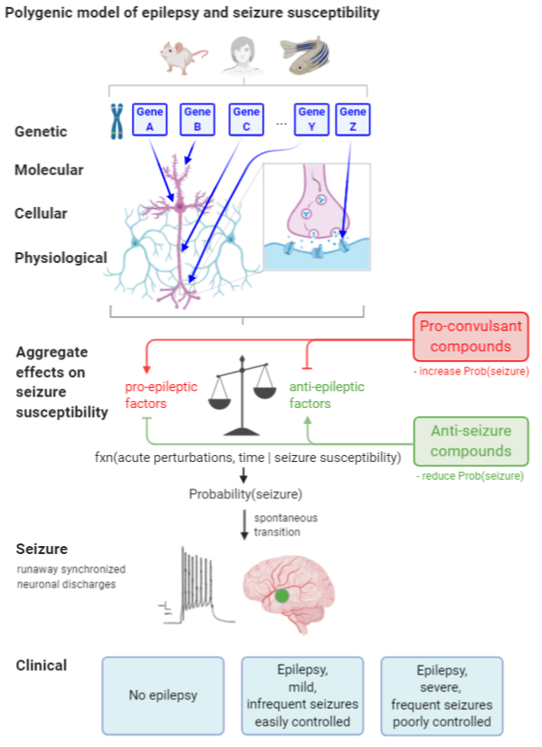
Overarching interests
Molecular mechanisms of epilepsy,
and epilepsy severity
  Genetic generalized
  Focal acquired
Tools for accelerating basic and
translational investigations
  Cell-based models of epilepsy genes
  Animal models of chemical and genetic seizures
  (mouse, zebrafish)
  High-throughput chemical and genetic screens

Slide 3
Overarching interests
Molecular mechanisms of epilepsy,
and epilepsy severity
  Genetic generalized
  Focal acquired
Tools for accelerating basic and
translational investigations
  Cell-based models of epilepsy genes
  Animal models of chemical and genetic seizures
  (mouse, zebrafish)
  High-throughput chemical and genetic screens

Slide 4
Objectives
Develop a fluorescence-based assay of human GAT1 function using iGABA-Snfr
Assess effects of human variants on GAT1 function
Optimize assay for assigning likely pathogenicity to variants of uncertain significance
Optimize assay for high-throughput screening for GAT1 agonists

Slide 5
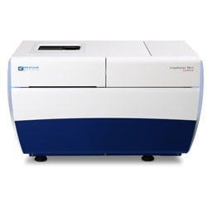
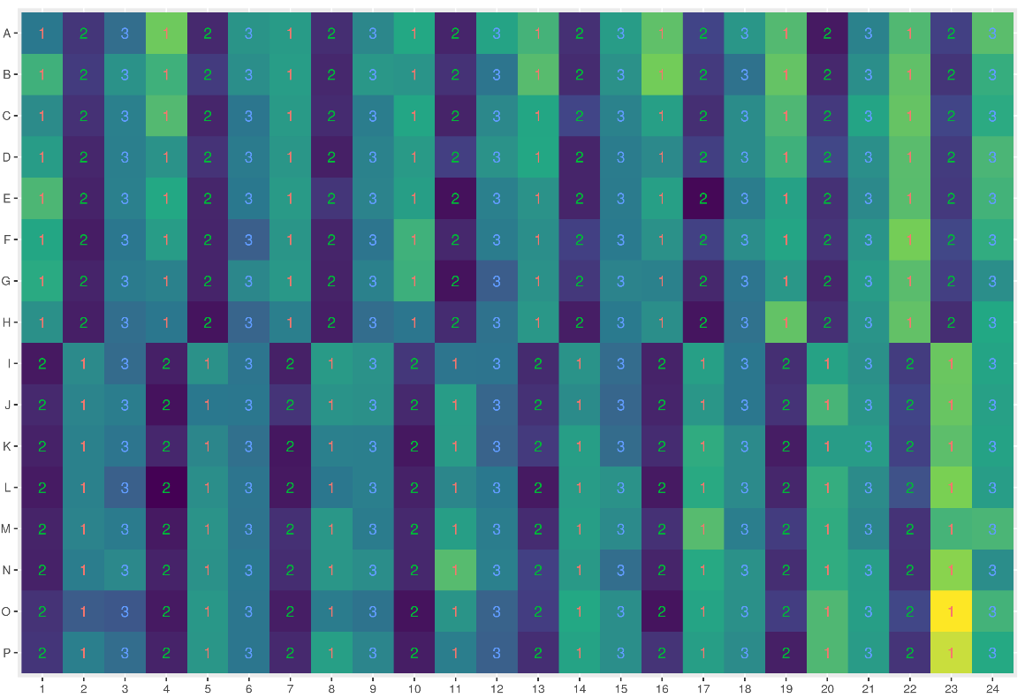
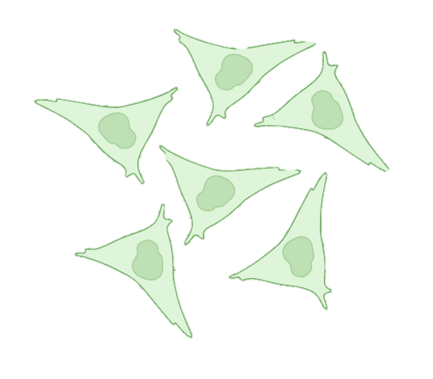
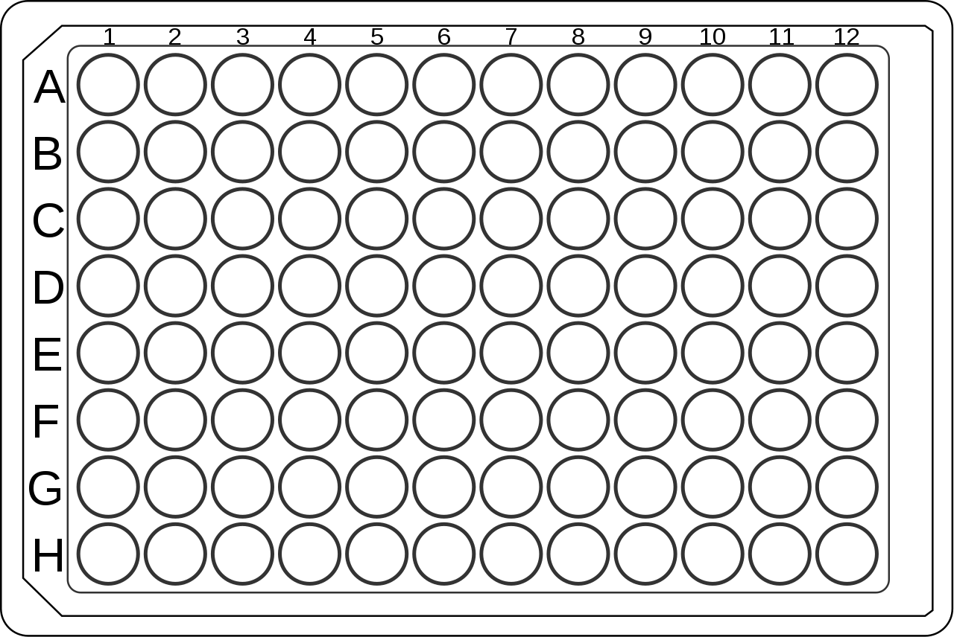
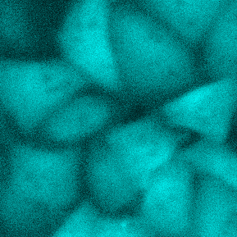
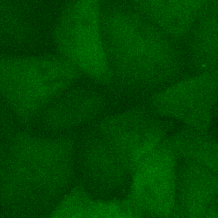
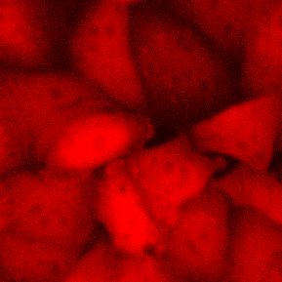
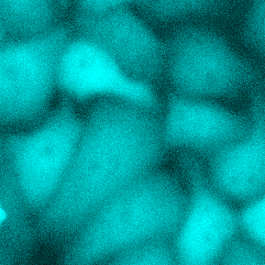
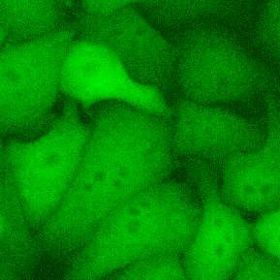
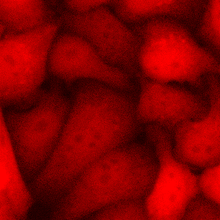
Development of fluorescence-mediated cell-based assay for hGAT1 function.
A
B
No GABA
+ GABA
CMV
hGAT1
tdTomato
hGAT1
(membrane)
GABA
P2A
CMV
iGABA-Snfr-F102Y-Y137L
mBFP
iGABA-Snfr (cytosolic)
P2A
C
HeLa cell
Functional validation of
GAT1 variants
High-throughput compound screening for agonists
HeLa cells
Transient transfection
or stable cell line
96-well or
384-well plate
Automated high-content
fluorescence imaging
and analysis
Estimated GABA
transporter activity
Applications
D
E
Vehicle
GABA 100uM
mBFP
iGABA-Snfr
tdTomato
McGraw et al. In preparation
Notes:
Figure 2. Development of fluorescence-mediated cell-based assay for hGAT1 function.
(A) Constructs used to express human GAT1 (left) and a genetically encoded GABA sensor, iGABA-Snfr (right) with stoichiometrically linked fluorophores.
(B) Schematic for assay
(C) Workflow for assay
(D) Automated analysis to measure per-cell average iGABA-Snfr fluorescence.
(E) Relative frequency histograms of iGABA-Snfr fluorescence after incubation with GABA (100uM) versus vehicle, as measured by automated analysis at the per-cell level within a single site (top) and the per-well averages (lower) across a representative 96-well plate (N=48 wells per condition, 4 sites per well).

Slide 6
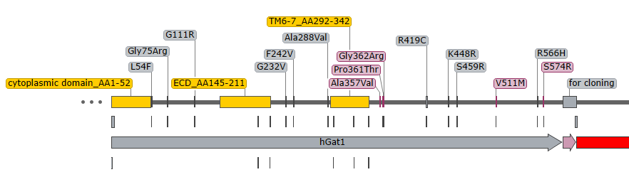
Validation of iGABA-Snfr assay for assessing GAT1 loss-of-function variants
CPD
TM
TM
TM
ECD
TM
TM
TM
TM
TM
TM
TM
TM
TM
GAT1 WT
GAT1 ΔCPD
GAT1 ΔECD
GAT1 ΔTM6-7
A
B
McGraw et al. In preparation
Notes:
Figure XX. Validation of iGABA-Snfr assay for assessing GAT1 loss-of-function variants.
(A) GABA dose series (5-log range) demonstrates enhanced intracellular GABA accumulation in wildtype GAT1 compared to GAT1 constructs harboring deletions of critical domains (ECD, CPD, and TM6-7). Data are the mean +/- SEM of independent per-well averages of iGABA (N=4 wells per condition (construct, GABA concentration), N=4 sites per well)
(B) Normalized change in iGABA fluorescence is significantly greater in wildtype GAT1 versus GAT1 deletion constructs at GABA concentrations 1uM and 100uM. For each construct, data are the difference in iGABA fluorescence between GABA conditions and vehicle control, divided by vehicle control. (Kruskal-Wallis test with Dunn’s multiple comparisons test)
(C) Quality control includes assessment of group CoV (left). The CoV for 4 on-plate technical replicates (wells) must not exceed 10%. Data are from paired groups (positive vs negative controls; N=4 wells per group, 4 sites per well, ~100-200 cells per site) across independent assay plates.
(D) The robust strictly standardized mean difference (RSSMD) and robust z-prime are calculated between positive (GABA 1uM) and negative (vehicle) controls (right).
For C-D, assay format is 96-well plate, transient transfection, incubation time 6-7 hrs.
(E)
(F)
(Kruskal-Wallis test with Dunn’s multiple comparisons test)

Slide 7
Validation of iGABA-Snfr assay for assessing GAT1 loss-of-function variants
C
D
McGraw et al. In preparation
Notes:
Figure XX. Validation of iGABA-Snfr assay for assessing GAT1 loss-of-function variants.
(C) Quality control includes assessment of group CoV (left). The CoV for 4 on-plate technical replicates (wells) must not exceed 10%. Data are from paired groups (positive vs negative controls; N=4 wells per group, 4 sites per well, ~100-200 cells per site) across independent assay plates.
(D) The robust strictly standardized mean difference (RSSMD) and robust z-prime are calculated between positive (GABA 1uM) and negative (vehicle) controls (right).
For C-D, assay format is 96-well plate, transient transfection, incubation time 6-7 hrs.
(E)
(F)
(Kruskal-Wallis test with Dunn’s multiple comparisons test)

Slide 8
Selecting human GAT1 variants of interest
S295L
Benign
G111R
R195H
G362R
Pathogenic
A288V
R419C
G75R
I322M
K488R
R566H
F242V
VUS
L54F
G232V
V342M
S459R
S574R
R211C
A357V
V511M
CPD
TM
TM
TM
ECD
TM
TM
TM
TM
TM
TM
TM
TM
TM
These variants account for most common recurrent variants, and comprise 50 out of 88 cases reported with missense variants in SLC6A1 Connect and other references (=56.8% cases)
McGraw et al. In preparation
Notes:
Figure 1. GAT1 variants
(A) Table of selected variants reported in human patients with information regarding reported phenotype and predicted pathogenicity (PolyPhen, SIFT) and ClinVar annotation. Variants of uncertain significance or whose reported pathogenicity is at odds with its predicted effect are indicated with an asterisk in the corresponding column.
These variants account for 50 out of 88 cases reported with missense variants in SLC6A1 Connect and other reference (=56.8% cases)

Slide 9
The GABA fluorescence assay can establish reduced GABA transport activity in variants of uncertain significance
McGraw et al. In preparation
Notes:
Figure 4. The GABA fluorescence assay can establish reduced GABA transport activity in variants of uncertain significance
Likely benign → iGABA not significantly different vs WT:
R195H, I322M (N=2/2)
Known pathogenic → confirmed reduced iGABA:
G75R, G232V, A288V, V342M, A357V, G362R (N=6/6 pathogenic)
VUS -> confirmed reduced iGABA:
L54F, G111R, S459R, V511M, R566H (5 / 9 VUS)
VUS → iGABA not significantly different vs WT
R211C, F242V, R419C, K448R. (N=4/9 VUS)
Need to repeat:
S574R, R211C, I322M.

Slide 10
The iGABA fluorescence assay can establish reduced GABA transport activity in variants of uncertain significance
McGraw et al. In preparation
Notes:
Figure 4. The GABA fluorescence assay can establish reduced GABA transport activity in variants of uncertain significance

Slide 11
The GABA fluorescence assay can establish reduced GABA transport activity in variants of uncertain significance
↓ reduced GABA uptake vs WT
↔ no change in GABA uptake vs WT
nt not yet tested
Benign
nt
S295L
↓
↓
↔
G362R
G111R
R195H
↓
Pathogenic
A288V
R419C
I322M
↔
↓
R566H
G75R
↔
F242V
↔
K488R
↓
VUS
↓
V342M
S459R
S574R
L54F
↓
↓
nt
↓
G232V
↓
A357V
↓
R211C
V511M
↔
CPD
TM
TM
TM
ECD
TM
TM
TM
TM
TM
TM
TM
TM
TM
Variant classification | Results of iGABA-Snfr assay
Known pathogenic | reduced GABA uptake (6/6 tested): G75R, G232V, A288V, V342M, A357V, G362R.
VUS | reduced GABA uptake ( 5 / 9 tested): L54F, G111R, S459R, V511M, R566H
VUS | no change (4 / 9 tested): R211C, F242V, R419C, K448R
Benign | No change (1/2 tested): R195H. * I322M failed QC
McGraw et al. In preparation
Notes:
Figure 1. GAT1 variants
(A) Table of selected variants reported in human patients with information regarding reported phenotype and predicted pathogenicity (PolyPhen, SIFT) and ClinVar annotation. Variants of uncertain significance or whose reported pathogenicity is at odds with its predicted effect are indicated with an asterisk in the corresponding column.
These variants account for 50 out of 88 cases reported with missense variants in SLC6A1 Connect and other reference (=56.8% cases)
Figure 4. The GABA fluorescence assay can establish reduced GABA transport activity in variants of uncertain significance
Likely benign → iGABA not significantly different vs WT:
R195H, I322M (N=2/2)
Known pathogenic → confirmed reduced iGABA:
G75R, G232V, A288V, V342M, A357V, G362R (N=6/6 pathogenic)
VUS -> confirmed reduced iGABA:
L54F, G111R, S459R, V511M, R566H (5 / 9 VUS)
VUS → iGABA not significantly different vs WT
R211C, F242V, R419C, K448R. (N=4/9 VUS)
Need to repeat:
S574R, R211C, I322M.

Slide 12
Summary
Cell-based iGABA-Snfr assay of hGAT1 function
  Non-radioactive method based on automated high-throughput imaging / analysis
  Suitable for assessing deficits in whole cell GABA uptake based on fractional change in intracellular GABA
    Does not assess surface expression – but could with modification
  Suitable for assessing pathogenicity of coding variants in SLC6A1

Slide 13
Next steps
Establish RSSMD criteria for pathogenicity → can be used as a molecular diagnostic tool to assess novel variants or VUS
Establish RSSMD criteria for enhanced GABA uptake → can be used to identify GAT1 agonists
Assess variant-specific effects on GAT1 gene delivery
High-throughput compound screening
  Drug-repurposing
  In silico approach using generative AI to develop novel GAT1 agonists (Sean Ekins, Collaborations Pharmaceuticals)

Slide 14



Acknowledgements
McGraw Research Group
Guoqi Zhang, MD
Cristina Baker
Zoe Gardner
Lauren Licursi
Cagri Bayraktutan
Lab of Ann Poduri MD, MPH (BCH)
Barbara Robens PhD
Laura Turner
Mark Lacoursiere
Ikhianosen Ukhuedoba
Tina Yang
Howard Koh MD, PhD
Rosamund Stone Zander (RSZ) Translational Research Center
Assay Development and Screening Facility
Lee Barrett, PhD (Clifford Woolf Lab)
Funding
NIH NINDS K08NS118107 (C.M.)
NIH NINDS R21NS127345 (C.M.)
Epilepsy Study Consortium (C.M.)
CURE Taking Flight (C.M.)
LLF PoE Pilot Award CDKL5-21-105-01 (C.M.)
LLF PoE Pilot Award CDKL5-23-D-103-01 (C.M./R.C.S.)
epilepsy-genetics.mgh.harvard.edu

Slide 16
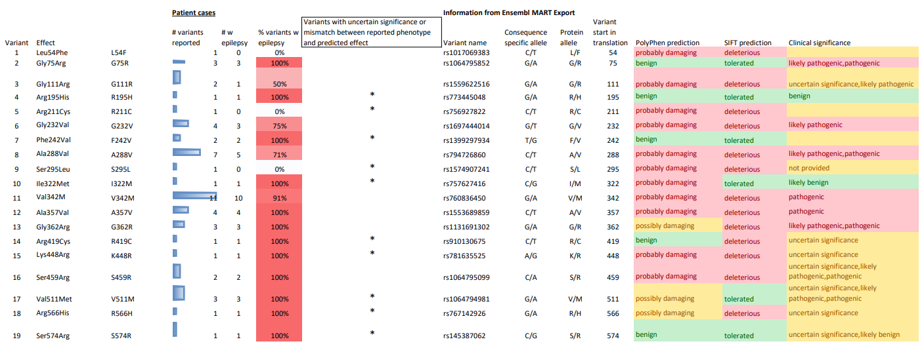
Selecting human GAT1 variants of interest
A
CPD
TM
TM
TM
ECD
TM
TM
TM
TM
TM
TM
TM
TM
TM
B
McGraw et al. In preparation
Notes:
Figure 1. GAT1 variants
(A) Table of selected variants reported in human patients with information regarding reported phenotype and predicted pathogenicity (PolyPhen, SIFT) and ClinVar annotation. Variants of uncertain significance or whose reported pathogenicity is at odds with its predicted effect are indicated with an asterisk in the corresponding column.
These variants account for 50 out of 88 cases reported with missense variants in SLC6A1 Connect and other reference (=56.8% cases)

