Slide 1


COMBINEDBrain
Developing Treatments for SLC6A1-Related Disorder: The Existing Resource ToolBox
SLC6A Connect Annual Meeting 2023
November 30th, 2023
Anna Pfalzer, PhD
Chief Scientific Officer
www.COMBINEDBrain.org

Slide 2
COMBINEDBrain
Mission:
The Consortium for Outcome Measures and Biomarkers for Neurodevelopmental Disorders is devoted to speeding the path to clinical treatments for people with severe rare genetic neurodevelopmental disorders by pooling efforts, studies and data.
Structure:
Non-profit consortium led by patient advocacy foundations, working with the clinicians, researchers and pharmaceutical firms that are developing treatments for the disorders they represent.
www.COMBINEDBrain.org

Slide 3
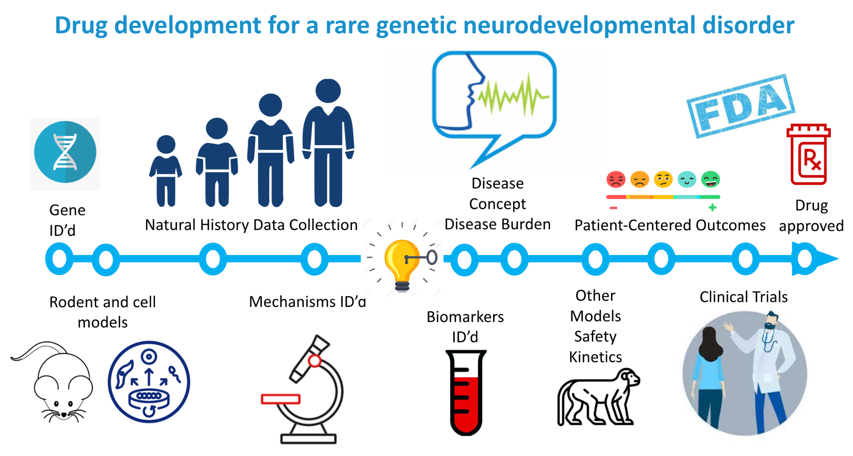
Drug development for a rare, genetic neurodevelopmental disorder
CB
www.COMBINEDBrain.org

Slide 4
Patient-derived cell models
Researcher with existing cell models ??? Transfer in samples to Repository!
CB
Sample Type | Genetic Variant | Location
PBMCs | c.913G>A; p.A305T | CB Repository
PBMCs | WT (unaffected sibling) | CB Repository
PBMCs | c.1426+1G>A | CB Repository
iPSCs | c.154G>A; p.D52N | CB Repository
iPSCs | C.331G>A;p.G111R | CB Repository
www.COMBINEDBrain.org

Slide 5
Drug development for a rare, genetic neurodevelopmental disorder
CB
www.COMBINEDBrain.org

Slide 6

Natural History Data Collection
CB
Across Healthcare- Matrix
Online data platform
  Surveys:
  1.ClinGen Surveys
    Pregnancy
    Medical History
    Development
    Cognition
      Motor
      Organ systems
    2.Vineland Adaptive Behavior Scale (Version III)
    3. PEHLS Seizure survey
**Data is owned by participants and PAGs**
SLC6A1 participants (as of 11/30/23)
n=17 registered
n=17 completed >1 survery
n= 8 completed all surveys
www.COMBINEDBrain.org

Slide 7
Drug development for a rare, genetic neurodevelopmental disorder
CB
www.COMBINEDBrain.org

Slide 8
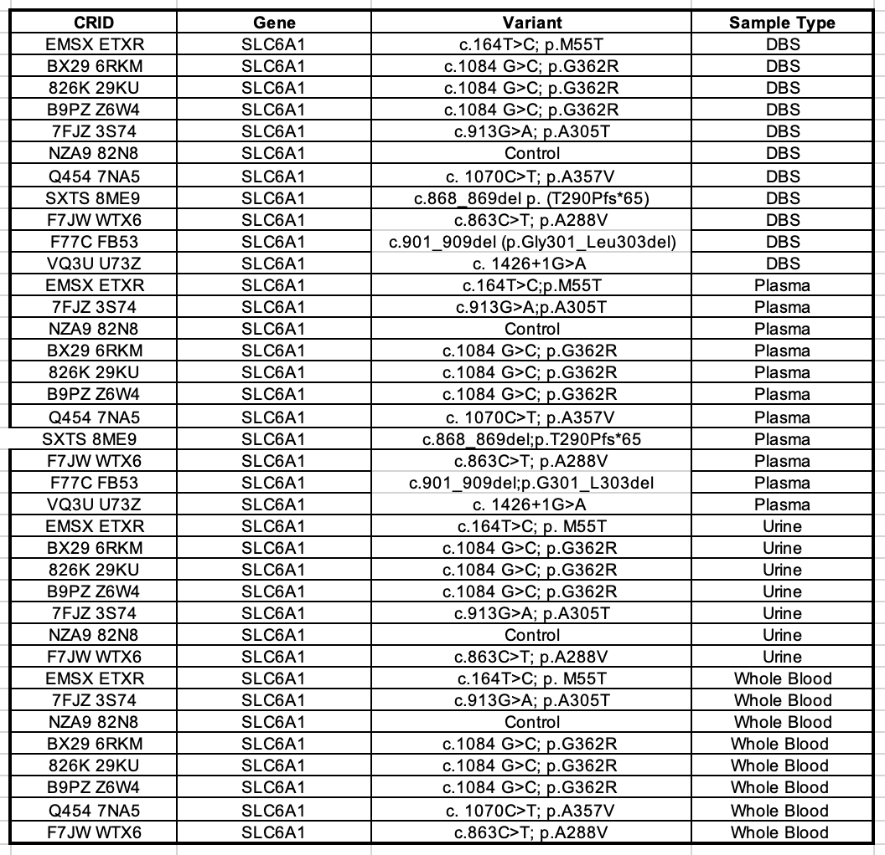
Patient samples
CB
Plasma (n=11)
Dried blood spot (DBS) (n=11)
Whole blood (n=9)
Urine (n=7)
Clinical information collected along
with biorepsitory
Vineland Adaptive Behavioral
Scale III
PEHLS Seizure survey
ClinGen Surveys
www.COMBINEDBrain.org

Slide 9
Drug development for a rare, genetic neurodevelopmental disorder
CB
www.COMBINEDBrain.org

Slide 10
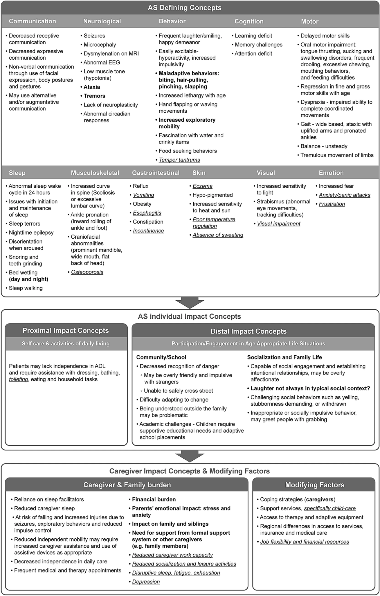
Disease Concept Model Development
CB
Disease Concept Models
Provides overview of symptoms
Patient/family priority
Basis for outcome measures for clinical trials
Qualitative interviews
Caregiver
Healthcare providers
Educators
Interview until saturation
Publish
**Draft Disease Concept Model published**
www.COMBINEDBrain.org

Slide 11
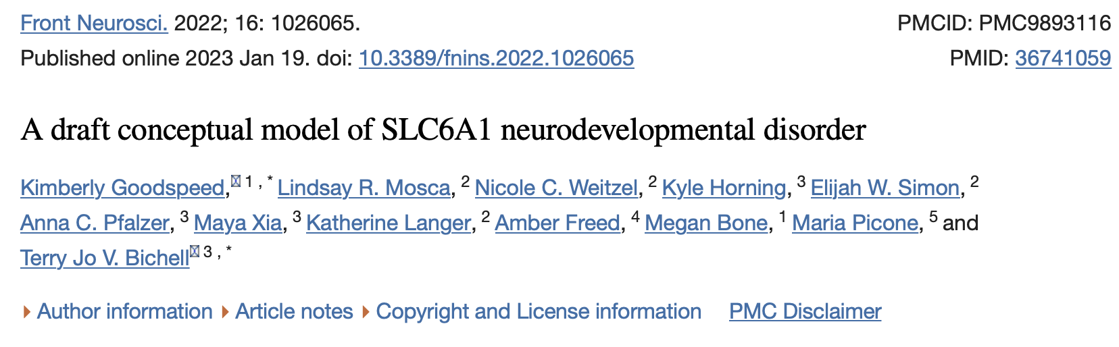
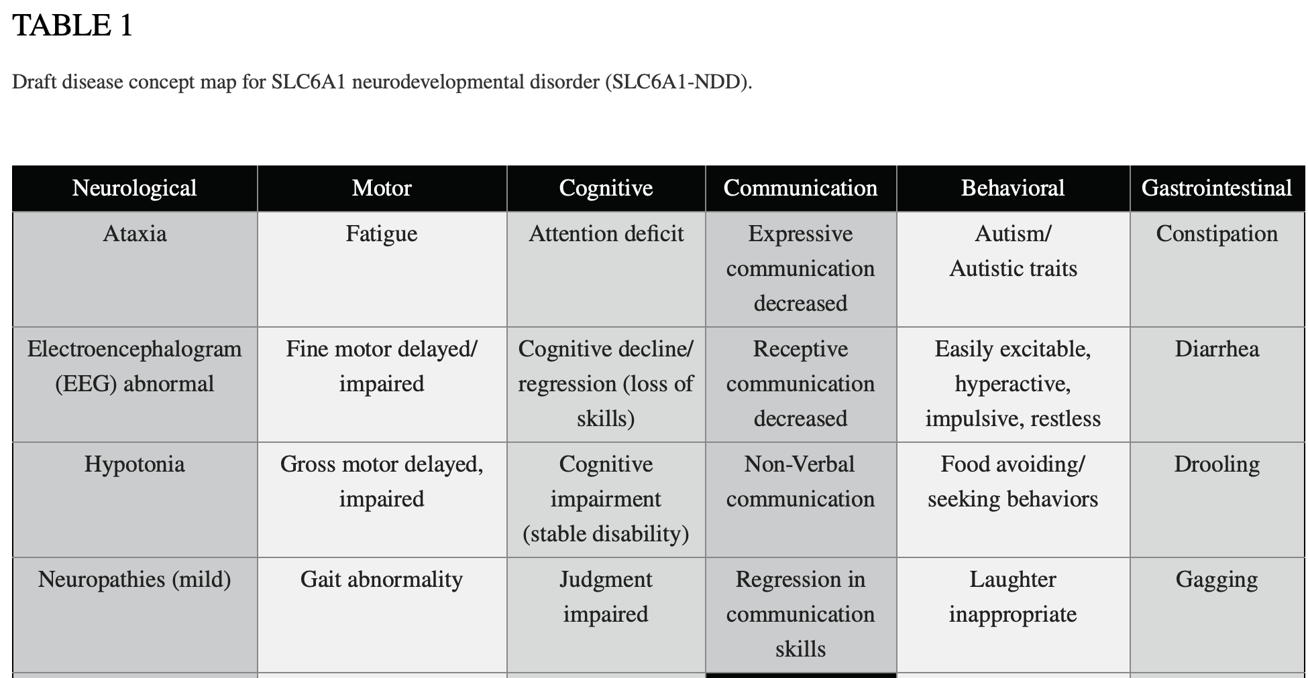
Draft Disease Concept Model for SLC6A1-Related Disorder
CB
www.COMBINEDBrain.org

Slide 12
Developing Outcome Measures Validated for USP7-Related Disorders
CB
www.COMBINEDBrain.org

Slide 13

Validation of Communication Measure in SLC6A1- Related Disorders
CB
Draft Disorder Concept Model indicated an improvement in communication would make one of the greatest impacts of patient and family quality of life.
Grant from FDA to Duke University team led by Drs. Christy Zigler and Bryce Reeve and COMBINEDBrain to expand the ORCA from Angelman syndrome to 12 other neurodevelopmental disorders over a 5 -year period (2021-2026).
Pending expansion to additional disorders - including SLC6A1-Related Disorder
Presentable to FDA as an outcome measure
www.COMBINEDBrain.org

Slide 14
Drug development for a rare, genetic neurodevelopmental disorder
CB
www.COMBINEDBrain.org

Slide 15
COMBINEDBrain
Director, Terry Jo Bichell, MPH, PhD
Deputy Director, Kristin Hatcher, MSEd
Chief Operating Office, Taylor Morris, BS
Chief Scientific Officer, Anna Pfalzer, PhD
Post-doctoral fellow, Sarah Poliquin, PhD
Post-doctoral fellow, Rachel Heilmann, DPh
Special Project Manager, Donnielle Rome-Martin, DPT
Special Project Manager, Brittany Short, MPH
Executive Assistant, William Keener
Graduate Intern, Ananya Terala, BS
Graduate Intern, Martina Hannaalla, BS
Graduate Intern, Katie Schmidt, BS
Graduate Intern, Hilly Yehoshua, BS
Graduate Intern, Sasha Elmizadeh, BS
Research Intern, Elijah Simon
Research Intern, Nick Aguilar
www.COMBINEDBrain.org

Slide 16

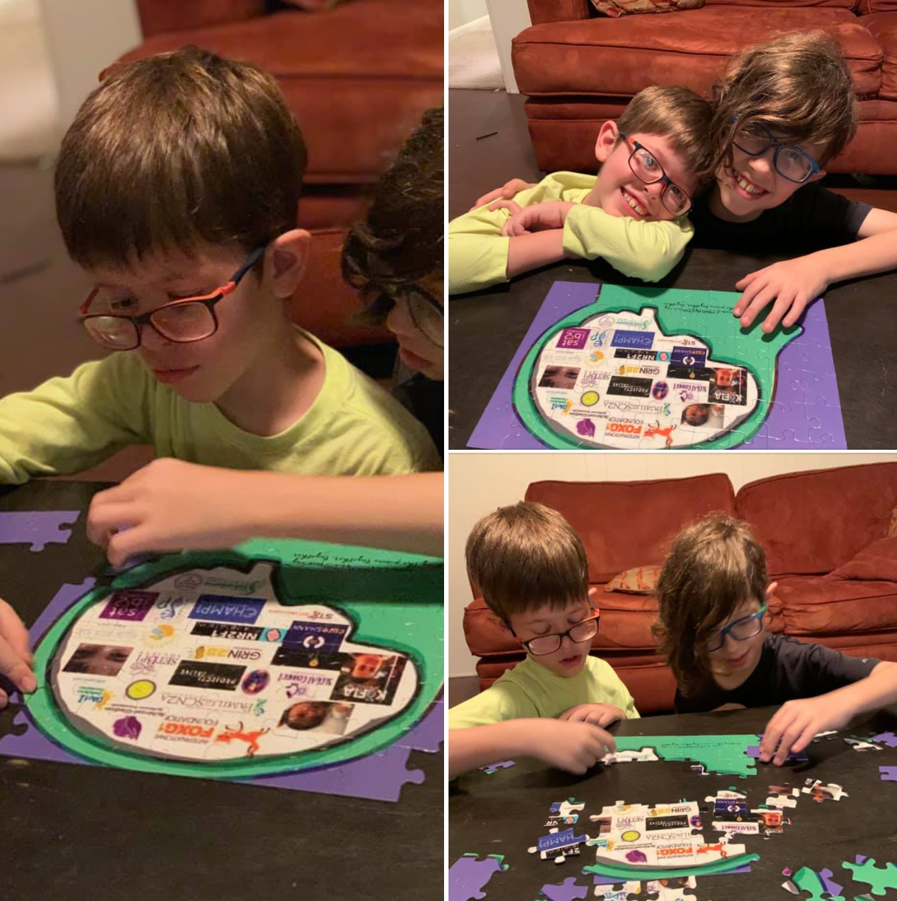
Putting the pieces together.
Together.
Questions
annapfalzer@combinedbrain.org
www.COMBINEDBrain.org

