Slide 1

Turning Hope Into Action

Slide 2








Thank you to our Sponsors

Slide 3
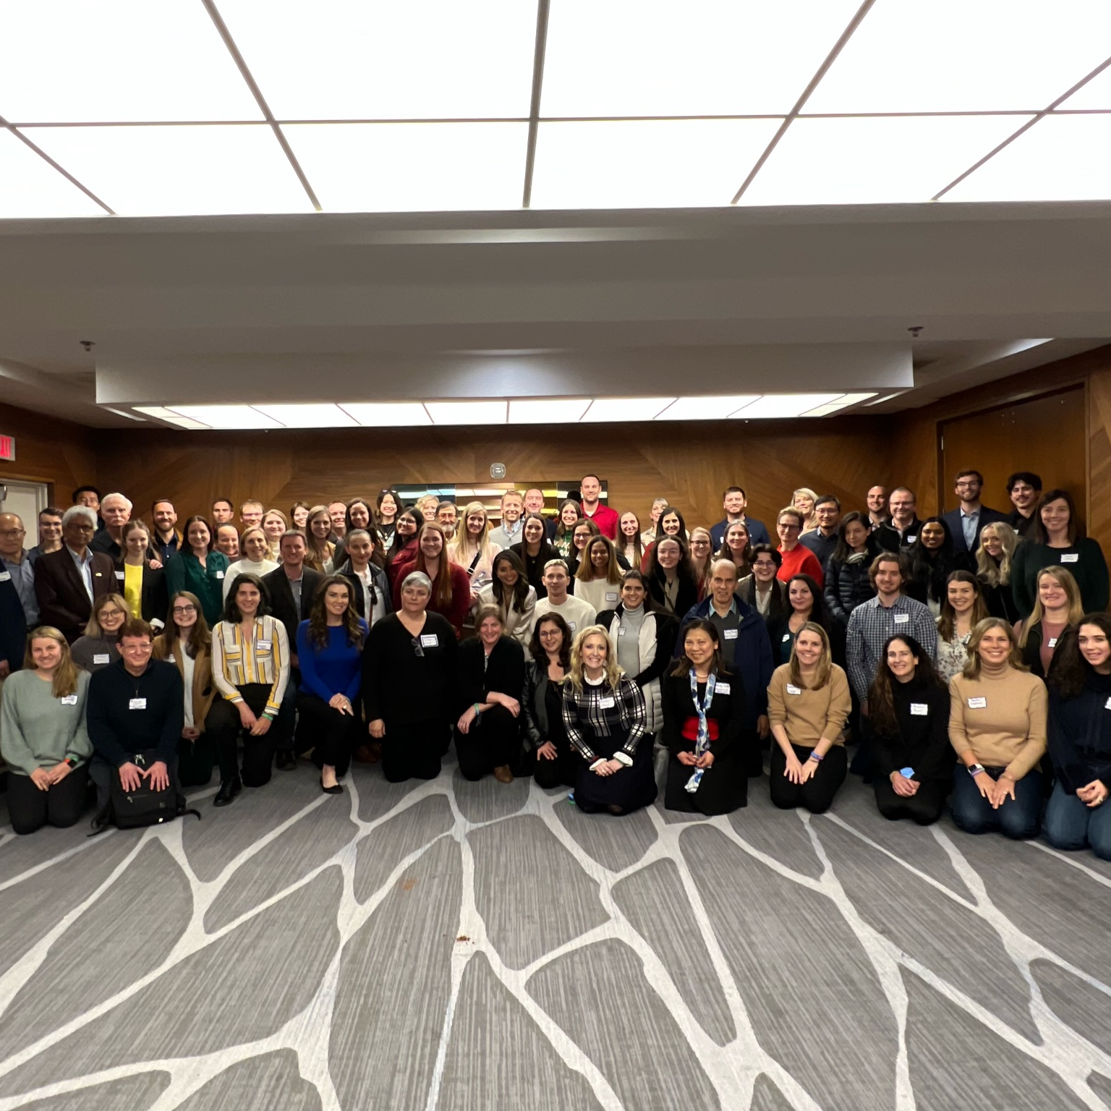
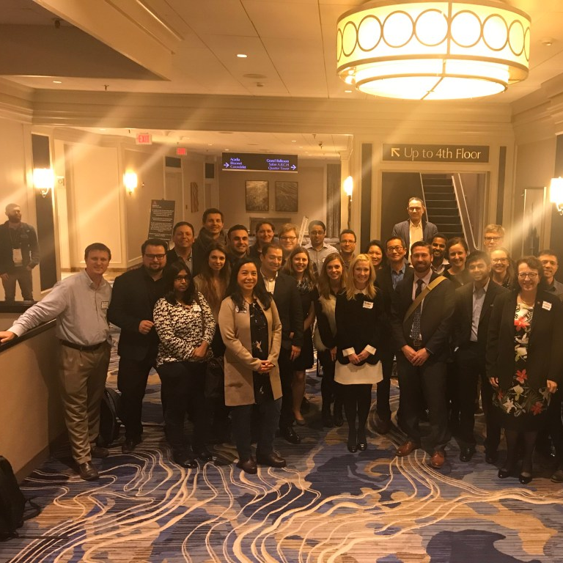
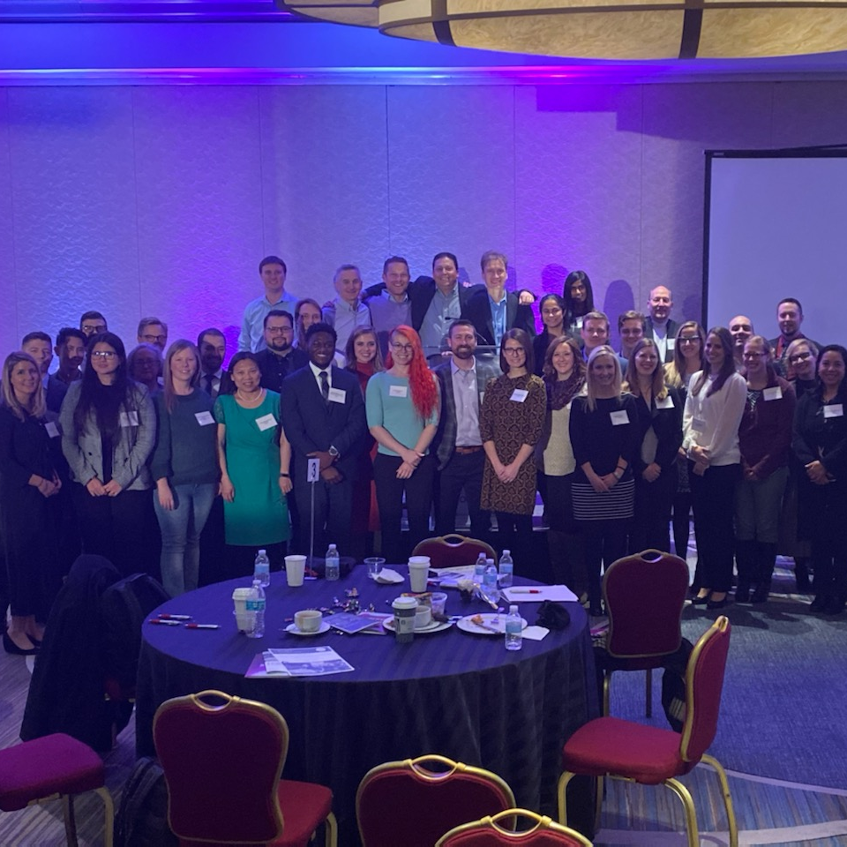
How We’ve Grown!
2018
2022
2019

Slide 4

Amber Freed
Before
SLC6A1
After
SLC6A1

Slide 5
SLC6A1 Connect Mission
SLC6A1 Connect is a Patient Advocacy Group dedicated to improving the lives of children and families affected by SLC6A1.
Our focus is to raise Awareness and Fundraise to advance scientific research that will ultimately Result in a Cure.

Slide 6

SLC6A1 Connect Core Beliefs
Our Goal is to Create Options
Options + Education = Patient Empowerment
Every Child and Situation is Unique
Objectivity
Collaboration

Slide 7
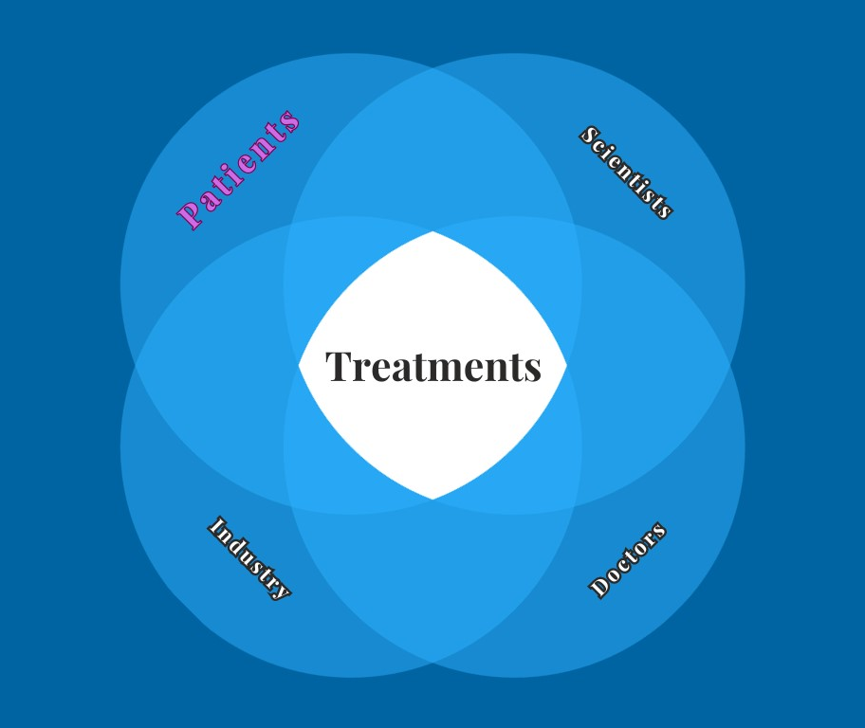
The Flywheel of Success

Slide 8

We Make it Easy
Knockout Mice
2 Point Mutation Mice
Conditional Mouse (Lox Stop)
Human Derived iPSC Models
GABAergic Neurons
Simons Searchlight
Ciitizen
Virtual Monthly Lab Meetings

Slide 9






SLC6A1 is Global and Unified

Slide 10

Happy Hour to Immediately Follow the Symposium

