Slide 1

SLC6A1 Connect International Symposium
Paul Wang, MD
December 1, 2022
Notes:
Hello and thank you for having us today and we are excited to share about SLC6A1 data.

Slide 2
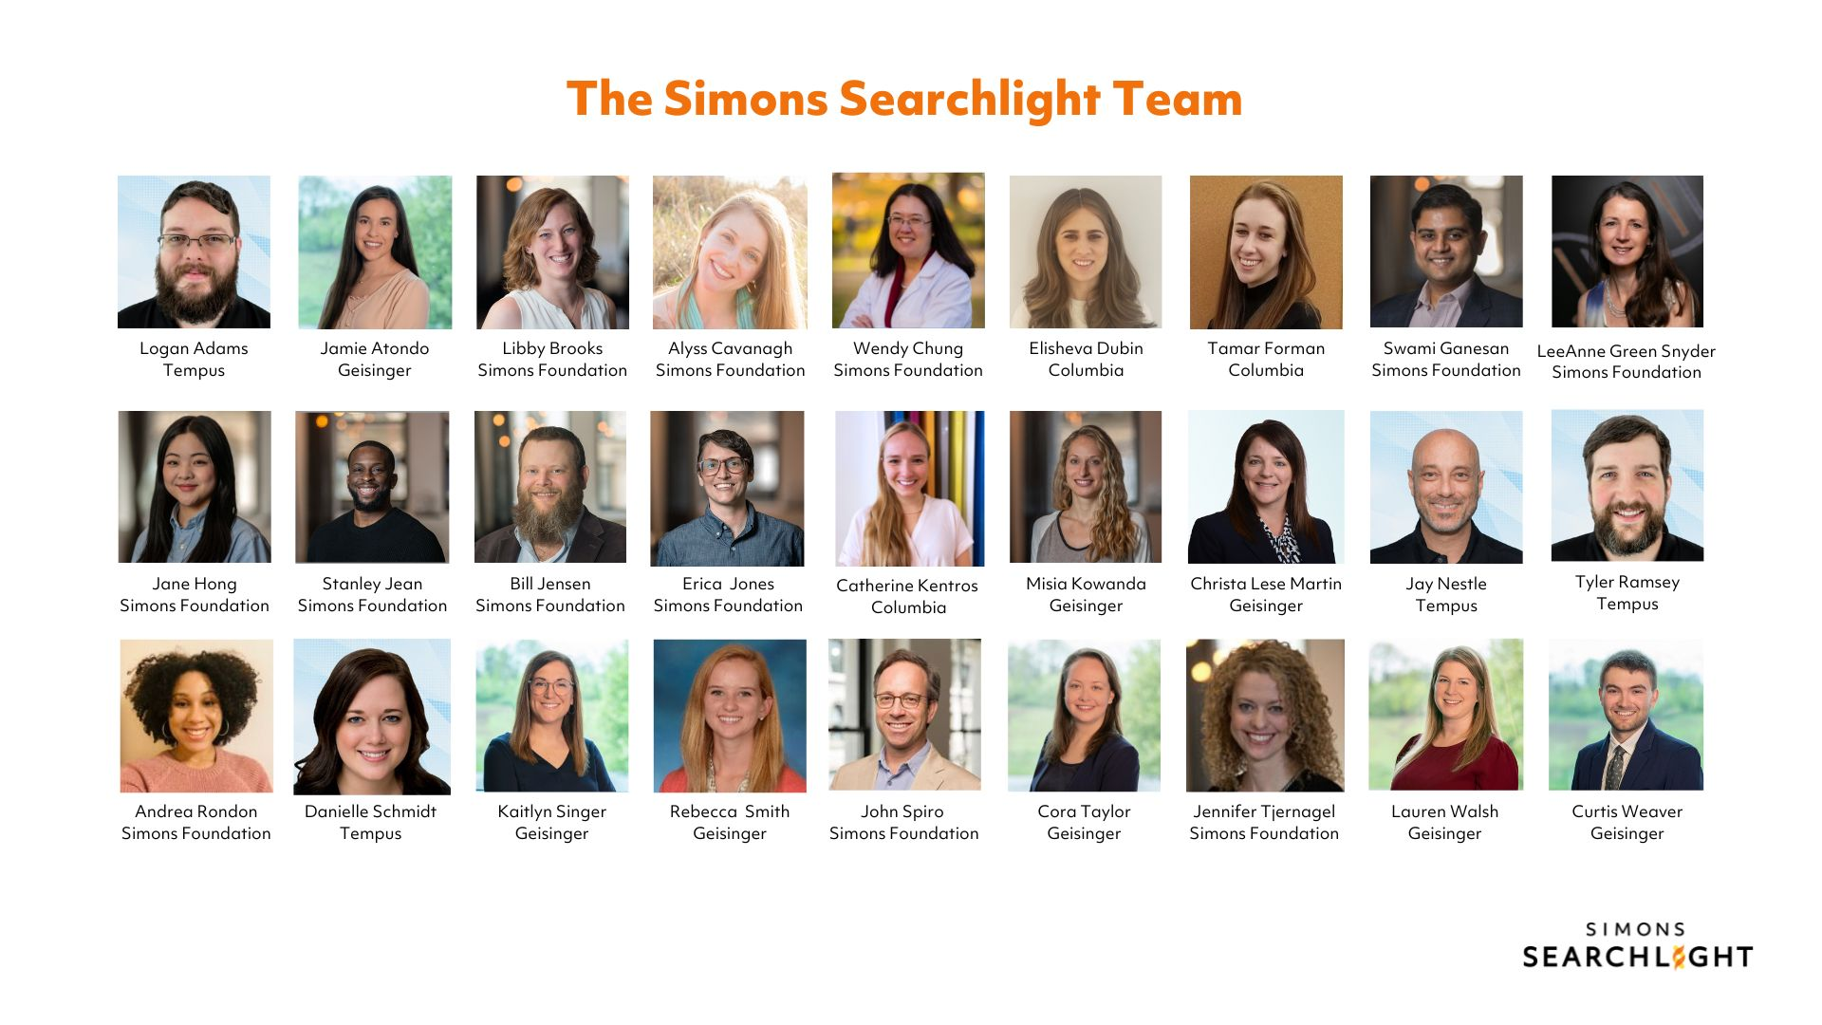
Notes:
Here is the Simons Searchlight team at a glance! It takes an incredible team behind the scenes to make this study run.
The Simons Searchlight team is made up of many talented staff members with years of experience working with rare neurogenetic communities. They represent expertise in a variety of disciplines: Clinicians, genetic counselors, project managers, developers, coordinators, communications specialists – all with the goal of supporting the Simons Searchlight community.
Our team is working with you every step of the way and to help you throughout your research participation journey. We are committed to doing this and we’ve been doing this for over ten years. We are in this for the long-haul and we will continue to help you.
[For examples, if needed: The clinical data team works on creating measurements that are family-facing and shares information collected back to families. The digital product team supports the clinical data team with survey execution and manages the participant user experience in the dashboard portal. The research coordination team regularly responds to questions from families and helps them navigate their participation. The genetic counseling team works with families to help them navigate their new genetic diagnosis and connects them with resources. And the communications team supports all of these departments in various capacities to ensure alignment and carries out other outreach efforts to raise awareness about the study.]

Slide 3

Simons Searchlight is…
Participant-centered and collects high-priority useful data from families
A place that qualified researchers can request to use data in their own research projects
Scalable and continues to grow
Using surveys that are standardized and validated
FREE to participate
Notes:
aims to accelerate science and improve lives for people with rare genetic neurodevelopmental disorders.
Surveys that are standardized, validated and sensitive in detecting differences are prioritized. By collecting this information over time, or longitudinally, we will all learn more about how the condition may change as people get older. Overall we aim to ensure to facilitate investigation by researchers in a way that is feasible and scalable, with a focus on generating knowledge that is useful and high priority to participants.

Slide 4

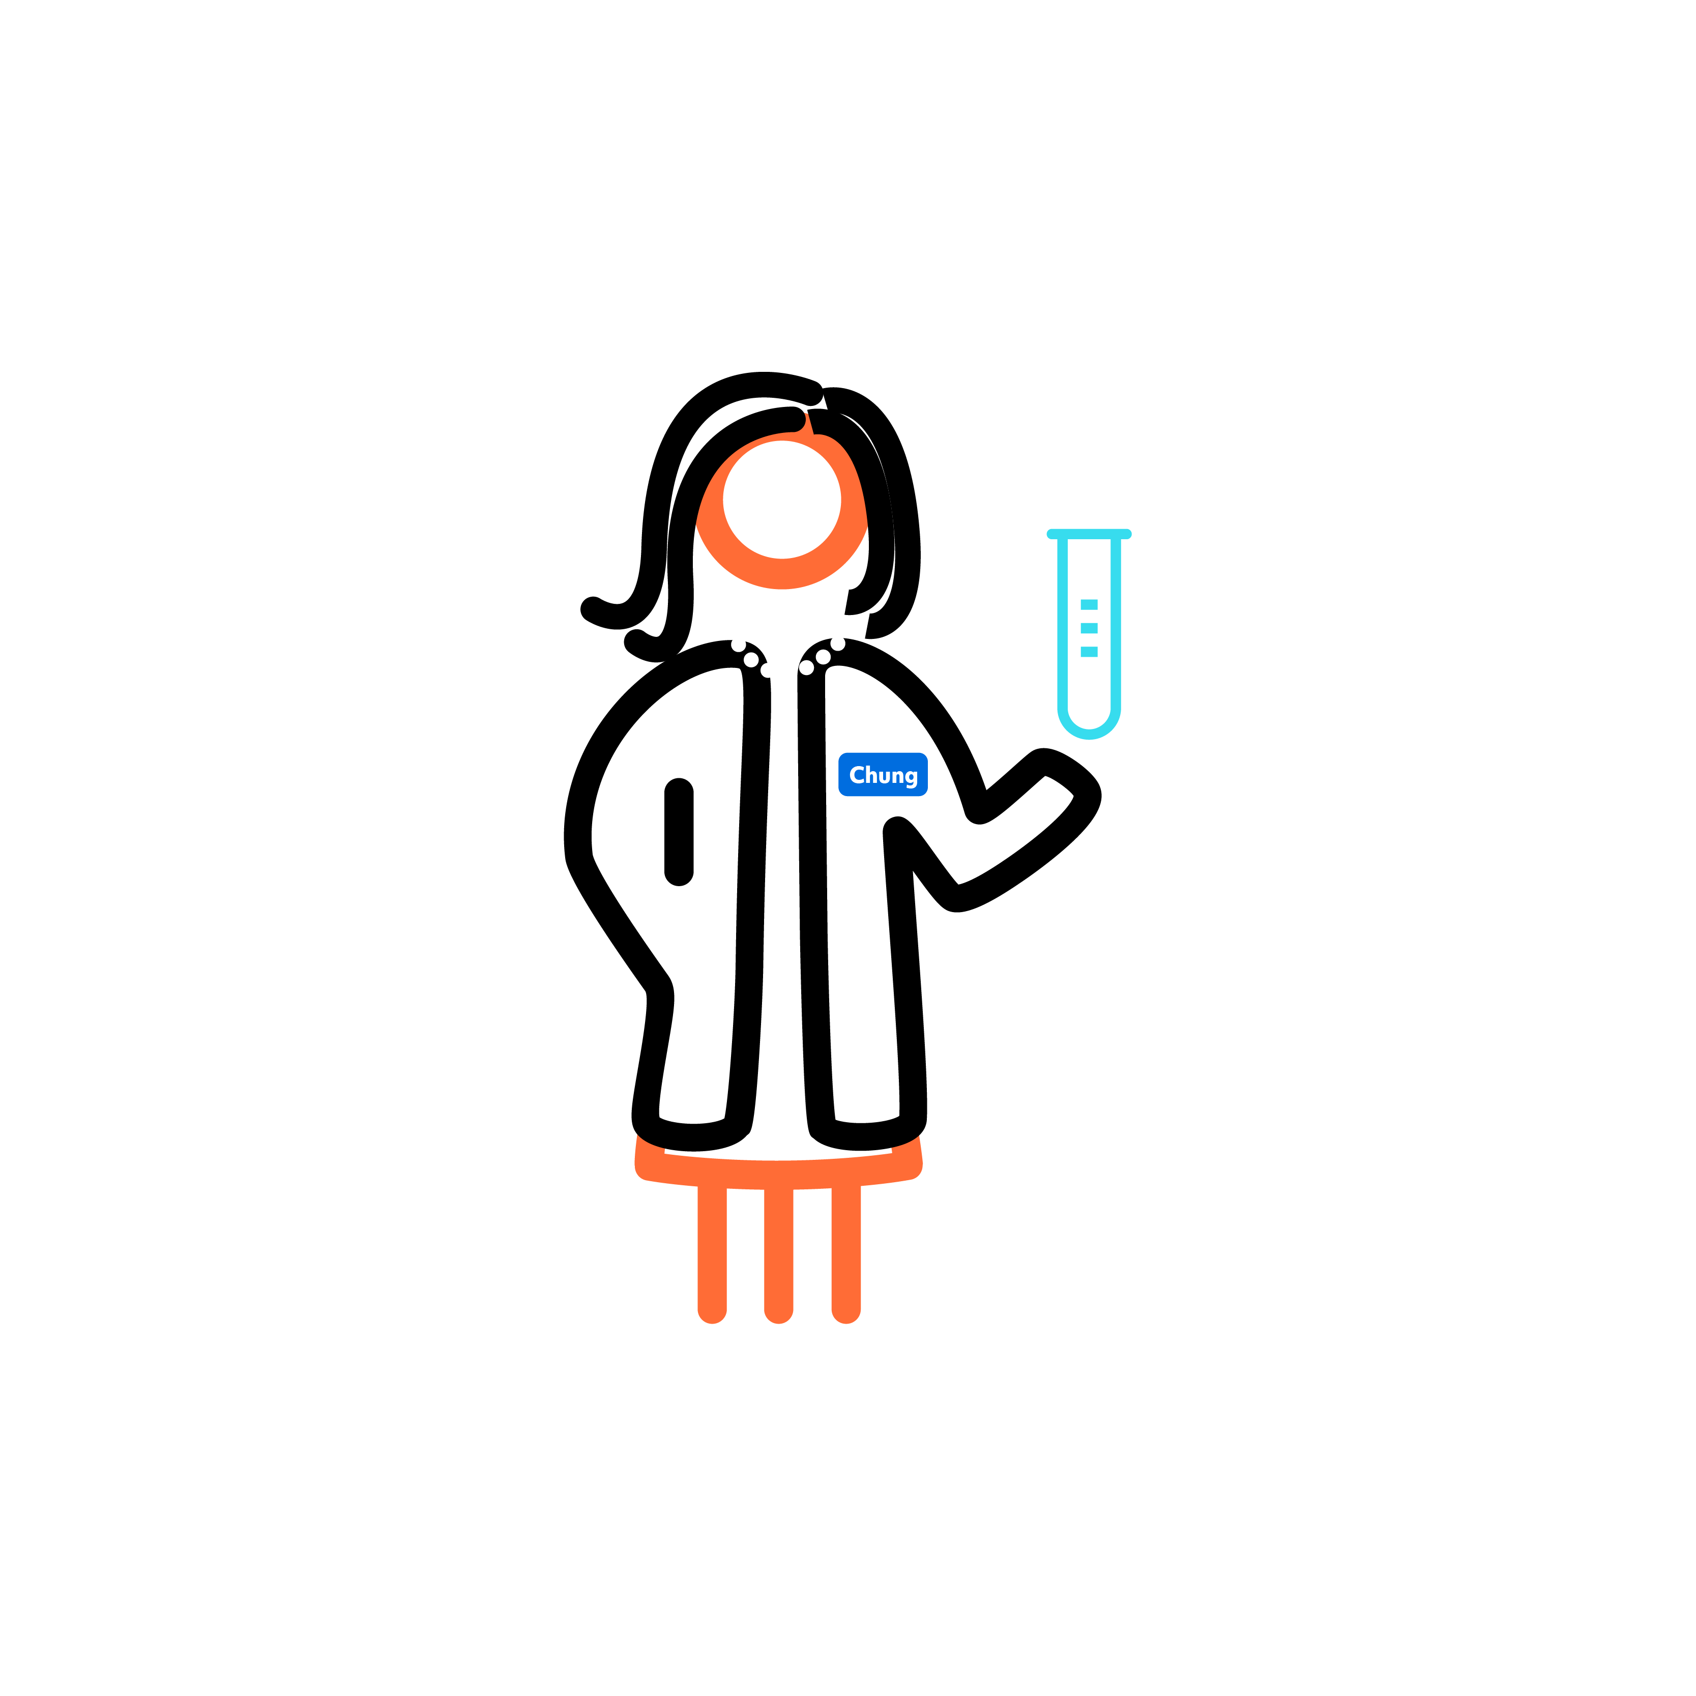



What are the goals of Simons Searchlight?
Our mission is to shed light on these conditions by collecting high quality natural history data and building strong partnerships between researchers, industry and families.
Collect detailed medical and behavioral histories along with blood samples
Synthesize the information you provide and share results back to families
Freely share data and samples with qualified researchers
Connect participants and researchers from around the world
Promote better understanding of these genetic changes
Notes:
Open to researchers for free.
Looking to adapt our study to meet needs of the community.

Slide 5
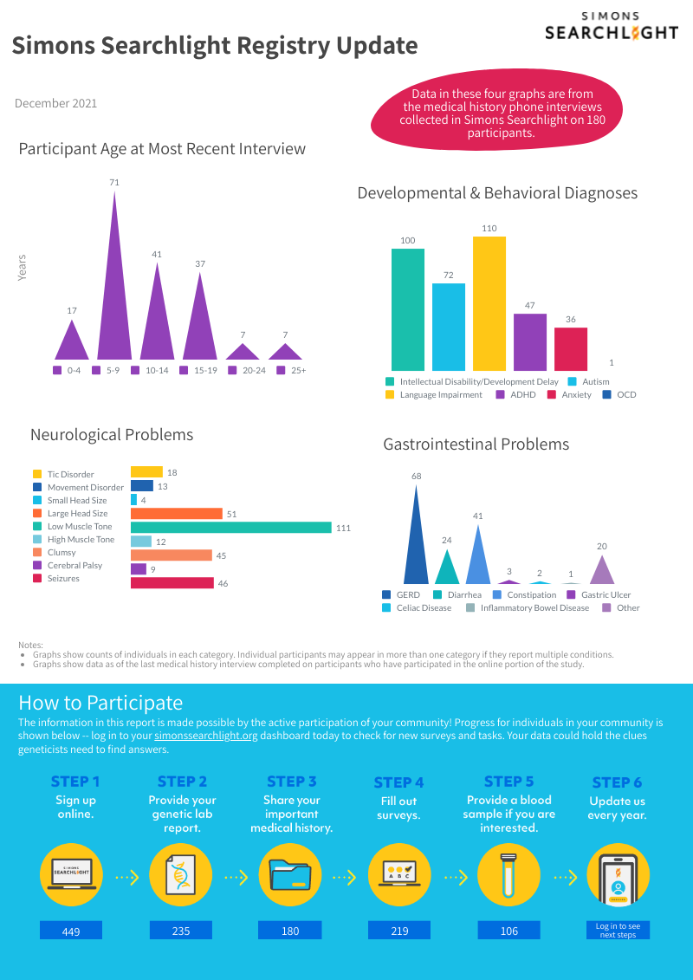
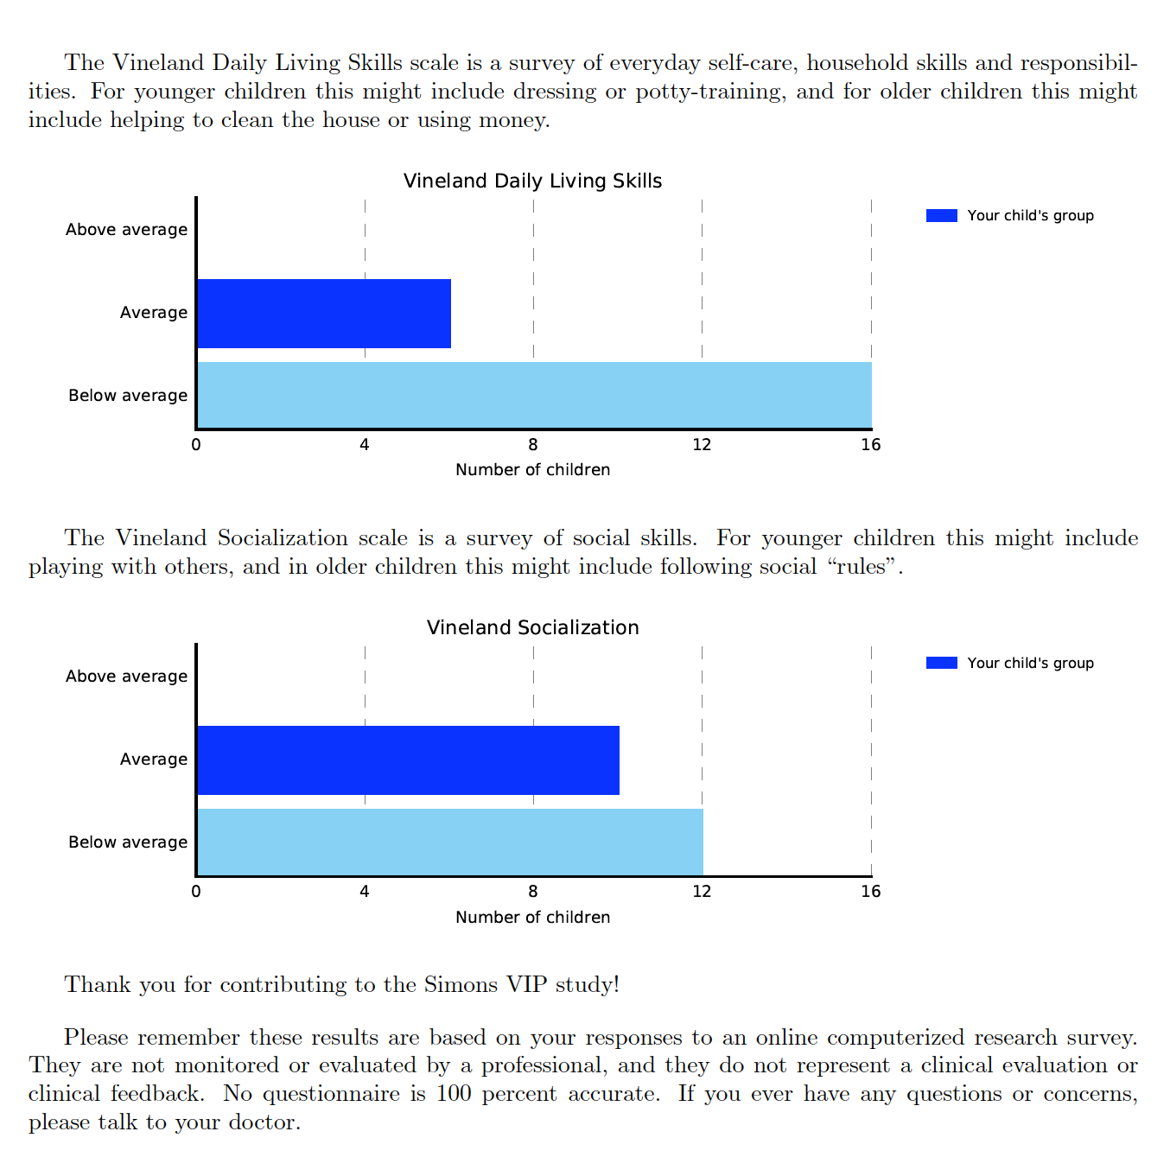
Information for Families
Personalized reports: SCQ, SRS, CBCL and Vineland located on your dashboard
Summary snapshots on your gene page
Presentations at conferences and meetings
Notes:
Giving information back to participants is high on our priority list - we have standardized reports that we will provide back for some of these surveys. The example on the upper right is for the Vineland survey, which provides information on daily functioning. The report explains a little bit about what the results mean and where your child falls within those ranges.
In addition to these individualized results reports, we also do summary snapshot documents that look at an entire community such as [GENE/Syndrome Name] and provide high level information in a visually easy to understand. You can see an example of this type of summary in the middle of the screen. We are currently working on doing these quarterly for communities that have enough data submitted.
We also will do more detailed presentations at conferences and meetings. The more data that is submitted by participants, the more information we have to share back with you.

Slide 6
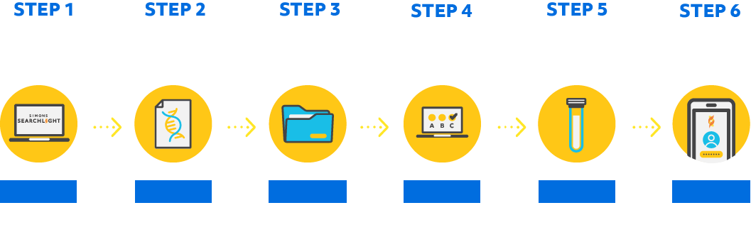
Progress of Individuals with SLC6A1
148
116
87
98
15
Login for more
We are a long-term study, gathering new information from you every year.
Notes:
Now let’s take a look at the progress of individuals with CLCN4 and where your community is in their Simons Searchlight participation journey. [WALK THROUGH THE NUMBERS AT EACH STEP]

Slide 7
Variants Observed in SLC6A1
86 individuals
Variant Category | Number | Breakpoints | Variant Classification
CNV breakpoints/ Deletions |  | Chr3:10270371-12306916 | Pathogenic
 |  | Chr3:10609866-11197092 | Pathogenic
 |  | Chr3:11049517-11290122 | Pathogenic
 |  | exon 9-10 deletion | Likely Pathogenic
Variant Category | Number | Coordinates | Variant Classification
Frameshift or nonsense |  | p.Lys36Glufs*171 | Pathogenic
 |  | p.Val115Tyrfs*22 | Pathogenic
 |  | p.Thr217_Ile220del | Likely Pathogenic
 |  | p.Leu286Alafs*70 | Pathogenic
 |  | p.Gln291* | Pathogenic
 |  | p.Gln374* | Pathogenic
 |  | p.Leu390_Leu392del | Likely Pathogenic
 |  | p.Leu408Trpfs*26 | Likely Pathogenic
 |  | p.Arg419Alafs*15 | Likely Pathogenic
 | 3 | p.Arg479* | Pathogenic
 | 2 | p.Trp532* | Pathogenic
 |  | p.Gln565* | Likely Pathogenic
Variant Category | Number | Coordinates | Variant Classification
Splice site or intronic | 2# | -3_7del10 | Likely Pathogenic
 |  | 471+1G>T | Likely Pathogenic
 |  | 714+2T>G | Likely Pathogenic
 |  | 1426+1G>A | Likely Pathogenic
 |  | 1695+1G>A | Pathogenic
 |  | 1696-1G>A | Likely Pathogenic
 |  | IVS11-2A>C | Likely Pathogenic
 |  | IVS14+2T>C | Pathogenic
 |  | IVS4-2A>C | Pathogenic
Variants as of November 2022
26 VUS in Simons Searchlight; not shown
# Indicates biological relatives

Slide 8
Variants Observed in SLC6A1 (Continued)
86 individuals
Variant Category | Number | Coordinates | Variant Classification
Missense | 2 | p.Arg44Trp | Likely Pathogenic
 |  | p.Arg44Gln | Likely Pathogenic
 |  | p.Arg69Ser | Likely Pathogenic
 | 3 | p.Gly75Arg | Pathogenic
 |  | p.Gly80Arg | Likely Pathogenic
 |  | p.Gly94Glu | Pathogenic
 |  | p.Glu101Gly | Likely Pathogenic
 |  | p.Gln106Arg | Likely Pathogenic
 | 3 | p.Gly111Arg | Pathogenic
 |  | p.Tyr139Cys | Likely Pathogenic
 |  | p.Leu251Pro | Likely Pathogenic
 |  | p.Gly263Arg | Likely Pathogenic
Variant Category | Number | Coordinates | Variant Classification
Missense | 2 | p.Ala288Val | Pathogenic
 |  | p.Phe294del | Likely Pathogenic
 |  | p.Ser295Leu | Likely Pathogenic
 | 6 | p.Gly297Arg | Pathogenic
 |  | p.Ala305Thr | Likely Pathogenic
 | 2 | p.Gly307Arg | Likely Pathogenic
 |  | p.Asn327Ser | Likely Pathogenic
 | 2 | p.Ser331Gly | Likely Pathogenic
 | 3 | p.Val342Met | Pathogenic
 |  | p.Ala357Thr | Pathogenic
 |  | p.Ala357Val | Pathogenic
 |  | p.Pro361Leu | Likely Pathogenic
 | 3#, 5 | p.Gly362Arg | Pathogenic
 | 2# | p.Ser387Pro | Likely Pathogenic
 |  | p.Glu402Gly | Likely Pathogenic
 |  | p.Ser459Arg | Pathogenic
 | 5 | p.Val511Met | Likely Pathogenic
 |  | p.Gly550Arg | Likely Pathogenic
Variants as of November 2022
26 VUS in Simons Searchlight; not shown
# Indicates biological relatives

Slide 9
Missense Variants Observed in SLC6A1
58 individuals
Missense variant
p.Asn327Ser
p.Ser331Gly
p.Val342Met
p.Ala357Thr
p.Ala357Val
p.Pro361Leu
p.Gly362Arg
p.Ser387Pro
p.Leu251Pro
p.Gly263Arg
p.Ala288Val
p.Phe294del
p.Ser295Leu
p.Gly297Arg
p.Ala305Thr
p.Gly307Arg
Variants
p.Glu402Gly
p.Ser459Arg
p.Val511Met
p.Gly550Arg
p.Arg44Trp
p.Arg44Gln
p.Arg69Ser
p.Gly75Arg
p.Gly80Arg
p.Gly94Glu
p.Glu101Gly
p.Gln106Arg
p.Gly111Arg
p.Tyr139Cys
Functional regions
599
PDZ-binding
Na+ binding sites

Slide 10
Simons Searchlight participants can donate a blood sample
Blood collection steps
Step 1: A blood sample kit is mailed to you free of charge
Step 2: Make an appointment at a local Quest Labs to have the blood drawn
Step 3: The lab mails the kit back to Simons Searchlight
Questions? Email coordinator@simonssearchlight.org
Notes:
Blood donated from participants, shipping and Rutgers
Audio: Individuals who register for Simons Searchlight have the option to donate blood for research. This can happen remotely through Quest Labs in the US, but also at in person family meetings where international participants can donate. The donated blood is sent by mail to our biobank at Rutgers University in New Jersey. This blood is used to make two types of research resources, one is a cell line, we won’t discuss in detail here, and another one is induced pluripotent stem cells or iPS cells. In my next slide, I will talk about how iPS cells are made and why they are valuable.

Slide 11
How will the sample be used in research and why is this important?
Infinity BiologiX
$$
Simons Foundation Autism Research Initiative
Nancy Lurie Marks Family Foundation
Induced pluripotent stem cells
blood
New York Stem Cell Foundation
6 – 9 months
Questions? Email coordinator@simonssearchlight.org
Notes:
Audio: So what exactly is Simons Searchlight doing to enable studies using iPS cells?
As mentioned in the very beginning participants in Simons Searchlight can donate blood that is shipped to and stored at our biobank at Rutgers University in New Jersey. The conversion of blood cells to iPS cells happens at the New York Stem Cell Foundation, and the resulting iPS cells are again stored in the biobank at Rutgers University. It takes about 6-9 months to make iPS cells.
All the iPS cells that are made with blood donated to Simons Searchlight are available to researchers worldwide. The iPS cell samples can be requested through a database, called SFARI Base. Once a researcher requests the samples, the request is reviewed to ensure it is legitimate and the samples are shipped to them.
SFARI has formed a collaboration with the Nancy Lurie Marks Family Foundation, short NLMFF, to finance the generation of iPS cells. With this, we save researchers time and money and ensure the generation of a high quality technically homogeneous iPS cell resource.
Thanks for listening and I’m happy to answer any questions.

Slide 12
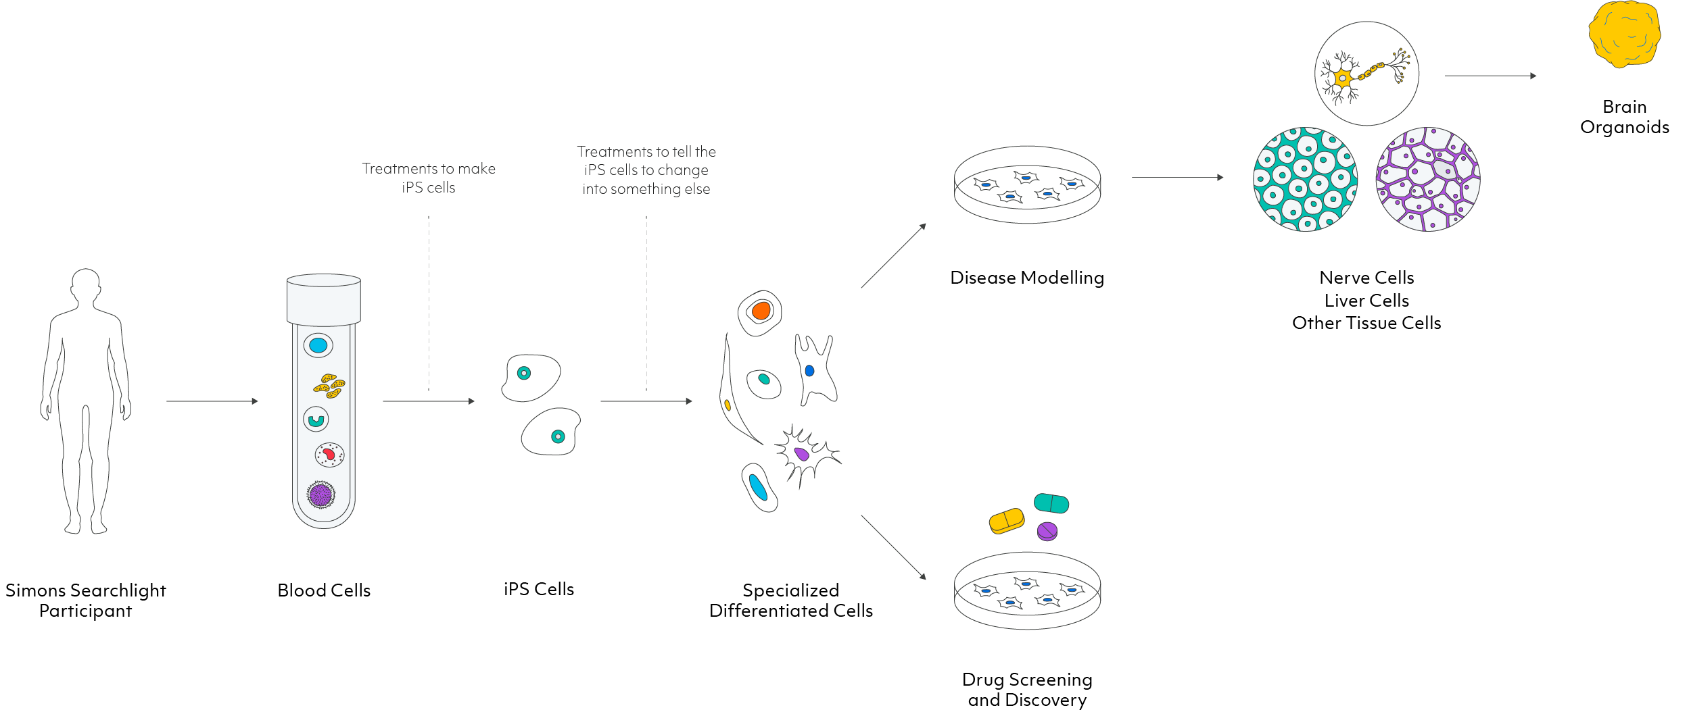
What are induced pluripotent stem cells (iPSCs)?
Questions? Email coordinator@simonssearchlight.org
Notes:
Audio: The iPS cells that we are making are made from Simons Searchlight participant blood donations but they can also be made from other sources, like skin cells. Within your blood there are many different types of cells that we cannot see with our bare eyes. Those blood cells that are used for making iPS cells are separated and treated in a special way that tells them to become iPS cells.
This first (use pointer to show it) step takes about 6-9 months, this is the time it takes from receiving the blood to making iPS cells. I want to point out that making the iPS cells is not an experiment. Making iPS cells, is generating a resource that researchers need to do specific experiments. By making this resource, SFARI saves researchers time and money, so they can focus on the real experiments.
But why are iPS cells so valuable?
iPS cells are very special because researchers, can force them to become the specific cells that make up the different tissues of the body such as the nerve cells that make up the brain, or the cells that make up the liver, or the cells that make up the heart. Those types of cells are all different and are not easily accessible from a living human. Blood cells that were not converted to iPS cells cannot turn into these different cell types on their own. The only other cell type that can develop into such special cell types are embryonic stem cells, which are not available from patients. That’s why iPS cells are so valuable, because they allow us to make and study usually inaccessible cells from a patient (point at Nerve Cells, Liver Cells…). Researchers can then use the ‘nerve cells’ they made from iPS cells, to understand how and why the cells of individuals with different neurodevelopmental conditions function differently from those of other people. In addition,they can be used to find and test drug therapies.

Slide 13
SLC6A1 iPS Cells
 | p. nomen | # of Carriers | Available
1 | p.Leu408Trpfs*26 | 1 | Available
2 | p.Gln291* | 1 | Quality control step
3 | p.Ser295Leu | 1 | Quality control step
4 | p.Ala288Val | 2 | Reprogramming
5 | p.Ser459Arg | 1 | Reprogramming
6 | p.Arg479* | 1 | Reprogramming
Researchers worldwide can request (non- and for-profit), for a nominal fee $120/sample
Request through SFARI Base
Researchers can submit requests now
SLC6A1 Biospecimens
Total families who donated | Carrier family members with samples | Number of iPSCs | Whole blood cell DNA | LCL | Spit DNA
14 | 13 | 1 | 8 | 1 | 0
The # of families with available specimen can differ from the # of carriers who donated

Slide 14
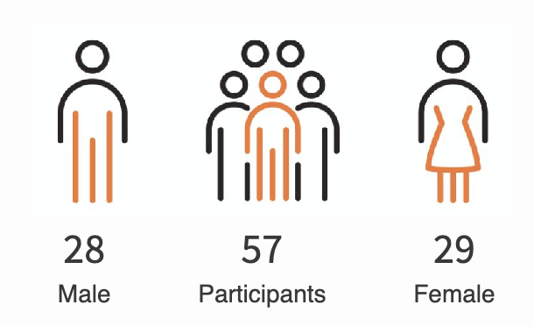
Simons Searchlight SLC6A1
Medical History Data
57 participants with pathogenic or likely pathogenic variants

Slide 15
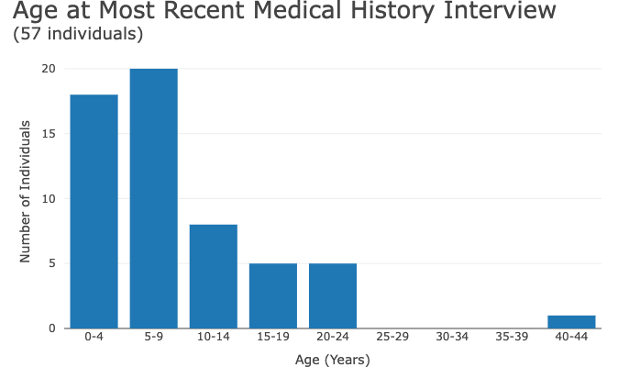

Slide 16
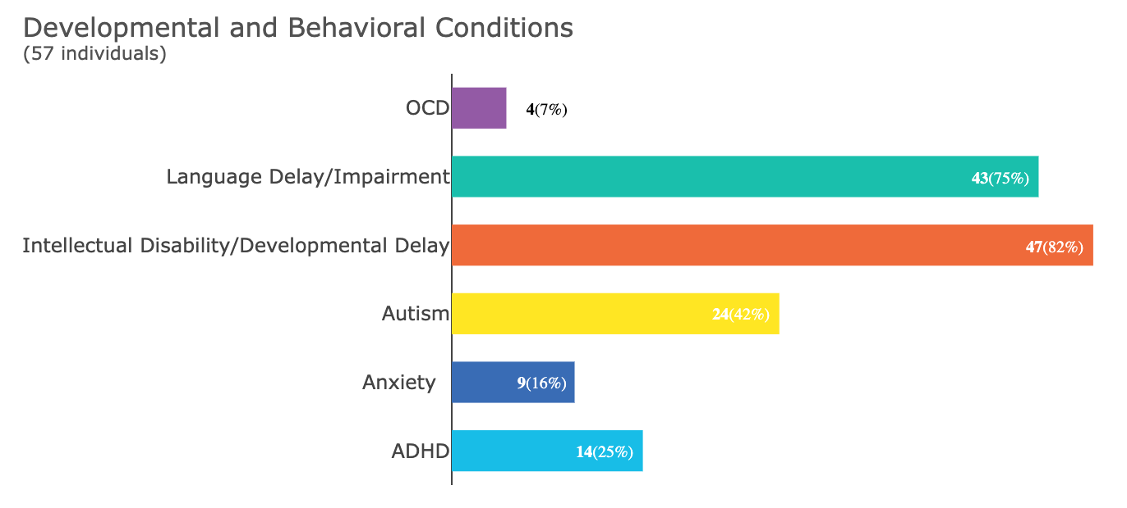

Slide 17
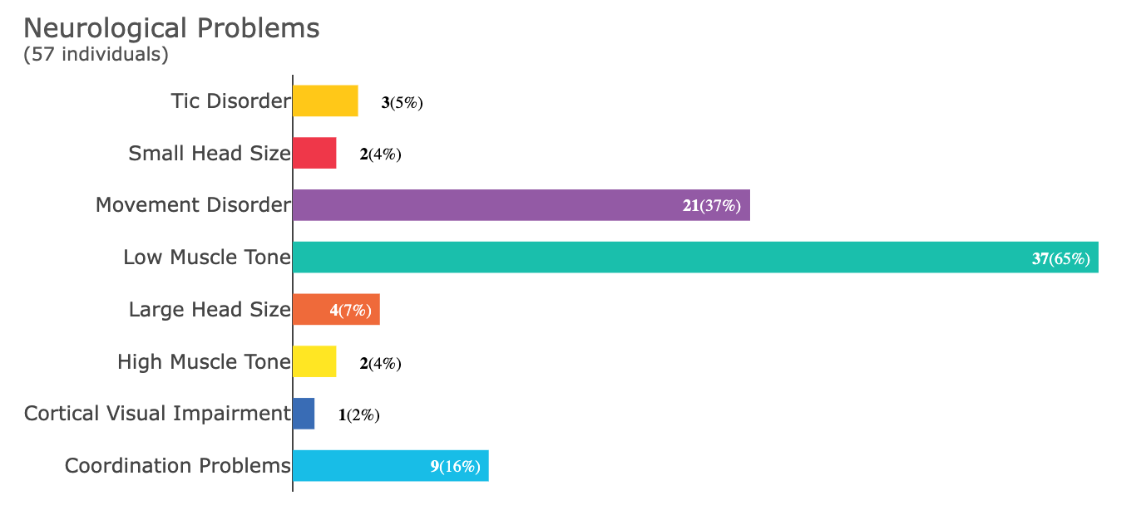
Notes:
Movement disorders:
3 dystonia
9 tremors (includes 1 "intention tremor")
6 ataxia
2 abnormal gait
1 Myoclonus
1 stereotypy
1 frequent falls

Slide 18
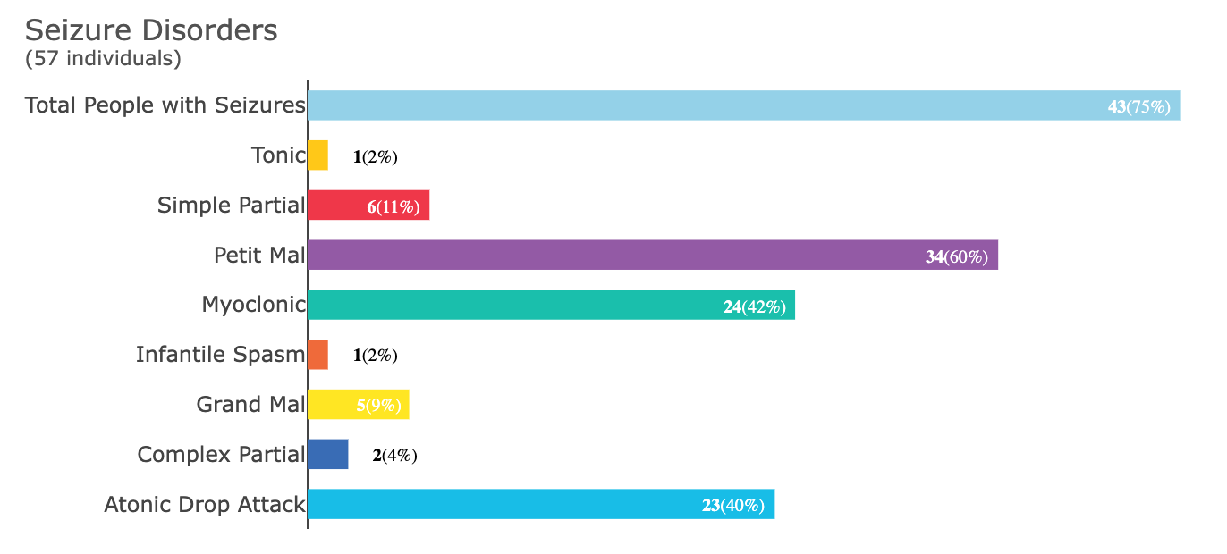


Slide 19
Seizure Course
Available in 50 individuals who completed the Seizure History Survey
Seizure onset was from 6 months through 23 years
  Average age of first seizure around 3½ years
45 (90%) of individuals with seizures have had to take medication for their seizures
  44 (98%) of them continue to take preventative medication for their seizures
14 (28%) of all individuals who ever had a seizure (including those who did not require medication) have achieved seizure control
  Average age at seizure control was around 6 years
* Additional people completed the Seizure History survey as compared to the medical history interview

Slide 20
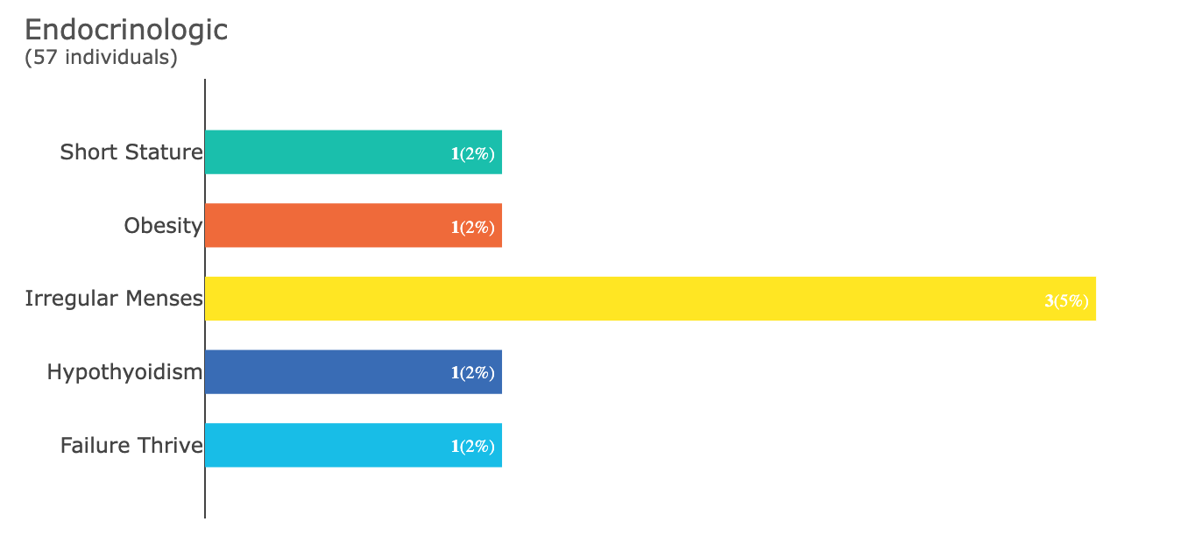
Notes:
In 4 individuals

Slide 21
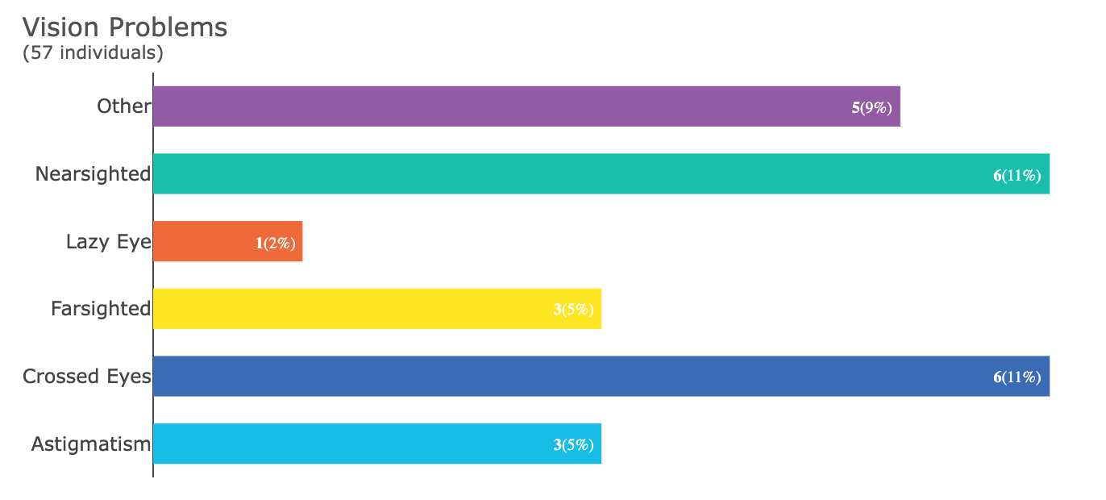
Notes:
1 eye surgery

Slide 22
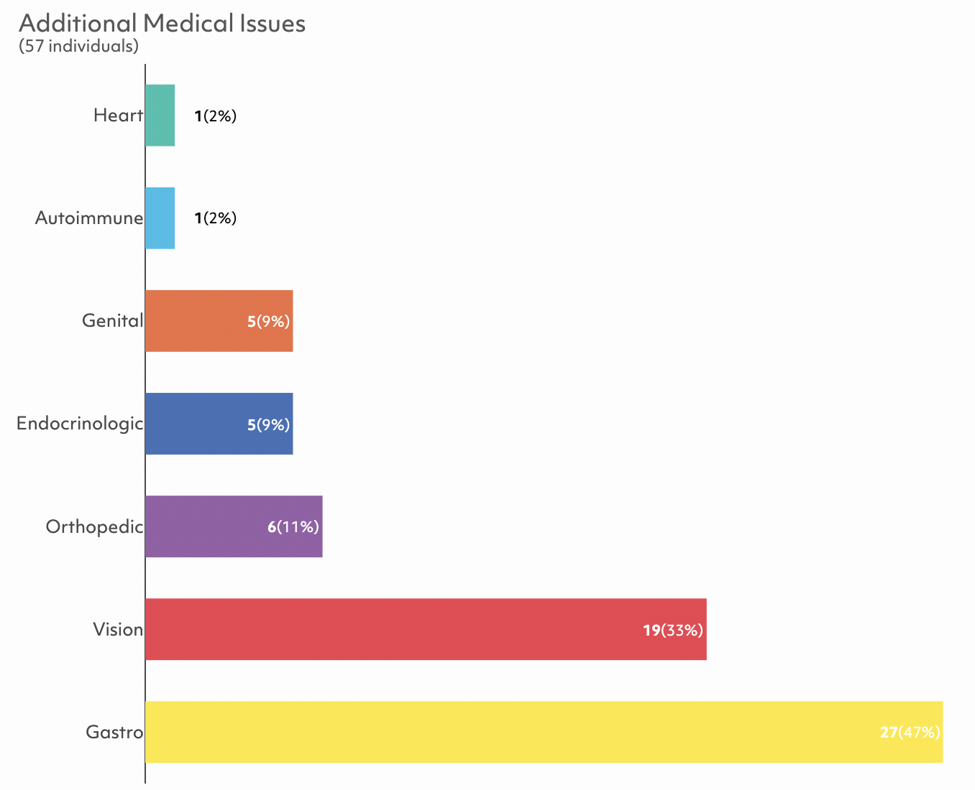
* Congenital heart disease
* Fibromyalgia
* Including menstrual issues
* Scoliosis (9), pectus excavatum
Notes:
Cancer type reported -

Slide 23
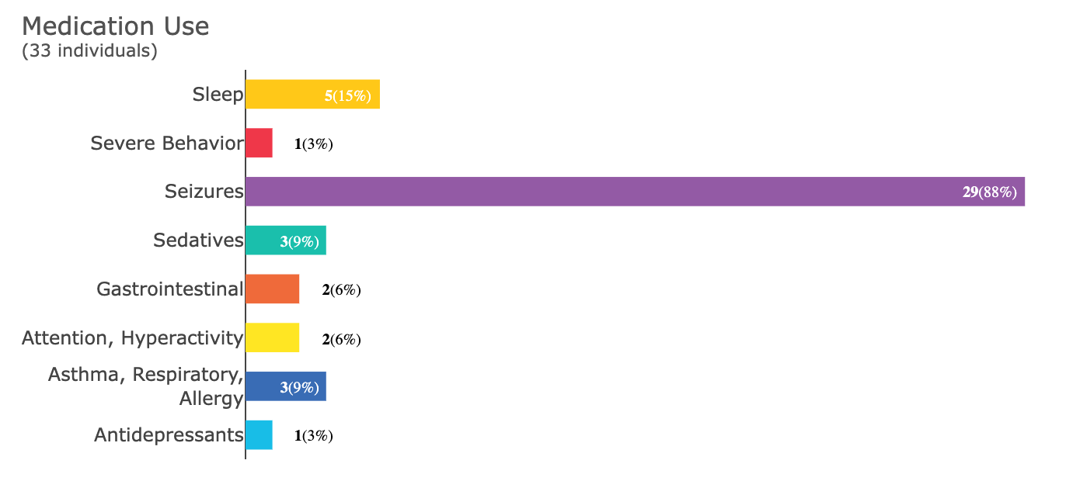
Notes:
Cancer type reported -

Slide 24
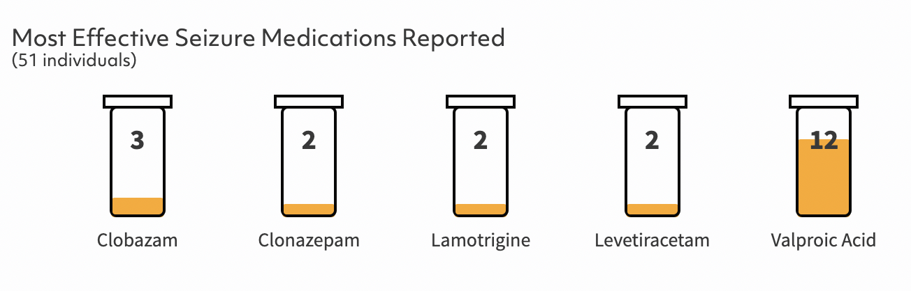

Slide 25
Vineland Adaptive Behavior Scales (Vineland-3)

Slide 26
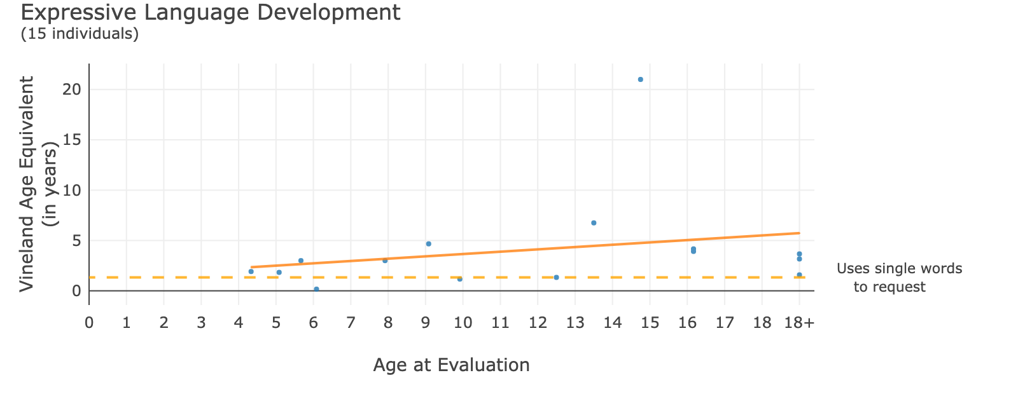
(16 individuals)
Each blue dot is a person
--- at this level, a person typically:
What does this mean as my child gets older?
Along the bottom is the actual age of the person
The dots are placed at the level at which they are expressing themselves
The diagonal line shows skills at older ages. As a person gets older, they may need help communicating.
* 1 outlier removed for data quality purposes
Notes:
We used a standardized measure called the Vineland Adaptive Behavior Scales to look at a model for development over time. This graph is like a growth chart. It shows age on the x-axis, and then each dot represents one person. xx individuals reported what they were able to do at a specific age which is shown on the y axis. When we plot them all together, we can see what people with SLC6A1 can do across ages.
This particular chart shows expressive language development, or the ability to verbalize to express yourself. The solid line shows the change with increasing age. This is a snapshot (cross-sectional) in time; and we aren’t saying everyone will be able to achieve these milestones exactly on the ages that we plotted. If everyone in SL fills out their Vineland every year, we will be able to plot true longitudinal growth in everyone. -- NOTE we are adding the ORCA for a finer-grained more inclusive measure of communication this coming year --
OR
ØEach dot is a person, and shows at what approximate age level they are functioning, at their current actual age
ØAll together, this graph shows what people with STXBP1 variants do at younger and older ages
ØThe dotted line shows the level where a person likely has speech

Slide 27
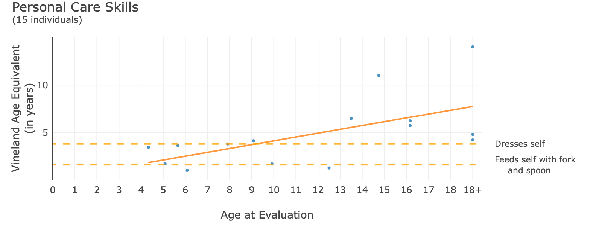
Each blue dot is a person
--- - at this level, a person typically:
What does this mean as my child gets older?
Along the bottom is the actual age of the person
The dots are placed at the level at which they are are able to care for themselves
The diagonal line shows more skills at older ages. As a person gets older, they may gain more independent skills.

Slide 28
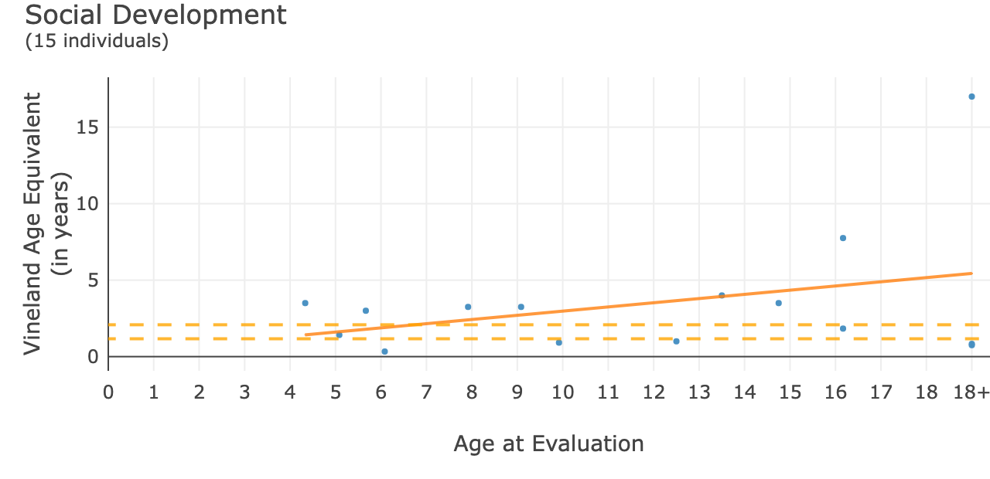
Each blue dot is a person
--- - at this level, a person typically:
Shows interest in friends
Makes eye contact during social interactions
What does this mean as my child gets older?
Along the bottom is the actual age of the person
The dots are placed at the level of their social behaviors
The diagonal line shows skills at older ages. As a person gets older, they may need support with interactions.

Slide 29
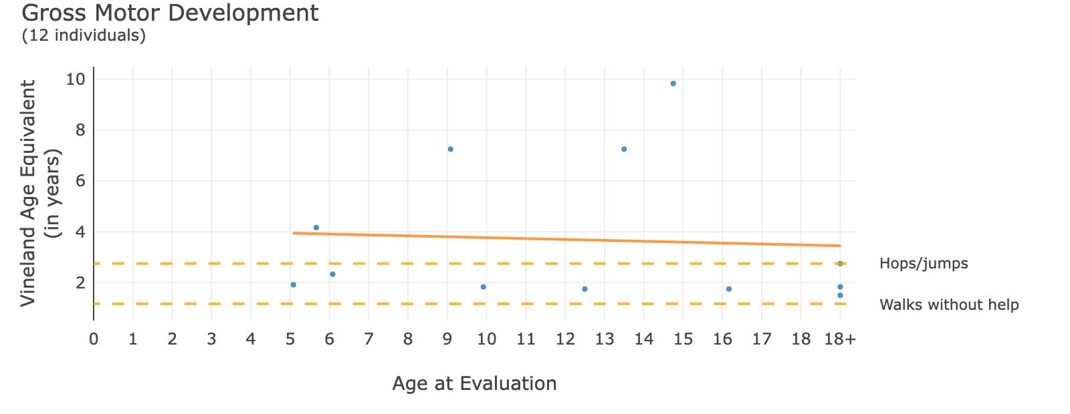
Note: This graph only shows children and individuals with delays. An additional 3 individuals (20%) may have higher level motor coordination, not shown here.
Each blue dot is a person
--- - at this level, a person typically:
What does this mean as my child gets older?
Along the bottom is the actual age of the person
The dots are placed at the level at which they are moving around, like walking
The diagonal line shows skills at older ages. Individuals are each different, and some need more support.

Slide 30
Child Behavior Checklist (CBCL)

Slide 31
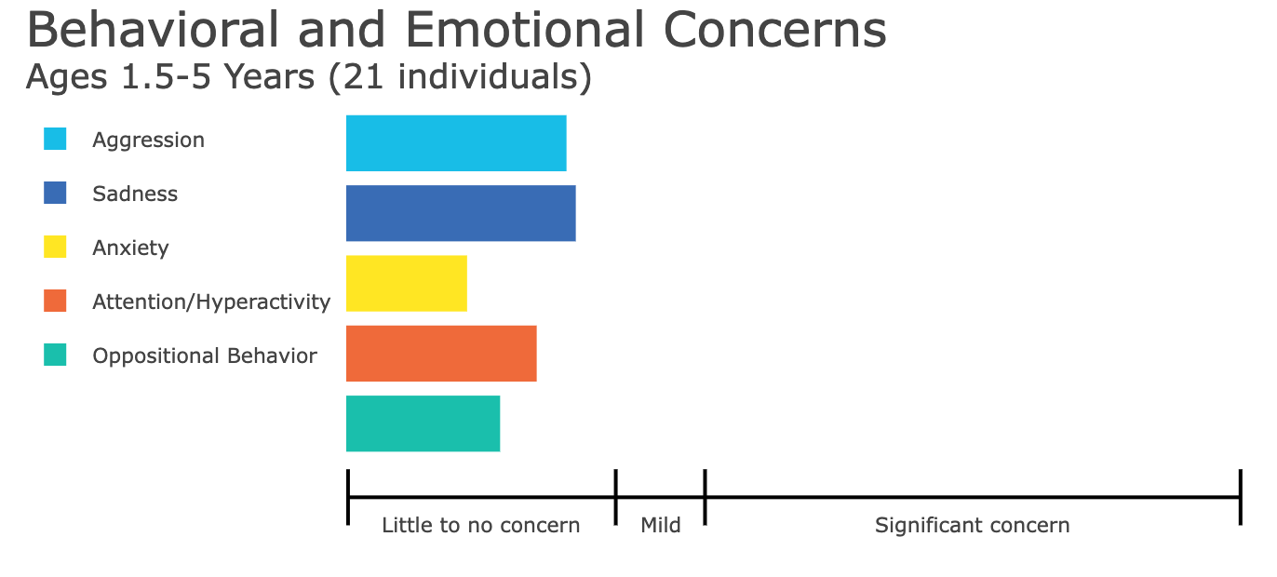
Child Behavior Checklist
Some individuals have more issues with mood such as crying, but overall as a group, young children with SLC6A1 do not have significant behavior issues.
Notes:
Group means

Slide 32
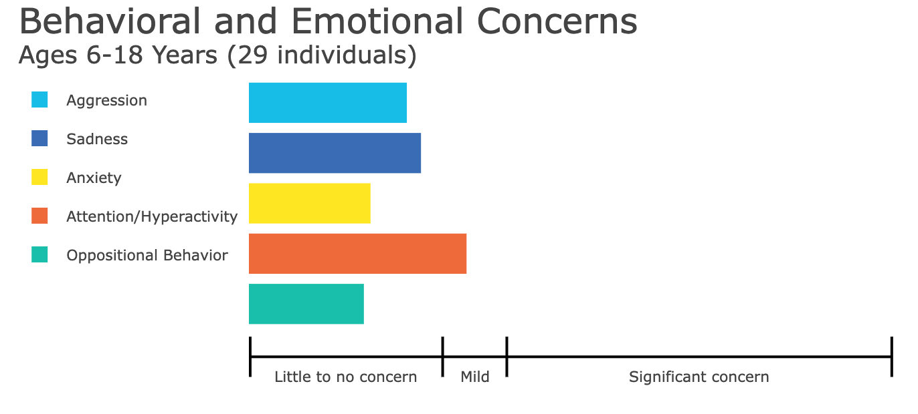
Child Behavior Checklist
Attention concerns are more common at school age, relative to expectations at that age
Notes:
Group means

Slide 33
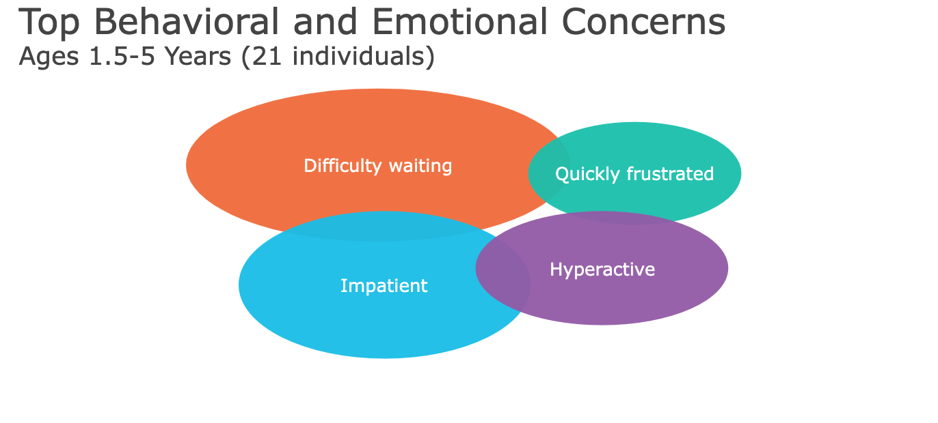
Child Behavior Checklist
Notes:
Group means

Slide 34
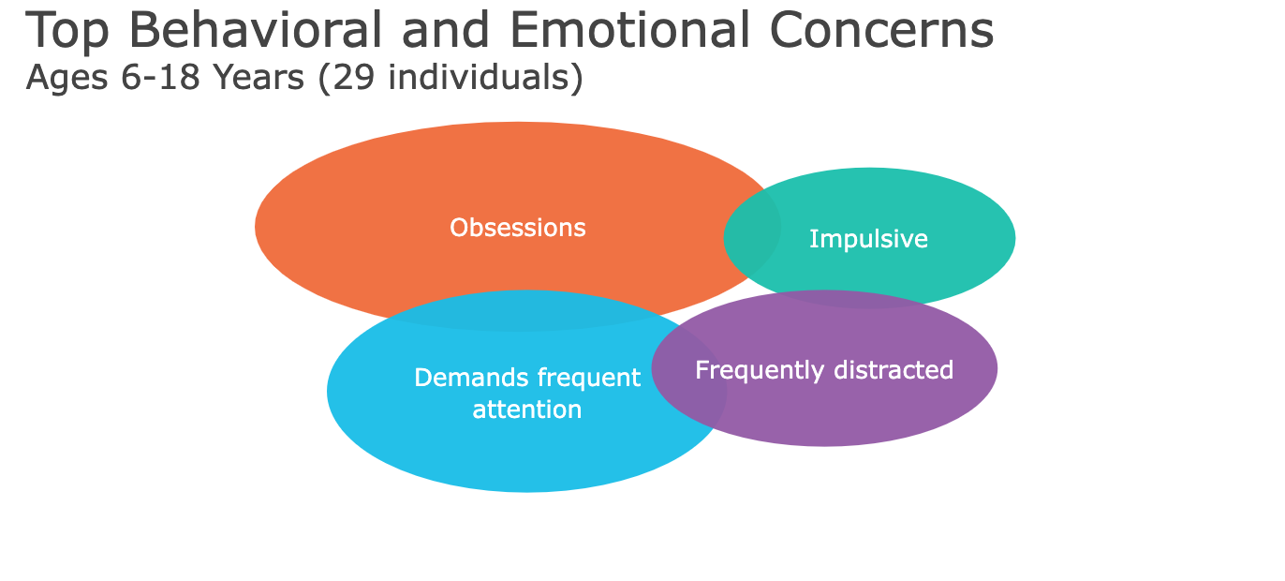
Child Behavior Checklist
Notes:
Group means

Slide 35

Summary: SLC6A1 Medical and Behavioral Phenotypes
Common issues
Other issues
Intellectual disability and developmental delay
Language delay
Autism
Hypotonia (low tone)
Seizures
Vision problems
Movement disorders
Impatient
Obsessive thoughts or behaviors

Slide 36
Quality of Life Survey

Slide 37



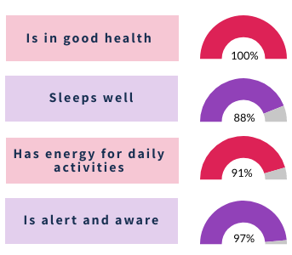
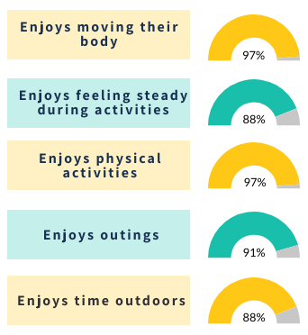
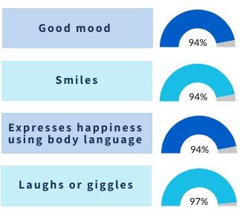
(33 individuals with SLC6A1)
We gratefully acknowledge Dr. Jenny Downs of the Telethon Kids Institute
Notes:
The Qi-Disability measures quality of life by looking at the following areas: physical health, psychological well-being, social relationships, leisure, and independence.

Slide 38


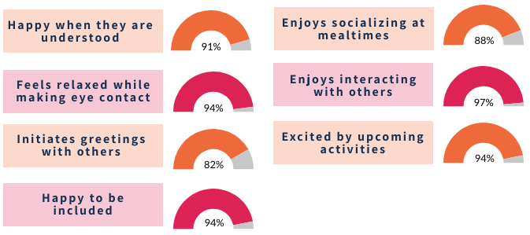
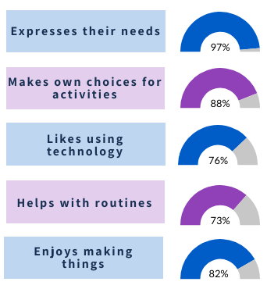
(33 individuals with SLC6A1)
We gratefully acknowledge Dr. Jenny Downs of the Telethon Kids Institute
Notes:
The Qi-Disability measures quality of life by looking at the following areas: physical health, psychological well-being, social relationships, leisure, and independence.

Slide 39

Thank you
Notes:
Whether you have not signed up or haven’t completed all the steps, joining Simon searchlight is a fairly straightforward process.
You sign up online you give us your genetics lab report that I talked about, you have a medical history phone call with our trained genetic counselor, and fill out your online surveys. We also offer support over the phone if you want assistance with any of these steps.
If you're interested in providing a bio specimen you can do that, and then importantly, following up with us over time So we can check in and see how everything's going and collect information on a yearly basis from you.
Overall, I want to highlight the general importance of research as well.
In addition to needing more numbers for research into these rare conditions, it's very important to represent YOURSELF in research.
Because the effects of all of these genetic variants can be different, you want to make sure researchers have their eyes on your particular experience.
And as far as a sense of urgency, why is it important to do this right now, the message continues to be how important it is to get your community ready. So having a research tool kit that includes natural history data, cell lines, mouse models, appropriate outcome measures, etc. If you have these components ready, you'll be in a good place to move forward as quickly as possible whenwhen opportunities for therapeutics arise.
Thank you again for including me in this conference, and I look forward to hearing from the other speakers.

