Slide 1

Patient Perspective:
Charlie’s Diagnostic Odyssey

Slide 2
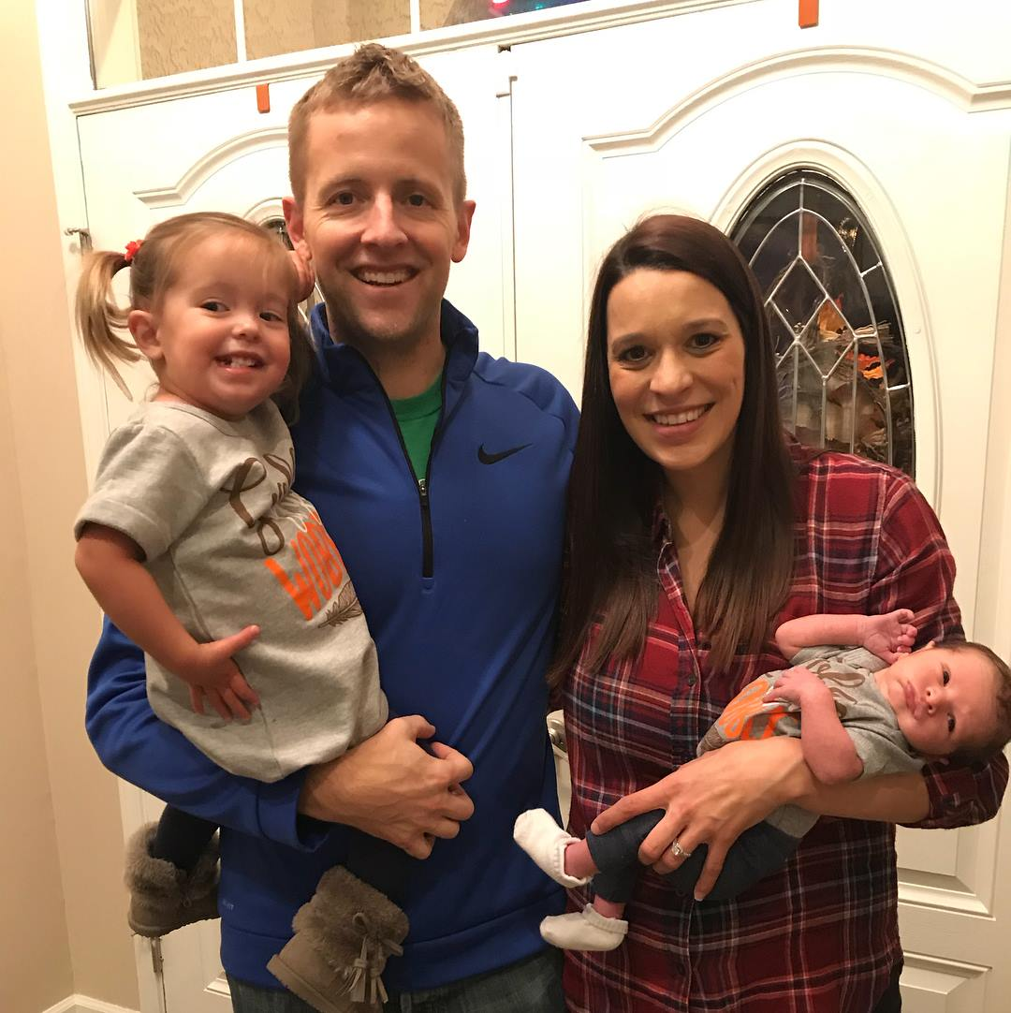
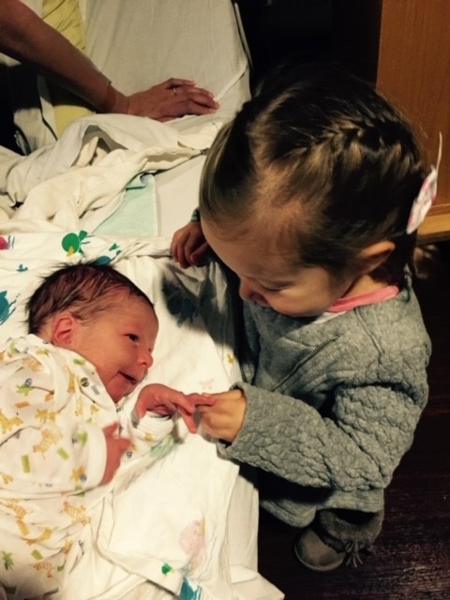
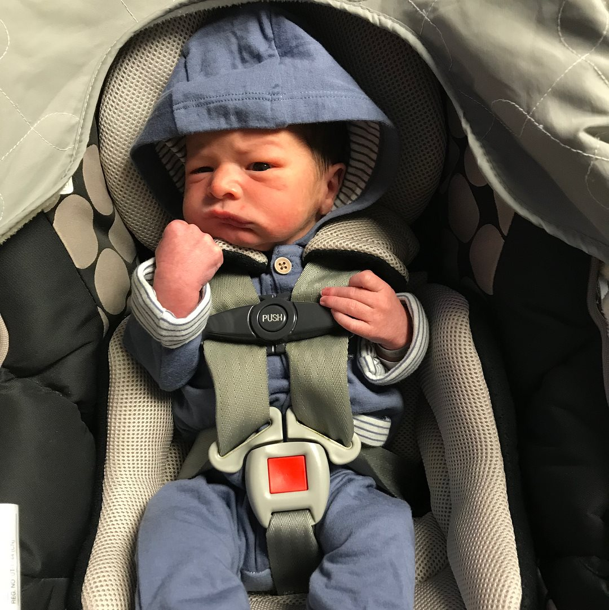
Family of 4

Slide 3
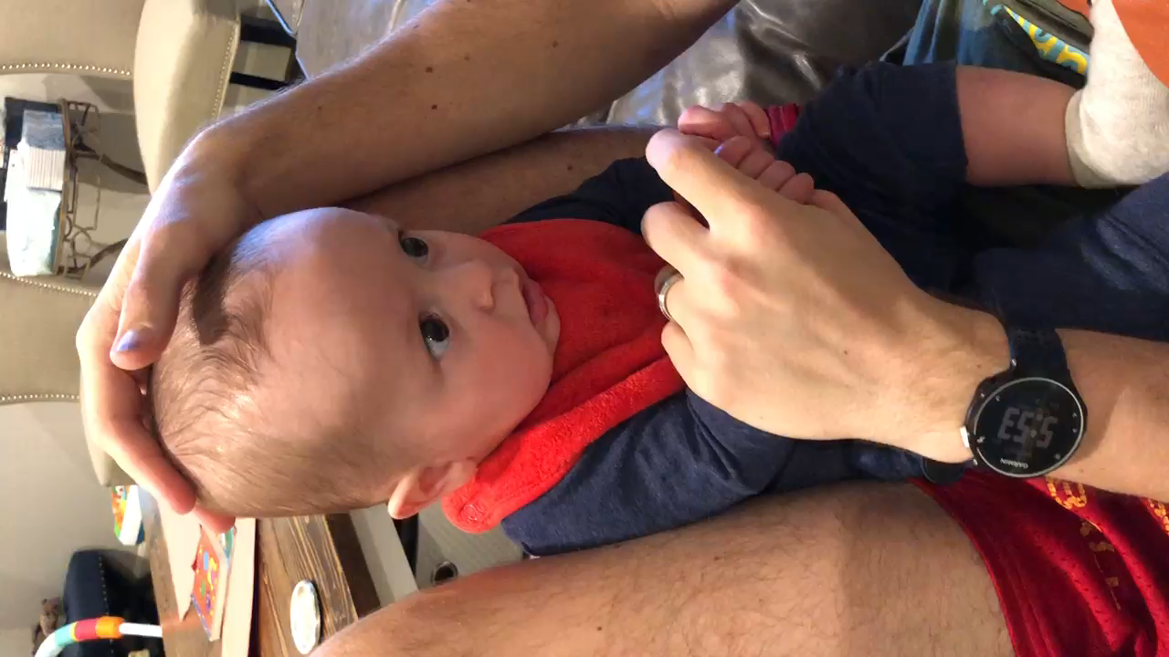

Slide 4
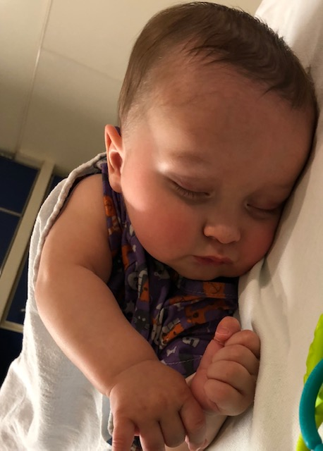
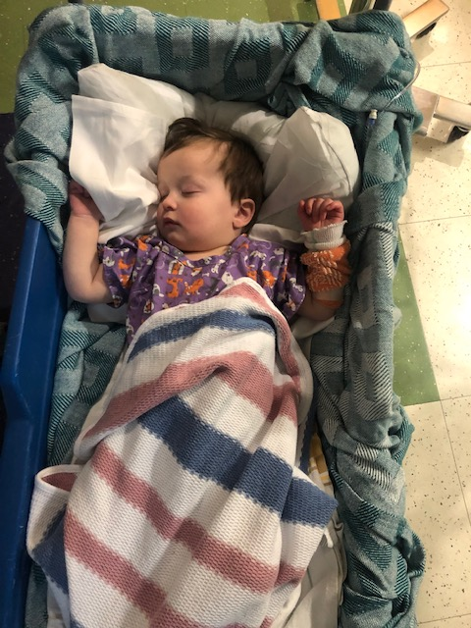
Our Struggle for Answers
Insurance denies Genetic Testing, determined not medically necessary. Appeals, determined not medically necessary.
Charlie begins missing almost every milestone. Tremors Daily.
16 months admitted to the hospital – Microarray testing approved –normal.
7 months – MRI
normal
15 months – Spinal Tap
normal
At 19 months we switch insurance and get the testing
approved through Invitae.

Slide 5
The Unimaginable Truth
The Phone Call…
On August 22 I received a call from our counselor
that would change everything.
He has a variant in his SLC6A1 gene and is 1 of 32 patients
in the world with this disease.

Slide 6
Named Our Demon
We now know why Charlie…
Tremors daily
Has staring spells and eye flutters
Struggles holding a spoon and self feeding
Misses nearly every milestone
Has a lack of impulse control and is aggressive
Debilitating Anxiety
Is cognitively unable to keep up with his peers

Slide 7
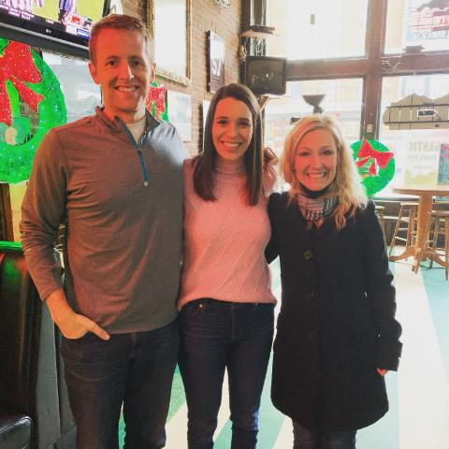
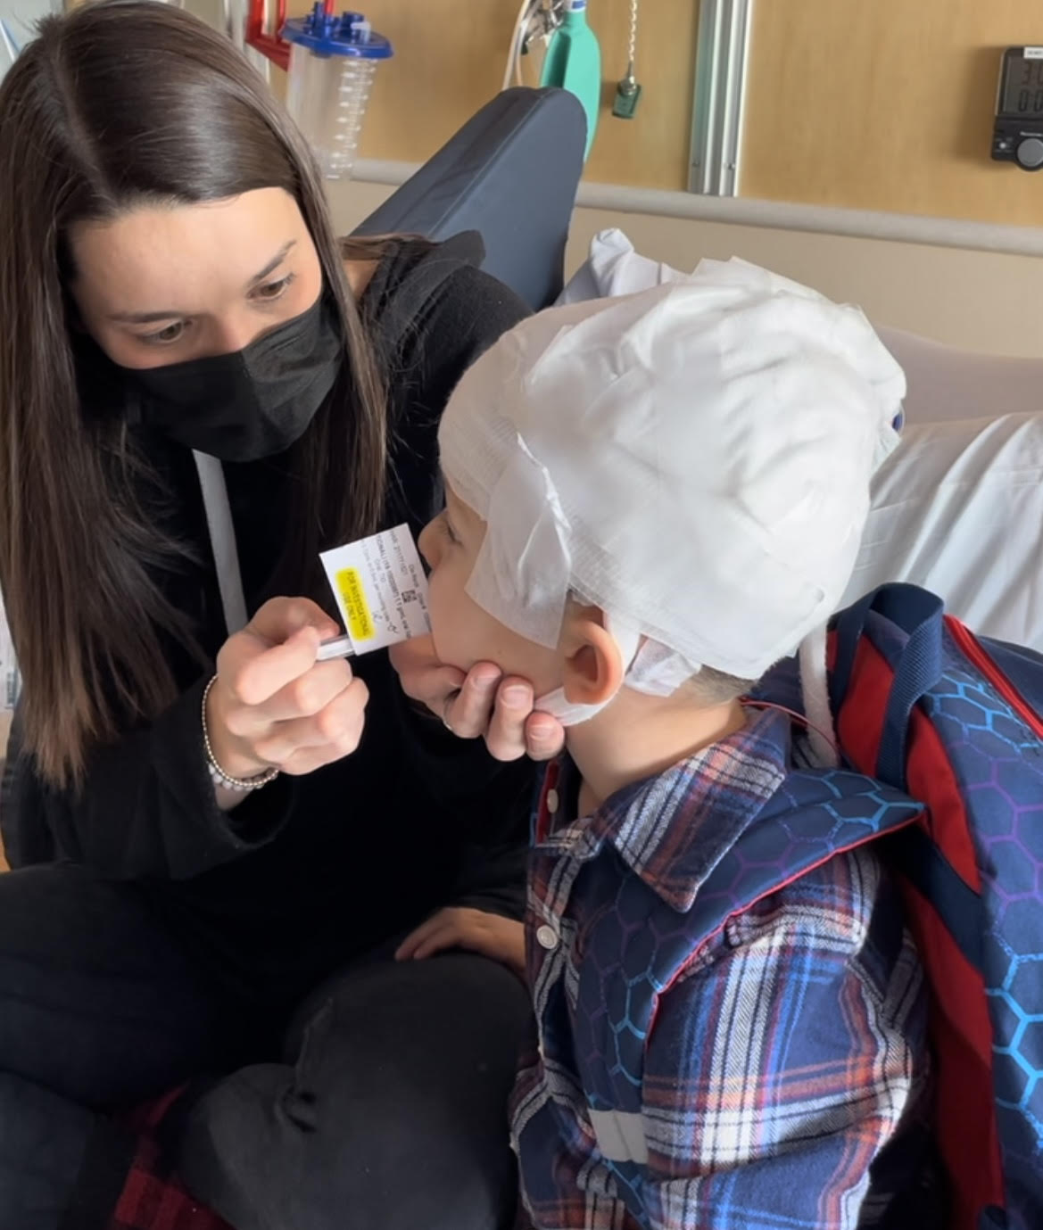
A Path Forward
3 years later…
Improved care and quality of life
Joined Amber and SLC6A1 Connect
Support medical research in order to develop a cure
Connected to Citizen and Simon Searchlight
Assist in fundraising and advocate for new treatments
Participate in the Natural History Study and Ravicti Clinical Trial

Slide 8
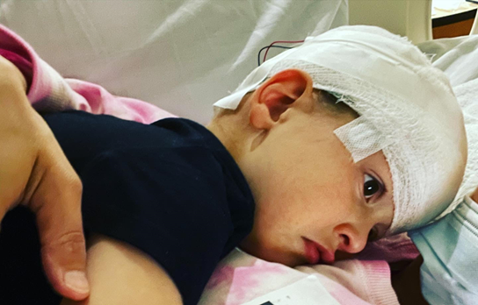
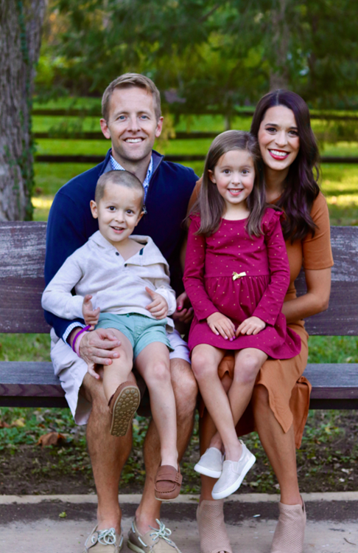
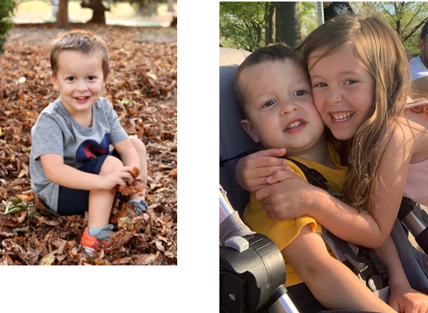
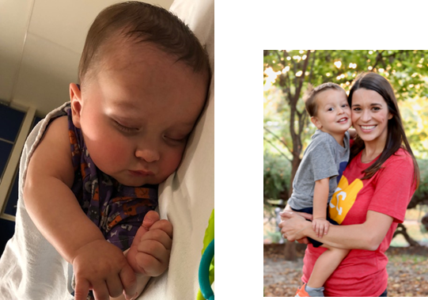
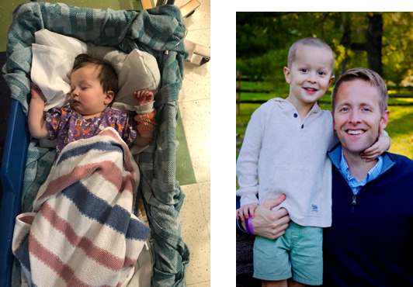
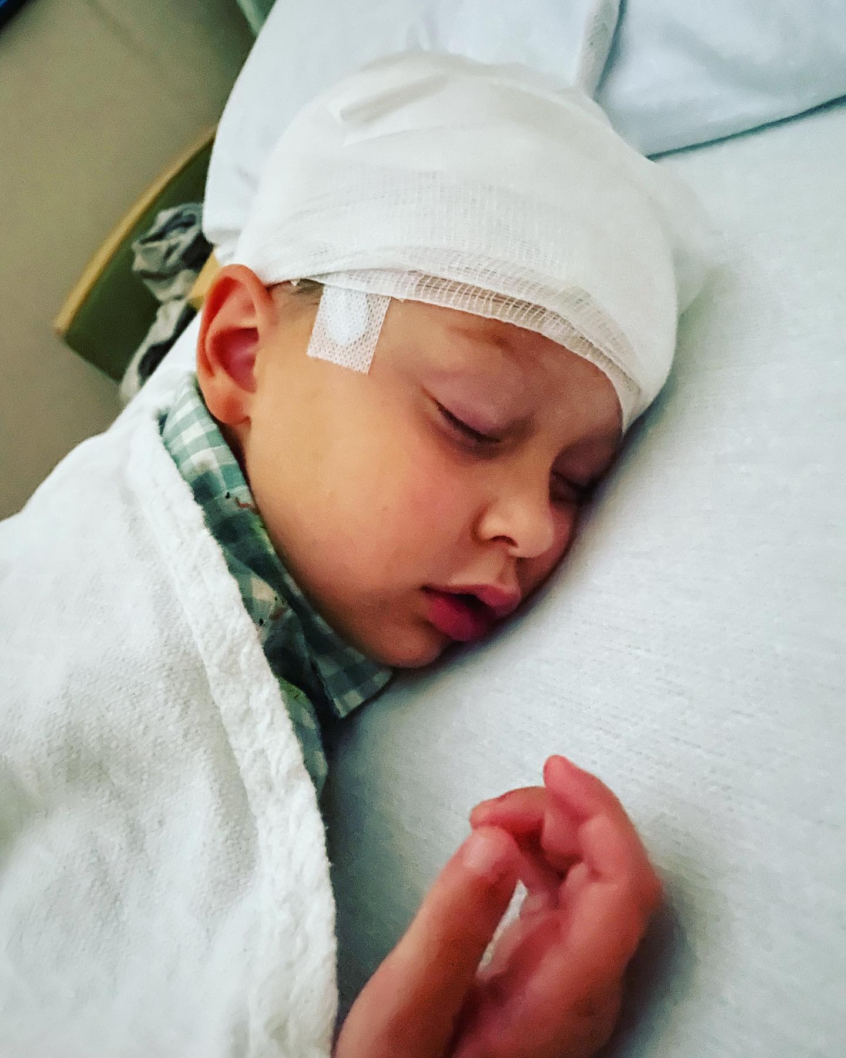
Because of YOU we can be the CHANGE

