Slide 1
SLC6A1 Connect
2022 Symposium

Slide 2

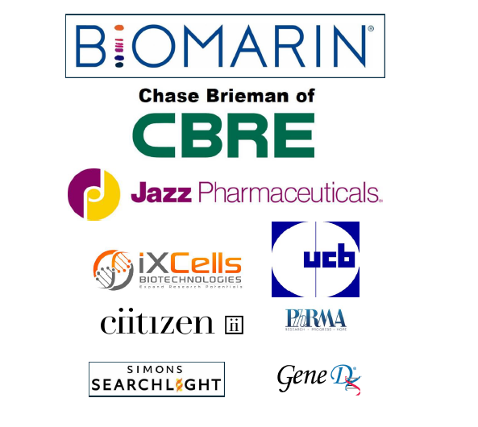
Thank you!

Slide 3
SLC6A1 Mission
SLC6A1 Connect is a patient advocacy group dedicated to improving the lives of children and families affected by SLC6A1.
Our focus is to raise awareness and fundraise to advance scientific research that will ultimately result in a cure.

Slide 4
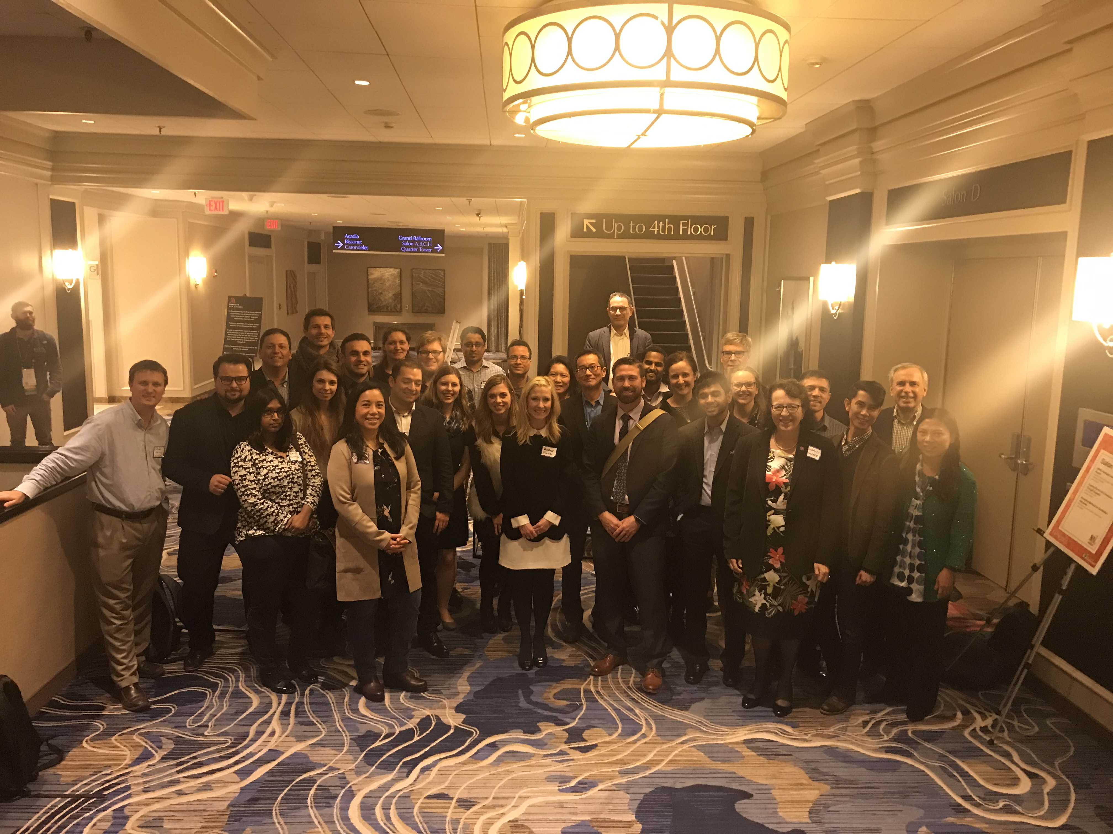
Where we Started
2018

Slide 5













4 Years Later…..
Raised Millions philanthropically
Built a Full Scientific DREAM Team
Mobilized all Effected Families
Funded a Drug Repurposing Trial
Multiple DNA Gene Therapy Programs Funded
Multiple RNA Therapies Programs Funded
Models for Days
WE HAVE HOPE

Slide 6
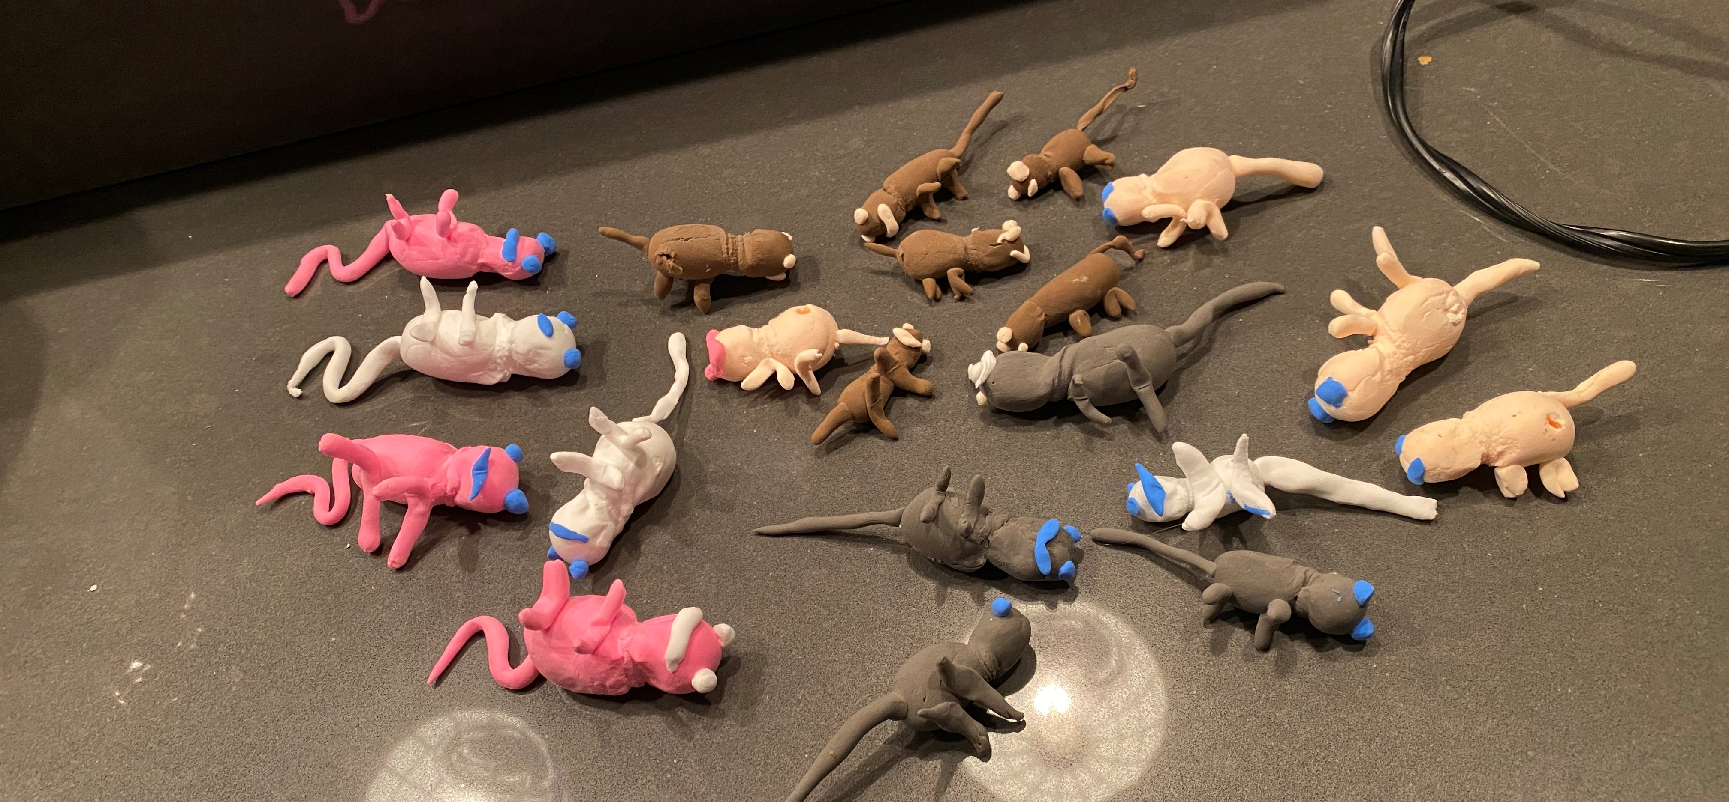
No More Crafting….

Slide 7
We are the Amazon of Rare Disease
Knockout Mice
2 Point Mutation Mice
Conditional Mouse (Lox Stop)
Human Derived iPSC Models
Patient Fibroblasts
GABAergic Neurons
Simons Searchlight
Ciitizen
AllStripes
These Tools are Unencumbered
Please Use Them

Slide 8
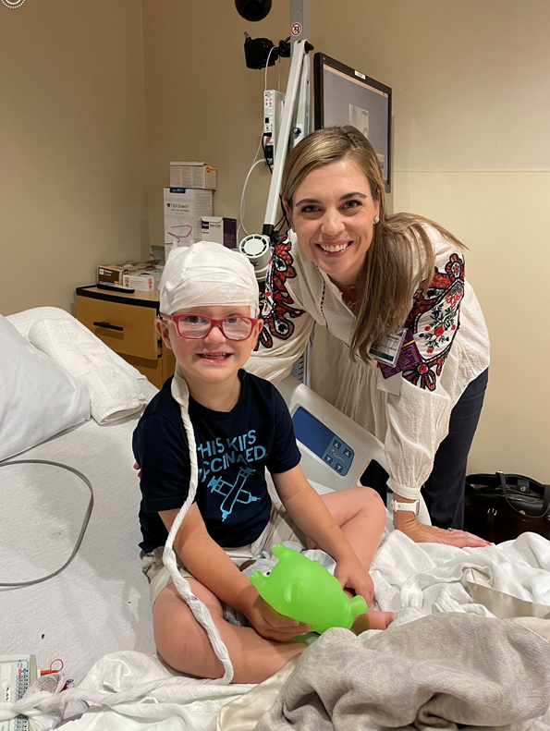
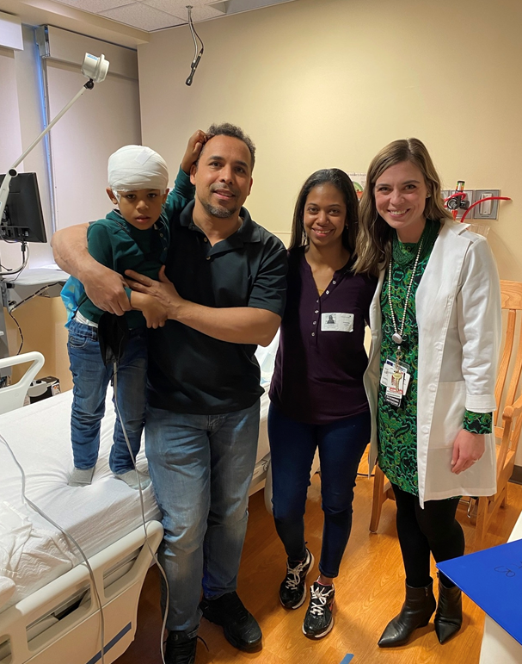
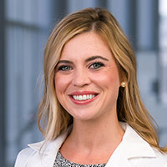
Our Natural History Study is Fully Enrolled

Slide 9
Virtual Monthly Lab Meeting

Slide 10

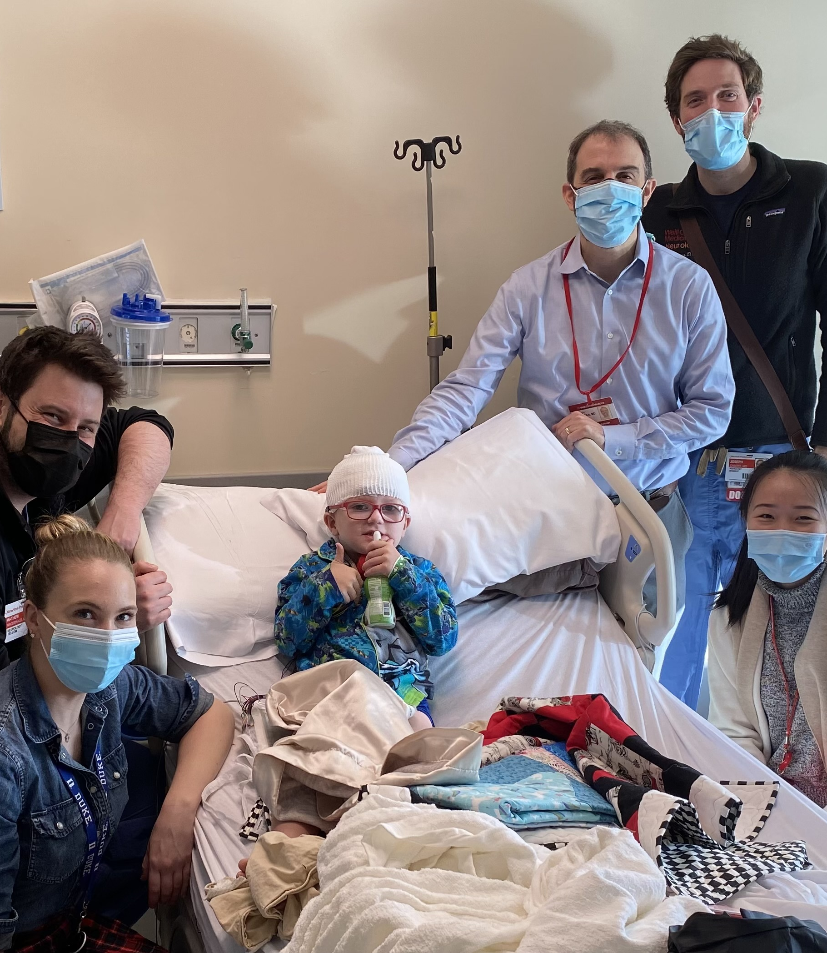
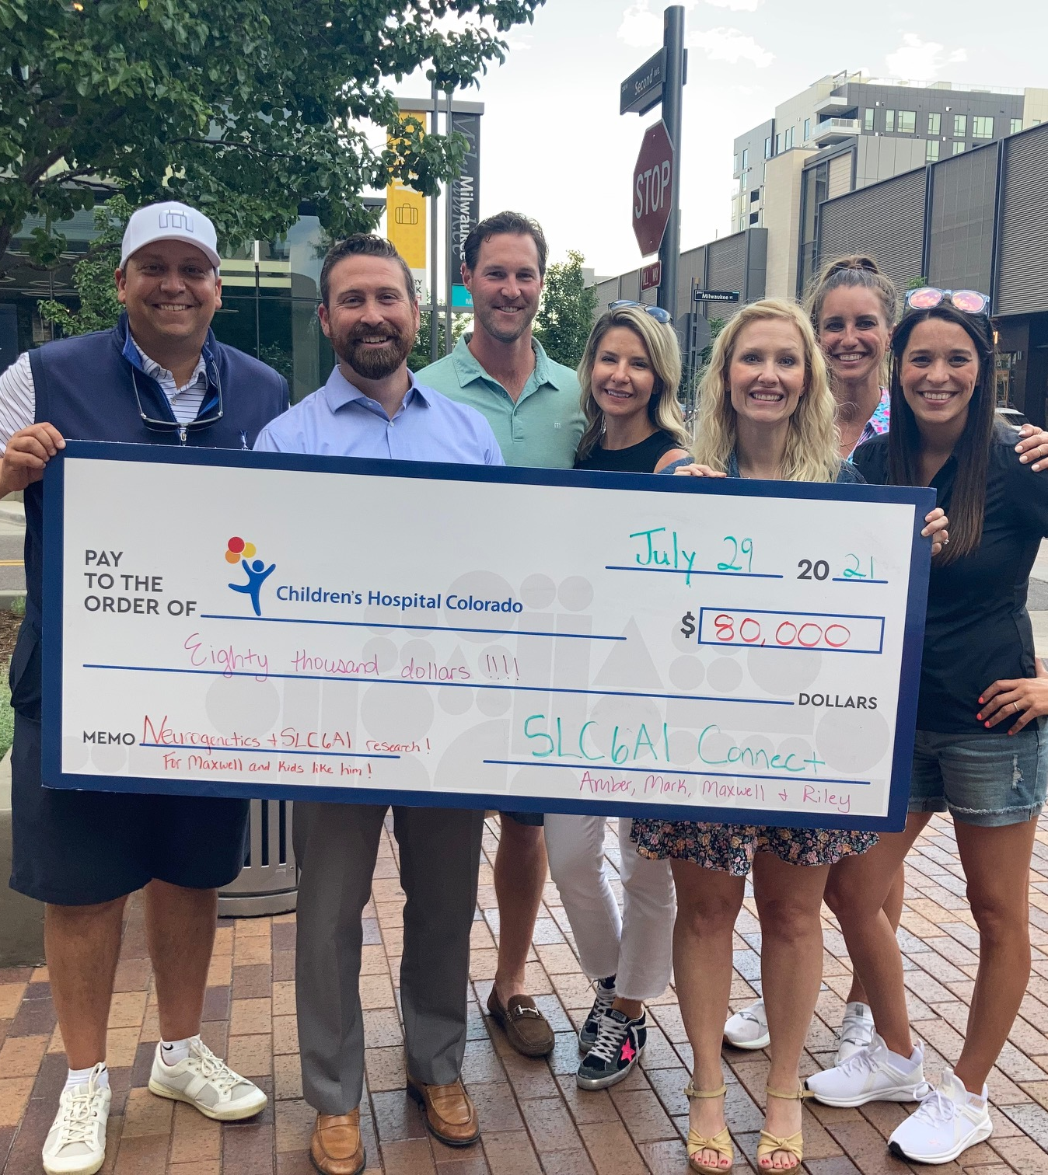
Drug Repurposing Trial

Slide 11

SLC6A1 Connect Beliefs
“The People Living with the Condition are the Experts.”
- Michael J. Fox

Slide 12
Addressing the Hard Stuff
Pursue Every Option with Equal Intensity
Wide Phenotypic Range = Creative Endpoints
No One Likes the Thought of Placebos
Biomarkers

Slide 13
Parent Resource Room
11:15am – 11:35am
12:15pm-12:40pm

Slide 14

Nudies Honkey Tonk!
Grab a Bracelet – this is an exclusive event

Slide 15
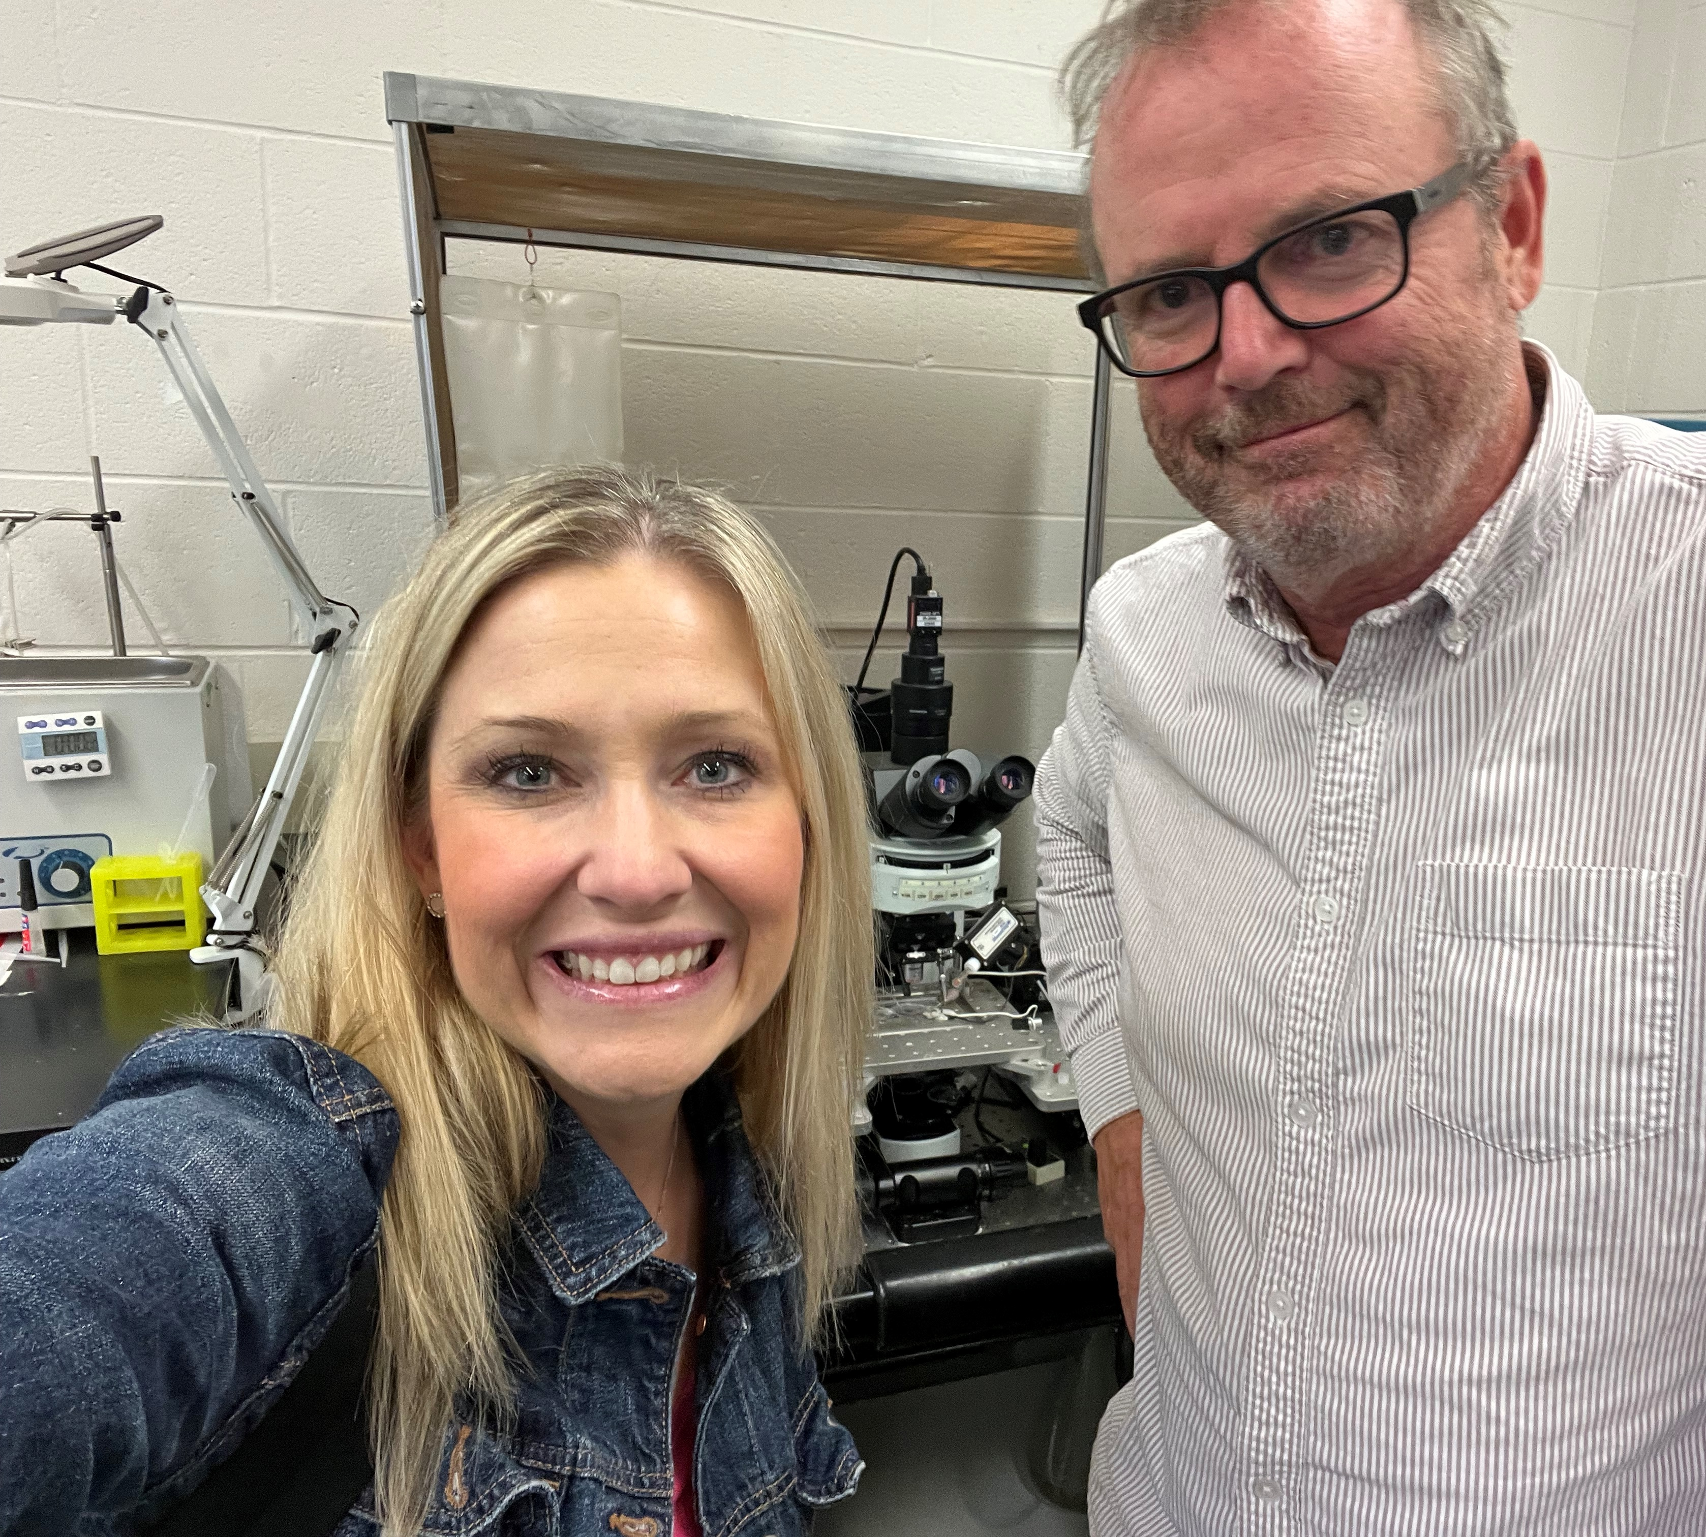
Scientific Champion of 2022

Slide 16
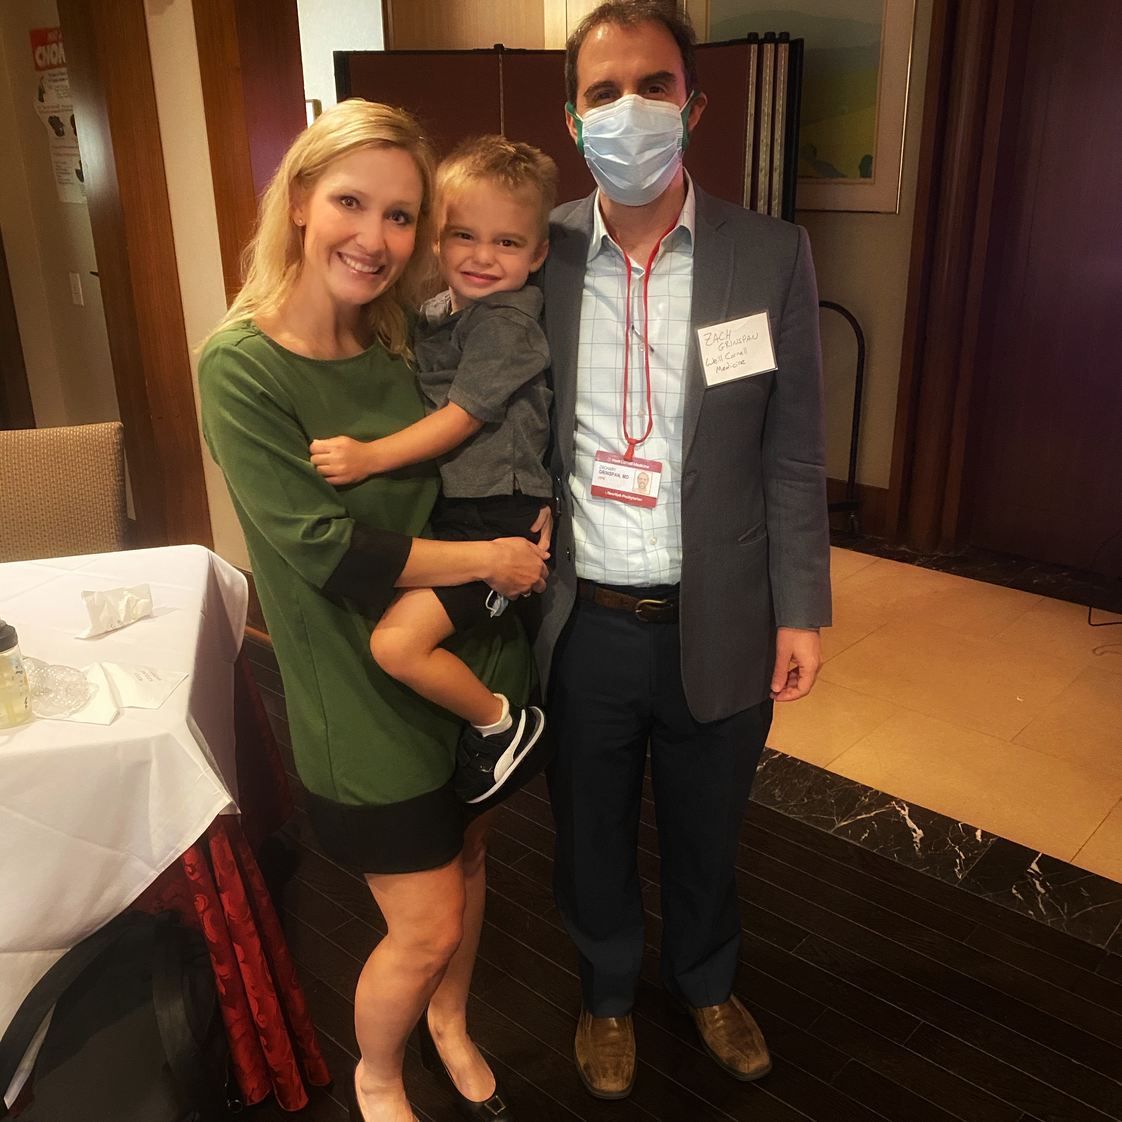
Scientific Champion of 2022

Slide 17

Volunteer of the Century

