Slide 1
Phenylbutyrate for STXBP1 and SLC6A1
Zachary Grinspan MD MS
Interim Chief of Child Neurology
Director of Pediatric Epilepsy
Departments of Pediatrics and Population Health Sciences
Weill Cornell Medicine
STXBP1 Conference Aug 2022

Slide 2


TEAM
Weill Cornell Medicine
  Zachary Grinspan MD MS
  Jacqueline Burré PhD
  Jennifer Cross MD
  M Elizabeth Ross MD PhD
  Guoan Zhang PhD
  Kerry Gao
  Natasha Basma, MPH
Children’s Hospital Colorado
  Scott Demarest MD
  Elizabeth Dubow MD
  Alexandra Lamar
  Flor Abila

Slide 3






THANK YOU!!!!

Slide 4
SLC6A1 Neurodevelopmental Disorder
Nearly all have epilepsy (91%; typically generalized)
Most with developmental delay / cognitive impairment (82%)
Hypotonia (79%)
Substantial minorities with autism spectrum disorder, movement disorder, problems with attention or aggression, high pain tolerance, sleep problems
SLC6A1 protein product = GABA transporter protein type 1 (GAT-1)

Slide 5
STXBP1 Encephalopathy
Nearly all have epilepsy (95%)
Seizure freedom for 1 in 3 patients; 1 in 3 remain therapy resistant.
Intellectual disability in all (88% severe to profound)
20% autism or autistic features
Other features: axial hypotonia, ataxia or ataxic gait, tremor, spasticity and dyskinesia, or dystonia.
MRI Brain normal in half. Others have cerebral atrophy (33%), thin corpus callosum (16%), hypomyelination (16%).
STXBP1 = Munc18-1; regulates synaptic vesicle tracking & docking

Slide 6
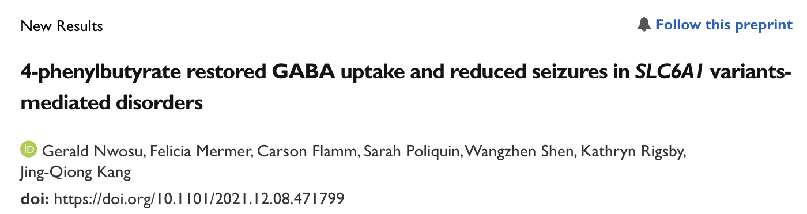
STXBP1

Slide 7
Sorbitol and Trehalose – Sugars
Phenylbutyrate – FDA Approved for urea cycle disorders & crosses blood-brain barrier
Sodium phenylbutyrate
Glycerol phenylbutyrate

Slide 8
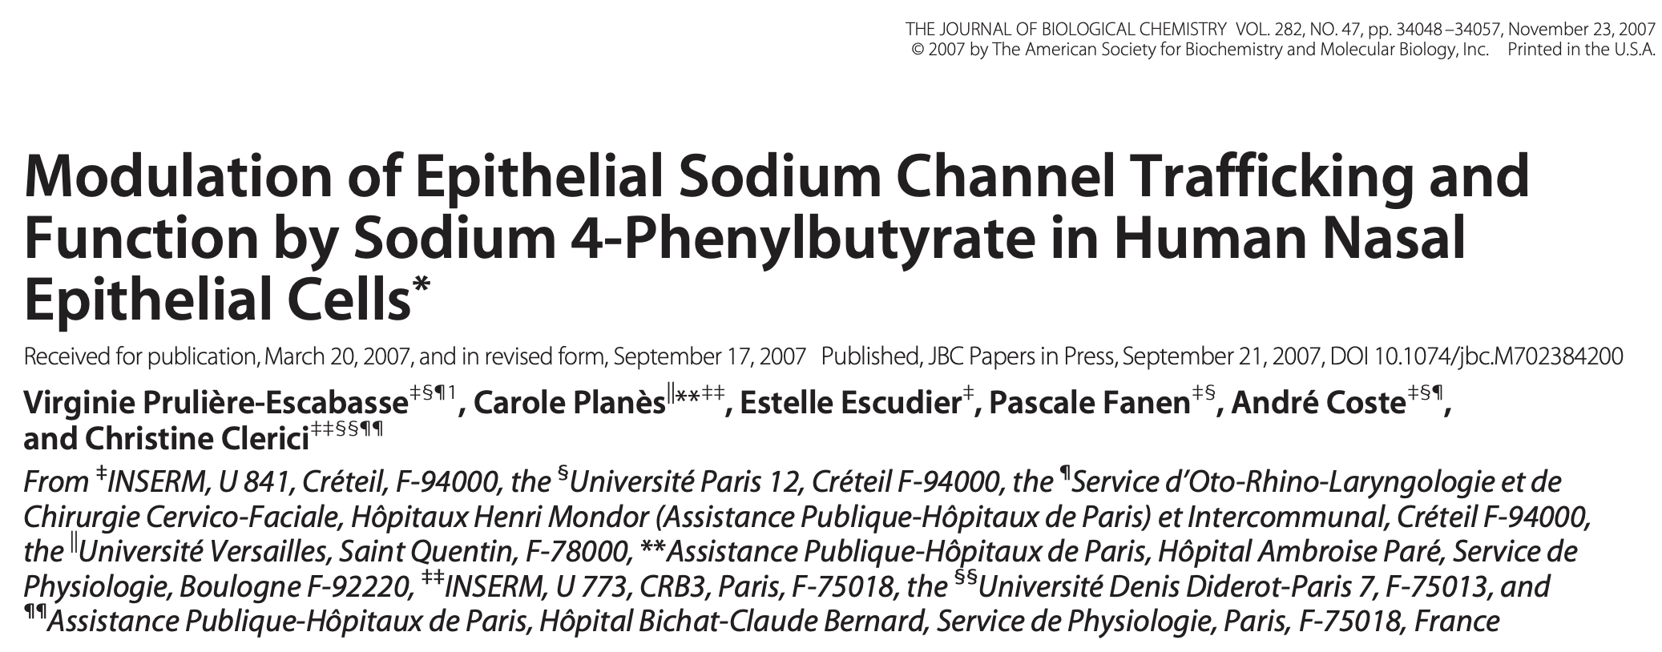
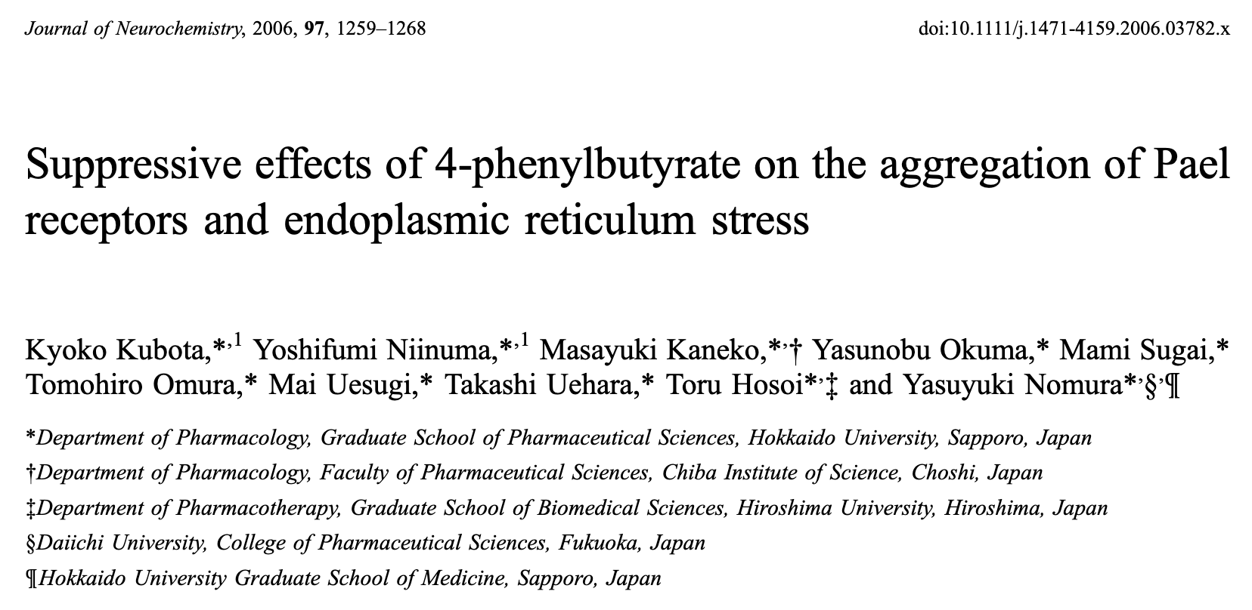
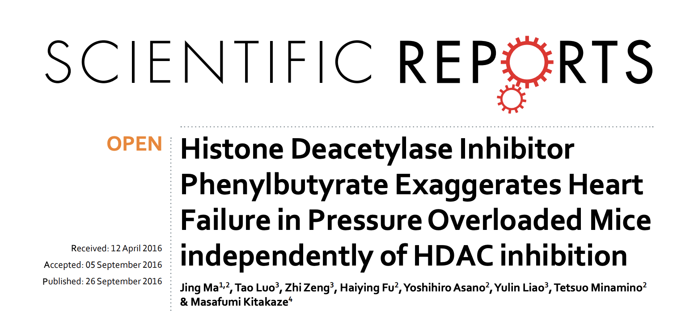
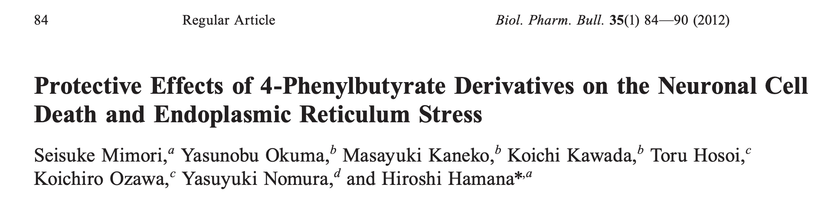
Phenylbutyrate
Mechanisms

Slide 9
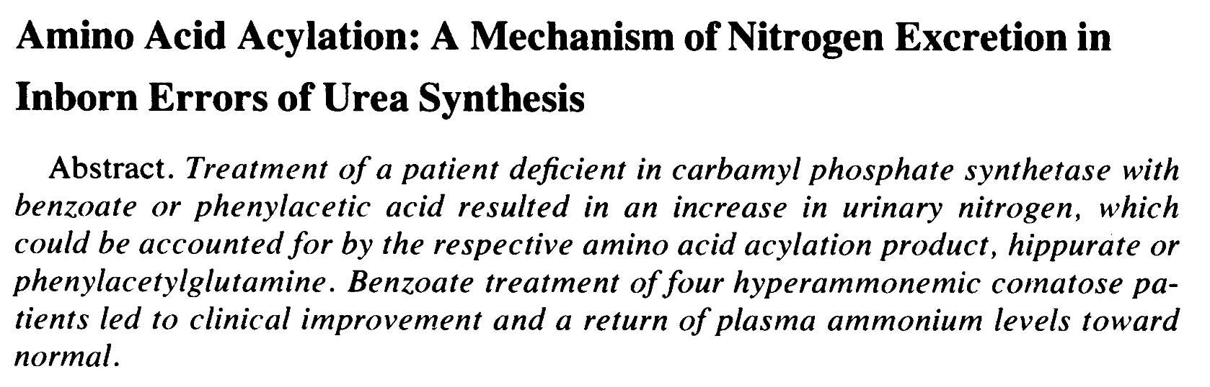
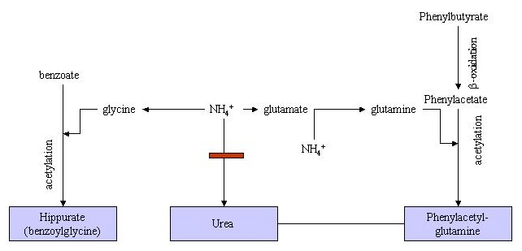
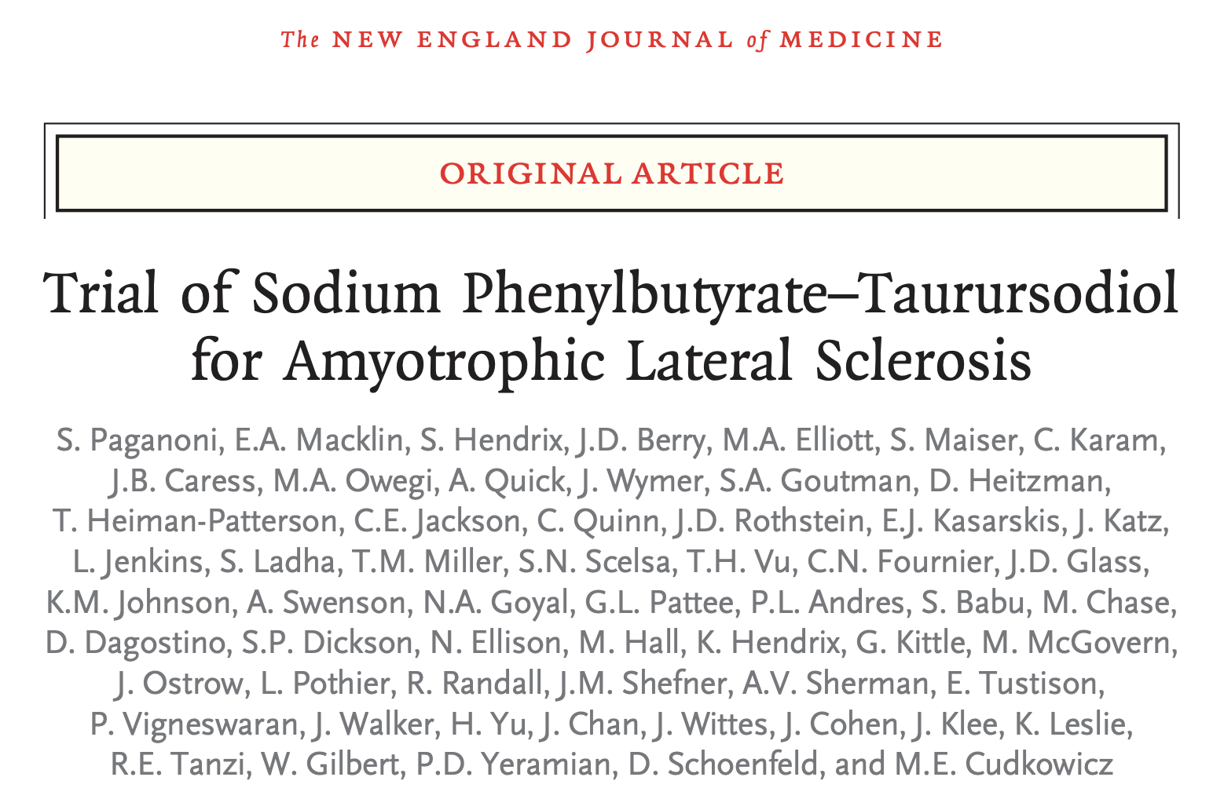
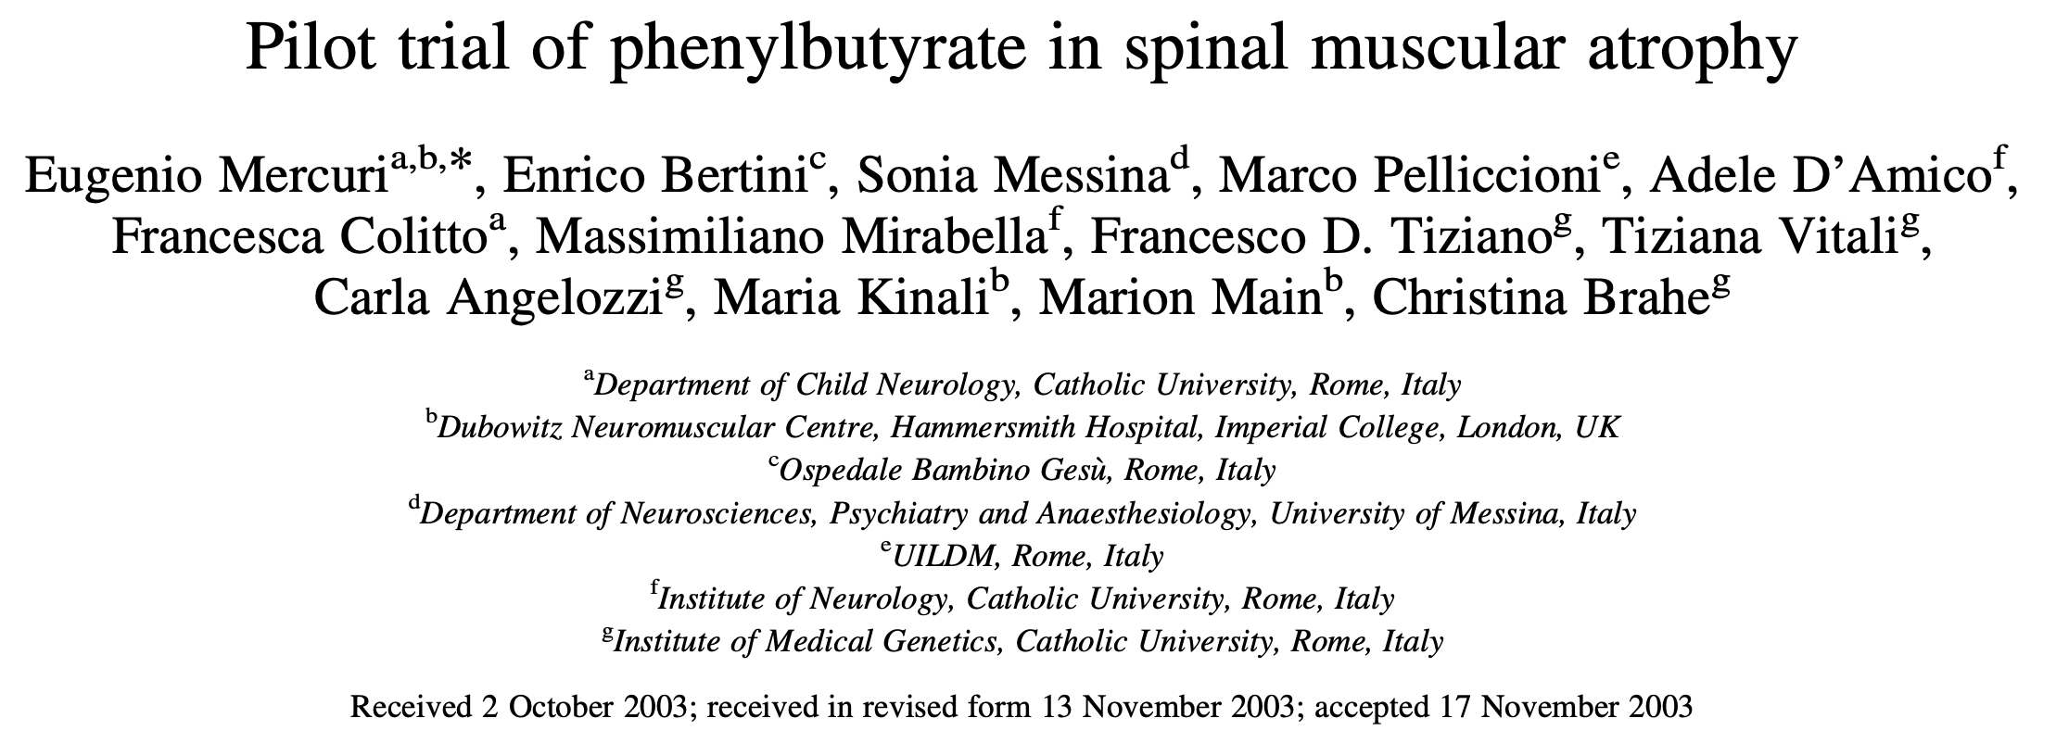
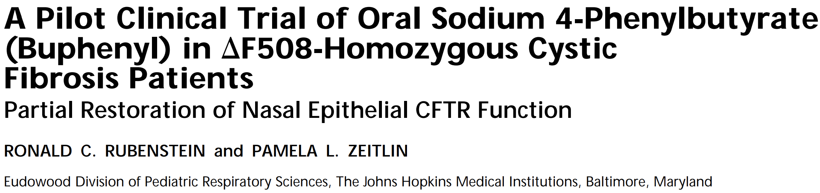
UREA CYCLE DISORDERS
Phenylbutyrate
Clinical Track Record

Slide 10
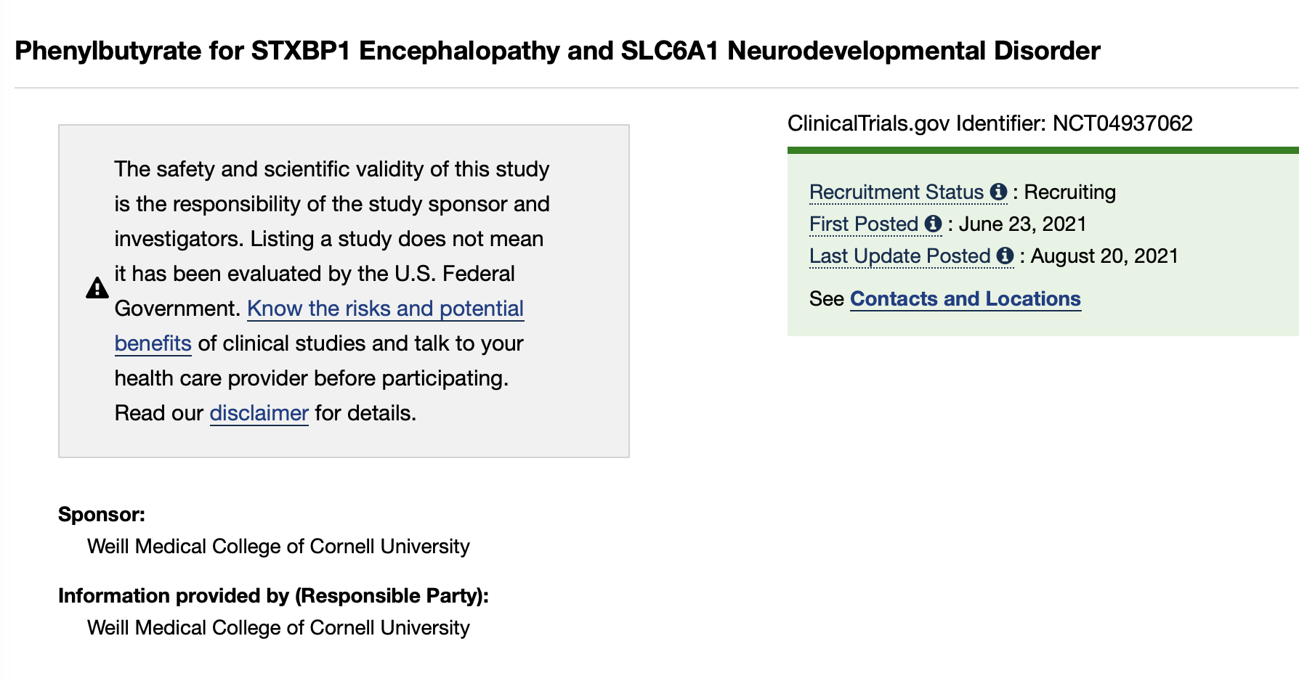
Goal enrollment: 20 children
10 STXBP1
10 SLC6A1

Slide 11
Inclusion / Exclusion
Inclusion
  2 month to 17 years with STXBP1-E and seizures
  2 month to 17 years with SLC6A1
  (preference for younger children)
Exclusion
  Taking alfentanil, quinidine, cyclosporine, or probenecid (known interactions with PB).
  Hepatic, renal, pancreatic insufficiency.
  Inborn errors of beta oxidation.
  Pregnancy
  Known hypersensitivity to phenylbutyrate
  Intestinal malabsorbtion
  Enrolled in another study within past 30 days

Slide 12
Safety & Tolerability
Known side effects
  Amenorrhea / menstrual dysfunction, decreased appetite, GI upset, sweet body odor, constipation, rectal bleeding, pancreatitis, aplastic anemia, arrhythmia, renal tubular acidosis, metabolic acidosis, rash, and somnolence.
  Confusion or change in mental status.
Drug interactions
  Phenylbutyrate may reduce the effectiveness of midazolam, which is often used as an anti-seizure medication.

Slide 13
Exploratory Outcomes
Seizure burden
EEGs abnormalities
Quality of Life (PEDSQL, PELHS-QOL-2)
Development (Vineland)
Communication (ORCA)
Behavior (ABC)
Sleep (CSHQ)
Qualitative description of abnormal movement captured on video
Caregiver qualitative experience

Slide 14
Study Design
8 weeks exposure to drug
(4 days up-titration, 2 weeks down-titration)
OPTION FOR EXTENDED USE
4 weeks
weekly phone calls
6 weeks
Full dose
2 weeks taper
2 weeks follow up
ENROLLMENT
ADMISSION #1
(brief up-titration)
Weill Cornell Medicine, NYC
ADMISSION #2
Weill Cornell Medicine, NYC

Slide 15
Early Results

Slide 18
NONSEIZURE OUTCOMES (at 10 weeks, preliminary)
Communication (ORCA). 8 of 11 with improvement.
Sleep (CSHQ). 5 of 12 with improvement.
Quality of Life (PedsQL). 4 of 11 with improvement.
EEG changes (next slides)

Slide 19
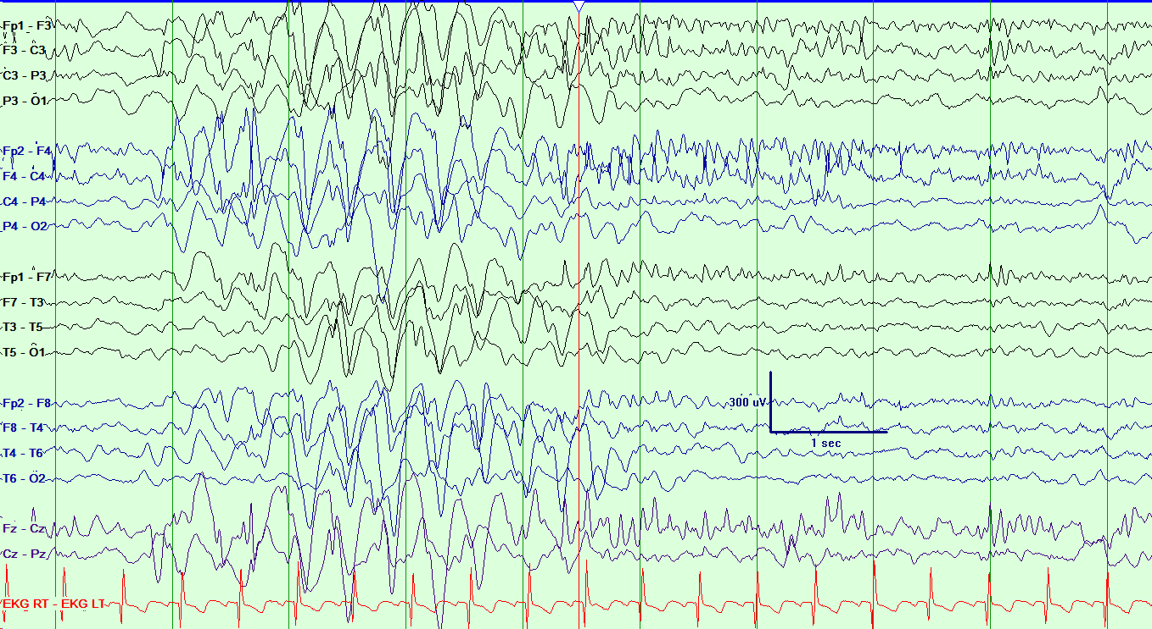
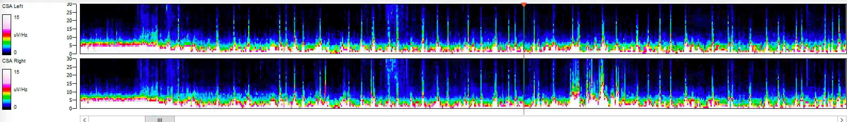
5 year old boy with SLC6A1, initial EEG

Slide 20
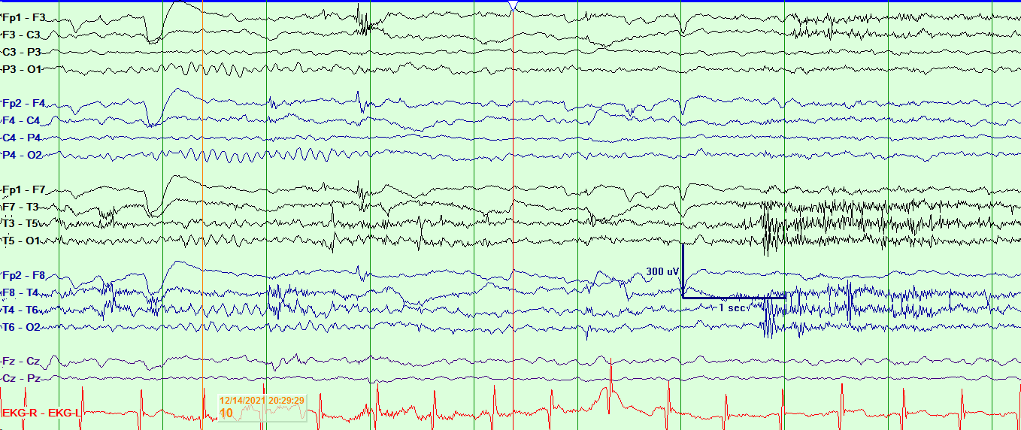
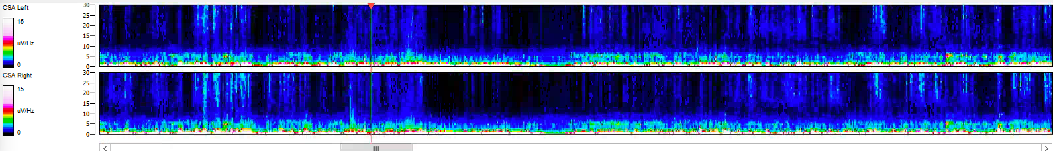
5 year old boy with SLC6A1, follow up EEG

Slide 21
Qualitative Findings
Safety -- no novel adverse events
  Odor, Sleepiness, Appetite Suppression
  One child with metabolic acidosis withdrew
Tolerability
  Few to none missed doses
Effective for tonic seizures, absence seizures, not epileptic spasms
Parents often report increased engagement, alertness

Slide 22
Limitations
Open label study
Absence / staring spells not clearly seizures in some children
Absence / staring spells are not countable

Slide 23
Next Steps
Full analysis pending
Working to obtain new sources of phenylbutyrate (industry, academia)
Considering expansion to additional rare diseases (SYNGAP1, SLC6A8, others)
EEG changes need to be quantified
Definitive trial?

Slide 24
THANK YOU!!!!

Slide 26








