Slide 1
NIH Funding Mechanisms
Vicky Whittemore, PhD
NINDS/NIH
SLC6A1 Connect International Symposium
December 1, 2022

Slide 2
NINDS Support for Research
Division of Clinical Research
Division of Neuroscience
Division of Translational Research (Including ETSP)
NINDS

Slide 3
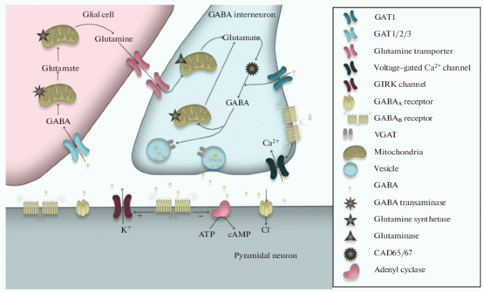
NIH Support for SLC6A1 Research
$636,601 in research funding on SLC6A1 in
FY2022
Two grants supported by NINDS:
  Developing a zebrafish model of
  Slc6a1/GAT1 hypofunction and an in vitro assay to identify novel treatments
    Christopher McGraw, K08NS118107-03
  Promoting Protein Trafficking with 4-phenylbutyrate to Treat Genetic Epilepsy
    Jing-Qiong Kang, R01NS121718-01A1

Slide 4
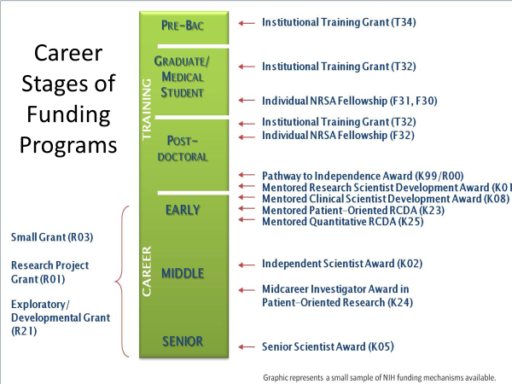
NIH Funding Mechanisms

Slide 5

Basic Science Funding Opportunity Announcements (FOAs)
Fellowships (F Awards)
Research Awards
  R21
  R01
  R35
  RM1
  P01
F30
F31
F32
Career Development Awards
K01
K08
K23
K99/R00
https://www.ninds.nih.gov/current-research/research-funded-ninds/neuroscience-research

Slide 6

New NINDS Interdisciplinary Team Science Initiative
Encourages interdisciplinary teams of experts
Requires a Multi-PI (MPI) structure with 3-6 PD/PIs,
Diverse teams, inclusive of all neuroscientists at all careers stages, to challenge existing paradigms, overcome long-standing roadblocks to progress, and/or develop new synergies across different scientific fields
Support for a single research plan with a single focus that is cohesive and well-integrated
NINDS Interdisciplinary Team Science (RM1 Clinical Trial Optional) (RFA-NS-22-036)
https://grants.nih.gov/grants/guide/rfa-files/RFA-NS-22-036.html

Slide 7

Diversity Funding Opportunity

Slide 8

NINDS Translational Research Initiatives
Neuroscience Biomarker Program
Innovation Grants to Nurture Initial Translational Efforts (IGNITE) Program
Epilepsy Therapy Screening Program (ETSP)
Blueprint Neurotherapeutics Network (BPN) Program
Blueprint Neurotherapeutics Network for Biologics (BPN-Biologics) Program
Translational Devices
Ultra-rare Gene-based Therapy (URGenT) Network
Small Business Innovation Research (SBIR) and Small Business Technology Transfer (STTR)
Biomarkers
Small molecules
Devices
Gene Therapy
https://www.ninds.nih.gov/current-research/research-funded-ninds/translational-research

Slide 9
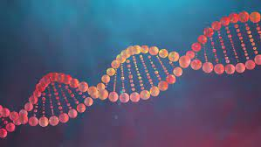
Ultra-rare Gene-based Therapy (URGenT) Network
The goals of the URGenT program are to:
Accelerate advancement of discoveries into the
clinic.
2. Provide resources and expertise not currently available
to applicants.
Deliver therapeutics to patients with ultra-rare neurological diseases.
Standardize and harmonize best practices and protocols for the development of gene-based therapies for ultra-rare diseases.
https://www.ninds.nih.gov/Current-Research/Research-Funded-NINDS/Translational-Research/urgent-network

Slide 10
Clinical Trial Funding Mechanisms
NeuroNEXT
Early phase clinical trials and biomarker studies preparatory to phase III clinical trials in neurological disorders.
NINDS Exploratory Clinical Trials (UG3/UH3 Clinical Trial Required)
Early phase clinical trials and biomarker studies preparatory to phase III clinical trials in neurological disorders.
R01 - Research Project Grant (Parent R01 Clinical Trial Required) PA-20-183
All grants requesting >$500K in any year is required to submit a pre-proposal for review
and approval to submit a full grant application.
https://www.ninds.nih.gov/current-research/research-funded-ninds/clinical-research

Slide 11
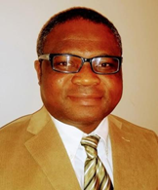

Contact A Program Director!
George Umanah, PhD
George.Umanah@nih.gov
Areas of Interest
Structure-function Relationship of Channels, Transporters and Receptors; Mitochondria, mTORopathy
Vicky Whittemore, PhD
Vicky.Whittemore@nih.gov
Areas of Interest
Genetic Epilepsies, SUDEP, Basic, Translational and
Clinical Studies on the Epilepsies

Slide 12
Thank you!
Vicky Whittemore, PhD
Program Director
National Institute of Neurological Disorders and Stroke
Email: Vicky.Whittemore@nih.gov
Website: http://www.ninds.nih.gov

