Slide 1
SLC6A1: MAE and more
Katrine Johannesen
MD, PhD student
Department of Epilepsy Genetics and Precision Medicine
The Danish Epilepsy Centre
Denmark
Notes:
Hi everybody. My name is Katrine Johannesen, I’m a medical doctor and PhD student at the Danish Epilepsy Centre, under the supervision of Rikke, and I’m happy to talk to you today. Today I will present our project on SLC6A1

Slide 2
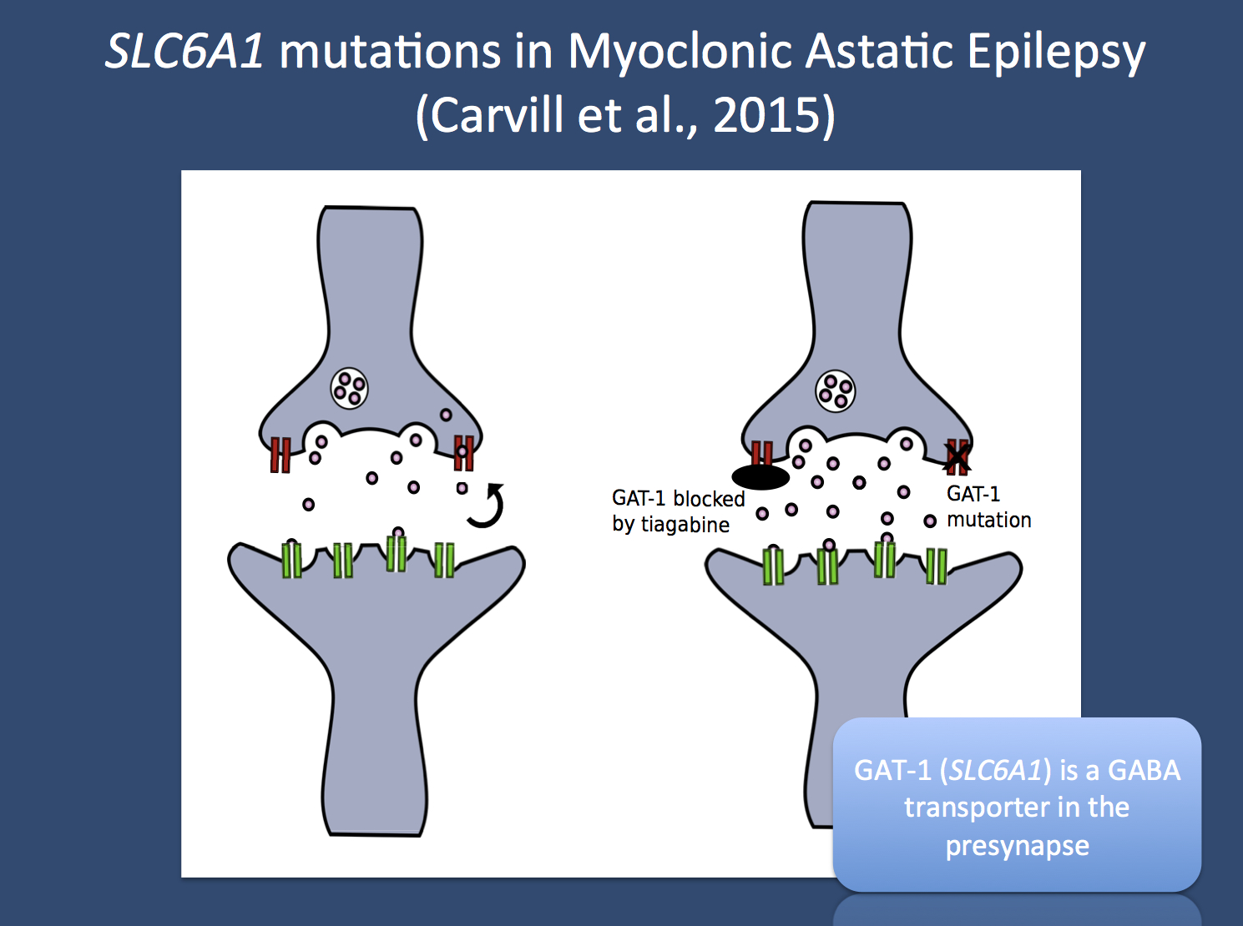
Background
SLC6A1 encodes the voltage-dependent GABA transporter (GAT-1)
GABA is the primary inhibitory neurotransmitter in the human brain
GAT-1 is one of the major GABA transporters in the human CNS
Expressed at the nerve terminals of GABAergic interneurons, as well as astrocytes.
Crucial for the reuptake of GABA from the synapse, and extracellular clearing
Found in neocortex and cerebellum
Notes:
The SLC6A1 gene encodes this voltage-dependet GABA transporter, the GAT-1. And as you know GABA is the most imporatant inhibitory neurotransmitter of the human brain. And at the same time the GAT-1 is also one of the primary GABA transporters of the human CNS. The transporter is expressed at the inhibitory interneurons as well as on astrocytes, and it is crucial for the reuptake of GABA from the synapse, and thus making sure that the extracellular space is cleared of excess GABA. Anatomically, it has been found to be expressed in the neocortex, as well as the cerebellum

Slide 3

Background
GAT-1 deficient mice exhibit:
  Spontaneous Spike-Wave discharges
  Atypical absence seizures
  Motor disturbances
  Stereotypic behavior
  Increased GABA levels
Notes:
The GAT-1 knock-out mouse present with spontaneous spike-wave disharge on the EEG, correlating to atyopical absence seizures. The mouse also displays motor disturbances and stereotypic behaviour, all thought to be caused by increased GABA levels, due to limited extracellular clearing.

Slide 4
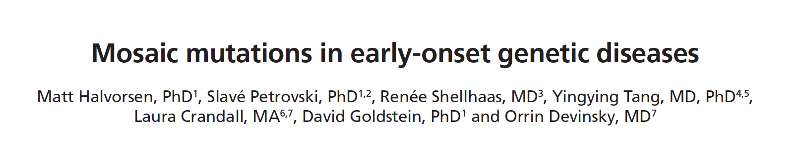
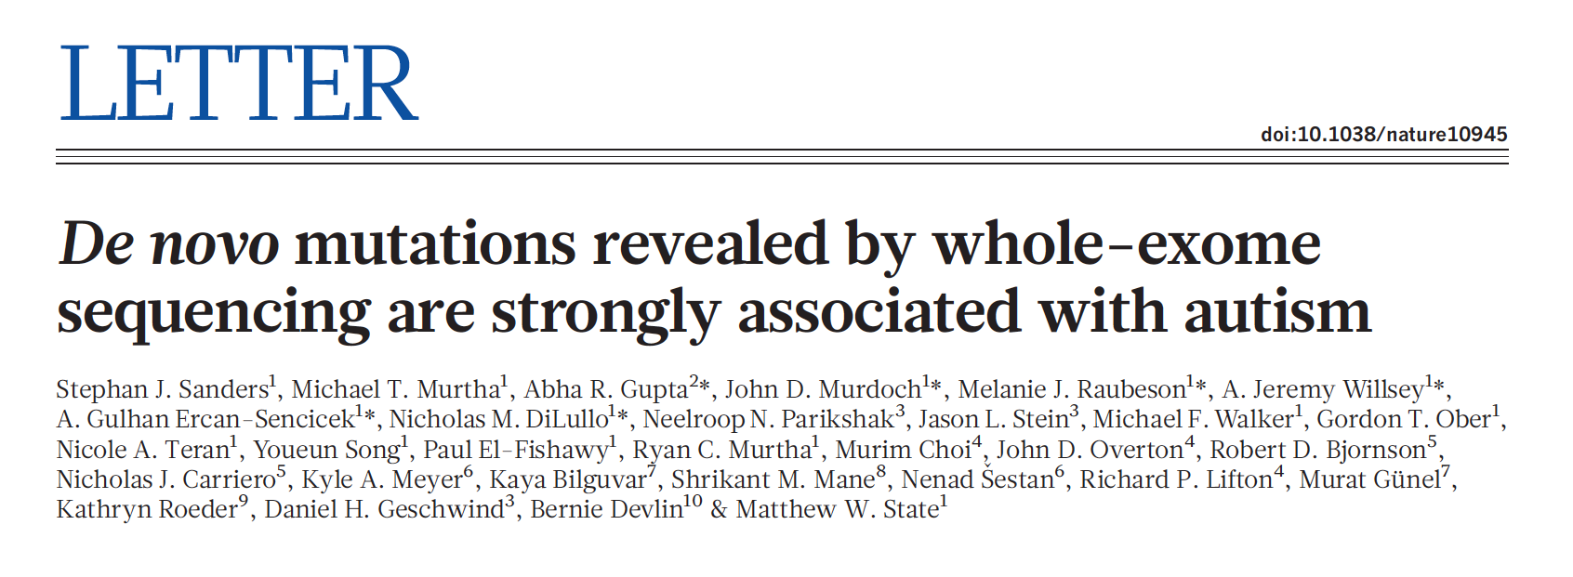
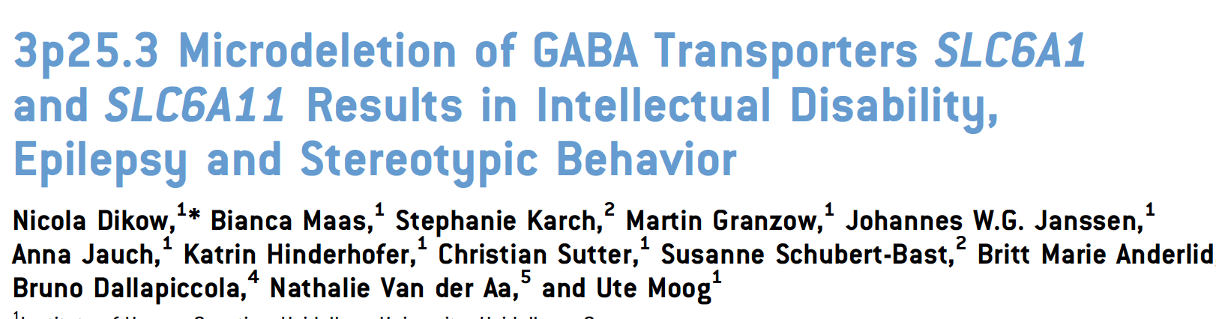

Previously..
Notes:
Previously, several patients with SLC6A1 variant have been reported
Rauch et al reported a frameshift variant in a patient with Myoclonic atonic epilepsy, as well as intellectual disablity with delayed speech and walking
Sanders et al reported a missense variant in a patient with absence seizures and an autism diagnosis
Dickow et al reported 3 patients, with microdeletions on chromosome 3 all including SLC6A1, the patients har epilepsy or EEG abnormalities, intellectual disability as well as ataxia and stereotypic hand movements
Halvorsen et al reported a patient with a missense variant and epileptic encephalopathy
So, these were all more or less sporadic reports on SLC6A1 patients

Slide 5
Previously..
In 2015, Carvill et al., performed targeted resequencing in 569 individuals with epileptic encephalopathy
Four likely pathogenic SLC6A1 mutations were found
All four individuals displayed a homogenic phenotype:
  Onset of myoclonic, myoclonic-atonic or atonic seizures in early childhood
  Presence of generalized spike-wave or poly-spike-wave discharges
Of the 569 cohort, 85 indviduals had a diagnosis of MAE
SLC6A1 was thus significantly enriched in MAE patients (4/85=4.7%)
Validation in another cohort identified 2 additional SLC6A1 MAE patients
In total 6/160 (3.75%) MAE patients have SLC6A1 mutations
Notes:
Then in 2015, Carvill et al published a large study on targeted resquencing in which they resequenced 569 patients with epileptic encephalopathies of unknown causes. Within this cohort thet found 4 individuals with an SLC6A1 viariant. All had a homogenous phenotype with onset of myoclonic, myoclonic-atonic or atonic seizures in early childhood, and all had the presence of generalized spike-wave or poly-spike-wave dsicharges on the EEGs.
Of the large cohort of 569 individuals these 4 patients all came from the subgroup which had a diagnosis of Myoclonic atonic epilepsy, thus comprising almost 5% of the MAE cohort, which led to the conclusion, that SLC6A1 is significantly enriched in MAE patients.
Validation of this in another cohort identified an additional 2 patients with SLC6A1 variant and a MAE diagnosis.
So, in total 3,75% of MAE patients have a variant in SLC6A1

Slide 6
Previously…
Atypical features noted by Carvill et al.:
    preceeding developmental delay
    developmental slowing or regression in 4/8
    Six individuals had autistic features
    Two had tremors, one of whom also had ataxia
    One had prominent manual stereotypies
    Only 3 individuals had GTCs (2 of who were mother and daughter)
    7/8 were female (possibly reflection of small cohort)
Notes:
In addition, Carvill et al noticed several atypical features of these MAE SLC6A1 patients;
They had preceeding developmental delay, and developmental slowing or regression occured in half of them.
6 patients had autistic features
2 had tremors, and one of these also had ataxia, a third patient had hand stereotypies
GTCs were rare
They also found an overweight of females, however this was probably due to the small cohort size

Slide 7
Myoclonic Atonic Epilepsy
Normal development before epilepsy onset and absence of structural brain abnormalities
Onset of myoclonic, myoclonic-atonic or atonic seizures between 7 months and 6 years of age
2-3 Hz generalized spikes/polyspikes-and-slow waves
Diagnosis of Benign Myoclonic Epilepsy of Infancy, Severe Myoclonic Epilepsy of Infancy and Lennox-Gastaut Syndrome have been excluded
Genes responsible for MAE: SLC2A1, GABRG2, CHD2
Notes:
So, before we move on to the study, just a few words on myoclonic atonic epilepsy.
According to the ILAE definition, patients with MAE have normal development before epilepsy and no structural brain abnormalities.
Onset of seizures should be between 7 months and 6 years of age, and seizures include myoclonic, myoclonic-atonic or atonic seizures. EEG will show a typical pattern of 2-3 Hz generalized spikes or polyspikes-and-slow waves
A diagnosis of benign myoclonic-epilepsy of infancey, severe myoclonic epilepsy of infancy and Lennox-Gastaut have to be excluded
Besides SLC6A1 genes repsonsible for MAE include SLC2A1, GABRG2 and CHD2

Slide 8
Methods
Inital study:
  Patients with presumed pathogenic variants in SLC6A1 were collected through an international collaboration between epilepsy genetic centers worldwide
  All EEGs were reviewed by a single epileptologist (Elena Gardella)
  Atypical absences were defined as absence seizures with additional clinical features (e.g. Myoclonic jerks) and with an EEG pattern of diffuse spike-wave <3 c/sec with a slower onset and offset compared to typical absence seizures
  Patients with an electro-clinical picture suggesting a generalized epilepsy resembling MAE, but not fulfilling the diagnostic criterias were classified as MAE-like
Follow-up study:
  Collecting through SLC6A1 Connect
Notes:
We did this by collecting data on patients with pathogenic variants in SLC6A1 in the large epilepsygenetics network we have, of whom many are present today.
So, combined this produces a rather larger cohort, which consists of patients with intellectual disability or childhood epilepsies, without an identified genetic cause.
As the SLC6A1 patients were found we collected data on clinic, neurophysiology and genetics
EEGs were primarily collected as raw data when possible, and was then reviewed by Elena Gardella, our neurophysiologist
Variants were classified as pathogenic if they were non-synonymous, splice-site altering or truncating, not seen in healthy control, predicted damaging and occured de novo or were inherited from an affected parent

Slide 9
Results
Initial study:
  27 unpublished patients with SLC6A1 (21 probands + six affected family members)
  4 previously published cases were included for electroencephalographic characterization
  In total, 31 patients with SLC6A1 variants
Follow-up study:
  13 unpublished patients (probands only)
  In total 40 probands
Notes:
This way we were able to collect a total of 27 unpublished patients with SLC6A1 , this included 21 probands and 6 affected family members
In addition we included 4 previously published cases for electroencephalographic charactarization, which gives a total of 31 patients. We could not replicate the large female overweight from the carvill study

Slide 10
CASE:
8 year old boy, with no family history of seizures
Cognition before seizure onset: Mild ID
Seizure onset: 22 months
Seizure types: Absences, atonic and myclonic
EEG: Generalized spike-wave (3 Hz)
Epilepsy syndrome: MAE-like
Cognition after seizure onset: Mild ID
Behavior and neurological findings: Normal
Treatment: Seizure-free with VPA and LTG
Variant: p. Ala288Val
Notes:
So, I’d like to present to cases from the study
The first one is a boy with no family history of seizures. Before onset of seizures he was already mildly delayed,. At 22 months old he developed seizure that included absences, atonic seizures and myoclonic seizures. His EEG showed a generalized 3 hz spike-wave pattern. These clinical features were consistent with an MAE-like syndrome. After seizure onset he continued to be mildly intellectually disabled, with normal neurologic features and normal behaviour. He became seizure-free with Valproic acid and lamotrigine.
The SLC6A1 variant Ala288Val was discovered in this patient

Slide 11
CASE:
Variant: p.Gly232Val
Proband: 17 y, normal before sz onset, partial seizure control with ESM, VPA, LTG
Sister: 10 y, normal before sz onset, seizure free with ESM
Mother: learning problems only
Notes:
The second patient was a familiy, with several affected family members. The proband, was normally developed before seizure onset at 1 year of age, when he developed absences and atonic seizures. After seizure onset he regressed to moderate intellectual disability, and only achieved partial seizure control with ethosuximide, valproic acid and lamotrigine. His sister was also normal before seizure onset. Seizures began at 13 months and were absence seizures, as well as atonic seizures. She later developed a mild ID, and became seizure free with ethosuximide.
The mother of these children also carried the glycine232Valin variant, but only suffered from learning disability

Slide 12
Epilepsy phenotype
27/40 individuals had epilepsy
Mean age at seizure onset was 3.7 years (0.5-7 years)
Seizure types:
  Absences without specifications (18/27)
  Atypical absences (10/27)
  Atonic seizures (14/27)
  Myoclonic or myoclonic-atonic seizures (13/27)
  GTC (5/27)
Epilepsy syndrome:
  MAE-like (17/27)
  MAE (5/27)
  LGS (1/27)
  EOAE (1/27)
  CAE (2/27)
  Focal epilepsy (2/27)
Notes:
Moving on to the epilepsy phenotype
Out of the 31 SLC6A1 carriers, 28 had epilepsy.
Seizure onset was 3.7 years, but varied greatly, from 6 months to 7 years. We had follow-up data for a mean of 11 years, but this also ranged a lot; from 2 – 21 years.
Seizure types were absences, atypical absences, atonic seizures, myoclonic or myoclonic-atoniz seizures, and a handfull had generalized tonic-clonic seizures.
Regarding syndrome classification, the majority had an MAE-like syndrome, and 4 had MAE, 1 had lennox-gastaut, one had early onset absence epilepsy and one had childhood absence epilepsy. 2 only had a focal epilepsy

Slide 13
Epilepsy phenotype
21/27 became seizure free
  11 with VPA either as monotherapy or in combination with CLZ, LTG or LEV
  9 with LTG, ESM, LEV and LTG or CLZ
5 patients achieved partial seizure control with VPA
VPA is thought to have a positive effect on the GABA system, which could explain the favorable response to this AED
Notes:
We also evaluated treatment outcome.
And this showed that 18 out of the 28 became seizure free. Ten of these used valproate, either as a monotherapy og in combination with clobazam, lamotrigine or levetirazetam
The remaining 8 became seizure free with lamotrgigne, ethosuximide, levetiracetam, lamotrigine, or clobazam
Besides the 10 patients who became seizure free with valproate, an additional 4 patients acheived partial seizure control. The antiepileptic mecanisms behind valproate are not fully elucidated, but it is thought to have a positive effect on the GABA system, which could be why we see so many favorable responses to this drug.
Of note, none of the patients tried ketognic diet

Slide 14
Epilepsy phenotype
7 subjects never displayed epileptic seizures, but only manifested learning disabilities or mild ID with or without autistic features
This phenotype is previously undescribed
Families with proband with MAE, and familymembers without epilepsy
This suggest variable expressivity (incomplete penetrans)
  Could be due to environmental or genetic modifying factores
Notes:
There were 3 individuals in the cohort that did not display any seizures at all, but only had learning disabilities or mild intellectual disability. This has not been described before. Two out of these three individuals had a relative with an MAE or MAE like phenotype. Suggesting that there is variable expressitivity connected to SLC6A1. We can only speculate on reasons, but these could include environmental or genetic modifying factors

Slide 15
Cognitive development
Before epilepsy onset(n=20):
After epilepsy onset (n=28):
Johannesen et al., 2018
Notes:
We then evaluated cognitive in these patients. Of not, we did not have data on all patients, so before epilepsy onset cognitive developement was assessed in 20 patients, and after epilepsy onset it was assessed in 28 patients.
So on the left we have cognitive development before epilepsy onset, whcih was normal in 20%, and then ranged from learning disabilities to severe intellectual disability, with half of the patients having mild intellectual disability.
After epilepsy onset, on the right, only 4 % remained at a normal cognitive level, and again the rest ranged from learning disability to severe intellectual disability, with half the patients suffering from mild intellectual disability.

Slide 16
Cognitive development
After epilepsy onset cognition deteriorated in 35%
The most common feature was language delay
There was no apparant correlation between seizure control and cognitive profile
Other features:
  Aggressive behaviour (19%)
  Attention deficit disorders (19%)
  Stereotypies/automatisms (16%)
  Autistic features (16%)
Notes:
So, in the patients were we had data on the cognitive level both before and after epilepsy onset, we saw that 35% had a cognitive deterioration. And that the most common feature in these patients was language delay.
However, there was no apparent correlation between the degree of seizure control and the cognitive profile.
Other characteristica included agressive behavior in 19%, attention deficit disorders in 19%, stereotypies in 16% and autistic features in 16%

Slide 17
Neurologic features
Mild ataxia or unsteady gait (23%)
Hypotonia (10%)
Impairment of fine motor skills (6%)
Tremor (6%)
Hand stereotypies
No dysmorphisms or malformations were present
Notes:
The majority of the patients were assesed neurologically, and 23 % of them displayed mild ataxia or an unsteady gait, 10% had hypotonia, 6% had impairment of their fine motor skills, 6% had tremor.
These patients are not dysmorph and do not have malformations.
Checkl tal!

Slide 18
Neurophysiology
EEG was available in 27 patients
All EEGs were abnormal
11/27 showed slowing of the background
25/27 showed burst of irregular generalized 2.5-3.5 Hz spikes/polyspikes and slow waves with a gradual onset in the occipital regions
These discharges correlated with epileptic seizures
Notes:
As described under methods, all EEGs where reviewed by Elena Gardella. We had EEGs available in 27 patients, and all had abnormal EEGs. In 11 patients there was a slowing of the background. In almost all patients, 25 put of 27, the EEG showed bursts of irregular generalized 2,5-3,5 Hz spikes/polyspikes and slow waves with a gradual onset in the occipital regions. These bursts correlated with the epileptic seizures of the patients.

Slide 19
Neurophysiology
Notes:
Similar EEG pattern in 3 different patients diagnosed as
MAE-like (Patient 20),
unclassified generalized (Patient 2),
and typical
MAE (Patient 31).
The EEG abnormalities consisted of prolonged bursts of irregular generalized 2.5-3.5 Hz slow waves with and without
prominent spikes/polyspikes component, typically starting gradually in the occipital regions. In Patient 20, roughly the same EEG pattern can
give rise to clinical manifestations consisting of atypical absence (to the left), or to a seizure with a brief atonic and myoclonic component (to the
right).

Slide 20
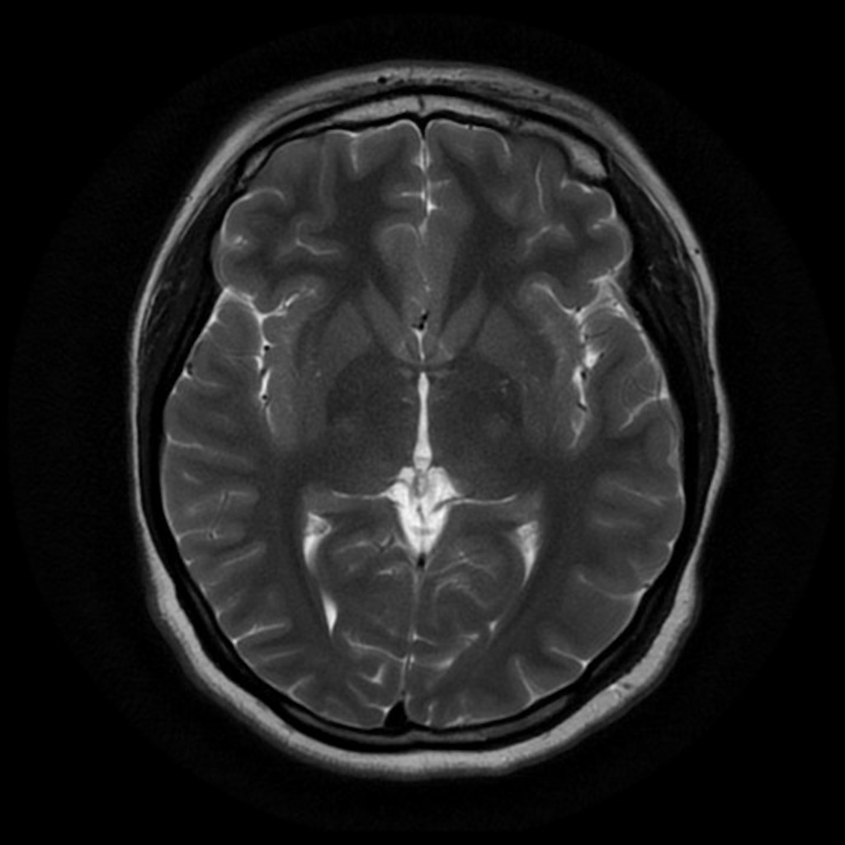
MRI
Unremarkable in most cases (19 had MRI data available)
Five had nonspecific MRI abnormalities
  mild vermian hypoplasia
  Enlarged frontal spaces
Case courtesy of A.Prof Frank Gaillard, Radiopaedia.org, rID: 37605
Notes:
MRI was normal in most cases, and only 5 had nonspecific abnormalities such as vermian hypoplasia and enlarged frontal spaces

Slide 21
Genetics
37 variants were de novo
2 variants segregated in a dominant manner in the affected family
(se figure on the right)
1 variant segregated in the affected family
Notes:
Back to the general results. Genetics showed 17 de novo variants, and 2 (one of which was the case before) that segregated in a dominant manner in the families, as shown in the pedigrees on the right.
In two probands we were not able to do the segregation analysis, but both were recurrent variants, and thus likely patogenic

Slide 22
Genetics
Types of mutations:
24 missense mutations (affecting highly conserved nucleotides)
2 splice-site mutations
2 frameshift mutation
3 nonsense mutations
2 in-frame deletions
1 deletoion
Suggesting loss-of-function as the most likely disease mecanism
Notes:
The variants were mainly missense, but also included 2 splice-site variants, 1 frameshift variant, 3 nonsense variant and one deletion. These all suggest a loss-of-function as the pathomecanism,

Slide 23
Genetics
Recurrent mutations:
Gly232Val
Ala288Met
Val342Met
Gly362Arg
Notes:
Returnng to the genetic part we found several recurrent variants, highlighted here in blue circles, but since the phenotype is quite homogenous and the variants are widespread through the gene, there is no genotype/phenotype correlation

Slide 24
Functional effects
Several mutations are loss-of-function per se, these include truncations, frameshifts and microdeletions
Furthermore, functional studies in the Arg44Gln and Ala288Val have shown significant decreases in GABA transport activity (up to 98%)
Increased synaptic GABA levels have been shown to be able to enhance the phasic and tonic inhibition. This leads to the apperance of spike-wave discharges
Tiagabine, an AED that blocks GAT-1, can cause myoclonic seizures and absence status epilepticus in humans
Notes:
Regarding the functional consequences, we were not able to do functional studies in this project, however several variants will as mentioned be loss-of-function per se, as they are truncations, frameshifts or even microdeletions. Also, previous functional studies have shown significant decreases in the GABA transport acitivity in the Arginine44gln variant and the Ala 288val variant. The consequent increase in GABA levels in the synapse have been sjown to enhance inhibition, and altså show up as spike-wave discharges on the EEG.
Furthermore, tiagabine, an antiepiletoc drugs that blocks GAT-1 causes myoclonic seizures and status epilepticus in humans. Supporting the loss-of-function hypothesis-.

Slide 25
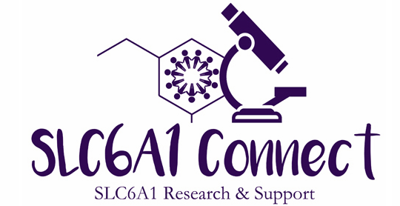
In the pipeline
SLC6A1 connect led by Amber Freed
Mouse model of SLC6A1
Gene replacement therapy
+
White paper coming out soon, including bioinformaticals

Slide 26
Take home messages
SLC6A1 mutations often cause MAE occuring in the context of abnormal early development
  Absence epilepsy
  No epilepsy
Mild to moderate ID
  Language delay/deficits
  Preceding epilepsy onset
Electro-clinical features of SLC6A1-related epilepsy are consistent in most patients
The contribution of epilepsy to the cognitive impairment in subjects with SLC6A1 mutations is uncertain
While we wait for precision medicine, VPA should be considered in epilepsy patients
Notes:
So, to conclude. SLC6A1 variants cause a specific epilepsy syndrome, which we can call MAE with a twist. That is MAE , but occuring in the context of abnormal early development. The most prevalent seizure type is absences. The patients in general have mild to moderate intellectual, with language delay being one of the most prominent features. The intellectual disability will be present before epilepsy onset, whoch occurs around 4 years of age.
EEG will in most cases show burst of irregular activity, correlating with seizure activity. However, in a few the EEG pattern can change over time,
So far, the contribution of epilepsy to the cognitive impairmet in subjects with SLC6A1 variants is uncertain

